Slide 1
Introduction to Ruby
SWEN 250 – Personal Software Engineering
October 28, 2019

Slide 2
History of Ruby
Originally conceived by Yukihiro Matsumoto (“Matz”)
February 24, 1993, Japan
First public release in 1995
Feb 24, 2013: Ruby 2.0 release
Motivation:
“Often people, especially computer engineers, focus on the machines. They think, "By doing this, the machine will run faster. By doing this, the machine will run more effectively. By doing this, the machine will something something something." They are focusing on machines. But in fact we need to focus on humans, on how humans care about doing programming or operating the application of the machines. We are the masters. They are the slaves.
“wanted a scripting language […] more powerful than Perl, and more object-oriented than Python”
wanted a natural and very expressive language in which programmers can easily express themselves.

Slide 3
What is Ruby?
Ruby is an interpreted, object-oriented, dynamically typed programming languages with a focus on simplicity and productivity.
Syntax inspired by Python and Perl
Semantics akin to dynamically class-based languages like Smalltalk
Scripting facilities akin to those of Python and Perl
Manipulation of text files
File handling
Execution of system tasks
Support for regular expressions
…
Notes:
Interpreted:
C/C++
Compiled to assembly/Run directly on machine
Java
Compiled to bytecode/Interpreted by JVM
Ruby
Interpreted (no compilation)
Object-oriented (encapsulation, inheritance, polymorphism)
Dynamically (typed are bound at execution time)

Slide 4
What is Ruby?
Ruby is an interpreted, object-oriented,, dynamically typed programming languages with a focus on simplicity and productivity.
Interpreted:
C/C++
Compiled to assembly/Run directly on machine
Java
Compiled to bytecode/Interpreted by JVM
Ruby
Interpreted (no compilation)

Slide 5
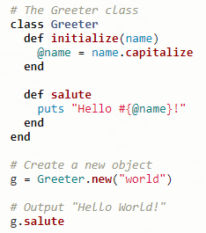
Ruby Characteristics
Everything is an object - everything
Rich built in data types:
String
Array
Hash
RegExp
Range

Slide 6
Ruby’s “killer app”
Ruby on Rails (a.k.a. “Rails” or “RoR”)
Open-source web-application framework
Implemented in Ruby
Allow to create powerful web applications
Web-application =
Ruby program + database + webserver

Slide 7
Ruby Basics
Ruby does not have a main method like Java
Just write your code directly in a file
Ruby statements do not end with semicolons
Method calls don’t need parenthesis
There is no maximum value for integers and longs like Java

Slide 8
Ruby Basics
Comments
String
Control Structure
Selection
Loops
Arrays
Hashes
I/O
RegExps

Slide 9
Comments
Literals:
Single line ( # )
Multiline comments (=begin and =end syntax)
Example:

Slide 10
Strings
Literals:
‘SWEN250’ vs “SWEN250”
Operators:
+ and +=
*
== < <=> comparisons
Methods:
capitalize
downcase
upcase
include?(str)
And many, many, many more.
Example:
Output:
Notes:
Return a copy of string with first letter capitalize

Slide 11
Strings (Single (‘) vs Double (“))
escape sequence
puts “Betty’s pie shop” VS puts ‘Betty\’s pie shop’
Single quotes
Support two escape sequences: \’ and \\
Double quotes (typically used)
Allow more escape sequences
Allow embed variables or Ruby code inside a string literal (interpolation)
Example:

Slide 12
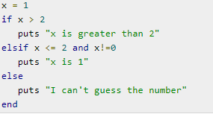
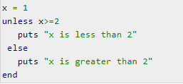
Control Structures: Selection
if condition
statements
elsif condition
statements
else
statements
end
Example
Output
unless condition
statements
end

Slide 13
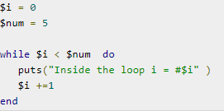
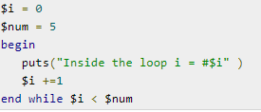
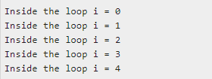
Control Structures: Loops
Example
Output
while condition
statements
end
begin
statements
end while condition

Slide 14
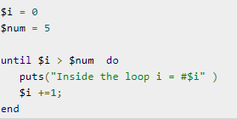
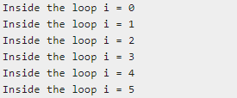
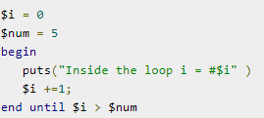
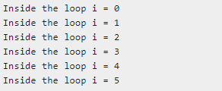
Control Structures: Loops
Example
Output
until condition
statements
end
begin
statements
end until condition

Slide 15
Arrays
Example | Output
A = [1, "foo", [6,7,8], 9.87] A[1] A[2][2] | => [1, "foo", [6, 7, 8], 9.87] => foo => 8
StudentsList = ["Robert","Alice","Jessamine"] puts StudentsList & ["Robert","Pippa","Jessamine"] | => Robert Jessamine
StudentsList = ["Robert","Alice","Jessamine","Steven","Charles","Pippa"] newList = StudentsList - ["Robert","Alice","Jessamine"] puts newList | => Steven Charles Pippa
Literals:
Operators:
Intersection (&)
Difference (-)

Slide 16
Arrays
Operators:
Catenation (+)
Repetition (*int)
Push on end (<< obj)
Example | Output
StudentList = [[1, 2] + [3, 4]] | => [[1, 2, 3, 4]]
array = [121,47,7] * 2 | => [121, 47, 7, 121, 47, 7]
StudentsList = ["Robert","Alice","Jessamine"] StudentsList<<"Emma" puts StudentsList | => Robert Alice Jessamine Emma

Slide 17
Arrays
Methods:
Length
first
last
Empty
push
pop
include
collect
Example | Output
Products =[“S1”,”F56”,”y2”] Products.length | => 3
Products.first | => “S1”
Products.last | => “y2”
Products.empty? | => flase
Products.push(“fe43”) | => ["S1", "F56", "y2", "fe43"]
Products.pop | => "y2”
Products.include?(“S1”) | => true
Products.collect {|x| x + "_"} | => ["S1_", "F56_", "y2_"]

Slide 18
Hashes
Example | Output
Test_grades = { "key1" => "value1" , "key2" => "value2" } | => {"key1"=>"value1", "key2"=>"value2"}
dictionary = { "one" => "eins", "two" => "zwei", "three" => "drei" } dictionary["zero"] = "null" puts dictionary | => {"one"=>"eins", "two"=>"zwei", "three"=>"drei", "zero"=>"null"}
dictionary.each_key {|key| puts key} | => one two three zero
dictionary.each_value {|value| puts value} | =>eins Zwei drei null
dictionary.each {|key, value| puts "#{key} is #{value}" } | =>one is eins two is zwei three is drei zero is null
Literals:
Operators:
h[key]
h[key] = value
Methods:
each_key
each_value
each

Slide 19
Hashes
Example | Output
Dictionary.empty? | =>false
dictionary.has_key?("two") | => true
dictionary.has_value?("tris") | => false
dictionary.shift puts dictionary | => {"two"=>"zwei", "three"=>"drei", "zero"=>"null"}
Methods:
empty?
has_key?
has_value?
shift

Slide 20
I/O
Class File:
f = File.new(name, mode)
name is a string giving the file name (host dependent).
mode is an access string: "r", "rw", "w", "w+"
f.close
f.puts, f.printf, f.gets, etc.
puts, printf are implicitly prefixed by $stdout.
gets is implicitly prefixed by $stdin
File.open(name, mode) block – open the file name, call block with the open file, close file when block exits.
Class Dir:
d = Dir.new(name) – open named directory.
d.close
Dir.foreach(name) block – pass each file name to block.

Slide 21
RegExps
Literals:
/regular expression/
/hay/ =~ 'haystack'
Rubular:
http://rubular.com/
Example:
'Some cats here'.gsub(/cats/,'dogs')

Slide 22
Resources
https://www.tutorialspoint.com/ruby/ruby_loops.htm
https://www.endpoint.com/blog/2011/06/07/using-set-operators-with-ruby-arrays
https://docs.ruby-lang.org/en/2.0.0/Array.html
Online Ruby IDE : https://repl.it/languages/ruby

