Slide 1
Introduction to Structured Query Language (SQL)
SWEN 250 - Personal Software Engineering

Slide 2
Data
Difference between information and data?
Data = raw facts
Information = processed data that is presented in a useful form
The success of a software system is usually judged by the quality of the information it provides
Systems require a medium to hold the data until it is ready for consumption
A database provides the ability to persist vast quantities of data of varying types for long periods
Notes:
Database has the ability to:
To manage large chunks of data
Easily update the data
Secure the data
Provides data integrity

Slide 3
Typical N-tier architecture
Client
Application/Web Server
Database Server
E.g. HTTP over TCP
E.g. JDBC over TCP

Slide 4
Developer point-of-view
Developer Workstation
Database Server
Database contained within the workstation

Slide 5
Database terminology
Field: the “smallest” item of stored data
Record: group of related fields and associated values
Columns: the fields of all records form the columns
Primary Key: a unique identifier for a record
Table: collection of related records that are frequently categorized for given purpose
Database: a collection of related tables
Database Management System (DBMS): a system providing control over definition, access and manipulation of the information stored in the database

Slide 6
Database terminology
Primary Key
Foreign Key (a cross-reference to another table)
ProductID | ProductName | SupplierID | Quantity | UnitPrice
1 | Chair | 1 | 100 | 10
2 | Table | 1 | 200 | 10.50
3 | Desk | 2 | 50 | 50
4 | Lamp | 3 | 10 | 40
5 | Pencil | 3 | 5 | 2.25
Columns
Data Rows/Records
Field
Database Table: Product

Slide 7
Types of Databases
Hierarchical model:
Data is stored in a parent-children relationship nodes
Need to traversed through each tree until the record is found
Hard to maintain links
Relational model:
Ignores how files are connected and organizes data into two-dimensional unordered-tables (i.e., rows and columns)
Data can be separated into multiple tables
Leverages relational algebra & relational calculus
No need for expensive rewrites of links
Object-oriented model:
Seeks optimization by organizing data as objects and their attributes
Often challenged by the translation to/from objects

Slide 8
Types of Databases
NoSQL model:
Replication across nodes in a cluster
Fast key-value stores
Schema-free document storage (i.e., they have a dynamic schema)
Extensible columns
XML oriented attributes
These databases are not so good for complex queries
Notes:
RDBMS is completely structured way of storing data. While the NoSQL is unstructured way of storing the data

Slide 9
Some database management systems and tools
Relational
Database Management Systems
NoSQL
Database Management Systems
DBA Tools
Notes:
RDBMS - A DBMS that manages data as a collection of tables in which all relationships are represented by common values in related tables

Slide 10
Structured Query Language (SQL)
Think of SQL as the language used by developers to “talk” to a DBMS
More formally - Standardized (ANSI,ISO) domain specific language for managing data in a DBMS
Specify syntax/semantics for data definition and manipulation
Almost all DBMS vendors use the same command (or slight variants) to achieve the same action
Program
SQL queries
Data access
DBMS
(query processing)
Databases
User

Slide 11
SQL statement categories
SQL commands are used for:
Creating/altering the structure of tables (i.e., Data Definition)
Inserting, deleting and updating records in a table (i.e., Data Manipulation)
Granting and revoking user permissions (i.e., Data Control)
Retrieving data (i.e., Data Query)
SQL
DDL - Data Definition Language
DML - Data Manipulation Language
DCL - Data Control Language
DQL - Data Query Language

Slide 12
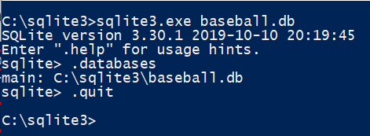
Creating a database
Syntax: CREATE DATABASE databasename;
Example: CREATE DATABASE baseball;
Demo
Note: SQLite does not contain a “CREATE DATABASE” command. Perform the following steps:
Creates an empty database
List of databases created
Exit

Slide 13
Creating tables
Syntax: CREATE TABLE table_name (column1 datatype, column2 datatype,…);
Example:
CREATE TABLE Players (id Integer Primary Key AutoIncrement, name Text, team_id Integer, position Text) ;
CREATE TABLE Teams (id Integer Primary Key AutoIncrement, name Text, city Text) ;
Demo
Shows the schema of the database
Create tables

Slide 14
Inserting rows
Syntax: INSERT INTO table_name (column1, column2,...) VALUES (value1, value2,...);
Example:
INSERT INTO Teams (name, city) values ("Yankees", "New York");
INSERT INTO Teams (name, city) values ("Red Sox", "Boston");
INSERT INTO Teams (name, city) values ("Giants", "San Francisco");
INSERT INTO Teams (name, city) values ("Cardinals", "St. Louis");
INSERT INTO Teams (name, city) values ("Mets", "New York");
Demo
Note: The primary key (id) is automatically incremented on inserts

Slide 15
Inserting rows…
INSERT INTO Players (name, team_id, position) values ("Ichiro Suzuki", 1, "OF");
INSERT INTO Players (name, team_id, position) values ("Derek Jeter", 1, "SS");
INSERT INTO Players (name, team_id, position) values ("Jacoby Ellsbury", 2, "OF");
INSERT INTO Players (name, team_id, position) values ("Pablo Sandoval", 3, "3B");
INSERT INTO Players (name, team_id, position) values ("Dustin Pedroia", 2, " 2B");
INSERT INTO Players (name, team_id, position) values ("Matt Holiday", 5, " OF");
INSERT INTO Players (name, team_id, position) values ("Carlos Beltran", 5, " OF");
INSERT INTO Players (name, team_id, position) values ("Ike Davis", 4, " 1B");
INSERT INTO Players (name, team_id, position) values ("Stephen Drew", 2, "SS");

Slide 16
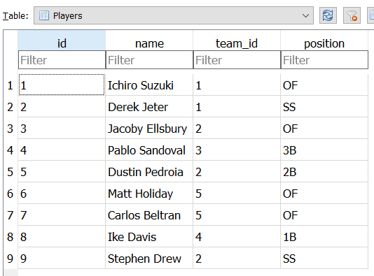
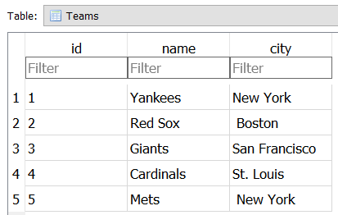
Inserting rows…

Slide 17
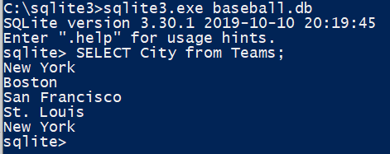
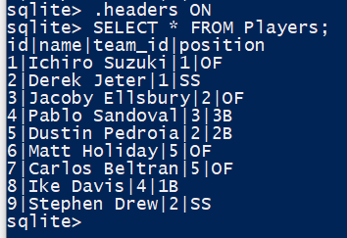
Retrieving data
Syntax: SELECT column1, column2,... FROM table_name;
The SELECT statement is used to select data from a database
Example 01: SELECT City FROM Teams;
-- retrieve all cities from the Teams tables
Example 02: SELECT * FROM Players;
-- retrieve all records from the Players tables
Shows the column names
SELECT * = Retrieves values for all columns

Slide 18
Retrieving data - distinct
Syntax: SELECT DISTINCT column1, column2,... FROM table_name;
The SELECT DISTINCT statement is used to return only distinct (different) values
Example 01: SELECT DISTINCT City FROM Teams;

Slide 19
Retrieving data - grouping
Syntax: SELECT column_name(s) FROM table_name GROUP BY column_name(s)
The GROUP BY statement groups rows that have the same values into summary rows
Example 01: select position, count(*) as Count from Players group by position order by Count desc;
-- retrieves a count of the number of records for each position in the Players table
Returns the number of rows that match the criteria
Sorts the result in decreasing order

Slide 20
Retrieving data - conditions
Syntax: SELECT column1, column2,... FROM table_name WHERE condition;
The WHERE clause is used to filter records
Example 01: SELECT * from Players where position = "OF";
-- retrieves only a subset of the records from the Players table
Example 02: SELECT * from Players where position = "1B" or position = "2B" or position = "3B";

Slide 21
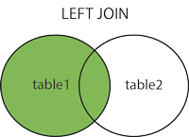
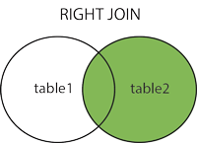
Retrieving data - joins
A JOIN clause is used to combine rows from two or more tables, based on a related column between them
Types of Joins:
Inner Join - selects records that have matching values in both tables
Left Join - returns all records from the left table (table1), and the matched records from the right table (table2)
Right Join - returns all records from the right table (table2), and the matched records from the left table (table1)
Note: Not all DBMS support the different types of joins

Slide 22
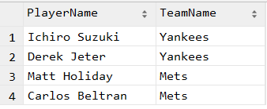
Retrieving data - joins
-- retrieve only players associated with a New York team select Players.name 'PlayerName', Teams.name as 'TeamName' from Players inner join Teams on Players.team_id = Teams.id where Teams.city = 'New York';
Foreign key

Slide 23
Retrieving data - joins
-- List the names of the out fielders NOT playing in New York select Players.name from Players, Teams where Players.team_id = Teams.id and Players.position='OF' and Teams.city != 'New York';
Note: A SQL join can be performed without specifying the ‘Join’ keyword, as in the above query.
The same query with the ‘Join’ keyword:
select Players.name from Players inner join Teams on Players.team_id=Teams.id
where Players.position='OF' and Teams.city != 'New York';

Slide 24
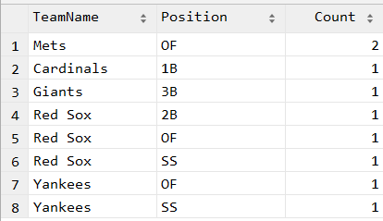
Retrieving data - joins
-- count the number of positions for each team select Teams.name as TeamName, Players.position as Position, count(*) as Count from Players inner join Teams on Players.team_id=Teams.id group by Teams.name,Players.position order by Count desc;

Slide 25
Additional resources
SQL Tutorial on w3schools.com - https://www.w3schools.com/sql/default.asp
Data types in SQLite - https://www.sqlite.org/datatype3.html
Query Plan - https://en.wikipedia.org/wiki/Query_plan

