Slide 1
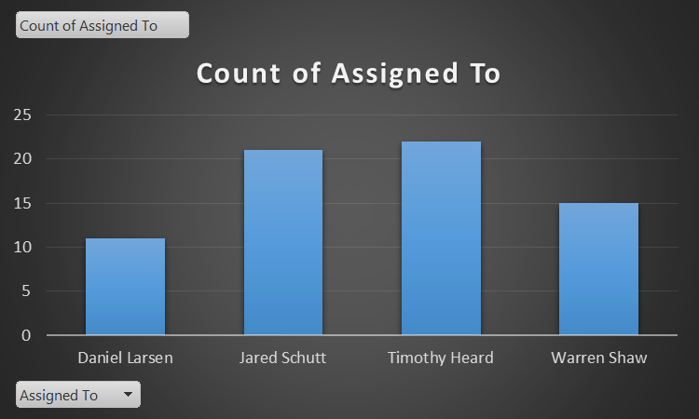
148.15 Hours in Work Items
2988 SLOC

Slide 2
Burndown Chart

