Slide 1
Wegman’s Deli Kiosk
Senior Project Fall Semester Review
Presented by the DELI-cious Developers
Daniel Larsen Tim Heard Jared Schutt Warren Shaw
Notes:
Dan

Slide 2
Agenda
Project Overview
Technology Stack & Technology Rationale
Design Trade-Offs
Methodology& Risk Management
System Topology
High Level Server Design& Server Subsystem Design
High Level App Design& App Subsystem Design
Testing & Metrics
Current Progress
Questions & Comments
Notes:
Dan
5MIN

Slide 3
Project Overview
Develop a Deli Kiosk Solution to be used in Wegman’s Stores
Orders are generated by customers from a kiosk Generated orders are printed to the deli Filled orders are placed in designated pickup area All information is processed on a local server
Goals
Mitigate long wait times and congestion in front of the Deli Counter Increase customer satisfaction Provide long term solution that can be integrated into current technology
Notes:
Dan
5MIN
SCOPE

Slide 4
Technology Stack
Notes:
Dan
5MIN

Slide 5
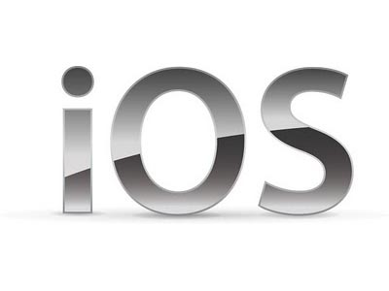
Technology Rationale – Why Not…
Team has little knowledge of iOS development
Development Fees
Availability of technology for developers
No utilization of native tablet features
Caching and device compatibility concerns
Difficult to control user experience from a kiosk
Forces dependencies on a server, increasing customization costs
Availability of technology for developers
Developers prefer not to program in java/android
Sponsor maintainability
Notes:
Dan
5MIN

Slide 6
Technology Rationale – Why…
Familiarity with development languages
Full control over User Experience
Wegman’s development parity
Stick to a full Microsoft Stack for compatibility and ease of use
Hardware availability
Notes:
Dan
5MIN

Slide 7
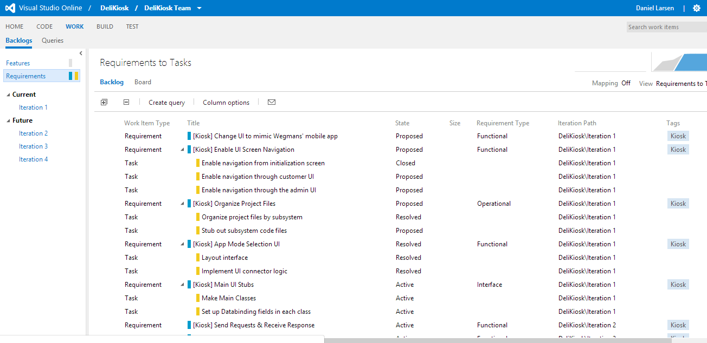
Technology Rationale – Why…
Team Foundation Service
Task / Req / Risk Tracking
Automatic Builds
Online Code Viewing
Integrated Testing in Builds
Git Integration
Work Item/Code Integration
Notes:
DAN
5MIN

Slide 8
Trade-offs of Initial Design
Dual App
Single App
Fat Client
Thin Client
Notes:
Dan
5MIN

Slide 9
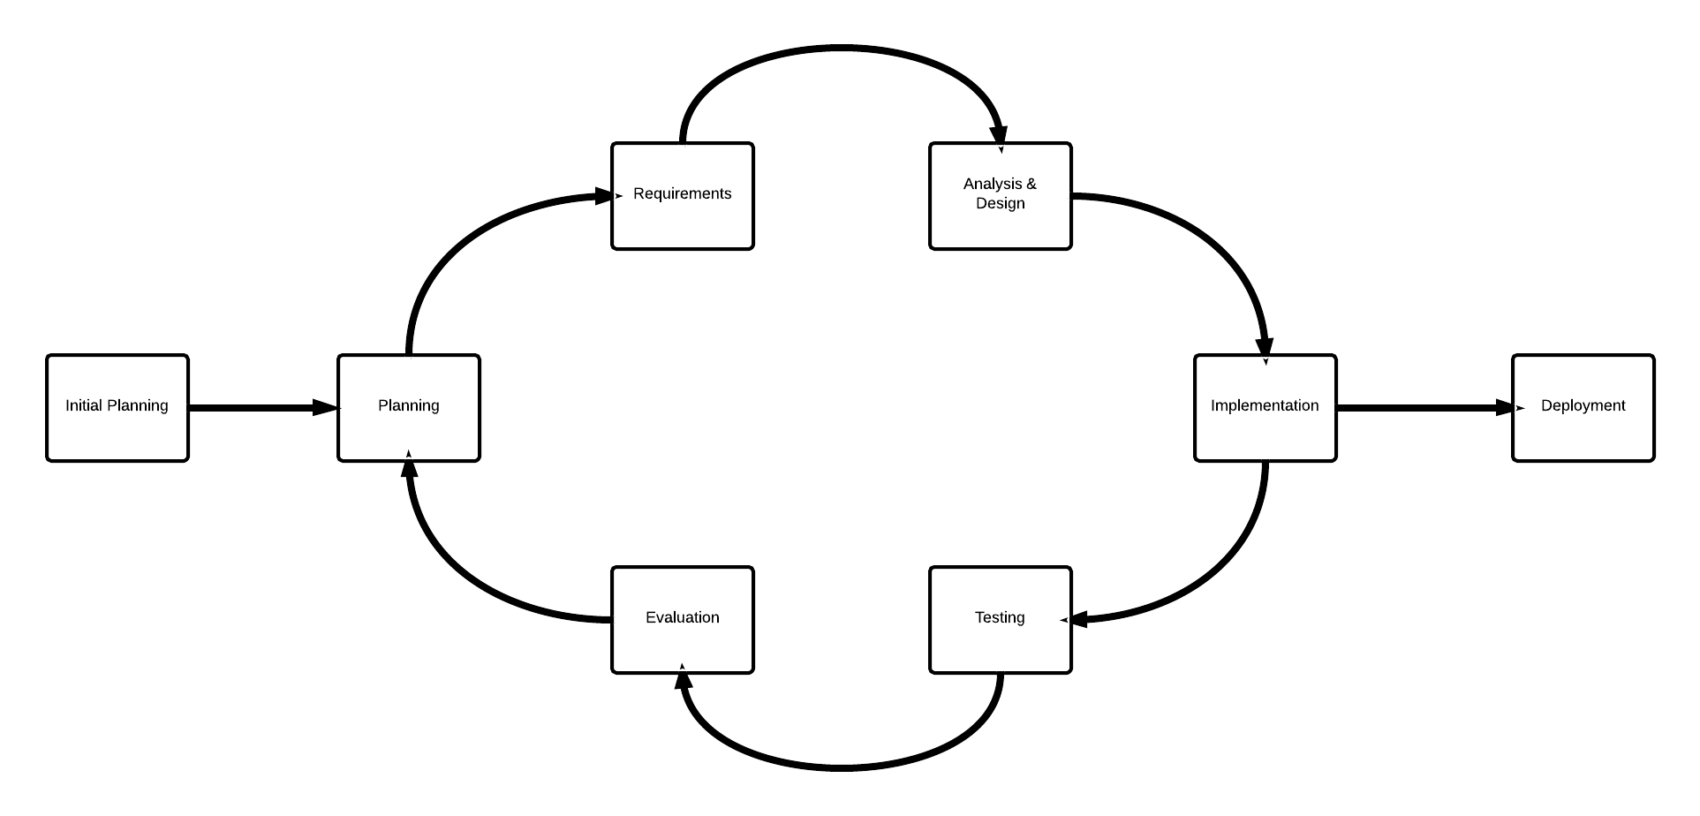
Methodology
Incremental Build Model
5 Iterations
5 Deliverables
Notes:
Jared
10 MIN

Slide 10
Methodology
Rationale
Combines elements of waterfall and prototyping
Product evolves over each iteration
Testing occurs earlier in lifecycle
Better customer visibility
Continuous risk management
Sponsor gets prototype faster than waterfall
Notes:
Jared
10 MIN

Slide 11
Methodology
Requirements Elicitation
Started at high level and refined to granular level
Identifying Stakeholders and Goals
User Scenarios and Use Cases
Priority Management
Prototyping
Notes:
Jared JARED
10 MIN

Slide 12
Risk Management
Methodology multiple iterations
Horizontal slice vs Vertical slice
Excel sheet with all Risks, ordered by RE
Multiple domain experts
TFS Tasks
Notes:
Warren
45 SECONDS

Slide 13
System Topology
Notes:
Jared
10 MIN

Slide 14
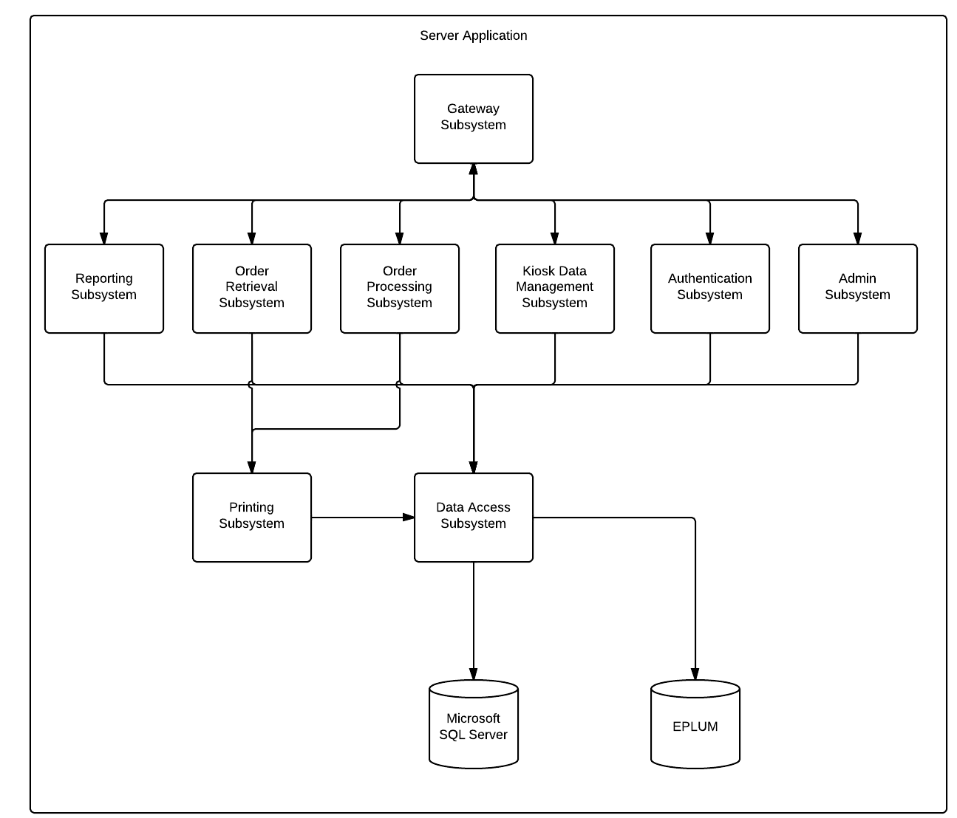
High Level System Design - Server
Notes:
Jared
10 MIN

Slide 15
Server Subsystem Design
Dynamic Workflow
Notes:
Warren
15 MIN

Slide 16
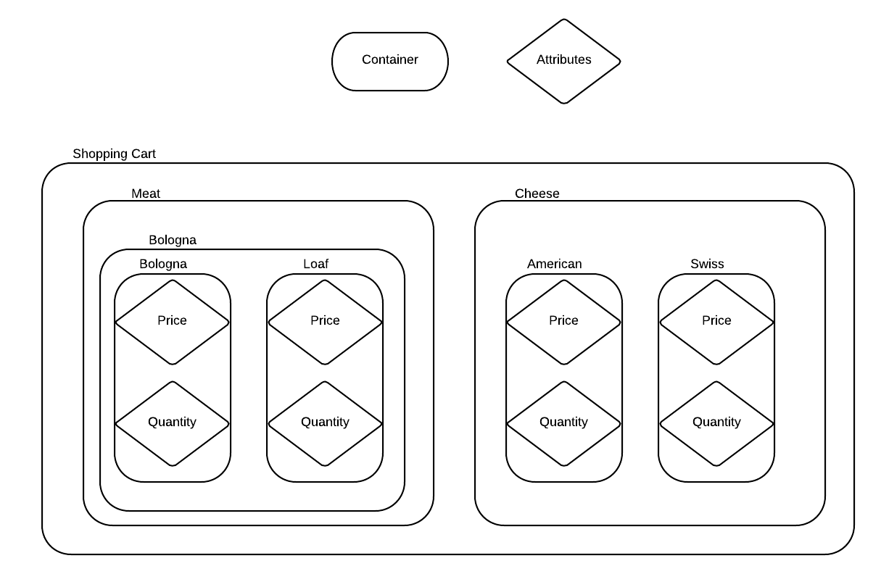
Server Subsystem Design
Notes:
Warren
15 MIN

Slide 17
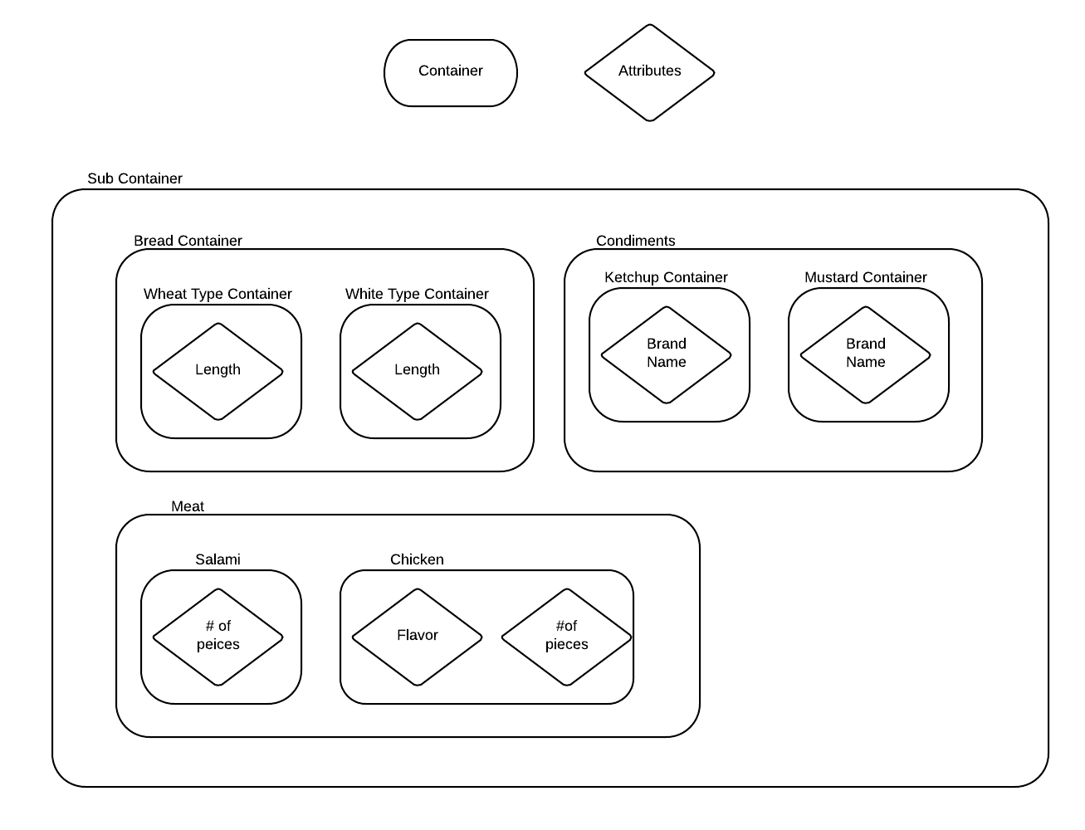
Server Subsystem Design
Notes:
Warren
15 MIN

Slide 18
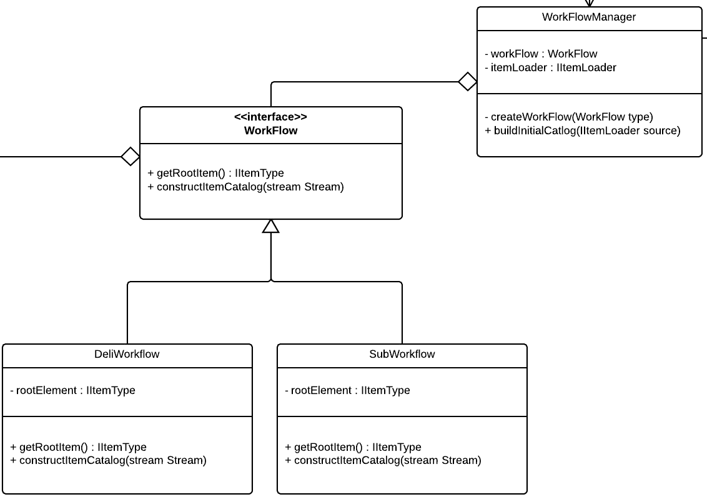
Server Subsystem Design
Workflow Constraints
Where do we enforce workflow logic?
Client
Server
Notes:
Warren
15 MIN

Slide 19
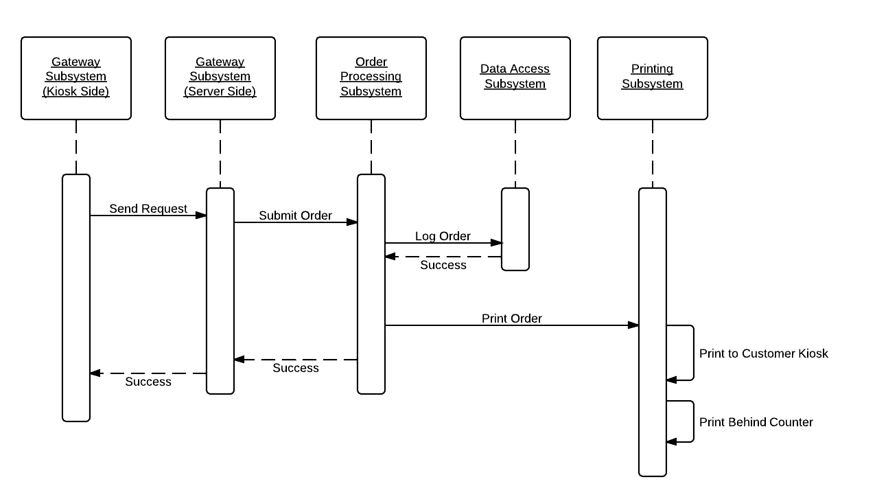
Server Subsystem Design
Creating an Order
Notes:
Warren
15 MIN

Slide 20
Application Subsystem Design - Features
Duality
Admin & Customer app in one
Report
All orders, all transactions, even employee efficiency
Monitor
Every order that is placed
Customize
Thickness & Tonnage for each item
Print
Receipts for both customer and employee
Keep Track
Of your entire order with a shopping cart
View
Promotions of special products
Notes:
Tim
19 MIN

Slide 21
High Level Design - Application
Notes:
Tim
19 MIN

Slide 22
Testing
Unit: 80% line coverage minimum
Usability: With the sponsor and actual end users
Time and Data Benchmarks
Stability Testing – Server running all the time
Continuous Builds & Unit Tests through TFS
Notes:
Tim
19 MIN

Slide 23
Metrics
Process Metrics
Task Slippage
the number of tasks needed to be done vs the number that were actually done.
Estimation accuracy
Overall estimation of tasks versus actual time
Technical Metrics
Requirements Volatility
Testing Coverage
Functional: % of functions covered
Class: % of classes covered
Personal Metrics:
Number of un-started tasks
Average time spent fixing problems
Notes:
Tim
19 MIN

Slide 24
Current Progress
70% finished with current iteration. Currently on task to finish this iterations functionality
Iteration planning for next iterations complete – Features become more complex as iterations continue
Printing works, Windows app made, WCF communications work
Notes:
Dan
20 MIN

Slide 25
Reflections
Printer Difficulties
IIS deployment
WCF Service setup
Windows App Development
TFS
Notes:
Dan
20 MIN

Slide 26
Questions?

Slide 27
Appendix
Server : Printing Subsystem

Slide 28
Appendix
Server Reporting Subsystem

Slide 29
Appendix
Server: Data Management Subsystem Updating

Slide 30
Appendix
Server : Order Retrieval Subsystem

Slide 31
Appendix
Server : Order Processing Subsystem

Slide 32
Appendix
Server : Admin Subsystem

Slide 33
Appendix
Server : Authentication Subsystem

Slide 34
Appendix
Server : Gateway Subsystem

Slide 35
Appendix
Kiosk : Order Management Subsystem

Slide 36
Appendix
Kiosk : Deli Item Subsystem

Slide 37
Appendix
Kiosk : Reporting Subsystem

Slide 38
Appendix
Kiosk : Cart Management Subsystem

Slide 39
Appendix
Kiosk : Admin Subsystem

Slide 40
Appendix
Kiosk : Splash Screen Subsystem

Slide 41
Appendix
Kiosk : Gateway Subsystem

