Slide 1
Tioga Tae Kwon Do Student Management System
Team Kwondo
May the 4th, 2017

Slide 2
The Team
Developers
Nicholas Coriale
Mike Washburn
Curtis Cali
Andrew Vogler
Andrew Deck
Project Sponsor - Paul Mittan, Tioga Tae Kwon Do
Faculty Coach - Dr. Scott Hawker
Notes:
Nick
Everyone introduce themselves
Nick cover project sponsor and faculty coach

Slide 3
Agenda
Problem Context
Requirements
Demo
Architecture
Challenges and Tradeoffs
Documentation Produced
Project Reflection
Future Goals
Questions
Notes:
Nick
Problem Context
Requirements
Demo
Architecture
Challenges and Tradeoffs
Documentation Produced
Project Reflection
Future Goals
Questions

Slide 4
Problem Context
Small Tae Kwon Do Studio in Waverly, NY
Less than 200 students
Primary goals
Store student information
Track student attendance and rank progression
Make performing daily tasks time efficient
Users are ages 3 and up
Pre-existing student management software solution
Had limited capabilities
Notes:
Mike
Sponsor owns a Tae Kwon Do Studio in Waverly NY
just under 200 students currently
the primary goals are to
store student personal information
track attendance and rank progression
as well as make performing daily tasks as quick as possible
User are ages 3 and up because students will be users
a solution was built by a previous senior project team but didn’t satisfy the sponsor’s needs

Slide 5
High Level Requirements
Track and manage student attendance
Manage student contact information
Register new students
Manage programs and student enrollment
Easily usable by users from 3+ years old
Track student belt and stripe progression
Self-contained deployment package
Notes:
AJ
We had the following high level requirements:
Track and manage student attendance
Manage student contact information
Register new students
Manage programs and student enrollment
Easily usable by users from 3+ years old
Track student belt and stripe progression
Self-contained deployment package

Slide 6
Demo
Notes:
AJ and Mike talk, Andrew drives

Slide 7
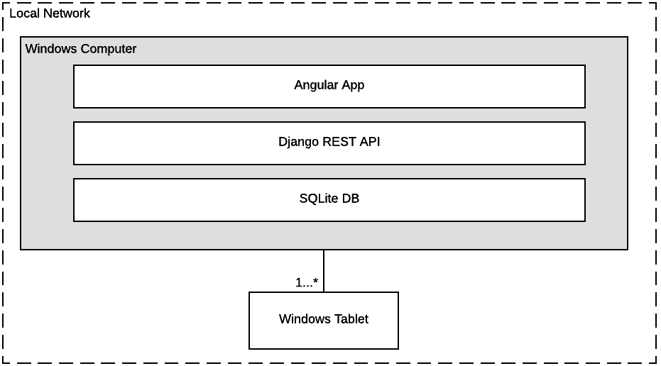
High Level Architecture
Notes:
Curtis
We used a layered architecture for our web app
Angular, Django, and SQLite can be deployed in a self contained package
We used the Django Rest Framework to easily implement a rest API
Windows based system on a local network hosts the server
Tablets connect to a central server through the TTKD’s WLAN

Slide 8
Implementation Challenges
Data needed to remain in the local network
Deployable into a self-contained software package
Mobile-friendly UI
Optimized API data responses
Utilized device cameras from web browsers on tablets
Notes:
Curtis
There were a few challenges to implementing our system:
Strong initial requirement, sponsor did not want any external connections to the system. This means we could not cloud/externally host the system and we could not use any external services
The resulting deployment from our system needed to be self-contained.
It should be able to be installed on a new system by the sponsor
Because the UI was going to be accessed from both tablets and desktops, the UI needed to work at multiple widths
The system was originally sending back large amounts of data in the API responses. This was due to the amount of joins between database tables in Django. Our solution to this was to create endpoints as needed that returned only the data needed, thus minimizing the amount of joins done and decreasing the API response time.
To make taking pictures of students and getting them into the system easier, we needed to use the onboard camera from the browser.

Slide 9
Implementation Tradeoffs
Dropped support for Firefox due to compatibility issue with webcam library
Had to implement https with a self signed certification for the webcam library to work in a deployed environment
Sacrificed implementing new requests in order to do more thorough testing and bug fixes
Notes:
Curtis
Of course with every software system, there were tradeoffs to be made, ours was no exception:
Connecting to the onboard camera was a major source of challenges during our implementation
Not taken away because it was a major feature
Library we used was incompatible with Firefox, but not Chrome, so we decided to drop support for Firefox
The solution required using HTTPS, so we implemented this with a self-signed certificate
Instead of adding additional features beyond the requirements during the last iteration, we decided to spend our time and testing and fixing the remaining bugs in the system. We feel that this resulted in a more polished final product.

Slide 10
Documentation Produced
Requirements Document
High Level Architecture Diagrams
Domain Model Diagram
Database Schema
API Definition
User Permission List
Technical Report
System User Guide
Notes:
Nick
Team stopped development in Mid April as planned to work on documentation while the sponsor uses the system
With this documentation the team feels that another team could resume work on this software if the need ever arrouse

Slide 11
Project Reflection: What Went Well?
Followed our process well
Added testing to process
Delivered all features from requirements
Achieved usability goals
Final iteration finished on schedule
Organized sponsor meeting
Live user testing at Tioga Tae Kwon Do
Sponsor is very happy with final product
Notes:
Followed our process well
Added testing to process
Delivered all features from requirements
Achieved usability goals
Final iteration finished on schedule
Organized sponsor meeting
Live user testing at Tioga Tae Kwon Do
Sponsor is very happy with final product

Slide 12
Project Reflection: Challenges and Obstacles
Failed to deliver Iteration 5 release
Insufficiently detailed wireframing
Timely code reviews
Deployment
Team distribution of knowledge
Final deployment
Notes:
However, with that being said there were definitely some challenges and obstacles we faced during development, some of which include:
Failed to deliver Iteration 5 release
Insufficiently detailed wireframing
Timely code reviews
Deployment
Team distribution of knowledge
Final deployment

Slide 13
Future Goals For The Product
Release software as open source
Product is used daily to satisfy the sponsor’s needs
If development was to ever resume:
Add user action logging
Improve security
Automate current program selection
Google Calendar Integration
Notes:
Nick
Before we end our presentation, we’d like to discuss what we’d like the future of our system to be
We intend to release the software as open source and hope that our system is used daily to satisfy the sponsor’s needs
In addition to those two future goals, we think the following improvements could be made:
Adding user action logging
Improving security
Automating current program selection
Google cal integration

Slide 14
Questions?

