Slide 1
Tioga Tae Kwon Do
Student Management System
Team Kwondo
Notes:
Scope: How do I keep customer in check? How do I keep scope from growing?
Metrics: Point out bad trend and explain
Verification testing, making sure what I enter is actually in the system. Enter in data through UI and make sure it is persisted in the DB
highlight data verification in demo. I.e. “Here is the attendance record we made earlier”

Slide 2
The Team
Developers
  Nicholas Coriale
  Mike Washburn
  Curtis Cali
  Andrew Vogler
  Andrew Deck
Project Sponsor - Paul Mittan, Tioga Tae Kwon Do
Faculty Coach - Dr. Scott Hawker
Notes:
Everyone introduce themselves
Nick cover project sponsor and faculty coach

Slide 3
Agenda
Problem context
Design methodology
Risk Management
Project Scope
High level architecture
Interesting features
Testing
Metrics
First semester reflection
Second semester plans
Demonstration
Questions
Notes:
Nick
Problem context
Design methodology
Risk Management
Project Scope
High level architecture
Interesting features
Testing
Metrics
First semester reflection
Second semester plans
Demonstration
Questions

Slide 4
Problem Context
Pre-existing student management software solution
Primary goals
  Store student personal and contact information
  Track student attendance and rank progression
Users are ages 3 and up
Windows based system on a local network
Notes:
Mike
Tioga Tae Kwon Do, Waverly NY
Have a Pre-existing Student Management done as a senior project
Sponsor wants full rebuild of system
Primary goals
Target user is age 3 and up

Slide 5
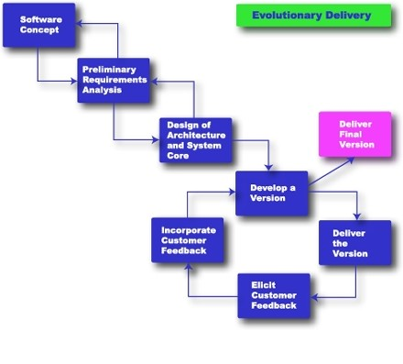
Design Methodology: Evolutionary Delivery
Notes:
Mike
2 weeks of requirements
Created a requirements document to verify requirements
2 weeks of design
Designed architecture and first wireframes
2 Week Iterations
Deployment at the end of every iteration
get sponsor feedback each iteration
Every iteration includes creating wireframes for the next iteration
We can re-prioritize tasks each iteration

Slide 6
Risk Management
Risks are tracked and documented each week
  New and Persistent risks
  Potential mitigation and prevention
Long term risk analysis of big features
  e.x. Google Calendar Integration
Mitigations are reviewed and discussed with sponsor
Notes:
Risks are documented each week
includes new risks and continuing risks
If the risk is significant, we think of mitigations, document them, and take action in the following week
Risk analysis of large features
Google Cal Integration
Something that we don’t need but would be nice
Decided it can be done, but shouldn’t be done before the core features are complete
GCal:
Feature may not be used = wasted development time
Difficulty of integration may not be worth the benefits
API Specs could change in the future
The Calendar has to be manually updated to be useful

Slide 7
Project Scope
Requirements:
  Student check-in
  Attendance tracking
  Student information
  Easy deployment
Out of Scope:
  Create class material
  Accept payments for classes
  Create a native app
Managing Requirements:
  Core requirements prioritized first
  Analyze requirements based on priority, feasibility, and risk
Notes:
Curtis
So a major part of the two-weeks of requirements analysis mentioned by Mike was determining the scope of the project scope.
We came up with the following broad features that the system would address:
Student check-in
Attendance tracking
Student information
Easy deployment
In addition to these features, we decided that the following functionality would be out of scope:
Creating class material
Accepting payments for classes
We would not create a native app for this project
To help us manage the scope of this project, we prioritized the core requirements first, this allows us to achieve minimum viable software so our sponsor has usable software. Aside from this, we analyzed requirements based on their priority, feasibility, and risk of implementation.

Slide 8
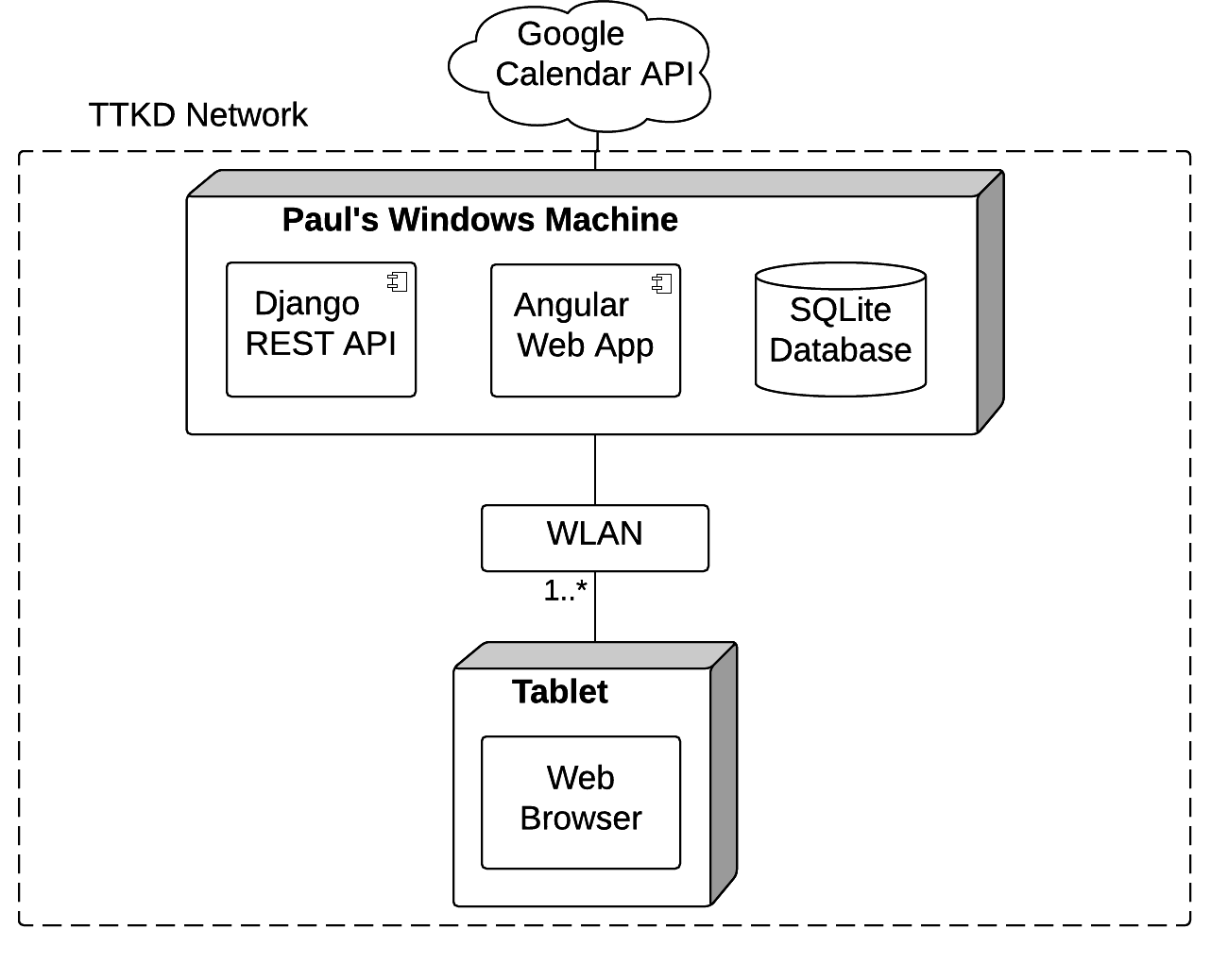
High Level Architecture
Notes:
Curtis
Once our requirements analysis was completed, we began to design our system, including the allocation view you see here, which displays the system in terms of the infrastructure it runs on.
The first thing I’ll point out is the dotted rectangle, this is the TTKD system boundary, which in our case is TTKD’s network. Our sponsor didn’t want the system to be accessible outside the network, so we’ve designed the system with this in mind. The only external connection the system has is the not-yet-implemented integration with Google Calendar.
The system itself runs on a single Windows machine and contains three major components: A REST API implemented with Django, a Web Application written with AngularJS, and a SQLite Database. Django was chosen because it’s easy to develop and deploy for us. Angular was chosen for its flexibility and the capability it affords us for UI development. Finally SQLite was chosen because it’s a relational database and the data involved here is tabular. In addition to this, SQLite uses a file, which makes deployment easier.
Finally, tablets running a web browser are used by either paul or instructors to access the system on TTKD’s wireless local area network.

Slide 9
Features: Student Check-in
Usability Concerns
  Students 3 and up
  All students must check themselves in
  Designed for tablets
Generates appropriate attendance records on the backend
  These can later be viewed by instructors and/or Paul
Notes:
Andrew
One of the main features f the system was the ability for students to check themselves into their class
The main concerns we had when designing this feature were regarding usability
Because students could be anywhere from ages 3 and up, they may not be able to read. Our solution was to display pictures of each student because even though small children can’t read,
They can recognize a picture of themself.
The second usability concern we had was the flow for checking in. Little kids aren’t able to follow complex flows so we had to come up with a very simple way for checking in. Our solution was to have the student tap on their picture once, and then a second time to confirm. Students can check in with only 2 taps of the screen.
Lastly we had to design the system to work on a tablet. Our solution was to use a simple grid layout of the student pictures. This fits well onto a tablet and is also user friendly.
By checking in an attendance record is created in the system, which allows for tracking student attendance

Slide 10
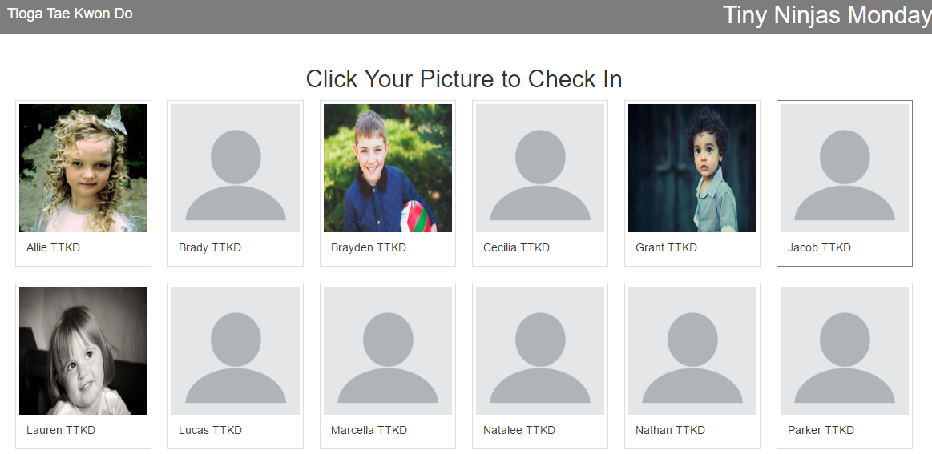
Student Check-in

Slide 11
Features: Attendance Tracking
Attendance can be tracked based on
  Students
  Class
  Date
Allows instructors and admin to visualize attendance
This shows:
  When the student attended
  How often they attended
  Which classes they attended
Notes:
Nick
So, you can check in, but why? So that your attendance can be tracked.
The act of checking in, and then tracking those attendances are two core requirements of the system.
Attendance can be tracked based on students, class and date.
Paul needs to be able to see who has, and hasn’t been coming to class for billing and promotions
He Also plans to use it to track the progress of students, tracking achievements over time
Most importantly attendance tracking removes the need for physical records

Slide 12
Features: Attendance Tracking
Notes:
Nick
Here is one of the wireframes for attendance tracking
We had to come up with a UI design that supports viewing attendance records by class, by student and by dates.
Representing all of this data in one page was a difficult design, and we came up with a condensed option to keep all ways of viewing these filters the same.
Searching by students would show an expanded view, while searching by class or date would used the condensed form

Slide 13
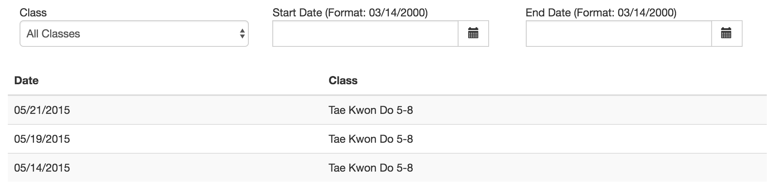
Features: Attendance Tracking
Notes:
Nick
Another way to see when a specific person attended is to go to their student page and then hit the attendance tab.
This shows a list of attendance records just for that person and it is filterable by class and by date.
Having this on the student page removes the need to navigate to another page to see a student's attendance while you are viewing their student page.
This is where Paul would likely examine how fast a student is progressing in their current belt compared to their attendance.
The choice to have this information on the student page was driven by the fact that it is such an important requirement.

Slide 14
Testing Process
Device screen resolution testing
Identified as an area of weakness
  Acknowledged lack of testing in our process
  Change process starting in second semester to correct the issue
Planned Changes
  Karma testing for service function calls and controller functionality
  Selenium testing for UI
  Planned live user testing with age specific focus groups
Notes:
AJ
Verification and validation are done through Karma tests and Selenium
Resolution testing - to make efficient use of space

Slide 15
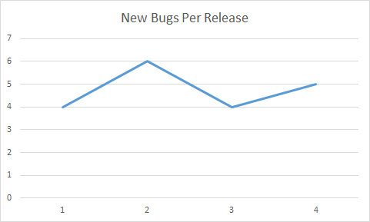
Bugs Per Release
Code Bugs
Iteration
Notes:
Bugs Per Release
New instances of broken code discovered per release

Slide 16
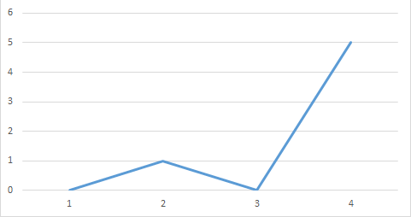
Requirement Defects Per Release
Requirements Defects
Iteration
Notes:
Requirements Defects Per Release
Requirements that were not satisfied or new requirements that were created per release
While the 4th release looks to be a very large skew it is still within our parameters especially since we had only 1 previous requirements defect or requirements changes.

Slide 17
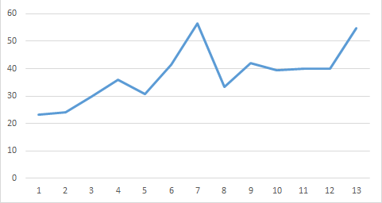
Time Tracking
Team Hours
Week
Notes:
Week 7 was iteration 1’s release
Week 13 had major git issues
Total Team Hours through week 13
491.05
Average Hours Per Week
37.77

Slide 18
First Semester Reflection
Things to improve:
Less distractions during meetings
Manage time deploying and wrapping up iterations
Better testing to find bugs in releases
Timely code reviews
Notes:
Curtis
With all this said and done, let’s reflect on our work this semester. We definitely thought there were things we could improve, these are the things we feel could use improvement:
Less distractions during meetings
Manage time deploying and wrapping up iterations to avoid unnecessary hiccups during deployments
As AJ mentioned, Better testing to find bugs in releases and ideally address them
Timely code reviews, to improve productivity in developments

Slide 19
First Semester Reflection (cont’d)
Things we’ve done well:
Core functionality is complete
Sponsor is happy with project progress
Sponsor meetings are organized and efficient
Division of work and meeting attendance are good
Adaptive response to sponsor feedback, afforded by the Evolutionary Delivery Methodology
Notes:
Curtis
Those were some of the things we thought could use improvement, but here are some of the things we’ve done well:
Core functionality is complete, the software as is, is usable
The sponsor is happy with project progress
Our sponsor meetings are organized and efficient
The division of work and meeting attendance are good
And finally, we’ve been happy with the adaptive response to sponsor feedback, afforded by the Evolutionary Delivery Methodology

Slide 20
Plans for Second Semester
Google calendar API integration
Support for partial registrations
Native picture taking, cropping, and positioning
Improve UI usability and aesthetics
Additional data export options
Incorporate more testing into our process
Extensive field testing
Notes:
Mike
Plans
Google Cal
Pre-filled registration forms
Native device picture taking
Improve Usability and appearance
Data Exporting
Incorporate more testing
Field testing

Slide 21

Demonstration
Notes:
Note that we are regularly getting feedback

Slide 22
Questions?

Slide 23
Deployment Process
Deployments at the end of each iteration
Application is packaged with a standalone Python version
All dependencies are included in the package
Launch to our team’s test server and also give Paul a copy of the packaged release
Core requirement was an easy to use one click executable, and we are satisfying that requirement
Notes:
AJ
We package all of the source code with Python and all of the dependencies removing the need to install any of them individually on the machine

Slide 24
Requirements Elicitation Process
Initial requirements discussions with sponsor
Created a requirements document to verify requirements
Every iteration includes creating wireframes for the next iteration
  Verifies requirements
  Allows two weeks for feedback/changes to wireframes
Notes:
Curtis

Slide 25
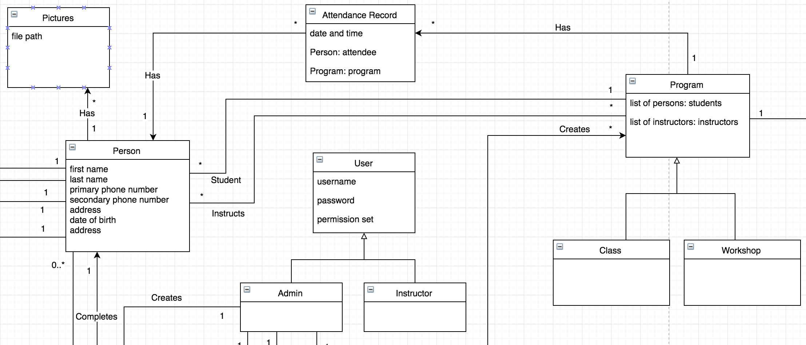
Core Domain Model
Notes:
Andrew
Main focus of the domain model is the Person. Every student is a person. With this we can maintain a student’s information and pictures by associating them with a person. Persons are also associated with programs, and through the programs attendance is tracked.

Slide 26
Metrics
Total Team Hours | 491.05
Average Hours Per Week | 37.77
Team Time & Effort Tracking
Individual Time & Effort Tracking
Requirements Defects Per Release
  Requirements that were not satisfied or new requirements that were created per release
Bugs Per Release
  Instances of broken code per release
Release | Bugs Per Release | Requirements Defects Per Release
1 | 4 | 0
2 | 6 | 1
3 | 4 | 0
4 | 5 | 5
Notes:
AJ
Average team hours per week
Metrics are up to release 4 (11/17)
5 requirements is within tolerance - some could have been introduced in earlier releases, but were found in release 4
Happy with the number of bugs per release

