Slide 1
Minimap
North Star + Lockheed Martin
Benjin Dubishar, Chris Carey, Josh Osgood, JP Mardelli
Prof. John Loser, Paul Mittan
13 May, 2014

Slide 2
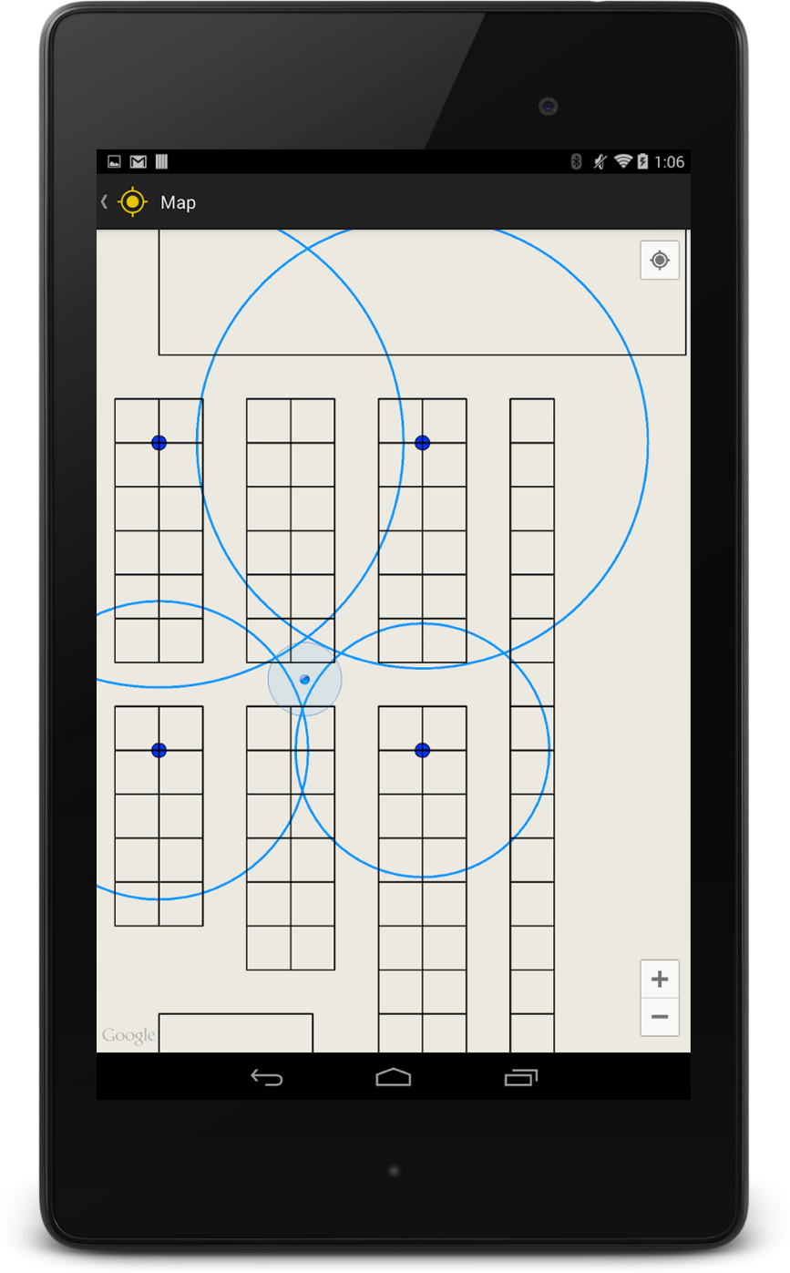
Context
Indoor map of project fair venue
GPS-like indoor positioning and navigation

Slide 3
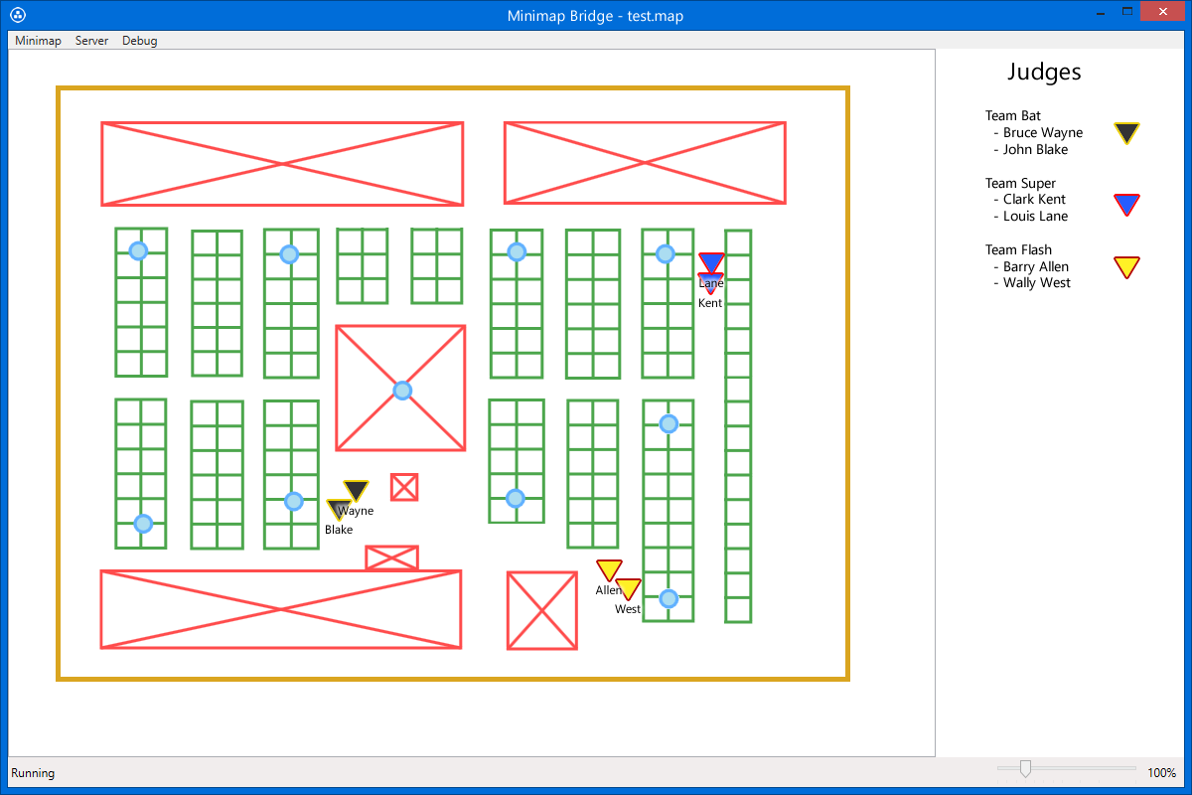
Goals
Simple to set up and use
High accuracy, low latency

Slide 4
Demo
Map construction
Server
System setup
Server handshake
Client positioning
Proximity zones and settings

Slide 5
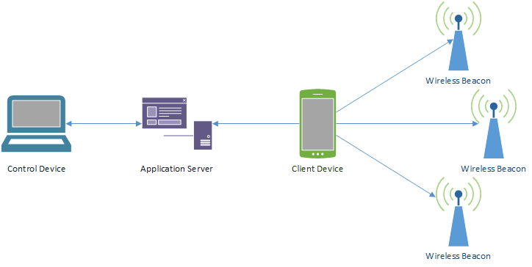
Network Architecture
Control
Cartographer
Bridge
C#
Application Server
REST
Supports any client
Client
Up to 15 devices
Android 4.3+
Beacons
Bluetooth 4.0 LE

Slide 6
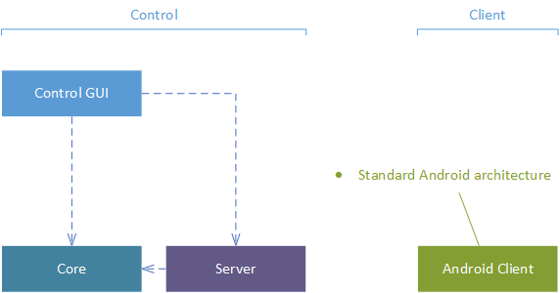
System Architecture

Slide 7
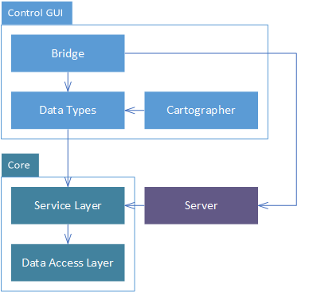
System Architecture
Data Types
Translates Core data objects
Core
Service-oriented architecture
Local data repository
Server
RESTful interface
ASP.NET Web API
OWIN

Slide 8
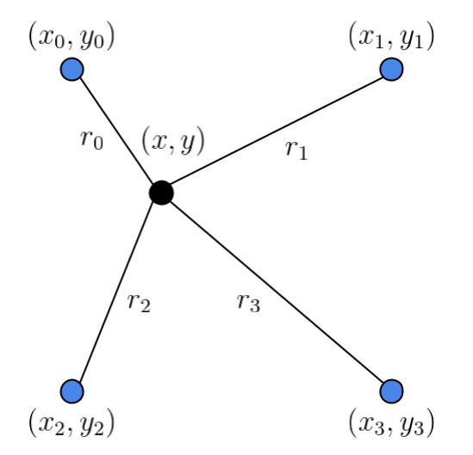
Multilateration
Distance equations:
Function to minimize:
Difference between calculated and estimated distances

Slide 9
Multilateration
Gauss-Newton Algorithm:
Jacobian matrix components:

Slide 10
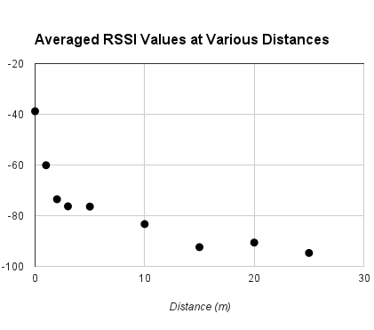
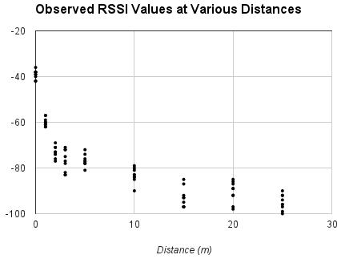
Challenges

Slide 11
Implementation Status Incomplete Features and Tasks
Control
Animation of user locations
Itinerary creation

Slide 12
Implementation Status Limitations
Indoor localization
Limited precision and accuracy
RSSI refresh rate of 4000 milliseconds
Maximum usable beacon scan range of 15-20 m
No rotated objects in .map file

Slide 13
Assessment What went well
Control application deployment
Indoor localization update rate
Simple-to-use UIs
Deployment at Penn State
Sponsor and client/user communication
“Position follows you as you move”

Slide 14
Assessment Challenges
Indoor localization accuracy & precision
Adapting hardware for unintended purpose
Slow client development loop
Possible wireless bandwidth congestion
Under investigation
“Position accuracy is not bad”

Slide 15
For Future Teams
Handing off
Trade study and technical report
Extensible Android app
JSON API endpoint for potential iOS app
Future
Possible combination with scoring app
iOS app
Continue to evaluate possible positioning technologies
Accuracy improvement

Slide 16
Minimap
Benjin Dubishar
Chris Carey
Josh Osgood
JP Mardelli

Slide 17
Metrics/Process
Spiral - two week cycles
Velocity
Total time worked, categorized
Accuracy metrics
Latency
Precision
Accuracy

