Slide 1
Minimap
RIT North Star + Lockheed Martin
Benjin Dubishar, Chris Carey, Josh Osgood, JP Mardelli
Prof. John Loser, Paul Mittan
3 December, 2013

Slide 2
Product
what we’re making

Slide 3
Context
large, indoor venues
science, career fairs
hundreds of presentations
teams of judges
difficult for judges to navigate

Slide 4
Project Definition
“The goal of this project is to design and implement an electronic tracking system similar to a portable GPS that can be used inside a large room / building (i.e. gymnasium). The system should behave similar to a GPS, where an indicator for the location of the device will autonomously update its position as it is moving around a large room.”
- Project proposal

Slide 5
Project Definition
“similar to a portable GPS” - why not GPS?
consumer device accuracy
buildings/indoors interference
satellite acquisition time

Slide 6
Project Definition
System to assist judges in navigating to their objectives
Tablet app, positioning system
Position broadcasting, syncing
High-fidelity, low-latency

Slide 7
Scope
Within Scope
Map creation tool
Itinerary ingestion tool
Tracking user position and displaying it on map
Displaying all user positions on map
Outside scope
Syncing itinerary checklists
Storing user data about itinerary points (e.g. scores for projects)

Slide 8
Requirements Elicitation
Sponsor interview
High-level architecture
Iterative UI mockups
List of questions/concerns

Slide 9
Core Requirements
Stable
User position tracking, map display
Server for client communication and synchronization
Map creation/ingestion
Client position broadcast
Itinerary creation and display
Volatile

Slide 10
Non-Functional Requirements
Accuracy
Latency
Cost
Usability
Open Source

Slide 11
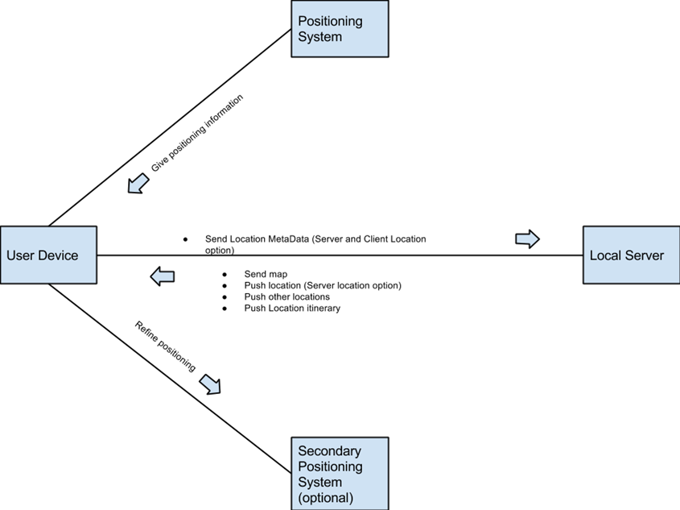
Architecture Design
Server coordinating data
Positioning refinement support
Multiple concurrent devices
Cartographer
Itinerary Creator

Slide 12
Operational Design
Indoor Localization via triangulation or trilateration

Slide 13
Trade Study

Slide 14
Technology Selection - Trade Study
“The first goal of the student team would be to evaluate a minimum of three possible solutions to this problem, looking at past examples or other research and performing a Trade Study to determine the most appropriate approach given the constraints of this project (technical competence, cost and schedule).”
- Project proposal

Slide 15
Trade Study
6 research papers reviewed
12 projects surveyed
16 page Trade Study document produced (2923 words)

Slide 16
Terms to Know
Received Signal Strength Indication
$\frac{1}{r^{2}}$drop-off value measured in decibels
Time-of-Flight
Time for a networking packet to travel between a server and client
Trilateration
Location determination technique using distances from multiple points

Slide 17
Technology Selection - Trade Study
WiFi Signal Strength (RSSI)
WiFi Time-of-Flight (ToF)
Bluetooth Signal Strength (RSSI)
Ultrasonic Trilateration
Notes:
(Chris)

Slide 18
Technology Selection - WiFi RSSI
Availability
Android compatibility
Poor accuracy
No iOS compatibility
Notes:
(Chris)
Availability
Low cost
Android Compatibility
Supported by all Android devices/versions
Poor Accuracy
Improved by fingerprinting
Processing power
Calibration
Developer experience
Unavailable on iOS

Slide 19
Technology Selection - WiFi ToF
Low computational complexity
Unachievable time precision required
Hardware configurability
Notes:
(Chris)
Availability
Low cost
Android Compatibility
Supported by all Android devices/versions
Poor Accuracy
Improved by fingerprinting
Processing power
Calibration
Developer experience
Unavailable on iOS

Slide 20
Technology Selection - Bluetooth
Low cost
Scalability
Accuracy
Cross-platform compatibility
Hardware requirements
Notes:
(Chris)
Availability
Low cost
Android Compatibility
Supported by all Android devices/versions
Poor Accuracy
Improved by fingerprinting
Processing power
Calibration
Developer experience
Unavailable on iOS

Slide 21
Technology Selection - Ultrasonic
Achievable precision
Cross-platform compatibility
Implementation complexity
High cost
Health concerns
Notes:
(Chris)
Availability
Low cost
Android Compatibility
Supported by all Android devices/versions
Poor Accuracy
Improved by fingerprinting
Processing power
Calibration
Developer experience
Unavailable on iOS

Slide 22
Technology Selection - Comparison
 | Accuracy | Cost | Difficulty | Overall
RSSI Trilateration | 1 | 9 | 8 | 5.1
ToF Trilateration | 4 | 8 | 2 | 4.8
Trilateration | 8 | 5 | 9 | 7.5
Trilateration | 10 | 1 | 2 | 5.7
Radio Field ID | Not viable – not on consumer devices
Near-Field Comm. | Not viable – max range 10cm
Notes:
(Chris)

Slide 23
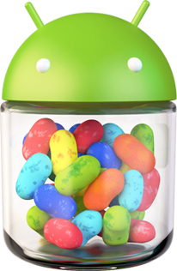
Technology Choices - Platforms
Android 4.3
ASP.NET Web API

Slide 24
Testing
Testing against ground truth
Accuracy thresholds
Calibration or adjustments
Tracking position in different environments (alone, crowded, obstacles)
= expected
= observed

Slide 25
Risk Management - Technical Risks
No Platform Independent Solution Exists
Mitigation: Fallback to Android
Limited Android Experience
Mitigation: Allot time for self-learning
Incapable Hardware
Mitigation: Early implementation and testing

Slide 26
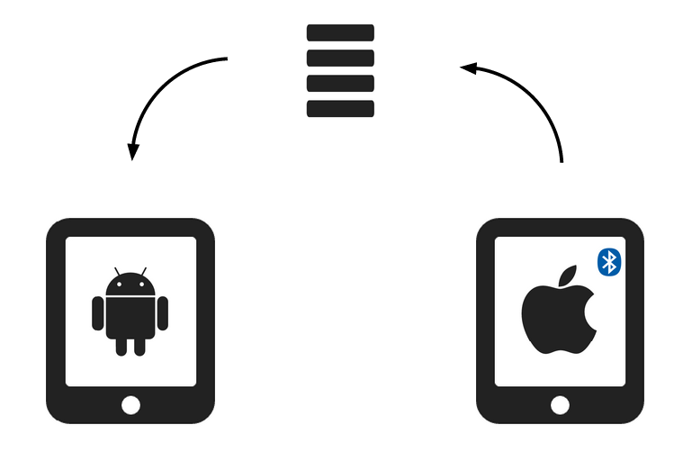
Risk Management - Budget Risks
Limited Budget or Delay in Hardware Acquisition
Mitigation: Fallback on owned devices

Slide 27
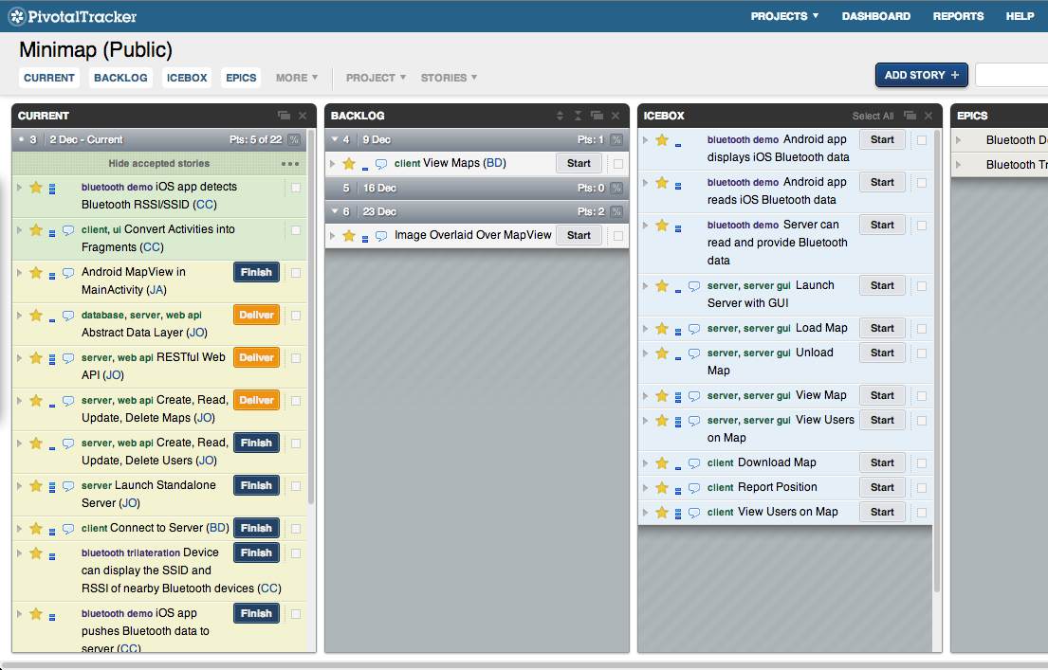
Risk Management - Schedule Risks
Scope Creep Mitigation: Assess priority and difficulty of all new requirements

Slide 28
Process
how we’re making it

Slide 29
Process - Development
Project Concerns
Spiral Development
Adapt to changing requirements
Capabilities of server
Mitigate risk
Viability of trilateration technologies
Hardware availability
Collection of Agile methodologies
Address risk before each sprint
Plan around risk and hardware availability
Adapt to new requirements
Internal task prioritization

Slide 30
Scheduling
Client
Control
Week 5-6: Android Skeleton Setup
Week 7-8: Wi-Fi Triangulation Exploration
Week 9-10: Other Technology Exploration
Week 11-12: UI Navigation
Week 13-14: Bluetooth RSSI/Distance Readings, Map with Beacons
End Goal (10): Technology Chosen
End Goal (15): Receive Map, Display Map, Location on Map
Week 5-6: Choose Technology
Week 7-10: Focus on Client
Week 11-12: Ingest Map Configuration
Week 13-14: Collect Locations
End Goal: Deliver Map to Client

Slide 31
Process - UI Design
Review Requirements
UI Wireframe Cycles
Each member draws a wireframe individually
Each member shares their wireframe with the group
Repeat until convergence
Convert to high-fidelity mock-ups for sponsor review
Notes:
(Chris)

Slide 32
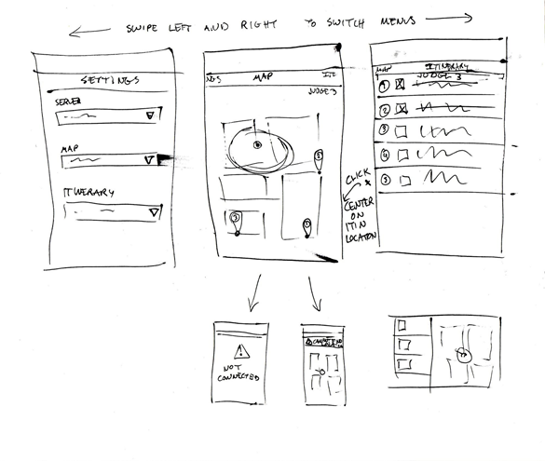
Process - UI Design Example
Round 1
Round 2
Notes:
(Chris)

Slide 33
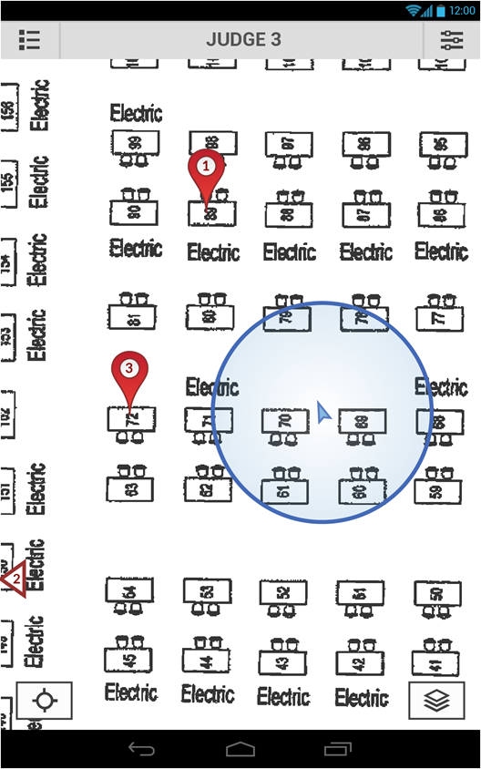
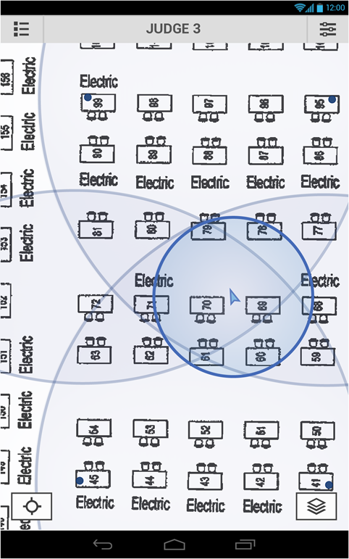
Notes:
(Chris)

Slide 34
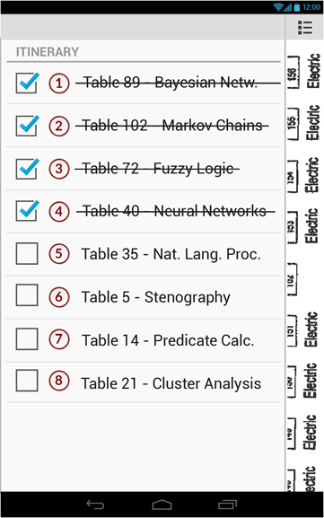
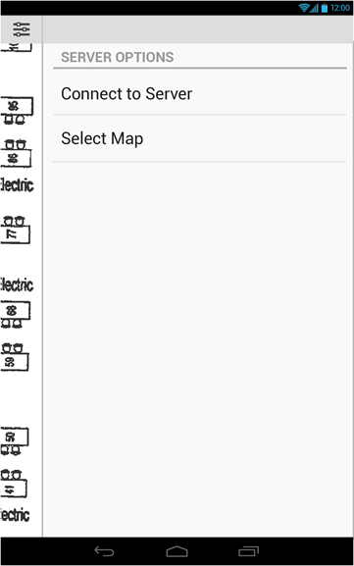
Notes:
(Chris)

Slide 35
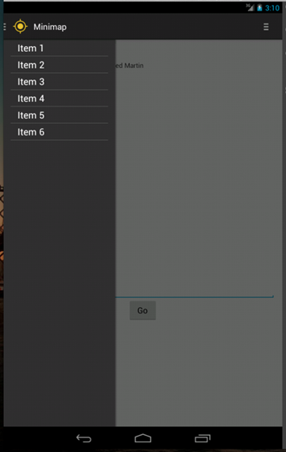
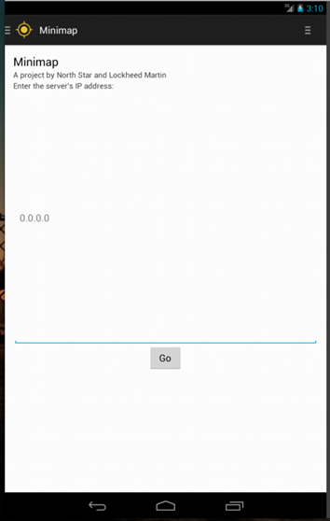
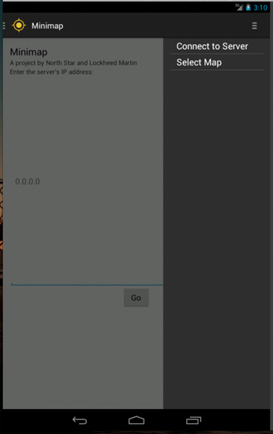
Notes:
(Chris)

Slide 36
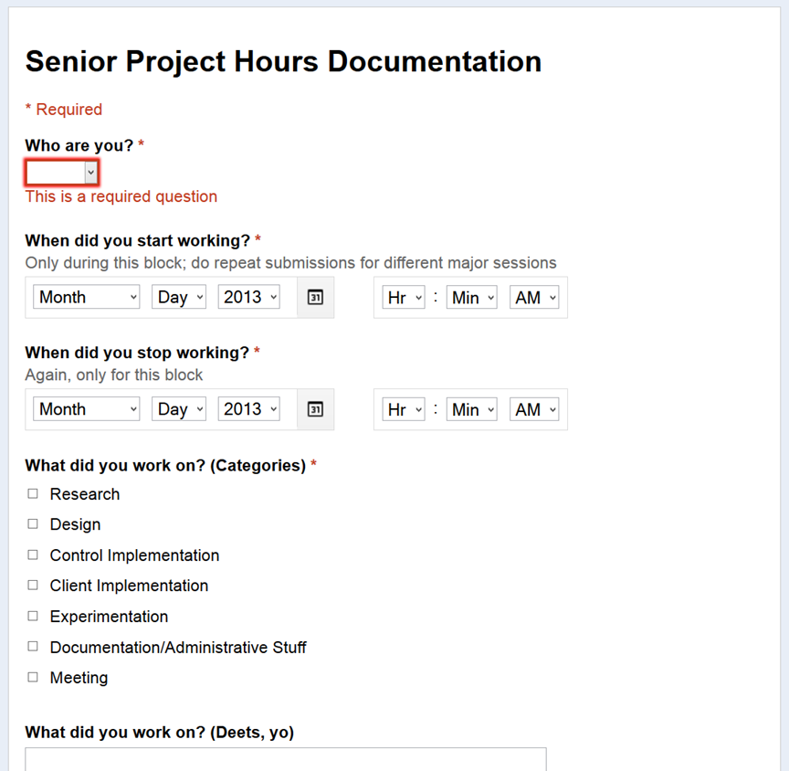
Metrics

Slide 38
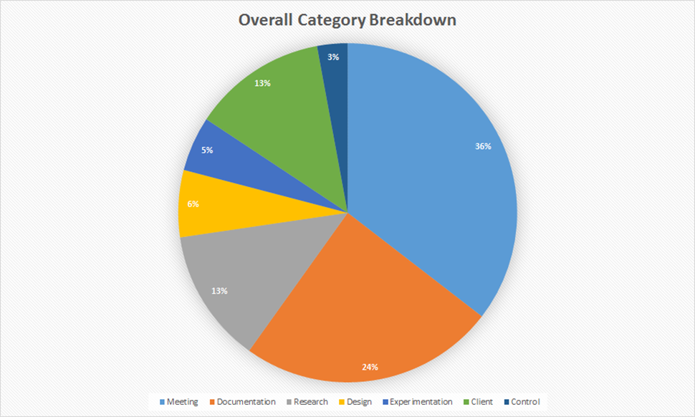

Slide 39
Implementation Status
UI scaffolding (double-drawer)
Bluetooth-reading prototypes
REST request from client app
Standalone server
exposed through RESTful API

Slide 40
Reflection
Efficient meetings and information transfer
UI design sessions
Straightforward architecture
Learn from past attempts
Brand new technology
Android development ramp-up
Unstable Android emulators

Slide 41
Future <Josh?>

Slide 42
Minimap
Benjin Dubishar
Chris Carey
Josh Osgood
JP Mardelli

