Slide 1
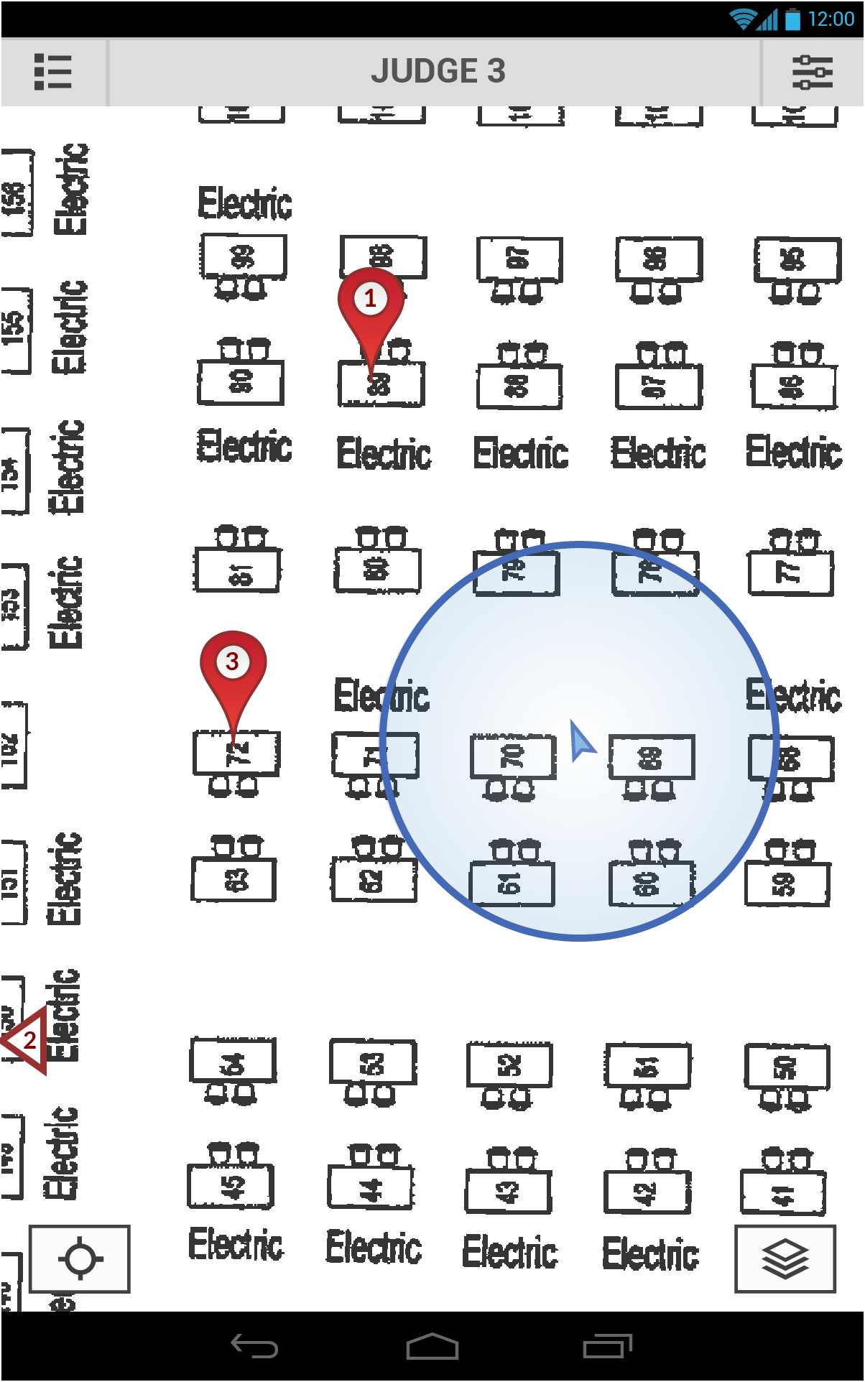
Not Shown:
Drag map to move
Click on location marker to attain more information

Slide 3
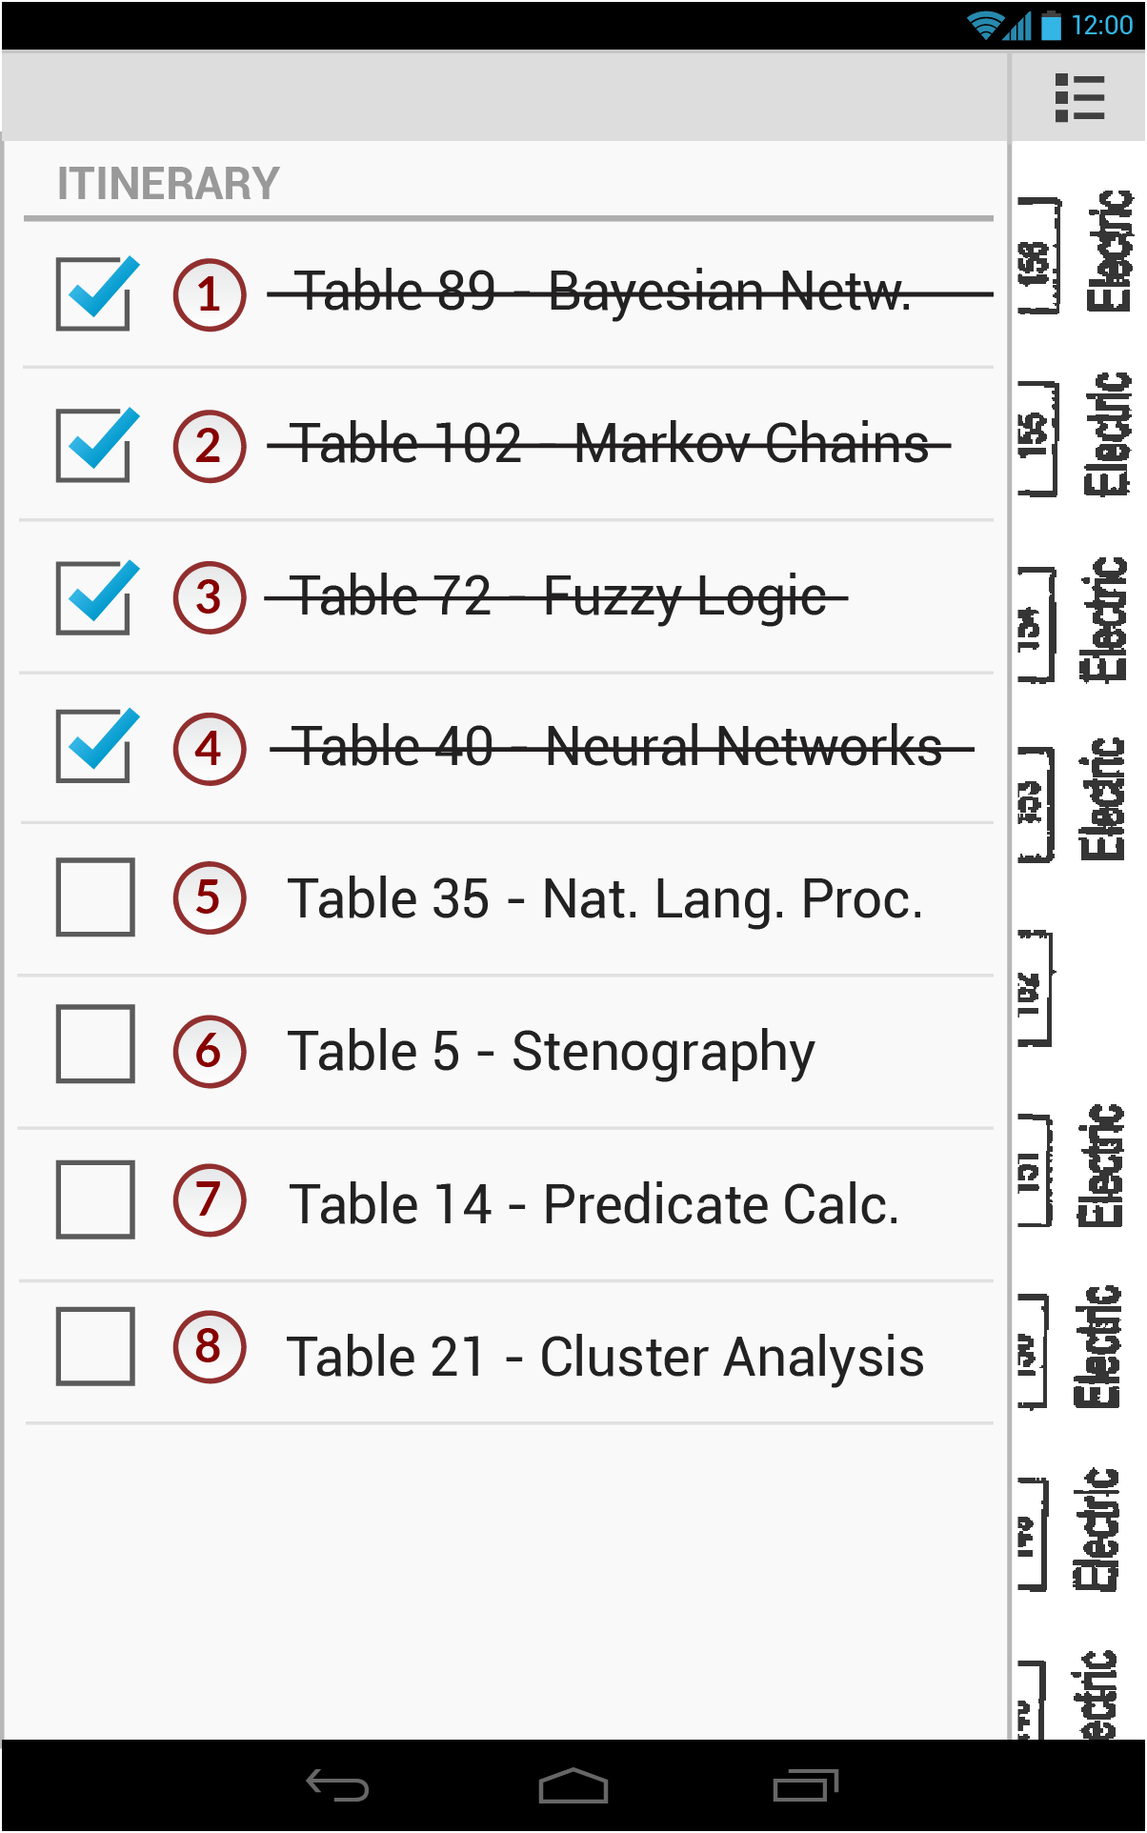
Not Shown:
Click on checkbox to mark as done
Click on number to show location on map
Off-canvas menu slide animations

Slide 7
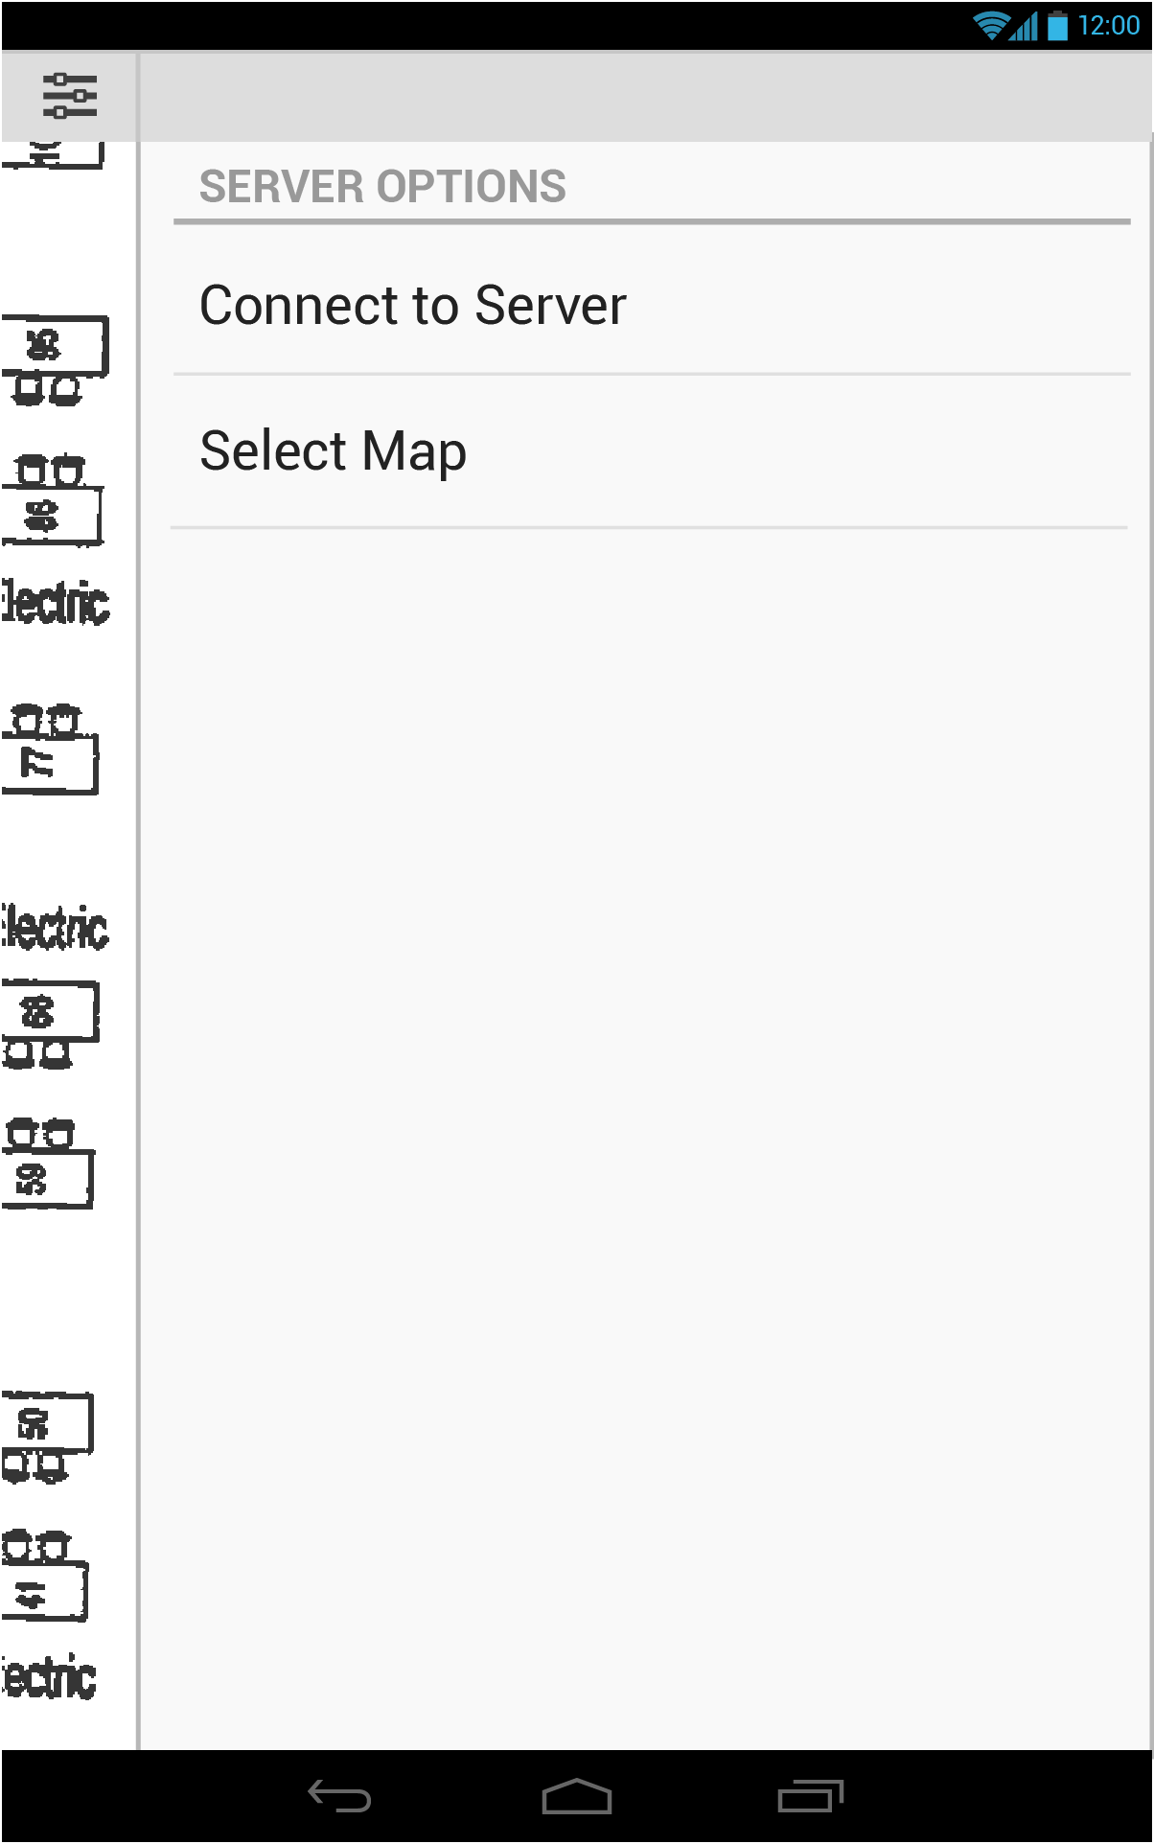

Slide 9
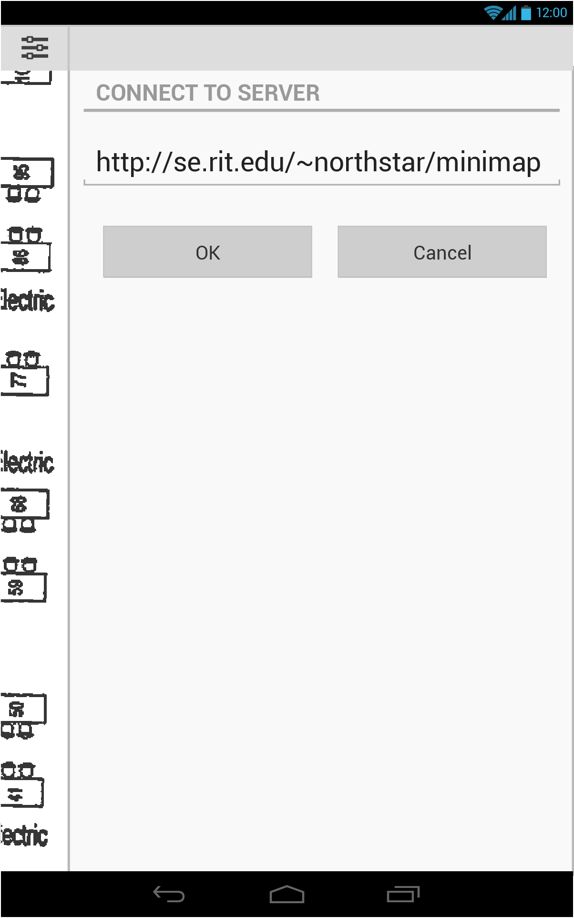
Not Shown:
Enter server URL via keyboard input

Slide 13
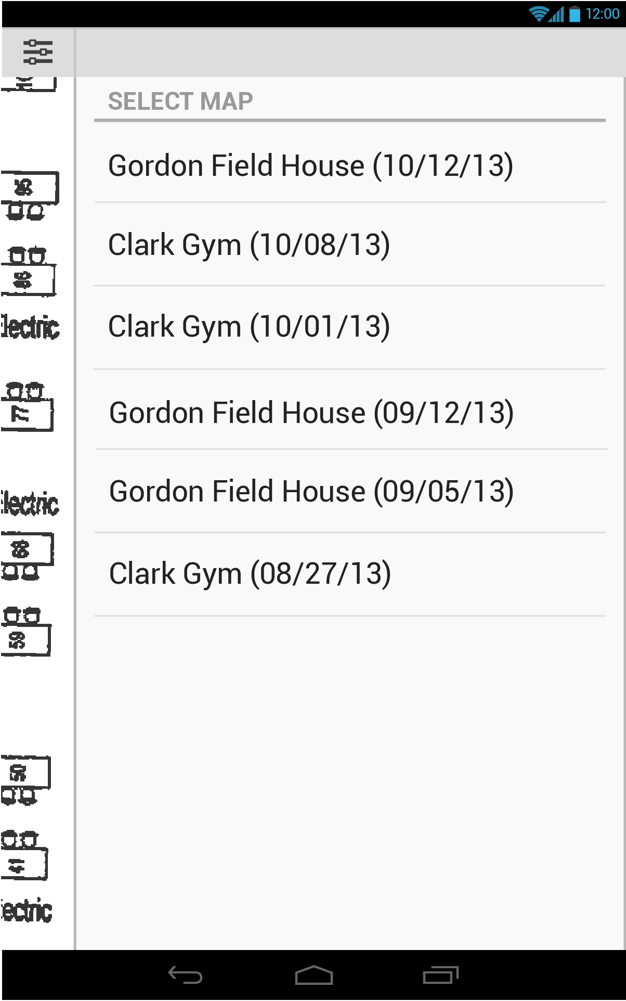
Not Shown:
Click on map to select and apply

Slide 17
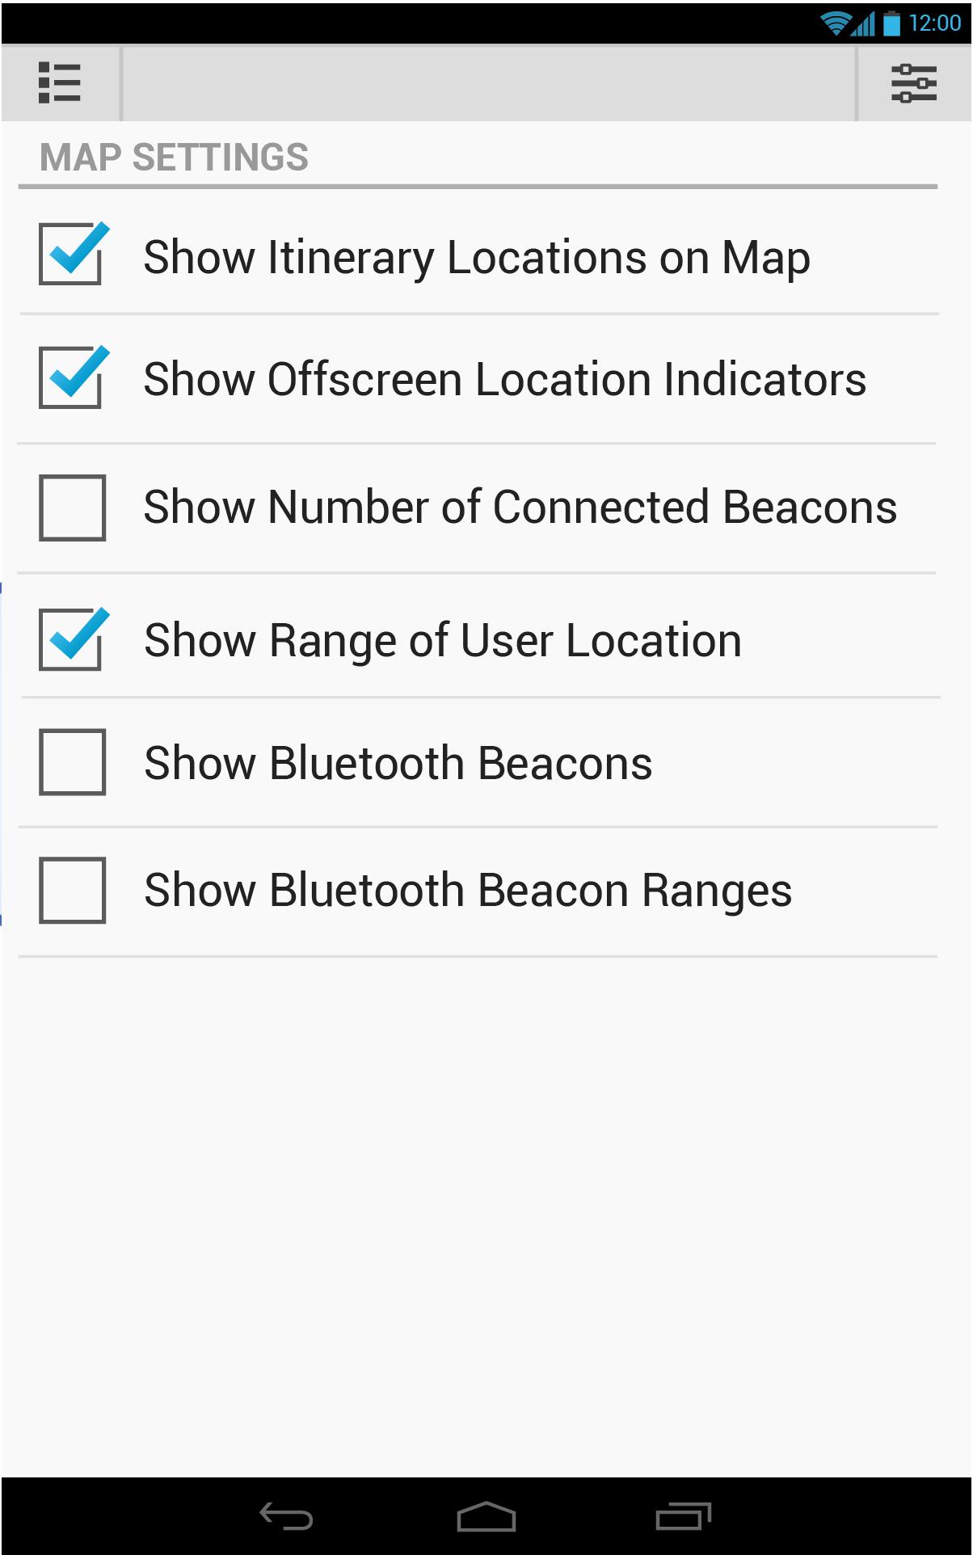

Slide 19
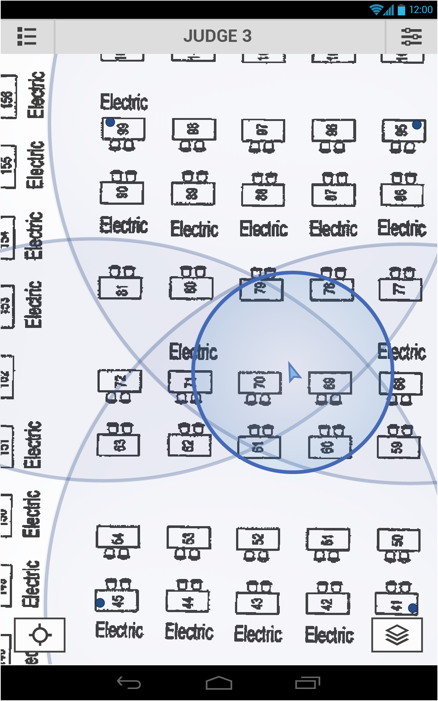
Not Shown:
Click on bottom left button to center map on user

