Slide 1
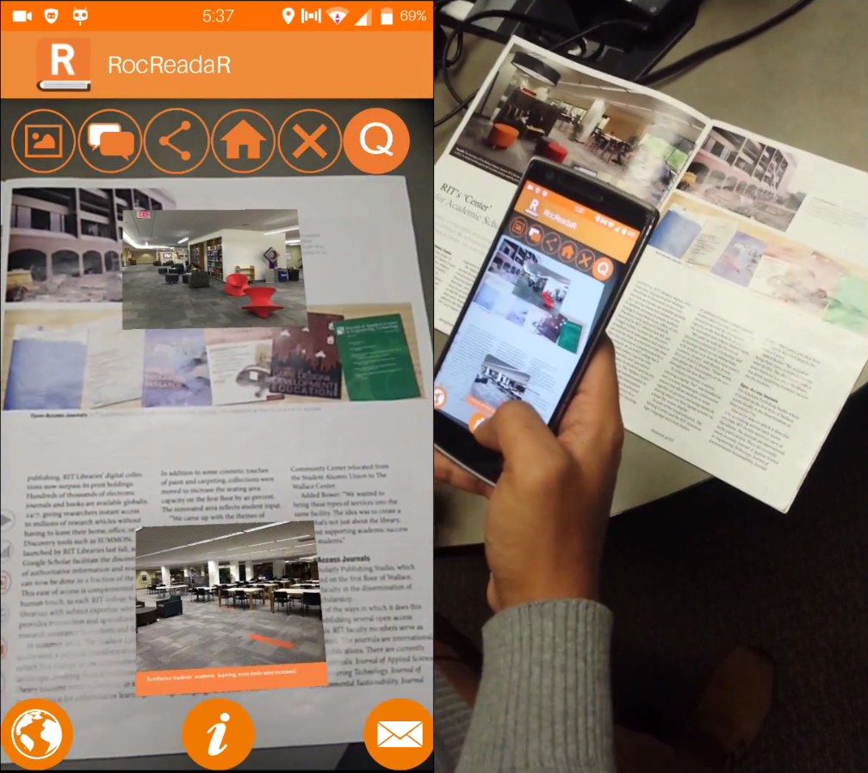
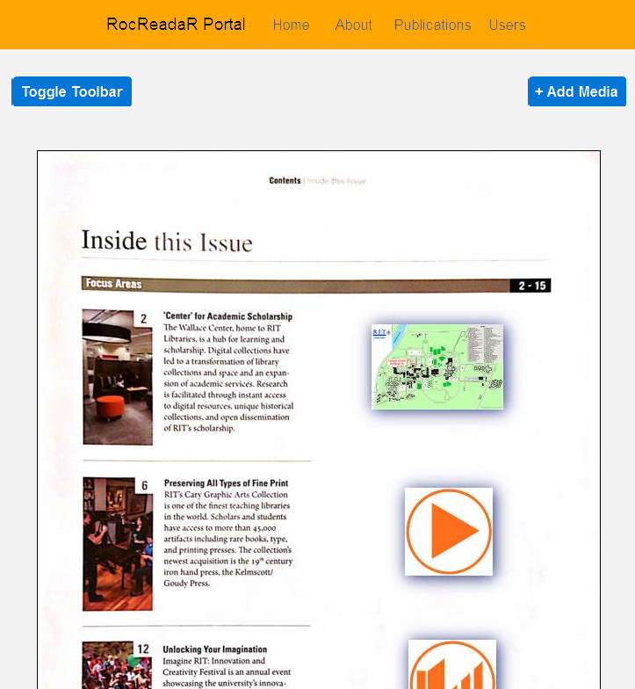
ROCREADAR
Faculty Coach
Donald Boyd
Team Rock Raiders, Class of 2016
Harris Borawski, Md Towhidul Chowdhury, Alex Bogart, Ian Salitrynski
Project Sponsors
Elena Fedorovskaya, Andrea Hickerson
RocReadaR Mobile App
Motivation
The RocReadaR App is part of a College of Imaging Arts and Sciences (CIAS) project. It is currently being developed by the RocReadaR team, in parallel to the RocReadaR Portal being developed by the Senior Project Team. The RocReadaR App scans magazine pages and displays relevant digital media. For example, a printed piece of media may have an article on a presentation that happened at RIT. When scanned using the RocReadaR App, a video of the presentation is shown. This provides aspects of both print and digital media. Users can view media related to articles and find more information about their interests.
Print media provides many benefits over digital media. It is tangible, helps with retention, and creates an emotional and sensory connection with the user. The RocReadaR project is an attempt in studying the best way to link print and digital media, to get the benefits of both.
Affordances
The Icons pictured on the right are printed in magazines. These inform users of the digital media available when scanning printed media. The same icons are used in the RocReadaR App to view the digital media.
RocReadaR Portal
Scalability and Performance
The RocReadaR Portal, developed by the Senior Project Team, provides access for publishers and editors of print media to upload digital media to be displayed when magazines are scanned, and edit how this is displayed in the RocReadaR App. Images of the print media must be uploaded in order for the RocReadaR App to identify the pages. The Portal also provides an endpoint for the App, which performs the image recognition required to find the correct digital media to display.
The RocReadaR Portal is deployed in Google Cloud Platform - a cloud web service. Multiple servers can be created at runtime to meet the demands of many users. A specialized search order helps increase the speed of image recognition.
Maintainability
The RocReadaR App uses an HTML wrapper with Javascript for the main functionality. Node.js , Express, Loopback, and Angular are used for the RocReadaR Portal, so the same language is used for all parts of the application. Extensive documentation is available on the CIAS Confluence site.

