Slide 1
Understanding Leadership
“Leadership is not about titles, positions or flowcharts. It is
about one life influencing another.” - John C. Maxwell
Designed for chapter 1, pages 1-23 of Project Team Leadership and Communication by Samuel Malachowsky, ISBN 9781732378902, 9781732378919.
Notes:
Corresponds to chapter 1, pages 1-23 of the Project Team Leadership and Communication book. ISBN: 9781732378902 (Softcover), 9781732378919 (Hardcover). These slides may only be posted or used in conjunction with the book in a training or classroom environment. Key terms (page 21) are often italicized on the slides.
Outline:
Job Titles
Leadership Styles
Affiliative
Authoritarian / Commanding / Autocratic
Coaching
Democratic
Laissez-faire
Pacesetting
Transformational / Visionary
Influence
Types
Motivators
Extrinsic
Intrinsic
Organizational Culture
Stakeholders (“Who we lead”)
Project Management
The Discipline
Ethics
Summary and Conclusions
Learning Objectives:
1.1 The Leader’s Title
Understand that title isn't synonymous with the need or authority to engage in leadership
1.2 Leadership Styles
Describe 7 basic leadership styles
Recognize the importance of choosing an appropriate style
Identify common pitfalls related to appropriate leadership styles
1.3 Influence
Describe 5 types of influence
Recognize personal preferences and their relationship to influence
1.4 Motivators
Describe 6 types of motivators and give examples of each
Classify the 6 motivators as extrinsic or intrinsic
Relate biases individuals may have towards or against individual motivators
1.5 Matching Leadership with Culture
Define ‘culture’ in the context of a project, team, and organization
Recognize contexts that affect and are affected by culture
1.6 Who We Lead
Define 'stakeholder' in the context of a project effort
Identify 3 common groups of project stakeholders
1.7 The Discipline of Project Management
Relate the various leadership titles and the field of project management
Describe several aspects of professional discipline and ethics
1.8 Chapter Tool: Who We Are as Leaders
Examine individual preferences relating to motivators, influence, and previous project experience
Associated Class Activities: (Separate Slides)
Applying Leadership Styles (5 minutes, section 1.2)
Recommend basic leadership styles for basic team scenarios
Professionalism and Ethics (10-15 minutes, sections 1.1 and 1.7)
Compare leadership titles and relate ethical challenges each might face
Matching Influence to Leadership (5-10 minutes, sections 1.2 and 1.3)
Decide which type of influence is appropriate / inappropriate for multiple leadership styles
Your Motivators (5-10 minutes, section 1.4)
Contrast types of motivators and relate individual preferences
Who We Are As Leaders (15 minutes, section 1.9)
Analyze individual and group preferences relating to motivators, influence, and stakeholder experiences

Slide 2
Job Titles
Loosely correlated to actual duties of jobs
The actual title can affect perceptions
  Manager vs. Coach vs. Foreman
“Project Manager” title can mean any number of things
Notes:
Corresponds to section 1.1, page 2 of the Project Team Leadership and Communication book.
The word leadership evokes:
Responsibility
Burden
Honor
Duty
Calling
Ability
The book includes a 2-minute exercise on page 2 entitled: What’s in a Name?

Slide 3
Leadership Styles
Leadership style should be chosen based on the team’s features, what they are trying to achieve, and the individuals
Leaders have a ‘default’ style they prefer
  This may not be appropriate for their team
  Stress or circumstances can cause leaders to choose or revert to the wrong style
There are dozens (7 main styles covered here)
Goleman, Daniel. Primal Leadership: Realizing the Power of Emotional Intelligence. Boston, Mass. :Harvard Business School Press, 2002.
Notes:
Corresponds to section 1.2, pages 2-5 of the Project Team Leadership and Communication book.
The next 7 slides are the styles:
Affiliative
Authoritarian / Commanding / Autocratic
Coaching
Democratic
Laissez-faire
Pacesetting
Transformational / Visionary

Slide 4
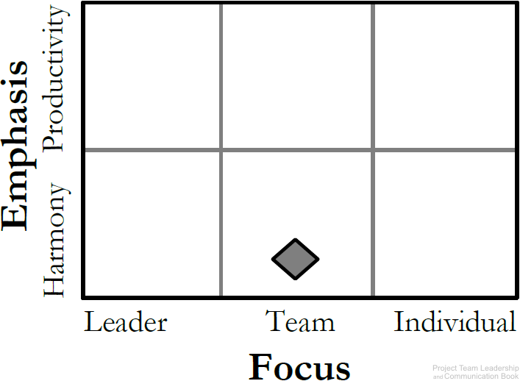
Affiliative Leadership Style
Emphasizes connection, harmony, and conflict resolution
Good for ‘hurting’ teams in need of a morale boost
Can be abused
Works best in combination with others
Diagram: Malachowsky, Samuel. Project Team Leadership and Communication. Lintwood Press. 2018. p. 3.
Goleman, Daniel. Primal Leadership: Realizing the Power of Emotional Intelligence. Boston, Mass. :Harvard Business School Press, 2002.
Notes:
Corresponds to page 3 of the Project Team Leadership and Communication book.
Emphasis is either on harmony or productivity, focus is on the leader, team, or individual.
The Affiliative Leadership Style emphasizes harmony and focuses on the team.

Slide 5
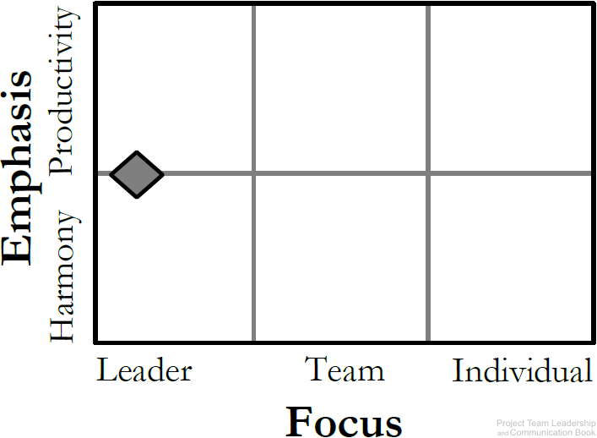
Authoritarian / Commanding / Autocratic Leadership Style
‘Classic’ leadership structure
Strong, dominating leader(s)
Can cause poor morale if teams aren’t used to it
Good for emergencies/crisis situations
Diagram: Malachowsky, Samuel. Project Team Leadership and Communication. Lintwood Press. 2018. p. 3.
Goleman, Daniel. Primal Leadership: Realizing the Power of Emotional Intelligence. Boston, Mass. :Harvard Business School Press, 2002.
Notes:
Corresponds to page 3 of the Project Team Leadership and Communication book.
Emphasis is either on harmony or productivity, focus is on the leader, team, or individual.
The Authoritarian / Commanding / Autocratic Leadership Style focuses heavily on the leader.

Slide 6
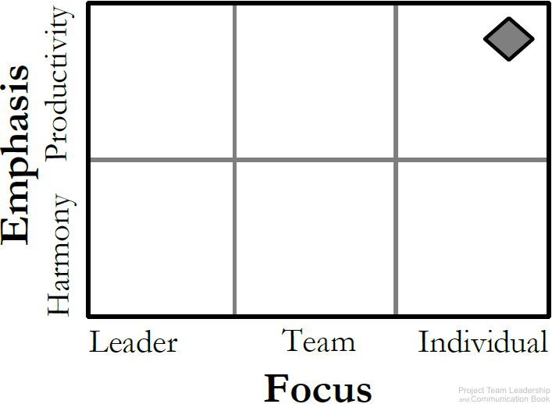
Coaching Leadership Style
About connecting the goals of the team/project with individuals
Best for teams who have the desire to succeed and are motivated
Can lead to micromanagement
Diagram: Malachowsky, Samuel. Project Team Leadership and Communication. Lintwood Press. 2018. p. 3.
Goleman, Daniel. Primal Leadership: Realizing the Power of Emotional Intelligence. Boston, Mass. :Harvard Business School Press, 2002.
Notes:
Corresponds to page 3 of the Project Team Leadership and Communication book.
Emphasis is either on harmony or productivity, focus is on the leader, team, or individual.
The Coaching Leadership Style emphasizes productivity and focuses on the individuals.

Slide 7
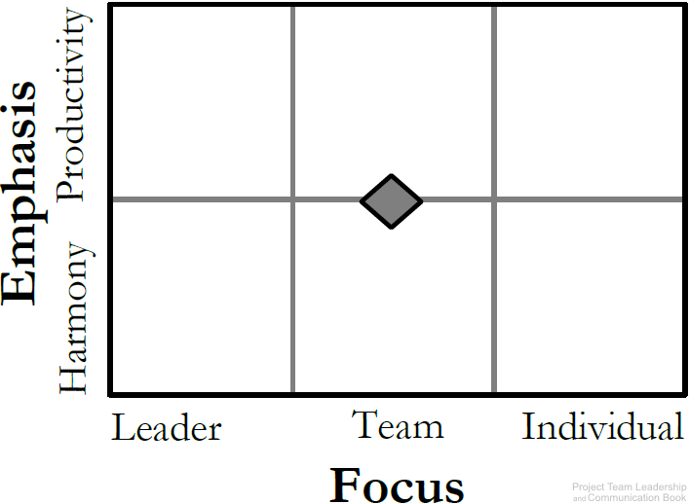
Democratic Leadership Style
Relies on the skills and knowledge of team members
Group makes decisions collectively
Can be time consuming and difficult for indecisive teams
Diagram: Malachowsky, Samuel. Project Team Leadership and Communication. Lintwood Press. 2018. p. 3.
Goleman, Daniel. Primal Leadership: Realizing the Power of Emotional Intelligence. Boston, Mass. :Harvard Business School Press, 2002.
Notes:
Corresponds to page 3 of the Project Team Leadership and Communication book.
Emphasis is either on harmony or productivity, focus is on the leader, team, or individual.
The Democratic Leadership Style focuses heavily on the team.

Slide 8
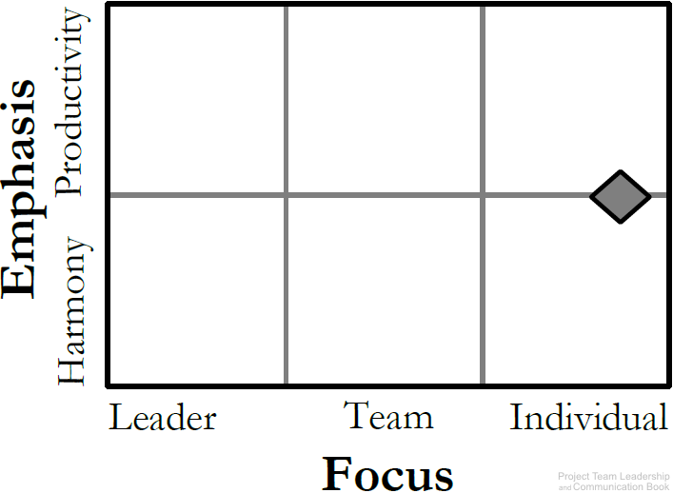
Laissez-faire Leadership Style
The ‘hands-off’ approach
Management trusts the team members to make decisions and meaningful progress
Leaders support rather than control
Requires self-motivated, hard-working, honest team members
Diagram: Malachowsky, Samuel. Project Team Leadership and Communication. Lintwood Press. 2018. p. 4.
Goleman, Daniel. Primal Leadership: Realizing the Power of Emotional Intelligence. Boston, Mass. :Harvard Business School Press, 2002.
Notes:
Corresponds to page 4 of the Project Team Leadership and Communication book.
Emphasis is either on harmony or productivity, focus is on the leader, team, or individual.
The Laissez-faire Leadership Style focuses heavily on the individual.

Slide 9
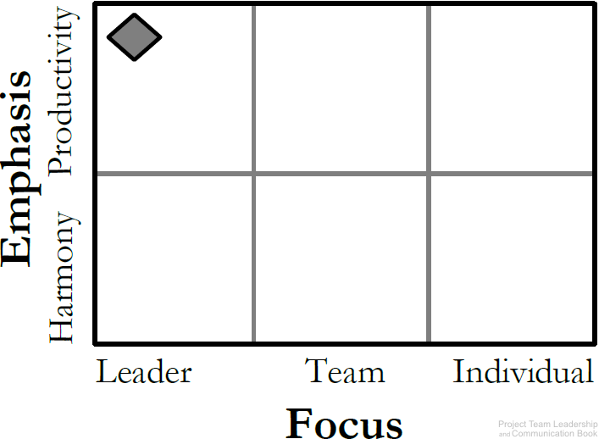
Pacesetting Leadership Style
This is ‘lead by example’
Leader is highly focused on performance and expects the same of the team
Works best with teams that already perform at a high level
Team members can feel as they’ll never ‘measure up,’ lowering moralle
Diagram: Malachowsky, Samuel. Project Team Leadership and Communication. Lintwood Press. 2018. p. 4.
Goleman, Daniel. Primal Leadership: Realizing the Power of Emotional Intelligence. Boston, Mass. :Harvard Business School Press, 2002.
Notes:
Corresponds to page 4 of the Project Team Leadership and Communication book.
Emphasis is either on harmony or productivity, focus is on the leader, team, or individual.
The Pacesetting Leadership Style emphasizes productivity and focuses on the leader.

Slide 10
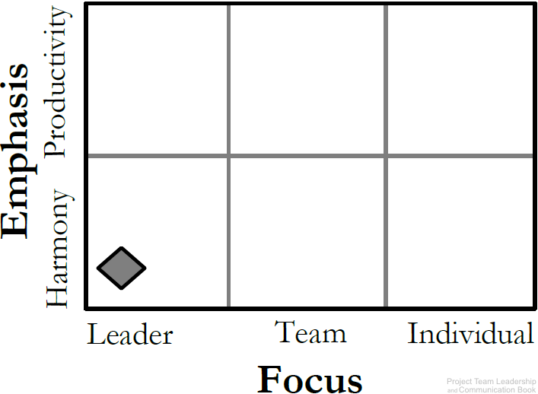
Transformational / Visionary Leadership Style
The leader focuses on setting a positive vision for the future
Team members are infused with a sense of purpose and excitement
Good for teams that have recently experienced failure
Can become unrealistic and overly optimistic
Diagram: Malachowsky, Samuel. Project Team Leadership and Communication. Lintwood Press. 2018. p. 4.
Goleman, Daniel. Primal Leadership: Realizing the Power of Emotional Intelligence. Boston, Mass. :Harvard Business School Press, 2002.
Notes:
Corresponds to page 3 of the Project Team Leadership and Communication book.
Emphasis is either on harmony or productivity, focus is on the leader, team, or individual.
The Transformational / Visionary Leadership Style emphasizes harmony and focuses on the leader.

Slide 11
Influence
Not just the leader; All team members have influence on their peers
Can be positive or negative
Choose appropriate combinations for each peer or team member
Being the ‘boss’ isn’t enough
Notes:
Corresponds to section 1.3, pages 5-7 of the Project Team Leadership and Communication book.
The next slide is the types of influence

Slide 12
Influence Types
Formal / Legitimate
  Classic title-based position of authority
Penalty / Coercive
  The ability or fear of punishment such as demotion
Reward
  The ability to reward
Expert
  A superior level of skill, experience, or knowledge
Referent
  Based on trust and respect, similar to the influence of trusted family members
Notes:
Corresponds to page 6 of the Project Team Leadership and Communication book.

Slide 13
Motivators
What makes us want to come to work
Norms often established by industry, organization, or previous leaders
What motivates you may or may not motivate others
Bias towards or against individual motivators can be a factor
Motivators are highly personal; the leader must consider each team member individually
Divided into Extrinsic and Intrinsic motivators
Notes:
Corresponds to section 1.4, pages 7-10 of the Project Team Leadership and Communication book.
The next 2 slide are the types of motivators

Slide 14
Extrinsic Motivators
Money / Power
  Want to ‘move up’ in the organization or earn higher wages
  Classic examples: Salespeople, CEO’s, Politicians
Recognition
  Often motivated most by acknowledgement of those in power
  Classic examples: Entertainment, Lawyers, Interns
Interpersonal Relationships
  Relationships with co-workers and a cooperative atmosphere are valued
  Classic examples: Religious Leaders, Social Workers
Ryan, Richard; Edward L. Deci. Intrinsic and Extrinsic Motivations: Classic Definitions and New Directions. Contemporary Educational Psychology. 25 (1): 54–67. 2000.
Notes:
Corresponds to pages 7-8 of the Project Team Leadership and Communication book.

Slide 15
Intrinsic Motivators
Autonomy / Interesting Work
  Prefer the excitement of new and innovative endeavors
  Classic Examples: Architects, Engineers
Purpose
  Need to feel that their work is beneficial to the causes they care about
  Classic Examples: Doctors, Teachers, Military
Mastery / Exploration
  Personal achievement, problem solving opportunities, and creative endeavors are sought
  Classic Examples: Artists, Scientists
Ryan, Richard; Edward L. Deci. Intrinsic and Extrinsic Motivations: Classic Definitions and New Directions. Contemporary Educational Psychology. 25 (1): 54–67. 2000.
Notes:
Corresponds to page 8 of the Project Team Leadership and Communication book.

Slide 16
Organizational Culture
The set of behaviors or beliefs that determine how an organization or team interacts or carries out work
Awareness of culture and different circumstances/attitudes is key
Influenced by:
  The industry, environment, customers, organizational practices
  Personalities, values, principles, etc. of the organization, leader, and team
Influences:
  Decision making, risk tolerance, decisiveness, orderliness, competitiveness
  Level of attention to detail, amount of process, emphasis on achievement
  Supportiveness, reward/punishment, team vs. individual contribution
O’Reilly, C. A. III, Chatman, J. A., and Caldwell, D. F. People and organizational culture: A profile comparison approach to assessing person-organization fit.
Academy of Management Journal, September 1991. p. 502, 516. 1991.
Notes:
Corresponds to section 1.5, pages 10-12 of the Project Team Leadership and Communication book.

Slide 17
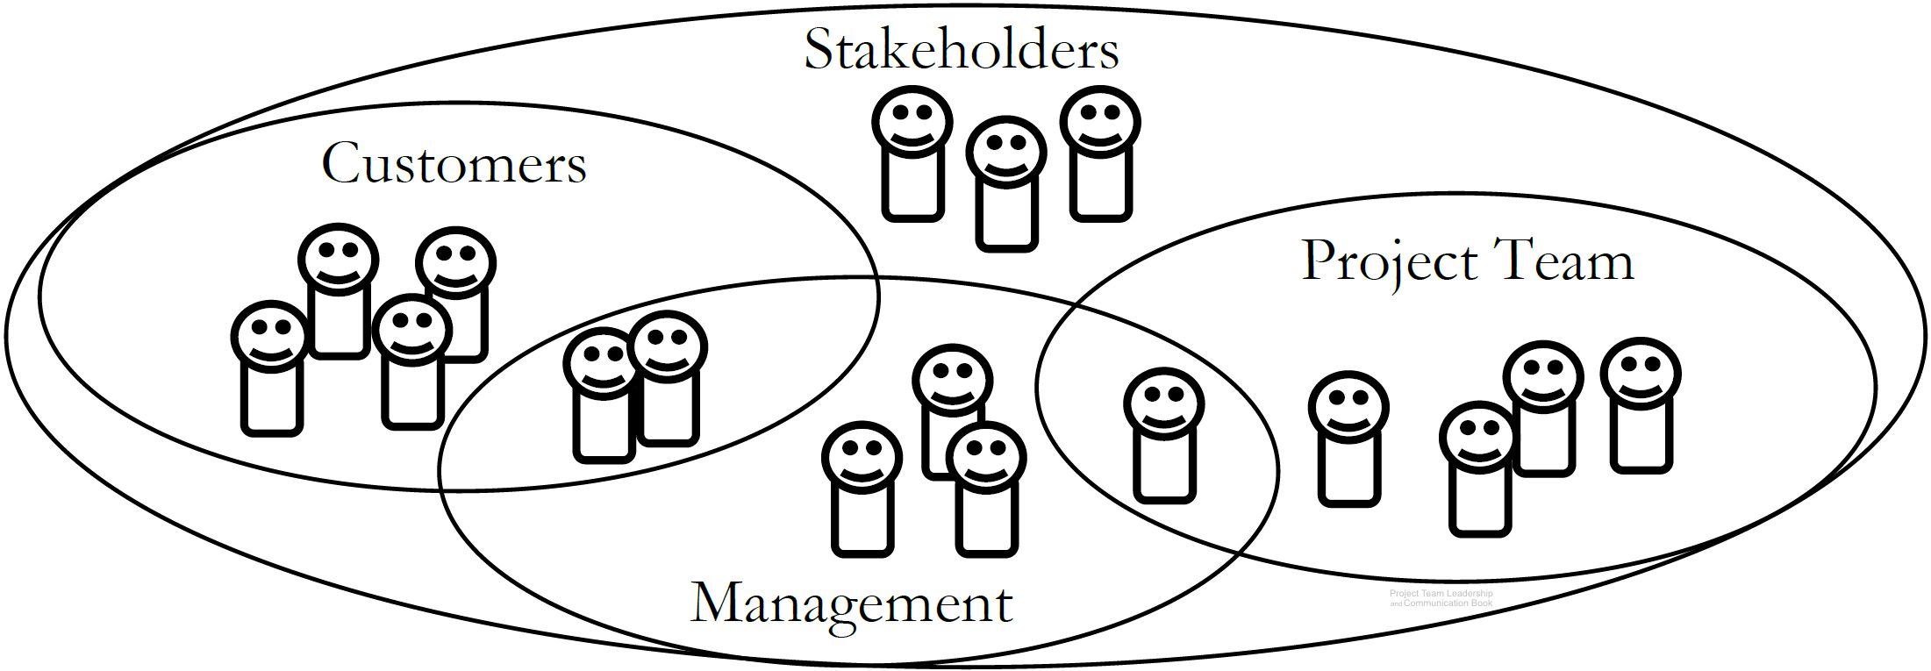
Stakeholders
Stakeholders are people who can affect or are affected by the execution or outcome of a project
Diagram: Malachowsky, Samuel. Project Team Leadership and Communication. Lintwood Press. 2018. p. 12.
Notes:
Corresponds to section 1.6, pages 12-13 of the Project Team Leadership and Communication book.
The Venn diagram illustrates how there are major stakeholder groups, but they can overlap. Each requires specific considerations and strategies.
Stakeholders are covered further in other chapters/slides, especially section 3.8 (pages 102-105) and 5.7 (pages 171-172).

Slide 18
Project Management – The Discipline
Can have many titles: Project Leader, Coordinator, Planner, Manager, Team Leader, Program Manager, Technical Lead, etc.
May not have direct (hire/fire) authority
‘Manages’ project outcomes, schedules, resources, and documentation
Large amounts of time often committed to project management tools, meetings, and communication
Professional certifications available (PMP, CAPM)
Notes:
Corresponds to section 1.7, pages 13-17 of the Project Team Leadership and Communication book.

Slide 19
Project Management – Professional Ethics
Ethics (self-discipline) are key to professionalism
Ethics influence and are influenced by organizational culture
Examples
  Honesty regarding qualifications
  Protecting proprietary information
  Confronting conflict directly
  Disclosing conflicts of interest
  Focusing on mutual cooperation
  Advocating for team members and stakeholders
Includes elements from the Project Management Institute’s 2006 Code of Ethics and Professional Conduct
Notes:
Corresponds to pages 15-16 of the Project Team Leadership and Communication book.

Slide 20
Summary and Conclusions
A leader’s title isn’t everything
We must be intentional in how we influence and motivate others
  Awareness of various types and techniques is key
Culture influences every aspect of the organization and team
Stakeholders are key to any project effort, and comprise multiple groups
Project Management is an important discipline which requires diverse skills and a commitment to ethics
Notes:
Corresponds to section 1.9, page 20 of the Project Team Leadership and Communication book. Summarizes chapter 1 and these slides.

Slide 21
Questions / Discussion
Notes:
Chapter 1 includes several additional support elements which could become classroom activities or discussion elements.
The chapter tool, entitled Chapter Tool: Who We Are as Leaders (section 1.8, pages 17-20) is designed to help readers explore their own motivators, influencers, and stakeholder experiences. Students could rate the accuracy of the test with their own perceptions, compare results, and have discussions about each element.
There are several key terms defined on page 21.
Review questions cover most of the chapter (pages 21-22, answers on page 223).
The exercises on page 22 are designed to allow readers to apply and extend what they’ve learned.

