Slide 1
Project Fundamentals
Understanding the work at hand
Designed for chapter 2, pages 25-77 of Project Team Leadership and Communication by Samuel Malachowsky, ISBN 9781732378902, 9781732378919.
.
Notes:
Corresponds to chapter 2, pages 25-77 of the Project Team Leadership and Communication book. ISBN: 9781732378902 (Softcover), 9781732378919 (Hardcover). These slides may only be posted or used in conjunction with the book in a training or classroom environment. Key terms (pages 74-75) are often italicized on the slides.
Outline:
What is a Project
Project Phases
Project Functions
Projects can Vary in Size and Scale
Organizational Structures
Functional
Project-Focused
Matrix
Organizational Values and Needs
Process
Plan-focused model
Cyclical model
Change-focused model
Quality
Project Quality
Product and Process Quality
Quality as a Balancing Act
The Project Triangle
Project Outcomes (The Layered Approach)
Goals, Scope Statements, Requirements/Specifications
Project Kickoff Meeting
Project Plan
Summary and Conclusion
Learning Objectives
2.1 What is a Project?
Define 'project,' identifying 2 defining features
List 4 project phases and 1 additional element
Recognize the interactions between projects/phases and the product lifecycle
2.2 The Project Environment
Identify 3 types of organizations in the context of how projects are organized
Recognize strengths and weaknesses of each of the 3 organizational types
2.3 Values, Needs, and Process
Recall factors influencing the values and needs of a project, team, or organization
List 3 fundamental process models and summarize the strengths and weaknesses of each
Recognize varying levels of detail/abstraction in documented processes
2.4 Quality and The Project Triangle
Define 'quality,' identifying 4 main aspects/concerns
Give examples of elements that are 'cost of quality' and 'cost of poor quality' in a project
Label the project triangle's 4 components
Relate examples of each project triangle component and the relationships between them
2.5 Defining Project Outcomes: A Layered Approach
Relate the concept of project goals, including examples of such
Relate the concept of project scope statements, including examples of such
Relate the concept of project requirements/specifications, including examples of such
Describe ‘the layered approach’ to project outcome definition
2.6 The Project’s Early Stages
Identify the primary objectives of a project kickoff meeting
List the essential elements of a basic project plan
2.7 Chapter Tool: Planning Project Quality
Relate basic steps for determining a project’s quality objectives
Associated Class Activities: (Separate Slides)
One Product, Multiple Projects (10 minutes, section 2.1)
Propose multiple projects within a single product’s life cycle
Organizational Culture and Structure (10 minutes, sections 1.5 and 2.2)
Analyze the cultural norms and organizational structures of multiple industries
‘Rolling Your Own’ Process (10-15 minutes, section 2.3)
Analyze a scenario and construct a basic process
Understanding Quality (10-15 minutes, section 2.4)
Develop scenario-specific quality-related elements of consideration
Layering Project Outcomes (10-15 minutes, section 2.5)
Construct scenario-specific goals, scope statements, and specifications/requirements
Outlining the Project Plan (10-15 minutes, section 2.6)
Design a project plan outline

Slide 2
What is a Project?
Based on a business need or opportunity
Often explored and initiated by the Project Sponsor(s), who writes or approves the Project Charter
Has the following features:
  A defined beginning and end
  Unique goals and outcomes
  Typically requires team members with varied skills
Contrasts with Operational Work, which is repetitive ‘business as usual’
Project Management Institute. A Guide to the Project Management Body of Knowledge – Fifth Edition. Project Management Institute Inc. p. 3. 2013.
Notes:
Corresponds to section 2.1, pages 25-30 of the Project Team Leadership and Communication book.

Slide 3
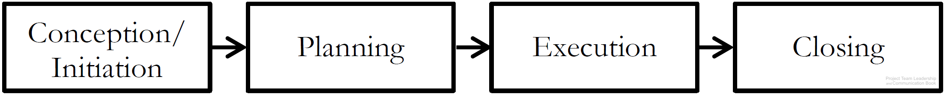
Project Phases
Conception/Initiation Phase
  Research conducted, leadership chosen, goals and requirements established
Planning Phase
  Detailed plans drafted and documented
Execution Phase
  Plans are implemented, intended result of project takes shape
Closing Phase
  Results handed off, lessons learned collected
Diagram: Malachowsky, Samuel. Project Team Leadership and Communication. Lintwood Press. 2018. p. 27.
Project Management Institute. A Guide to the Project Management Body of Knowledge – Fifth Edition. Project Management Institute Inc. p. 42. 2013.
Notes:
Corresponds to pages 27-28 of the Project Team Leadership and Communication book.

Slide 4
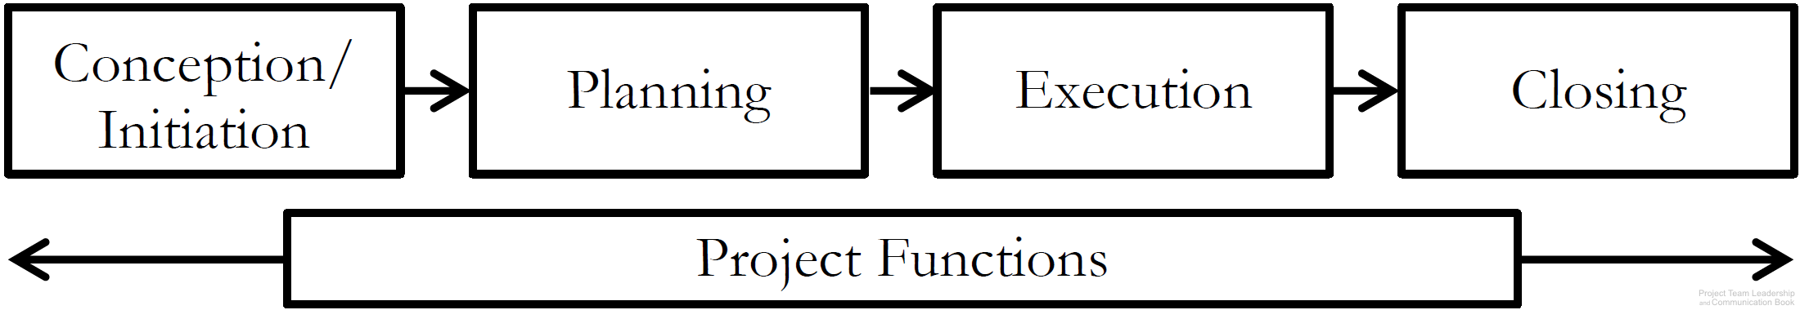
Project Functions
Unlike individual phases, Project Functions don’t occur at one point in time – they require continuous attention and/or action
  Risk and Issue Management
  Quality Management
  Communications Management
  Project Management itself!
Diagram: Malachowsky, Samuel. Project Team Leadership and Communication. Lintwood Press. 2018. p. 28.
Project Management Institute. A Guide to the Project Management Body of Knowledge – Fifth Edition. Project Management Institute Inc. p. 42. 2013.
Notes:
Corresponds to pages 28-29 of the Project Team Leadership and Communication book.
Risk and issue management is covered in the book on page 97.
Quality Management/Assurance is covered in the book in this chapter, page 43.
Communications Management is the subject of chapter 5, pages 149-178.

Slide 5
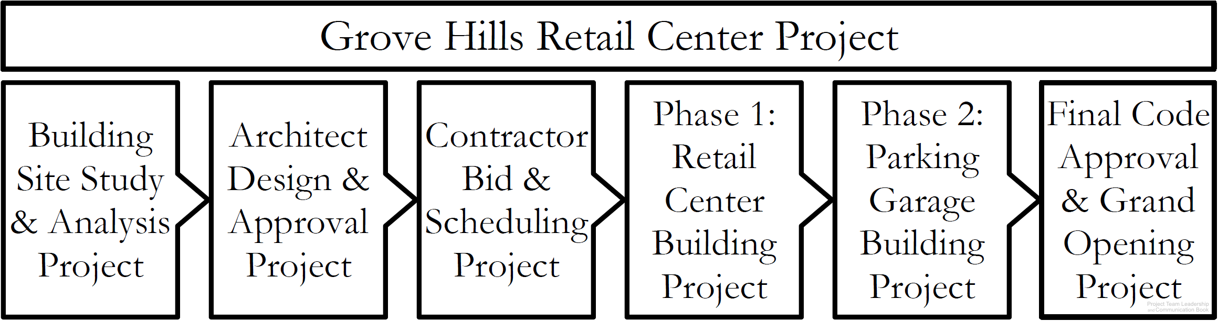
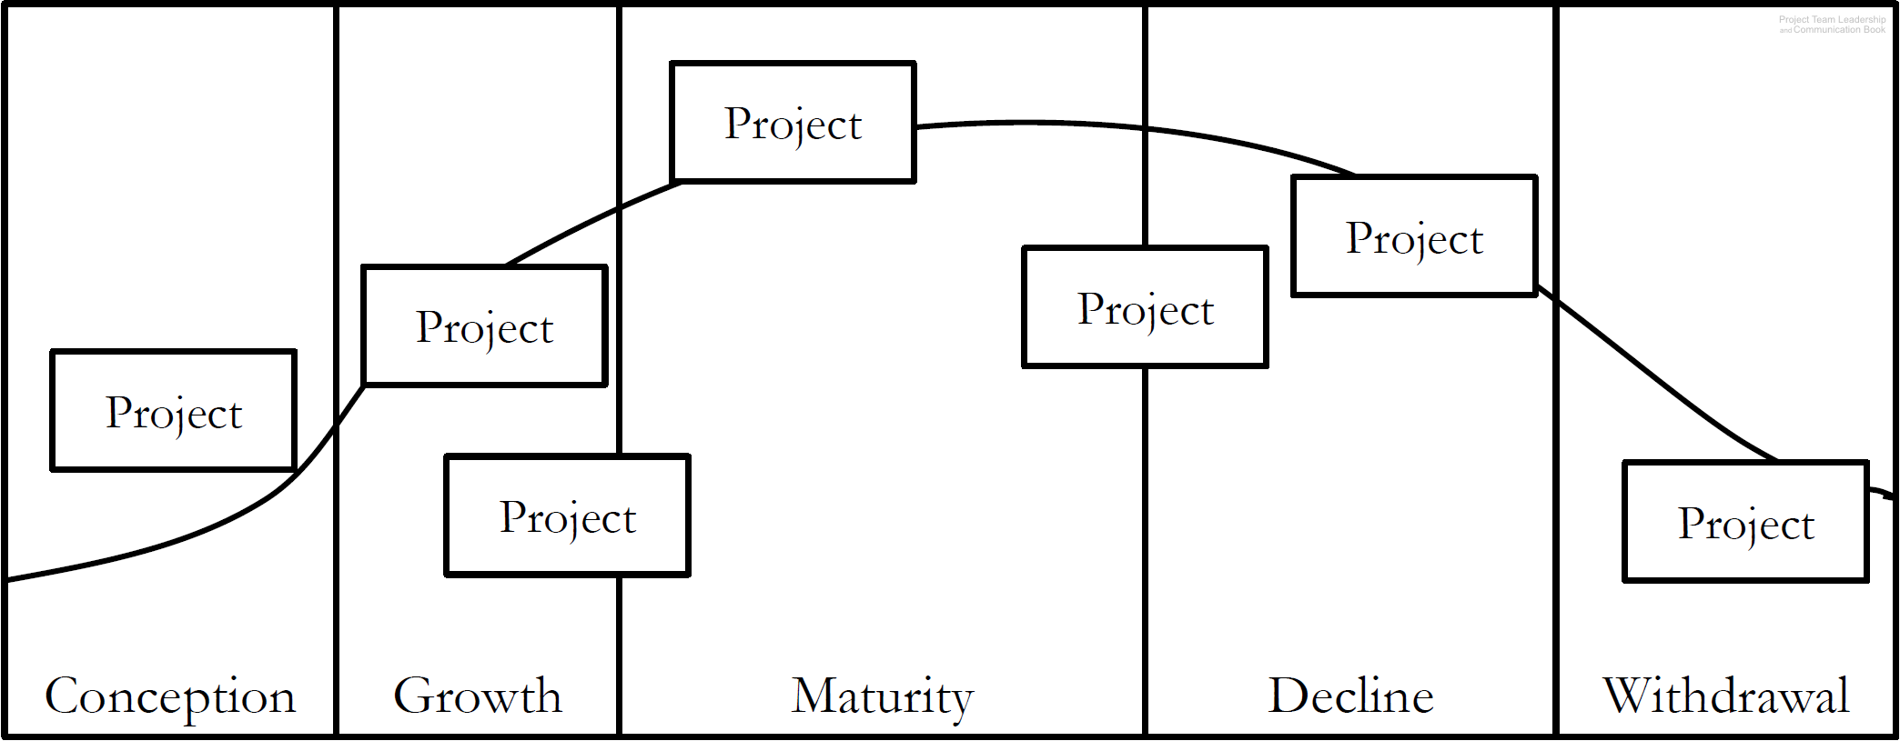
Projects Can Vary in Size and Scale
A large project can have multiple sub-projects
A product life cycle includes projects in every phase
Diagrams: Malachowsky, Samuel. Project Team Leadership and Communication. Lintwood Press. 2018. p. 29, 30.
Project Management Institute. A Guide to the Project Management Body of Knowledge – Fifth Edition. Project Management Institute Inc. p. 42. 2013.
Notes:
Corresponds to pages 29-30 of the Project Team Leadership and Communication book.
Product life cycle project examples: Marketing, setting up machinery, ramping up production, etc.

Slide 6
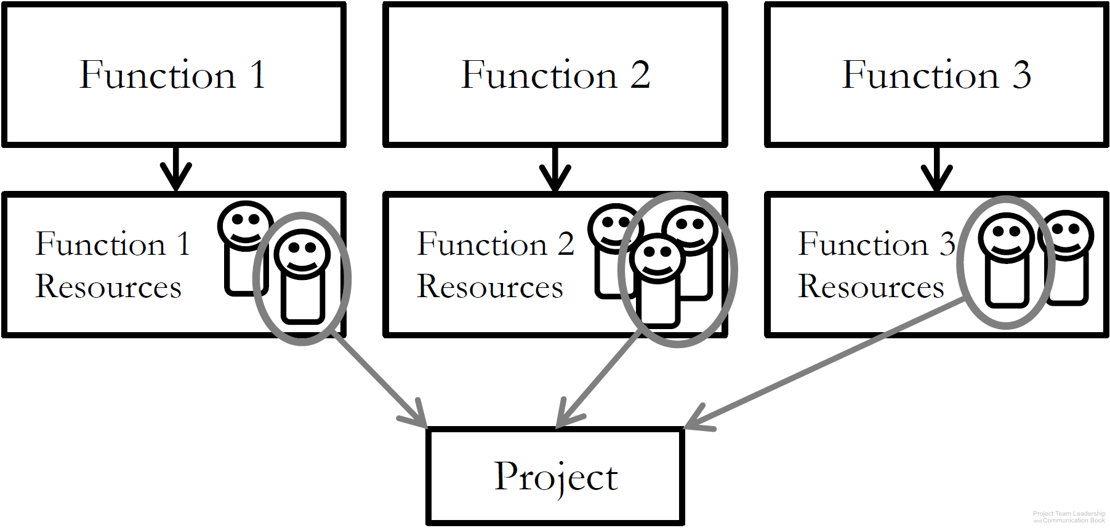
Functional Organizational Structure
‘Classic’ organizational structure
Organization made up of functional
‘silos’ (HR, Sales, Marketing, etc.)
Project teams consist of resources
from multiple departments
Strengths: resource redundancy
Weaknesses: resources don’t report to project leader, functional managers may not be supportive of project
Diagram: Malachowsky, Samuel. Project Team Leadership and Communication. Lintwood Press. 2018. p. 31.
Project Management Institute. A Guide to the Project Management Body of Knowledge – Fifth Edition. Project Management Institute Inc. p. 21-22. 2013.
Notes:
Corresponds to pages 30-32 of the Project Team Leadership and Communication book.

Slide 7
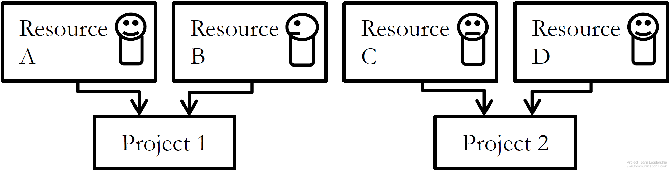
Project-Focused Organizational Structure
‘Flat’ organizational structure
Organization made of project
leads and resources, with few ‘layers’
Project teams consist of resources
specifically recruited/assigned to that project
Strengths: Autonomy/freedom/self-direction, no functional managers
Weaknesses: Resources are tempted to join other projects ‘jump ship’ to retain employment, projects must ‘stand on their own’, competition between projects for resources
Diagram: Malachowsky, Samuel. Project Team Leadership and Communication. Lintwood Press. 2018. p. 33.
Project Management Institute. A Guide to the Project Management Body of Knowledge – Fifth Edition. Project Management Institute Inc. p. 21-22. 2013.
Notes:
Corresponds to pages 33-34 of the Project Team Leadership and Communication book.

Slide 8
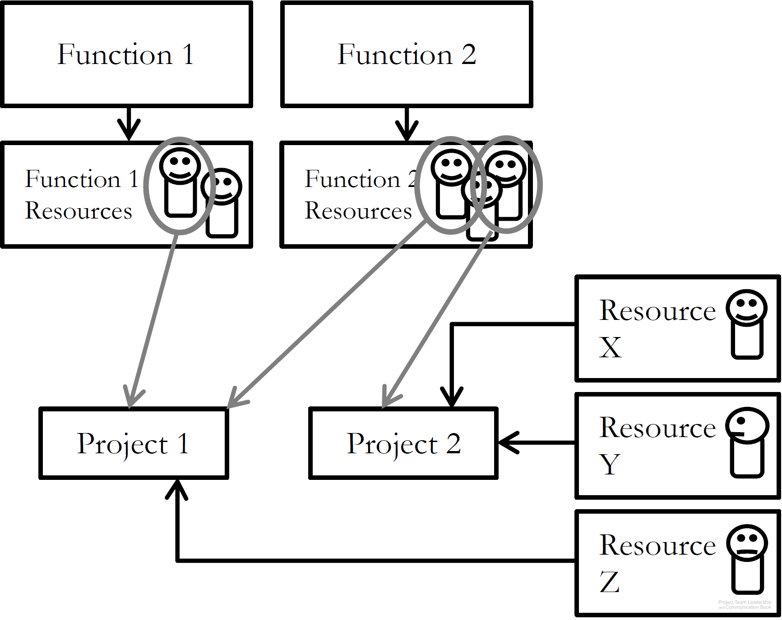
Matrix Organizational Structure
‘Strong’ or ‘weak’ matrix depending on ratio of Functional to Project-Focused aspects
Resources are often external contractors
Strengths: compatible with older, ‘classic’ orgs, can be adjusted as needed
Weaknesses: some resources may feel more detached from project than others, significant increase in number of stakeholders
Diagram: Malachowsky, Samuel. Project Team Leadership and Communication. Lintwood Press. 2018. p. 35.
Project Management Institute. A Guide to the Project Management Body of Knowledge – Fifth Edition. Project Management Institute Inc. p. 21-22. 2013.
Notes:
Corresponds to pages 34-35 of the Project Team Leadership and Communication book.

Slide 9
Organizational Values and Needs
Similar to the concept of culture, organizations have defining characteristics:
  How customers are treated (input, visibility into inner workings)
  Risk tolerance and preferred schedule certainty
  Experience level of personnel and management
And these can highlight certain needs. For example:
  The need for extremely clear requirements/specifications vs. the need for stakeholder input (prototypes, revisions, etc.)
  The need for a clear schedule vs. the need for a responsive project
  The need for many or few project artifacts (documentation)
Notes:
Corresponds to pages 36-37 of the Project Team Leadership and Communication book.
The next 3 slides cover 3 basic process structures each of which emphasize certain needs over others.

Slide 10
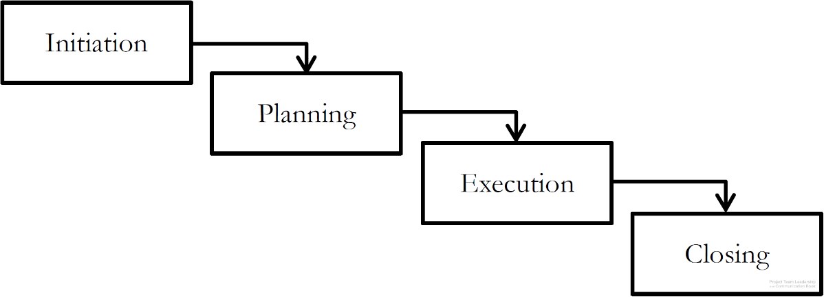
Plan-Focused Process Models
Each step must be
completely done before
the next can be begun
Plans are made for each step, then
executed ‘waterfall’ style
Strengths: high, schedule certainty, easy to understand, straightforward, time-tested
Weaknesses: does not handle uncertainty/change well, stakeholder visibility can be poor (only changes of phase)
Diagram: Malachowsky, Samuel. Project Team Leadership and Communication. Lintwood Press. 2018. p. 37.
Project Management Institute. A Guide to the Project Management Body of Knowledge – Fifth Edition. Project Management Institute Inc. p. 44-46. 2013.
Notes:
Corresponds to pages 37-38 of the Project Team Leadership and Communication book.
The book (page 38) and website contain additional diagrams such as a ‘sub-projects’ illustration and a standardized (between the three types) graphic of strengths and weaknesses.

Slide 11
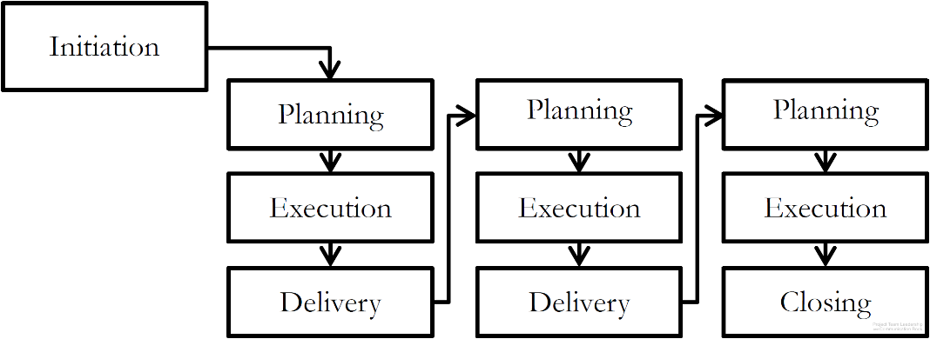
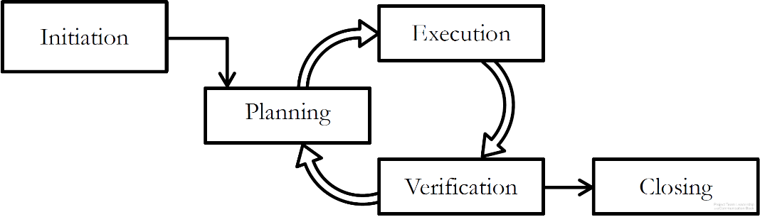
Cyclical Process Models
Projects cycle through delivery or feedback phases
Plans are made a little-at-a-time
Strengths: stakeholder visibility is often higher than Plan-Focused
Weaknesses: can be difficulty to know when to stop, requires strong disciplined leadership or can get out of control
Incremental Process Model
Iterative Process Model
Diagrams: Malachowsky, Samuel. Project Team Leadership and Communication. Lintwood Press. 2018. p. 39.
Project Management Institute. A Guide to the Project Management Body of Knowledge – Fifth Edition. Project Management Institute Inc. p. 44-46. 2013.
Notes:
Corresponds to pages 38-40 of the Project Team Leadership and Communication book.
The book (page 40) and website contain an additional diagram, a standardized (between the three types) graphic of strengths and weaknesses.

Slide 12
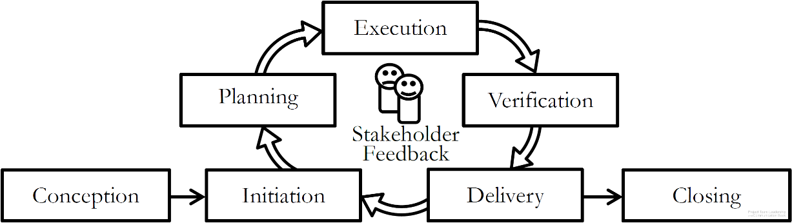
Change-Focused Process Models
Responsiveness to change and
stakeholder input is the most
important aspect
Similar to Cyclical Process Models
Requires experienced, disciplined leaders and team members
Strengths: stakeholder visibility is high (they’re consulted frequently), responds well to changing market conditions or circumstances
Weaknesses: can ‘go on forever’ if stakeholders are uncertain or conditions keep changing, requires frequent customer interactions
Diagram: Malachowsky, Samuel. Project Team Leadership and Communication. Lintwood Press. 2018. p. 40.
Project Management Institute. A Guide to the Project Management Body of Knowledge – Fifth Edition. Project Management Institute Inc. p. 44-46. 2013.
Notes:
Corresponds to pages 40-41 of the Project Team Leadership and Communication book.
The book (page 41) and website contain an additional diagram, a standardized (between the three types) graphic of strengths and weaknesses.
The appendix of the book (Agile: The Future of Projects?, pages 195-222) covers the most well-known change focused process models: Agile/Scrum.

Slide 13
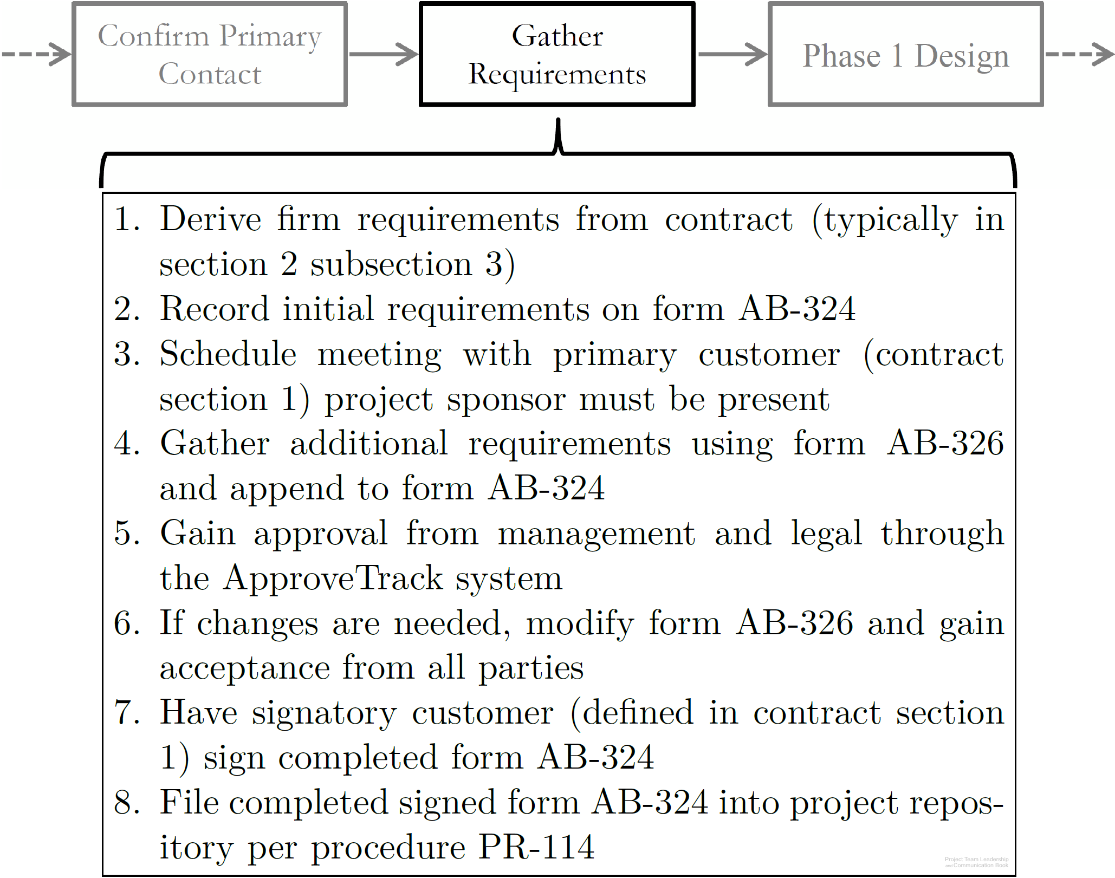
Process in Organizations
Process are actually much less abstract (they’re more exact) in organizations
Steps in some processes may be other processes
Standardization allows simplification, learning from experience of others, and cost savings
ISO 9001 is a process certification
Diagram: Malachowsky, Samuel. Project Team Leadership and Communication. Lintwood Press. 2018. p. 42.
Notes:
Corresponds to pages 42-43 of the Project Team Leadership and Communication book.

Slide 14
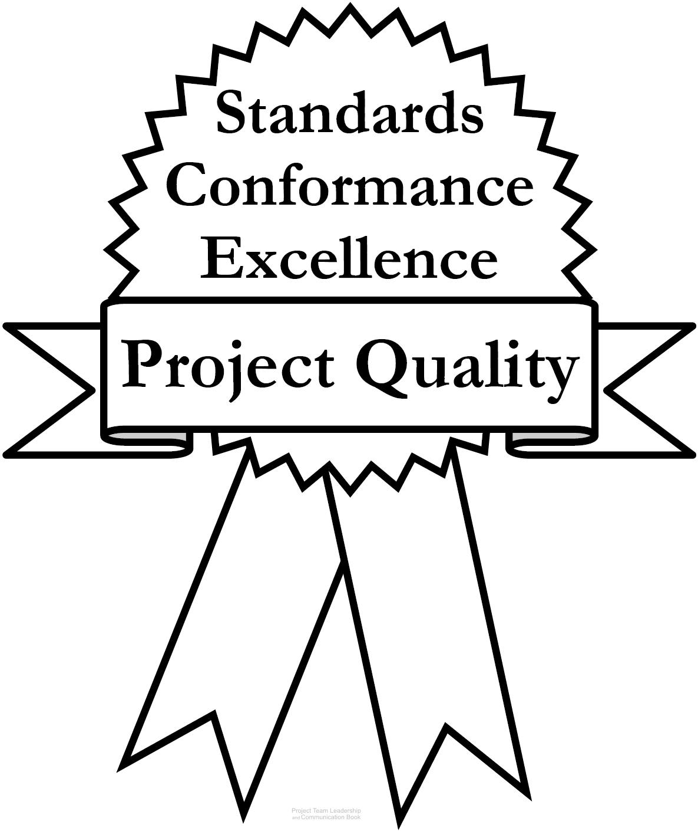
Project Quality
Quality is hard to define; most agree there are
three main aspects:
  Standards defined by the industry, organization, or team
  Conformance to the requirements, specifications, and
  commitments inherent to the project
  Excellence, the need to go beyond strictly meeting basic
  requirements/specifications. Thinking about elements such
  as the user’s perspective, maintenance, long-term cost, etc.
A fourth element can’t be ignored, though:
  Perception – do stakeholders have an appropriate, well-informed view of the project? Are communications appropriate? Is the team acting professionally?
Diagram: Malachowsky, Samuel. Project Team Leadership and Communication. Lintwood Press. 2018. p. 44.
Crosby, P.B. Completeness: Quality for the 21st century. Plume. p. 45. 1992.
Notes:
Corresponds to pages 43-45 of the Project Team Leadership and Communication book.
The chapter tool, entitled Planning Project Quality includes a step-by-step process for determining what aspects of quality are important to a project or organization. Elements from this are present on the next slide.

Slide 15
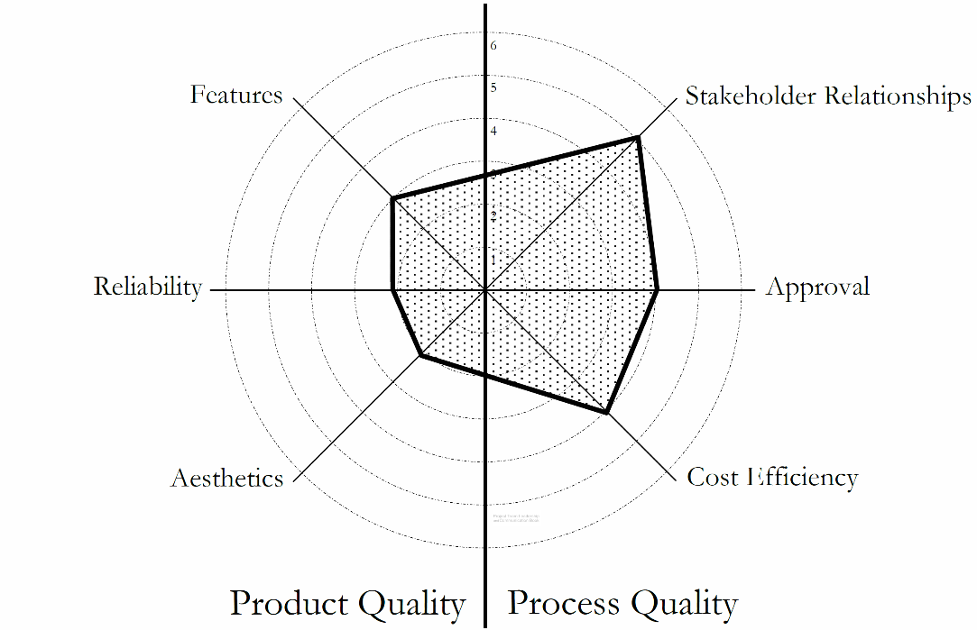
Product and Process Quality
Product Quality relates to what the project is trying to produce
  Examples include: Features, performance, durability, reliability, resources consumed
Process Quality relates to the team’s planning and execution of the project
  Examples include: Timeliness, safety, compliance, responsiveness to customer
Both must be addressed, balance must be achieved
‘Radar Chart’ Showing Balance/Prioritization of Quality in a Project
Diagram: Malachowsky, Samuel. Project Team Leadership and Communication. Lintwood Press. 2018. p. 71.
Notes:
Corresponds to section 2.7, pages 69-72 of the Project Team Leadership and Communication book.

Slide 16
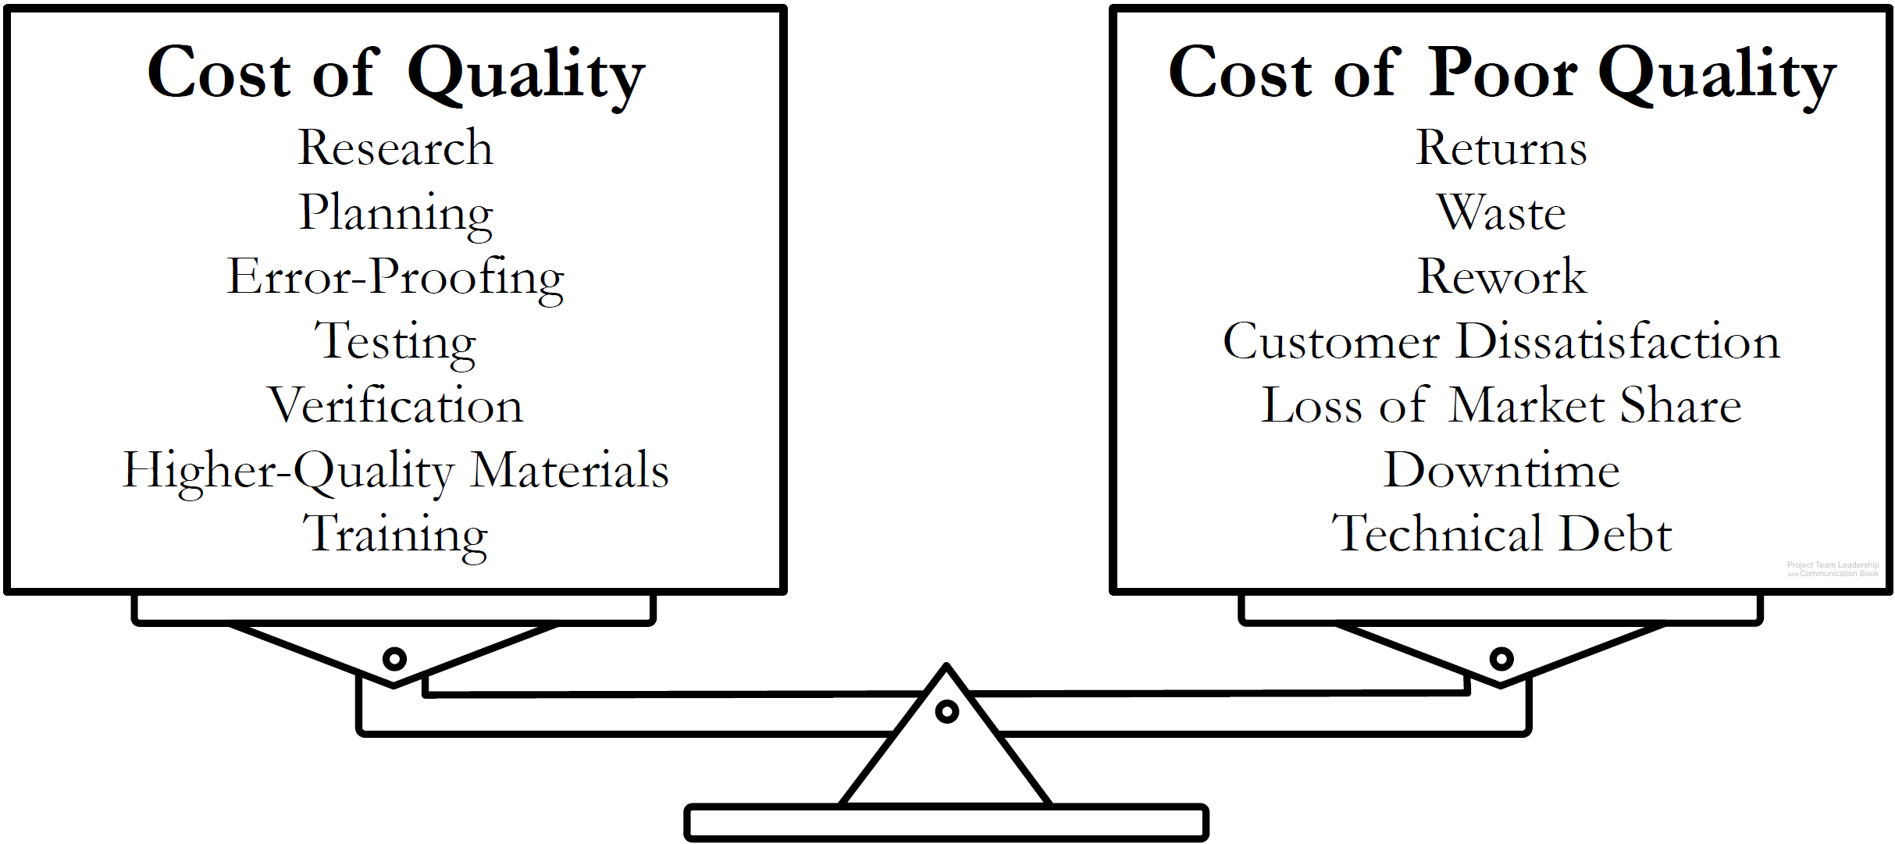
Quality is a Balancing Act
Projects must balance the cost of quality with the cost of poor quality
Determining where that balance lies requires teams to think about future implications of their actions
Diagram: Malachowsky, Samuel. Project Team Leadership and Communication. Lintwood Press. 2018. p. 46.
Feigenbaum, Armand V. Total Quality Control, Harvard Business Review November 1956, p. 34.
Notes:
Corresponds to pages 45-46 of the Project Team Leadership and Communication book.
The chapter tool, entitled Planning Project Quality includes a step-by-step process for determining what aspects of quality are important to a project or organization.
Technical debt is explained on page 46.

Slide 17
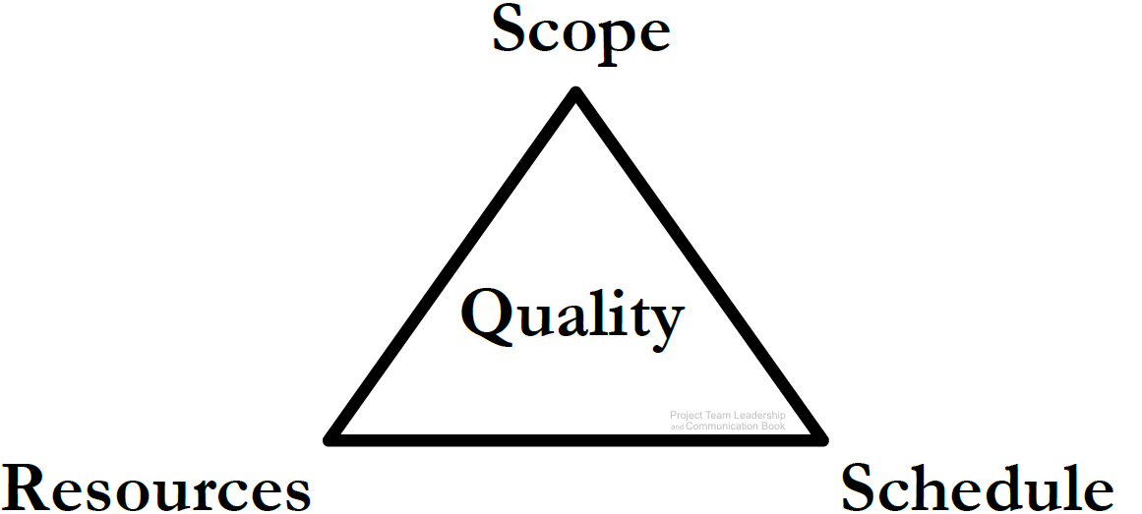
Projects are a Balancing Act, The Project Triangle
Resources: The budget, materials, wages, etc.
Schedule: The time expended
Scope: What is and isn’t included in the project outcomes
Quality can relate to any or all of the three
Balance: More scope requires more resources, more schedule, or both. Faster project means less scope/more resources, etc.
Diagram: Malachowsky, Samuel. Project Team Leadership and Communication. Lintwood Press. 2018. p. 46.
Notes:
Corresponds to pages 46-50 of the Project Team Leadership and Communication book.

Slide 18
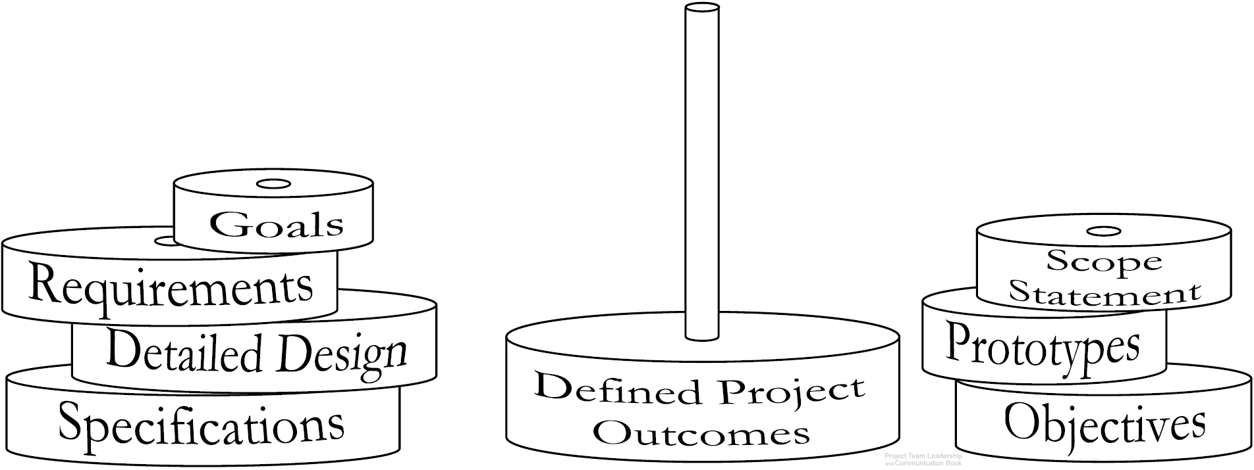
Defining Project Outcomes
Defining the projects outcomes, or deliverables often requires multiple artifacts (documents).
Artifacts are ‘stacked together’ to clarify all project outcomes
  Specific artifacts can vary by industry, organization, or team
Diagram: Malachowsky, Samuel. Project Team Leadership and Communication. Lintwood Press. 2018. p. 59.
Notes:
Corresponds to section 2.5, pages 51-61 of the Project Team Leadership and Communication book.
The book (page 53) and website contain an additional diagram which illustrates the abstract to exact nature of defining artifacts.
The next slide contains three artifact types.

Slide 19
Project Goal Statements
Goals – The overarching outcomes of the project
High-level: What the project is trying to achieve
Measurable: It should be clear when the goal is or isn’t met
Achievable: Within the capability of the resources/time available
“Increase pedestrian access to the
B-line subway by 50%”
“Create a connection platform that
will allow RB-8 tractors to power
the HST-4 jackhammer”
“Install a well that will provide potable drinking water for 300 residents”
Malachowsky, Samuel. Project Team Leadership and Communication. Lintwood Press. 2018. p. 52.
Notes:
Corresponds to section 2.5, pages 51-61 of the Project Team Leadership and Communication book.
Goals, pages 51-53. Sample goals on page 52.

Slide 20
Project Scope Statements
Scope Statements – What is and isn’t included in the project
A list of major delieverables
A basic strategy
Constraints, assumptions, and external dependencies
Often in the form of paragraphs with ‘bullets’
Project: PartCo RX-58 Installation
Scope Statement: This project will include installation, testing, and on-site training of the RX-58 stamping machine within PartCo’s Springtown manufacturing facility.
The project will not include electrical tie-in beyond an in-place power box, integration of the machine with upstream or downstream machines or processes, testing beyond basic functionality, training after the date of installation, or training for more than 10 employees of PartCo.
Malachowsky, Samuel. Project Team Leadership and Communication. Lintwood Press. 2018. p. 56.
Notes:
Corresponds to section 2.5, pages 51-61 of the Project Team Leadership and Communication book.
Scope Statements, pages 53-56. Sample scope statements on pages 55-56.

Slide 21
Project Requirements / Specifications
Requirements and/or Specifications – Details for what’s expected
Non-ambiguous
Reader should know exactly what’s needed
Functional (the outcomes) and non-functional (limits such as schedule, safety, etc.)
“All user-accessible web pages shall render properly on the latest major version of each of the top three mobile browsers”
“The secondary module casing shall be produced using 0.3 thick 304 grade stainless steel”
“The product in its entirety is to be delivered 45 business days after the Statement of Work is signed”
Notes:
Corresponds to section 2.5, pages 51-61 of the Project Team Leadership and Communication book.
Requirements and Specifications, pages 57-58. Sample requirements/specifications on page 57.

Slide 22
Kicking Off a Project
The ‘Project Kickoff Meeting’ is designed to:
Establish the project and begin the work
Introduce team members and stakeholders to each other, and define roles/responsibilities
Share clear goals and objectives, define what success means to the team
Choose/share tools, meeting times, etc.
Begin foundational work on the project plans
Notes:
Corresponds to pages 61-63 of the Project Team Leadership and Communication book.

Slide 23
The Project Plan (1 of 2)
The central artifact in planning any project
Can consist of one or more documents
Anyone reading the project plan should have all of the information they need to carry out the project as planned
Sections (continued on next slide):
  Executive Summary: Written last, one page, summarized the plan at a high level
  Outcomes: Includes goals, scope statements, requirements/specifications, and any other elements needed to clearly define the project’s outcomes
  Schedule and Budget: How time and resources are to be expended
Notes:
Corresponds to pages 63-69 of the Project Team Leadership and Communication book, which has much more detail for each section of the project plan.
Continued on next slide.

Slide 24
The Project Plan (2 of 2)
Sections (continued from previous slide):
  Resource and Process Management: How human resources (team members) are to be acquired and managed as well as how materials and other resources are to be acquired and managed. Includes processes and change procedures
  Quality Assurance Plan: How product and process quality are going to be managed
  Stakeholder Communication Plan: A listing of all project stakeholders and who/what/where/when/by whom communications are planned
  Risk and Issue Management: A listing and strategies for all risks and issues identified within the project
  Document Revision and Approval: A log of changes and sign-off/approval for the plan
Notes:
Corresponds to pages 63-69 of the Project Team Leadership and Communication book, which has much more detail for each section of the project plan.
Continued from previous slide.

Slide 25
Summary and Conclusions
Projects are unique and time limited, and vary from organization to organization (size, length, etc.)
Organizational structures, values, and needs have very significant effects on projects and how they’re carried out
Quality (the cost of quality and the cost of poor quality) and the Project Triangle represent a constant give-and-take balancing act
Project outcomes are defined in layers, which can include goals, objective, requirements/specifiactions, and other artifacts
Project kickoff meetings and creating the project plan are often the initial steps in any project
Notes:
Corresponds to section 2.8, page 73 of the Project Team Leadership and Communication book. Summarizes chapter 2 and these slides.

Slide 26
Questions / Discussion
Notes:
Chapter 2 includes several additional support elements which could become classroom activities or discussion elements.
The Project Plan outlined on pages 63-69 could be the basis for a group assignment in which teams create project plans for a real or fictional project.
The chapter tool, entitled Chapter Tool: Planning Project Quality (section 2.7, pages 69-72) is designed to help readers systematically determine what elements of quality are important to their project, team, or organization.
There are quite a few key terms defined on pages 74-75.
Review questions cover most of the chapter (pages 75-76, answers on page 223).
The exercises on pages 76-77 are designed to allow readers to apply and extend what they’ve learned.

