Slide 1
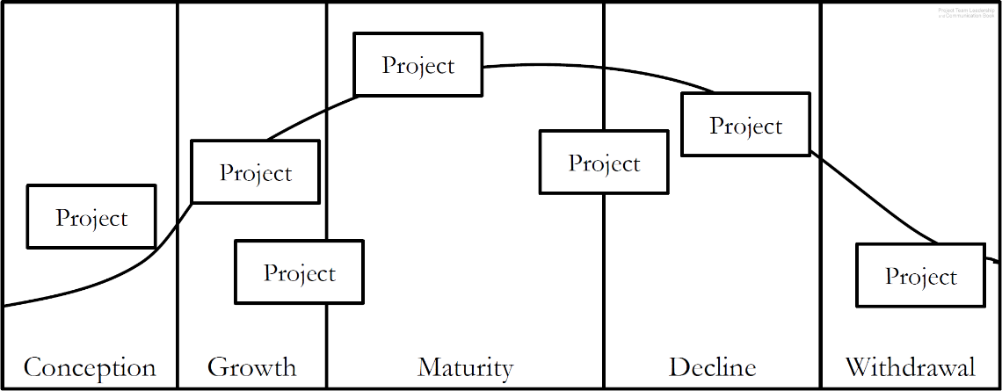
Activity – One Product, Multiple Projects
Consider the following scenario:
Your team is overseeing the design, production, and marketing of a new type of non-stick frying pan.
List 10 projects that might be a part of this product's life cycle. Be sure to include at least 1 from each phase (conception, growth, maturity, decline, withdrawal)
Diagram: Malachowsky, Samuel. Project Team Leadership and Communication. Lintwood Press. 2018. p. 30.
Notes:
Corresponds to pages 29-30 of the Project Team Leadership and Communication book.
Exercise #2 on page 76 is a similar question.
10 minute activity
Learning Objective: Propose multiple projects within a single product’s life cycle
Scenario/product can be changed to more closely match the student’s field of study, though thinking outside of their field can be beneficial for understanding.

Slide 2
Activity – Organizational Culture and Structure
For each of the industries listed below, answer the following questions:
In 3 words or less, what cultural value is commonly held by the average organization in the industry?
Which organizational structure (functional, project-focused, matrix) are organizations in the industry most likely to follow?
Automobile Manufacturing Agriculture Banking Software Development Defense Contractors Canned Food Manufacturing | Health Care Microbrewing Music Production Publishing/Printing University Education Venture Capital and Investment
Notes:
Corresponds to section 1.5, pages 10-12, and section 2.2, pages 30-35 of the Project Team Leadership and Communication book.
10-15 minute activity
Learning Objective: Analyze the cultural norms and organizational structures of multiple industries

Slide 3
Activity – ‘Rolling Your Own’ Process
In teams of 3-4, consider the following scenario:
Management at Austere Engineering, Inc. has recently come to the realization that there is no formal onboarding (hiring, orientation, training, etc.) process for new engineering team members.
Look at the values and needs listed on page 36. As a group, decide how important each of these elements are to Austere Engineering, Inc.
Considering the models illustrated on pages 37-41, create a basic process for onboarding a new engineer
Notes:
Corresponds to section 2.3, pages 36-43 of the Project Team Leadership and Communication book.
15-20 minute activity
Learning Objective: Analyze a scenario and construct a basic process
Scenario/product can be changed to more closely match the student’s field of study, though thinking outside of their field can be beneficial for understanding.

Slide 4
Activity – Understanding Quality
Organize into teams of 3-4 and consider the following scenario:
Your team is developing a ladder that is 30% lighter than most competing products. Recent tests have indicated that there are quality problems with both the design of the ladder and manufacturing process used to create it.
For each of the 4 quality concerns listed on pages 44-45 (standards, conformance, excellence, and perception), describe factors teams might examine when considering each aspect of quality (OSHA and ANSI standards, for instance)
Using a template similar to the balance-scales on page 46, list at least 5 scenario-specific costs of quality and 5 scenario-specific costs of poor quality.
Notes:
Corresponds to pages 44-46 of the Project Team Leadership and Communication book.
10-15 minute activity
Learning Objective: Develop scenario-specific quality-related elements of consideration
Scenario/product can be changed to more closely match the student’s field of study, though thinking outside of their field can be beneficial for understanding.

Slide 5
Activity – Layering Project Outcomes
Organize into teams of 3-4 and consider the following scenario:
You’re using the layered approach to define the outcomes of a playground project
for the local parks and recreation department.
Write 3 goals/objectives
Write a basic scope statement including what is and isn’t a part of the project
Write 3 specifications/requirements
Notes:
Corresponds to section 2.5, pages 51-61 of the Project Team Leadership and Communication book.
Similar to exercise 6 on pages 76-77
10-15 minute activity
Learning Objective: Construct scenario-specific goals, scope statements, and specifications/requirements
Scenario/product can be changed to more closely match the student’s field of study, though thinking outside of their field can be beneficial for understanding.

Slide 6
Activity – Outlining the Project Plan
A good project plan takes a great deal of thought and effort. Like a project, the first step is planning. Using the basic structure below as well as the guidelines provided in section 2.6 (pages 63-69), create an outline to be used by project teams.
  Executive Summary
  Outcomes
  Schedule and Budget
  Resource and Process Management
  Quality Assurance Plan
  Stakeholder Communication Plan
  Risk and Issue Management
  Document Revision and Approval
Notes:
Corresponds to section 2.6, pages 61-69 of the Project Team Leadership and Communication book.
10-15 minute activity
Learning Objective: Design a project plan outline

