Slide 1
Prioritization:
The Core of Project Leadership
Putting ‘this’ before ‘that,’ and deciding what is more important
Designed for chapter 3, pages 79-110 of Project Team Leadership and Communication by Samuel Malachowsky, ISBN 9781732378902, 9781732378919.
Notes:
Corresponds to chapter 3, pages 79-110 of the Project Team Leadership and Communication book. ISBN: 9781732378902 (Softcover), 9781732378919 (Hardcover). These slides may only be posted or used in conjunction with the book in a training or classroom environment. Key terms (pages 107-108) are often italicized on the slides.
Prioritization is essential because it answers many of the common question-categories in a project: what work is more important, the order to do things in, how far along we are, and what to do about problems that may arise
Outline:
Planning and Prioritizing Project Work
Estimation Techniques (3 Slides)
Expert Judgement
Group Consensus
Top-Down
Bottom-Up
Comparison or Analogy
Other Methods
Estimates vs. Commitments
Accuracy vs. Precision
Organizing Tasks: The Work Breakdown Structure
The One-to-Two Rule
Sequencing and Scheduling Tasks
Tracking Progress
Tracking Earned Value
Scheduling/Tracking Tools and Visualizations
Risk
Risk Identification
Risk Analysis
Risk Response
Prioritizing Stakeholders
Summary and Conclusions
Learning Objectives:
3.1 Why is Prioritization So Essential?
Identify the connection between the concept of prioritization and individual project activities
3.2 Estimation Methods
Describe 5 basic estimation methods
Recognize the strengths, weaknesses, and appropriate application of each estimation method
3.3 Estimates vs. Commitments
Relate issues and negative conditions that may arise during the estimation process
3.4 Accuracy and Precision
Define the terms ‘accuracy’ and ‘precision’ in a general context
Relate the concepts illustrated in the ‘cone of uncertainty’
List several ways to accurately express low-precision estimates
3.5 Project Scheduling
Describe how ‘work breakdown structures’ are constructed and recorded
Relate ‘precedence techniques’ including diagramming and related terms/techniques
List 3 common project schedule visualization tools
Relate scheduling activities to basic process concepts
3.6 Project Tracking
Define ‘project visibility’ in the context of project tracking
Describe the concept of ‘earned value’ in the context of a project
List 2 common project tracking visualization tools
3.7 Risk Management
Define ‘risk,’ identifying 3 essential elements in the context of a project
Relate techniques for identifying project risks, including SWOT analysis
Identify basic project risk analysis/quantification techniques
Describe 4 basic project risk response techniques
3.8 Chapter Tool: Prioritizing Stakeholders
Relate the basic structure of a ‘stakeholder register’
Describe a technique for identifying which of 4 basic stakeholder management techniques are appropriate
Associated Class Activities: (Separate Slides)
Which Estimation Technique? (5 minutes, section 3.2)
Determine appropriate estimation techniques based on brief scenarios
Estimating, Not Committing (5-10 minutes, sections 3.3 and 3.4)
Establish techniques for communicating an estimate without implying commitment
Organizing and Sequencing Tasks (15 minutes, section 3.5)
Construct a basic work breakdown structure and precedence diagram
Tracking Project Progress (10 minutes, section 3.6)
Calculate earned value and construct a basic Gantt chart
A Risky Scenario (10 minutes, section 3.7)
Determine basic risks and mitigations based on a scenario
Finding and Analyzing Stakeholders (15 minutes, section 3.8)
Propose a list of stakeholders, analyze them, and propose a management strategy for each

Slide 2
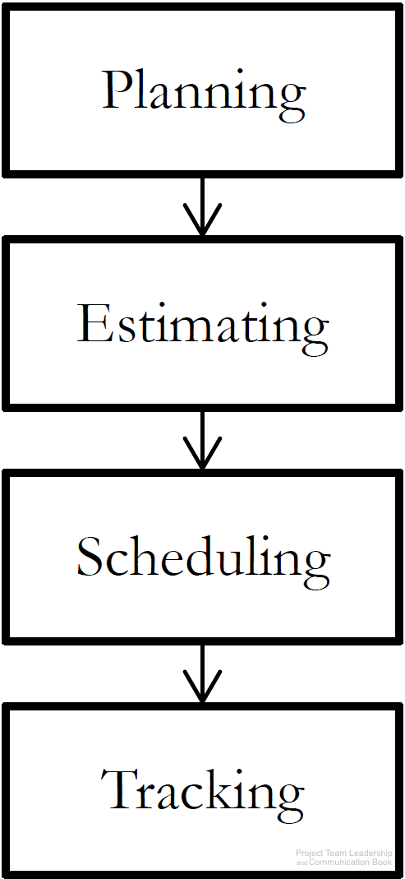
Planning and Prioritizing Project Work
Before work can be completed, three basic steps must take place:
  Planning takes place early in the project, and determines objectives to be completed, resources available, etc.
  Estimating is the process of determining how long or how many resources each planned element will take
  Scheduling is the ‘calandarization’ of estimated work
Once the work begins (execution of plans):
  Tracking must occur, comparing actual results with plans, estimates, and schedules
  If changes occur or results vary from plans, repeat the steps
Diagram: Malachowsky, Samuel. Project Team Leadership and Communication. Lintwood Press. 2018. p. 88.
Notes:
Corresponds to section 3.1, pages 79-80, and page 88 of the Project Team Leadership and Communication book.

Slide 3
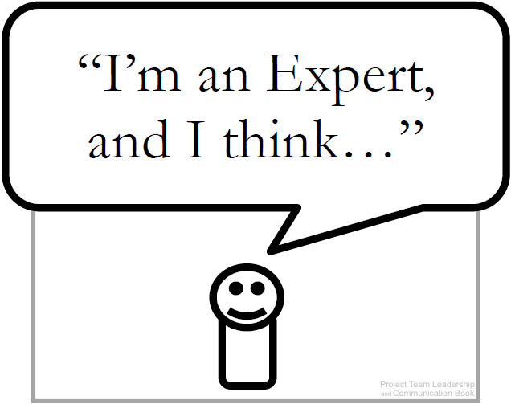
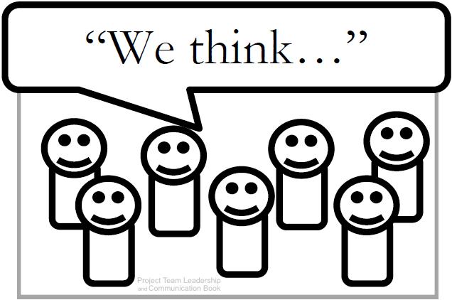
Estimation Techniques (1 of 3)
Expert Judgement: experience is used to estimate
The basis for all other techniques
Strengths: expert lends credibility to estimate
Weaknesses: one person’s ‘expertise’ may fail
Group Consensus: various techniques are used to poll the group and reach consensus
Strengths: group participation and ‘buy-in’
Weaknesses: bias and cultural issues manifest
Diagrams: Malachowsky, Samuel. Project Team Leadership and Communication. Lintwood Press. 2018. p. 80, 82.
Notes:
Corresponds to pages 80-81, and page 82 of the Project Team Leadership and Communication book.

Slide 4
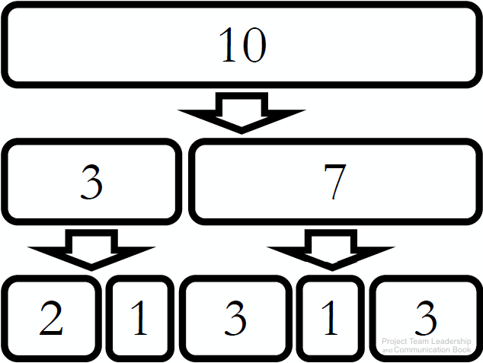
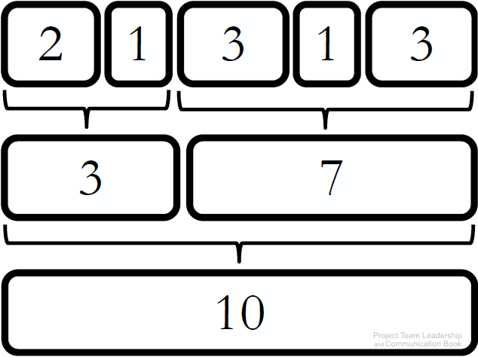
Estimation Techniques (2 of 3)
Top-Down: large units estimated then divided up
Strengths: usable when less detail is known
Weaknesses: inaccurate if major sections of the project aren’t considered
Bottom-Up: small units estimated then added together
Strengths: can be quite precise if used properly
Weaknesses: more time consuming than other techniques, changes to items can impact greatly
Diagrams: Malachowsky, Samuel. Project Team Leadership and Communication. Lintwood Press. 2018. p. 81.
Notes:
Corresponds to page 81 of the Project Team Leadership and Communication book.
The one-to-two rule, outlined on page 82, helps determine how granular estimates should get: the task should take 1-2 resources 1-2 weeks.

Slide 5

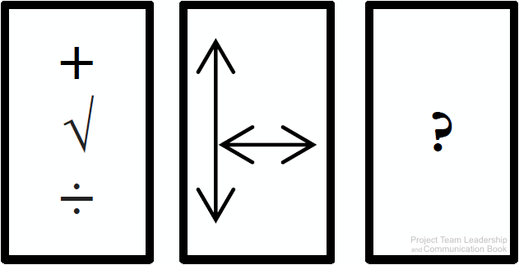
Estimation Techniques (3 of 3)
Comparison or Analogy: projects (or components) are compared to previous work
Strengths: based on actual results, increasing credibility and potentially accuracy
Weaknesses: all projects are unique, may be difficult to find comparisons, data may not exist
Other Methods: mathematical/statistical models, focusing on size rather than time, or industry-specific methods
Diagrams: Malachowsky, Samuel. Project Team Leadership and Communication. Lintwood Press. 2018. p. 81, 82.
Notes:
Corresponds to pages 81-82 and 82-83 of the Project Team Leadership and Communication book.

Slide 6
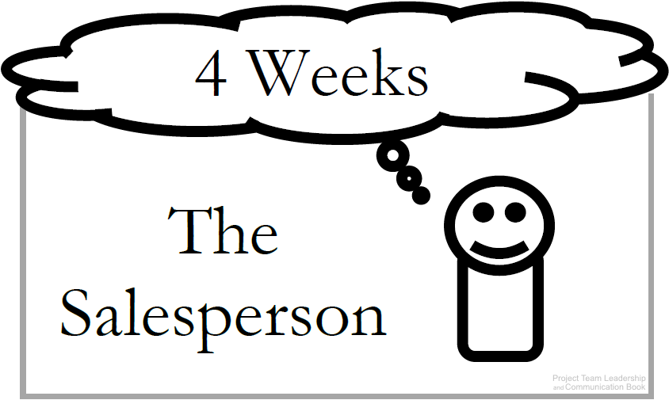
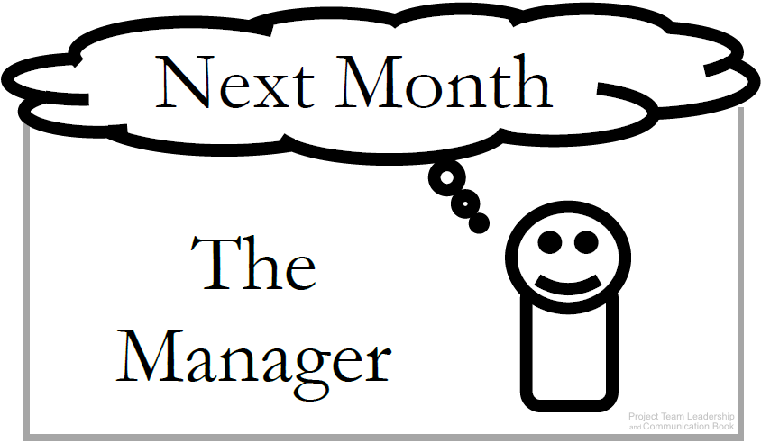
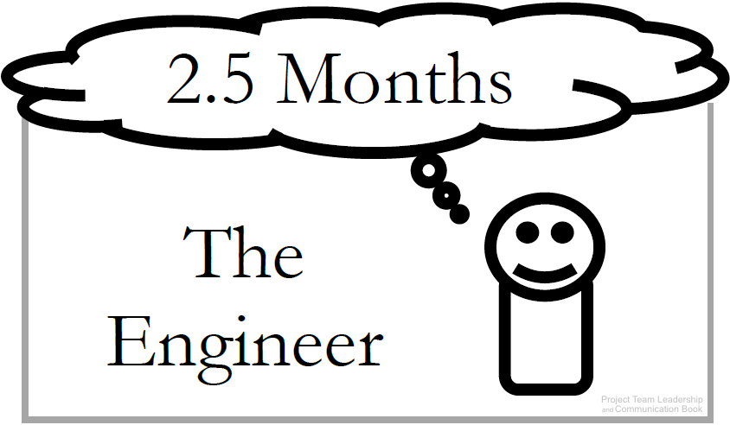
Estimates vs. Commitments
All parties must be careful not to confuse estimates with commitments
Commitments: Are deadlines ‘real’ or arbitrary?
Estimates: Presentation can be important: Ranges (6-8 Months), plus/minus qualifiers (7 Weeks +/– 1 Week), and Confidence factors (4 weeks: 30% chance, 5 weeks: 50% chance) can be helpful
Don’t confuse estimation with scheduling, which sets actual dates
Diagrams: Malachowsky, Samuel. Project Team Leadership and Communication. Lintwood Press. 2018. p. 84.
Notes:
Corresponds to pages 83-85 and 87 of the Project Team Leadership and Communication book.

Slide 7
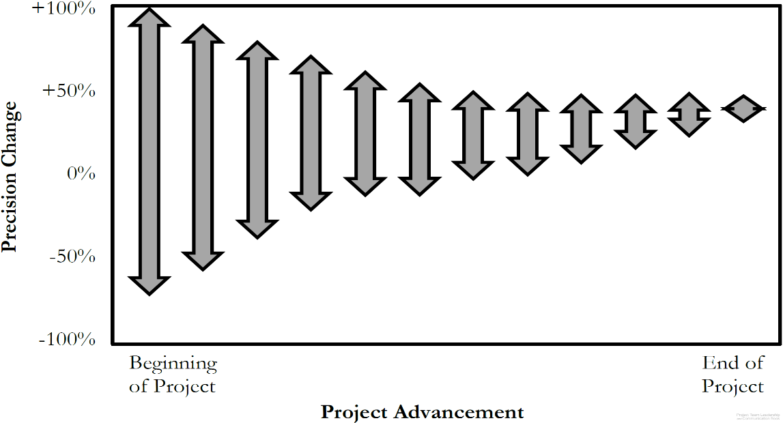
Accuracy vs. Precision
Accuracy is how true a value is
  ‘4-6’ is accurate if the actual # is 5.5
Precision is how exact a value is
  ‘4-6’ is less precise than ‘4.5-5.5’
Within a project communications
should always be as accurate as
possible (especially in estimating)
Because uncertainty is high at the beginning of a project, the only way to be accurate is to be less precise
As the project progresses, we can be more and more precise while remaining accurate throughout (ranges get smaller and smaller)
Diagram: Malachowsky, Samuel. Project Team Leadership and Communication. Lintwood Press. 2018. p. 86.
McConnell, Steve. Software Project Survival Guide: how to be sure your first important project isn’t your last. Redmond, WA: Microsoft Press. p. 31. 1998.
Notes:
Corresponds to section 3.4, pages 85-86 of the Project Team Leadership and Communication book.

Slide 8
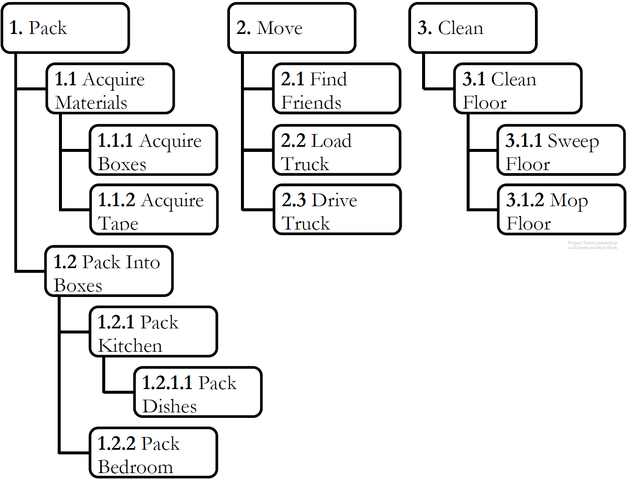
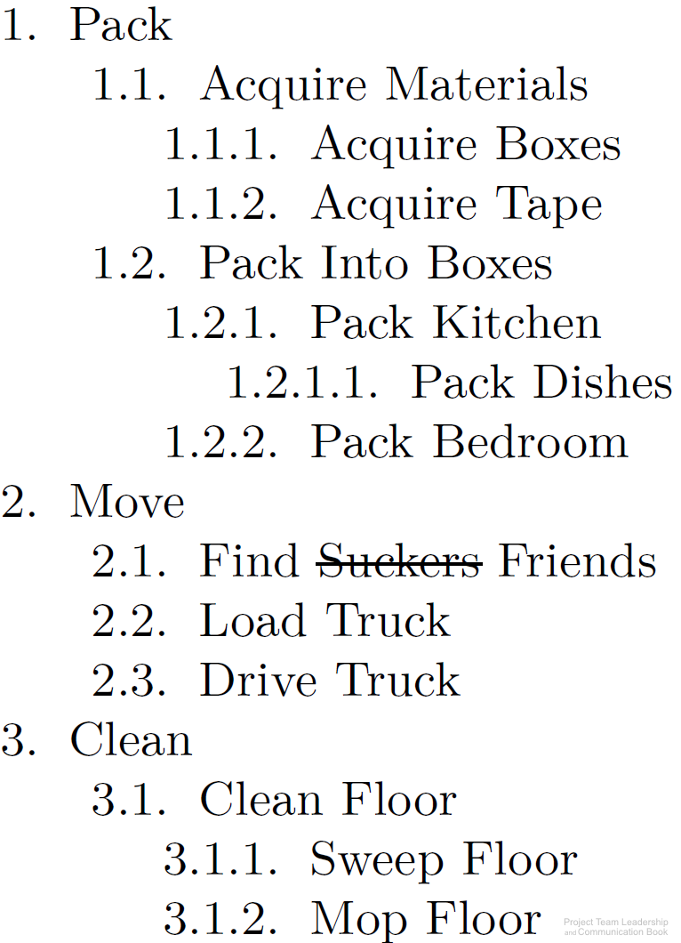
Organizing Tasks: The Work Breakdown Structure
Organizes elements with ‘sub-
numbers.’ 1.2.3 is part of 1.2
Two types: product & process
  Product divides by components
  Process divides by activities/tasks
Can be built ‘top down,’
‘bottom-up,’ or ‘rolling-wave’
A good way to organize brain-
storming efforts early in the project
Sequencing of tasks or components
isn’t needed until later in scheduling efforts
Diagrams: Malachowsky, Samuel. Project Team Leadership and Communication. Lintwood Press. 2018. p. 88.
Project Management Institute. A Guide to the Project Management Body of Knowledge – Fifth Edition. Project Management Institute Inc. p. 125-132. 2013.
Notes:
Corresponds to pages 88-89 of the Project Team Leadership and Communication book.
Exercise #4 on page 109 could be the basis for a whiteboard classroom activity (create a work breakdown structure from elements in a typical home)

Slide 9
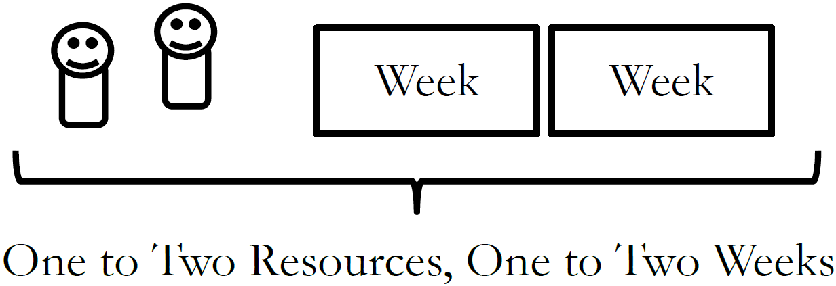
The One-to-Two Rule
How do you know when you’ve divided tasks into small enough ‘chunks’?
If tasks are too large, it becomes difficult to track progress
If tasks are too small, time is wasted micromanaging the project
Optimize with ‘The One-to-Two Rule,’
which states that tasks have been
divided enough when each requires
1-2 resources 1-2 weeks to complete it
Diagram: Malachowsky, Samuel. Project Team Leadership and Communication. Lintwood Press. 2018.
Notes:
Corresponds to page 83 of the Project Team Leadership and Communication book.

Slide 10
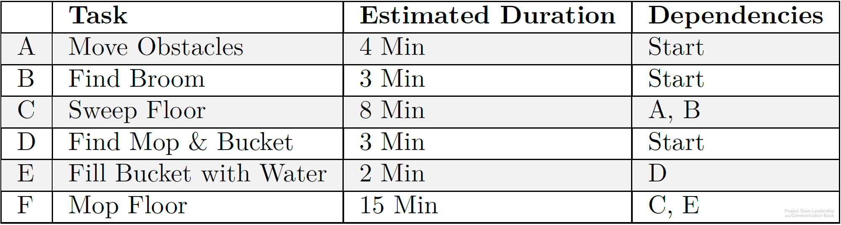
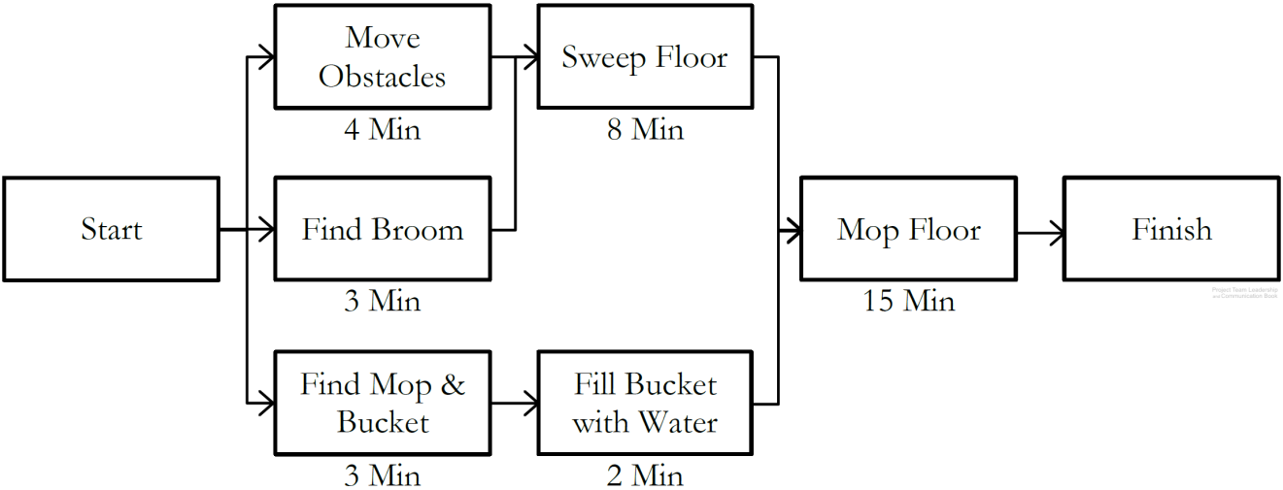
Sequencing and Scheduling Tasks
Predecessors or dependencies are determined for all tasks
Using this information, a precedence diagram is created
  The longest path, called the critical path, determines project length
  Slack time, the ability to delay starting without impacting the schedule, is available to some tasks which are not on the critical path
Tasks are then ‘calandarized,’ with actual dates based on resources available
Diagrams: Malachowsky, Samuel. Project Team Leadership and Communication. Lintwood Press. 2018. p. 89, 90.
Notes:
Corresponds to pages 89-90 of the Project Team Leadership and Communication book.
Exercise #6 on page 109 has another list of tasks, which could be the basis for a whiteboard classroom activity (create a precedence diagram, find the critical path, find the slack time of individual tasks)
Critical path: Start -> “Move Obstacles” -> “Sweep Floor” -> “Mop Floor” -> Finish
“Find Broom” has a slack time of 1 minute and is not on the critical path
“Sweep Floor” has a slack time of 0 minutes because it’s on the critical path

Slide 11
Tracking Progress
A main concern of project tracking is visibility. Often, the team isn’t aware of how far along they are due to long phases
Project Visibility is often only achieved when phases are started or completed
Diagram: Malachowsky, Samuel. Project Team Leadership and Communication. Lintwood Press. 2018. p. 94.
McConnell, Steve. Rapid Development: Taming Wild Software Schedules. Redmond, WA: Microsoft Press. p. 57. 1996.
Notes:
Corresponds to section 3.6, pages 94-97 of the Project Team Leadership and Communication book.

Slide 12
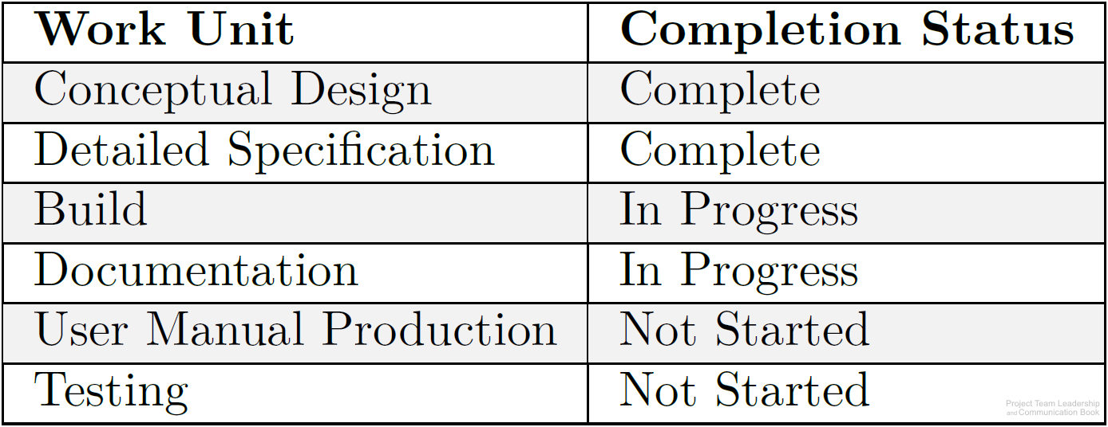
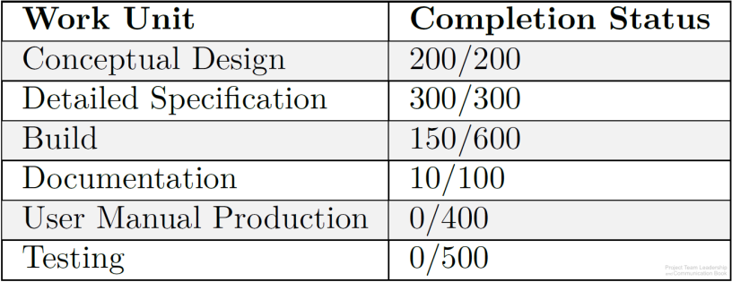
Tracking Earned Value
Tasks or groups of tasks are often tracked with little granularity (large chunks instead of small) and simple not-started / started / complete progress reporting
By giving each task a relative weight and assigning earned value to sub-tasks, the percentage of progress can be calculated (example: 660/2100=31% complete)
Calculated earned value can be compared to the time or resources expended
Diagrams: Malachowsky, Samuel. Project Team Leadership and Communication. Lintwood Press. 2018. p. 95.

Slide 13
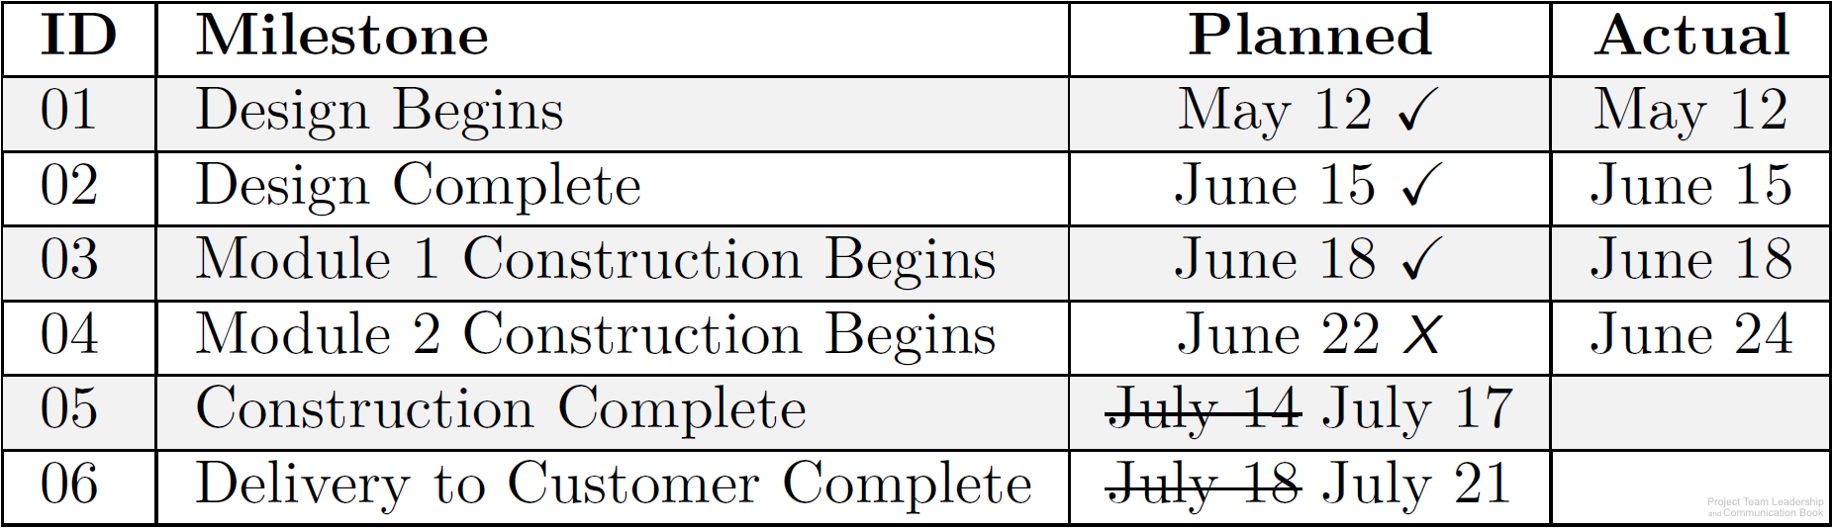
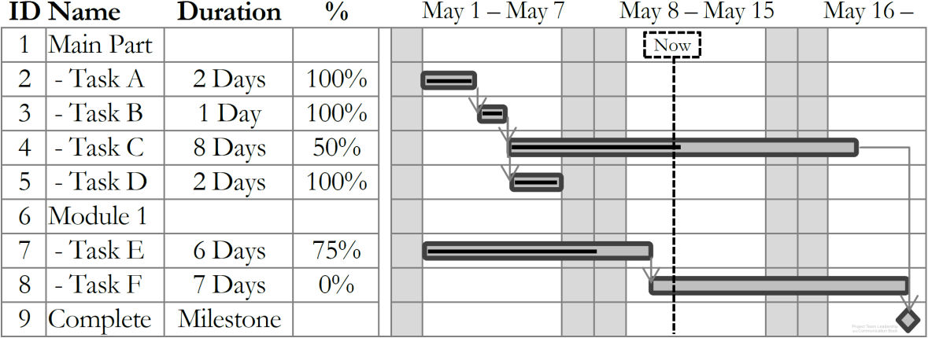
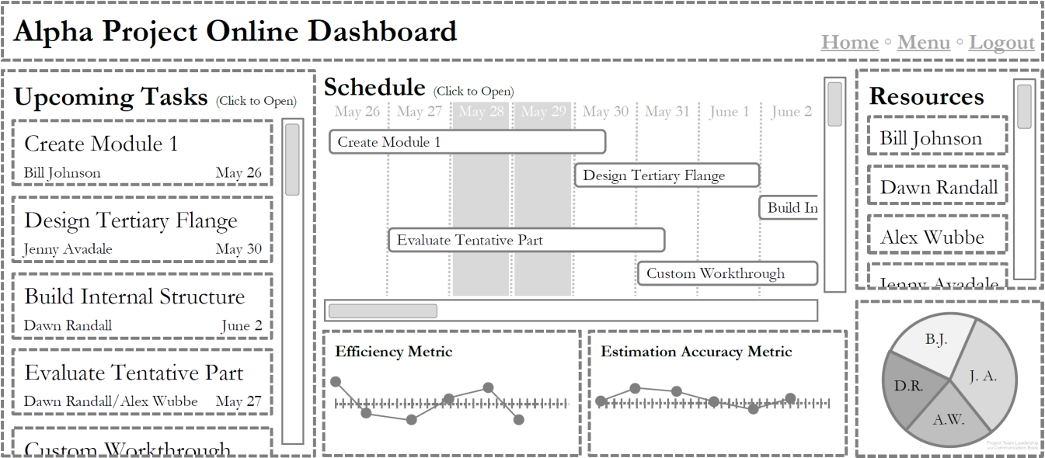
Scheduling/Tracking Tools and Visualizations
Milestone Charts list major points in time, or milestones, such as phases ending
Gantt Charts provide an easy-to-understand visualization of the schedule and progress
Many software packages and online tools are specifically designed for managing projects
Diagrams: Malachowsky, Samuel. Project Team Leadership and Communication. Lintwood Press. 2018. p. 92, 96.
Notes:
Corresponds to pages 90-92 and 96 of the Project Team Leadership and Communication book.
Microsoft Project is a commonly used software package which utilizes Gantt charts extensively.

Slide 14
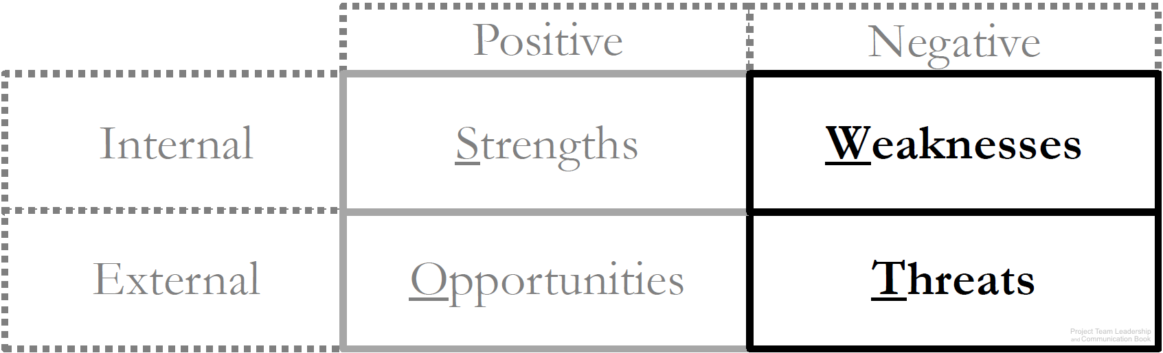
Risk Identification
“Risks are problems that haven’t happened yet”
  They’re uncertain ( 0%<100% chance)
  They would result in a loss to the project (typically time or resources)
  The project can do something to manage them (within the scope of the project)
Everyone should be involved in identifying risks, and they come from multiple places
  The team, stakeholders, organization, environment, finances, etc.
Use SWOT analysis to identify risks:
  Internal weaknesses and external
  threats represent potential risks
Diagram: Malachowsky, Samuel. Project Team Leadership and Communication. Lintwood Press. 2018. p. 98.
Notes:
Corresponds to pages 97-99 of the Project Team Leadership and Communication book.

Slide 15
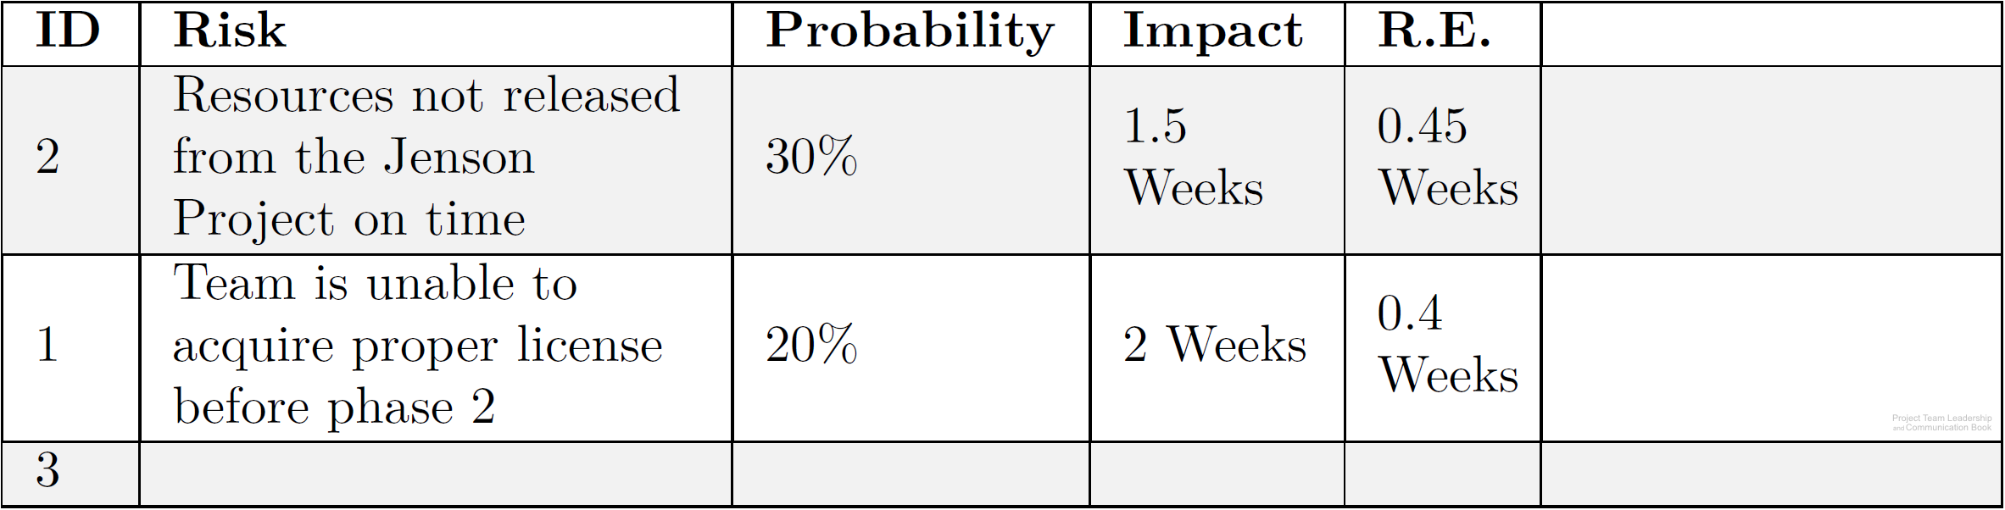
Risk Analysis
Risks may or may not occur, and their impact on the project is variable
  Project teams estimate the probability of the risk as well as possible
    Very Unlikely (15%), Unlikely (30%), Neutral (50%), Likely (70%) Very Likely (85%)
  The potential impact of the risk is also estimated
    Loss of 2 weeks, additional expenditures of $3,800, etc.
  These numbers are multiplied to calculate risk exposure. (30% X 2 weeks = 0.6 weeks)
Identified risks and their probabilities, impacts, and exposures are recorded in a risk register
  Risks with the highest risk
  exposure are placed at the top
  of the list and are highest
  priority
Diagram: Malachowsky, Samuel. Project Team Leadership and Communication. Lintwood Press. 2018. p. 100.
Notes:
Corresponds to pages 99-100 of the Project Team Leadership and Communication book.
Estimating risk probability can use estimation techniques (earlier this chapter)

Slide 16
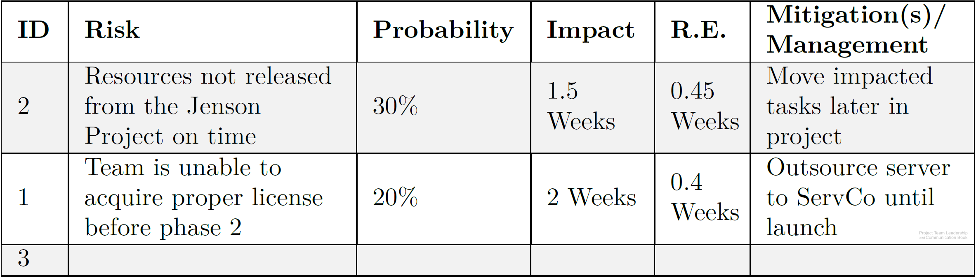
Risk Response
Risk “mitigation” or management: an intentional response to an identified risk
  Avoid – remove the risky part of the project
  Learn more – acquire additional knowledge on how to deal with the risk (research, prototype, etc.)
  Transfer – move the risk to a less vital part of the schedule (off the critical path) or to another entity more capable of handling it (a trained team, purchase insurance, etc.)
  Accept – Accept the risk as is, but formulate a way of lessening its impact or handling it if it occurs (a mitigation strategy)
Risk responses are reflected in
the project schedule/budget
  Total risk exposure is added to
  the final schedule length
Diagram: Malachowsky, Samuel. Project Team Leadership and Communication. Lintwood Press. 2018. p. 101.
Notes:
Corresponds to pages 100-101 of the Project Team Leadership and Communication book.

Slide 17
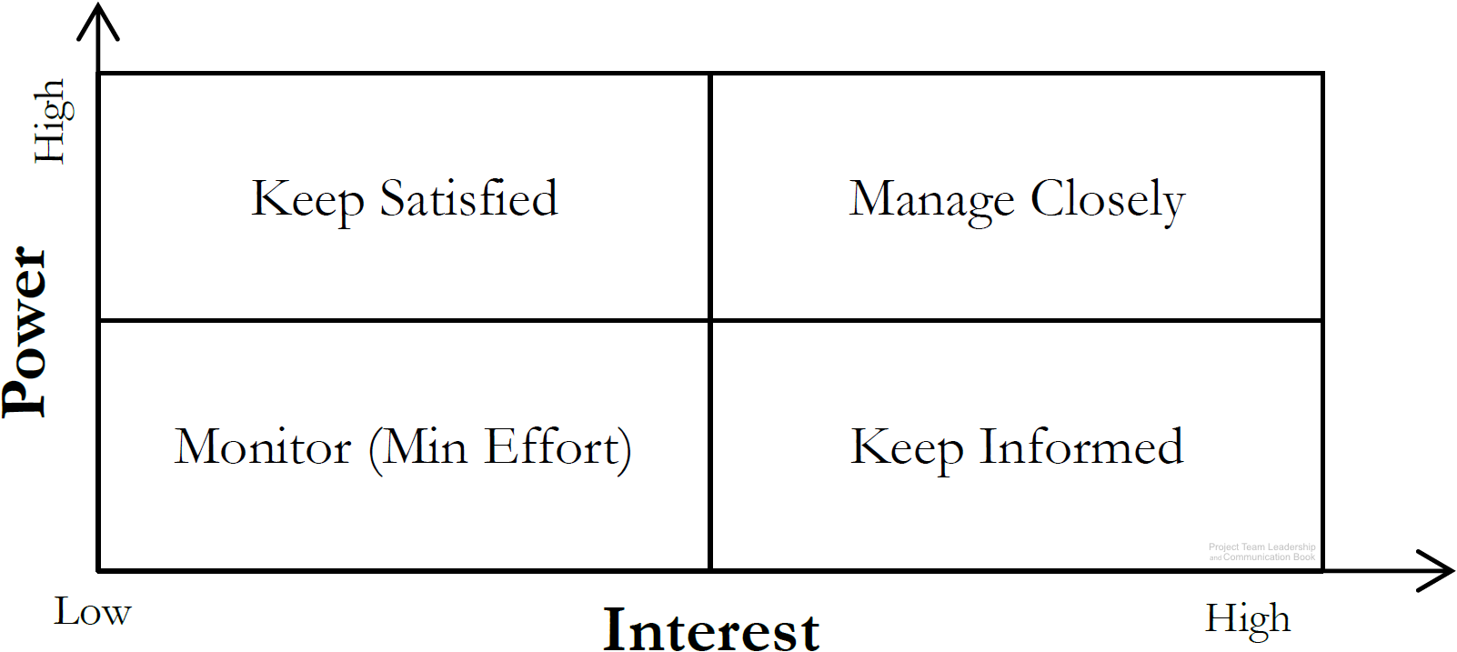
Prioritizing Stakeholders
Stakeholders are people who can affect or are affected by the execution or outcome of a project. Everyone should be involved in identifying them
  Stakeholders can be groups
Once identified, they should be analyzed
  High or low power, or ability to affect the project
  High or low interest, or how they’re affected by
  the projects positive or negative outcome
All information should be recorded/tracked
in a stakeholder register
ID | Name | Title | Info | Notes | Power | Interest | Strategy
1 | Casey Johnson | Sales Lead | cjohnson@co.com | Initiated the contract | Low | High | Keep Informed
2 | Jordan Baker | Team Specialist | 555-1532 |  | High | High | Manage Closely
Diagram: Malachowsky, Samuel. Project Team Leadership and Communication. Lintwood Press. 2018. p. 104.
Project Management Institute. A Guide to the Project Management Body of Knowledge – Fifth Edition. Project Management Institute Inc. p. 395-397. 2013.
Notes:
Corresponds to section 3.8, pages 102-105 of the Project Team Leadership and Communication book.
The definition of stakeholders was previously covered in chapter 1 slides

Slide 18
Summary and Conclusions
Project work requires planning, estimating, scheduling, and tracking
Estimating judges how long project work will take
  There are several techniques (top-down, bottom-up, analogy, etc.)
  Teams must provide clarity between and estimate and a commitment
  Early estimations should be imprecise (ranges, etc.) to remain accurate
In order to properly schedule tasks, they must first be sequenced
  Work Breakdown Structures assist in dividing work into smaller, estimate-able tasks
  Tasks have dependencies/precedence which must be accounted for in final schedule
  Use visualizations and tools such as milestone charts, Gantt charts, and precedence diagrams
Tracking after the project begins is what makes scheduling efforts ‘worth it’
Risks, especially those affecting schedule, can be identified (with SWOT analysis), analyzed (calculating risk exposure), and responded to (mitigation and tracking)
Stakeholder prioritization starts with identification, then analyzes and formulates strategies
Notes:
Corresponds to section 3.9, page 106 of the Project Team Leadership and Communication book. Summarizes chapter 3 and these slides.

Slide 19
Questions / Discussion
Notes:
Chapter 3 includes several additional support elements which could become classroom activities or discussion elements.
The chapter tool, entitled Chapter Tool: Who We Are as Leaders (section 3.8, pages 102-105) includes an exercise in finding, recording, and analyzing stakeholders that is an ideal classroom white-board discussion/activity.
There are quite a few key terms defined on pages 107-108.
Review questions cover most of the chapter (page 108, answers on page 223).
The exercises on pages 109-110 are designed to allow readers to apply and extend what they’ve learned.

