Slide 1
Team Structure and Development
Project team success factors
Designed for chapter 4, pages 111-148 of Project Team Leadership and Communication by Samuel Malachowsky, ISBN 9781732378902, 9781732378919.
Notes:
Corresponds to chapter 4, pages 111-148 of the Project Team Leadership and Communication book. ISBN: 9781732378902 (Softcover), 9781732378919 (Hardcover). These slides may only be posted or used in conjunction with the book in a training or classroom environment. Key terms (pages 145-146) are often italicized on the slides.
Outline:
What Makes a Team Successful
Common Team Structures (2 Slides)
Top-Down Teams
Interdisciplinary Teams
Superstar-Support Teams
Large and Variable-Structure Teams
Common Team Roles
Team Development Stages
Team Needs
Building Trust
Managing Conflict
Confronting / Problem Solving
Compromising
Withdrawal / Avoidance
Smoothing / Accommodating
Collaborating
Forcing
Achieving Commitment (2 Slides)
Embracing Accountability
The ‘RASCI’ Accountability Matrix
Focusing on Results
Summary and Conclusions
Learning Objectives:
4.1 What Makes a Team Successful?
Identify 6 basic factors for team success
List 3 basic team categories and their defining features
4.2 Team Structure
Name 4 basic project team structures
Identify defining features, strengths, and potential pitfalls for each project team structure
Recall factors that influence organizational team structures
Relate 5 common team roles, their basic responsibilities, and the basic skills needed for each
4.3 Team Development
Identify each of Tuckman’s 4 stages of team development
Relate factors related to progression through the team development stages
4.4 Needs and the Team
Identify 5 basic needs of a project team
4.5 Building Trust
Relate the factors that affect trust within a project team
Identify basic techniques team leaders can implement to build trust
4.6 Managing Conflict
Recognize the role of conflict within a team
Identify basic ‘ground rules’ of conflict within a team
Describe 6 conflict resolution techniques and when they may be appropriate
4.7 Achieving Commitment
Identify 3 parties involved in commitment in the context of a project
Describe factors for achieving commitment for each party
Recognize how commitment affects project team outcomes
4.8 Embracing Accountability
Identify 3 angles of accountability in the context of a project team
Recognize basic techniques for strengthening peer-to-peer accountability
Relate how to use the ‘RASCI accountability matrix’
4.9 Focusing on Results
Identify 4 core competencies incumbent to achieving results in the context of a successful project team
Describe how a team’s results may differ from combined individual results
4.10 Chapter Tool: Evaluating Your Team’s Maturity
Examine factors relating to team success factors, roles, ground rules, and needs
Associated Class Activities: (Separate Slides)
Team Structures (5 minutes, section 4.2)
Classify features of basic team structures
Which Stage of Development? (5 minutes, section 4.3)
Differentiate stages of team development by examining team actions
Trust and Commitment (5-10 minutes, sections 4.5 and 4.7)
Propose strategies for building trust and commitment in a project team environment
Conflict Management (10 minutes, section 4.6)
Apply conflict management techniques to a project team scenario
Building a ‘RASCI’ Accountability Matrix (10 minutes, section 4.8)
Assemble a basic team accountability matrix

Slide 2
What Makes a Team Successful
Successful teams include one or more ‘ingredients’:
  Complimentary skillsets
    Some overlap, but intentional, effective diversity of skills
  Common purpose and goals
    All team members are aware of why their project is important
  Good planning
    Plans are clearly laid-out ahead of time, and all team members can rely on each other to follow them
  Effective leadership
    Strong leaders that match the culture of the team and project
  Appropriate motivators
    Motivators that match the culture of the team as well as the individuals on it
  ‘Chemistry’
    Chemistry is hard to define, but you’ll know it when you see it
Notes:
Corresponds to section 4.1, pages 111-114 of the Project Team Leadership and Communication book.

Slide 3
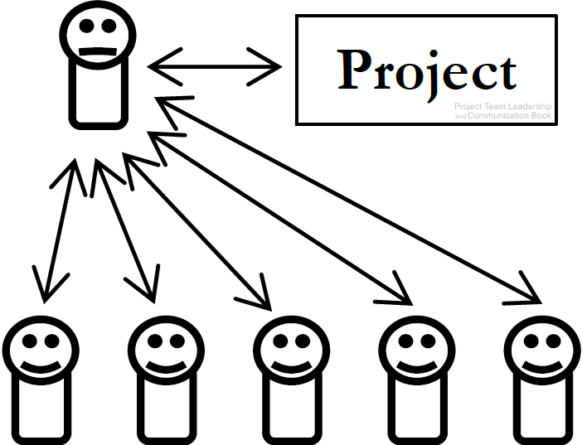
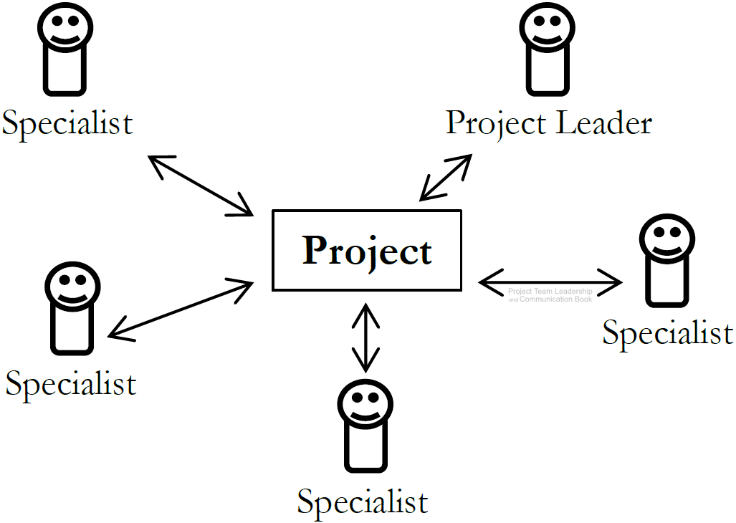
Common Team Structures (1 of 2)
Top-Down Teams
‘Classic’ team structure
Team members’ attachment is to the ‘boss’, who is primarily responsible for the success of the project (and can be singularly responsible for its failure)
Not necessarily an authoritarian style of leadership
Interdisciplinary Teams
Characterized by equal status of each team member, who are each concerned with the success of the project
Each team member has one or more specialties/skillsets
Decisions are often made at the group level
Leader is an equal with organizational/communication skillsets
Diagrams: Malachowsky, Samuel. Project Team Leadership and Communication. Lintwood Press. 2018. p. 114, 115.
Notes:
Corresponds to pages 114-116 of the Project Team Leadership and Communication book.
Team structures are influenced by the organizational culture, processes, and industry (pages 118-119)

Slide 4
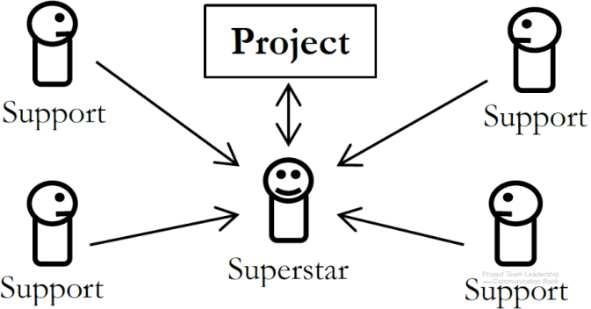
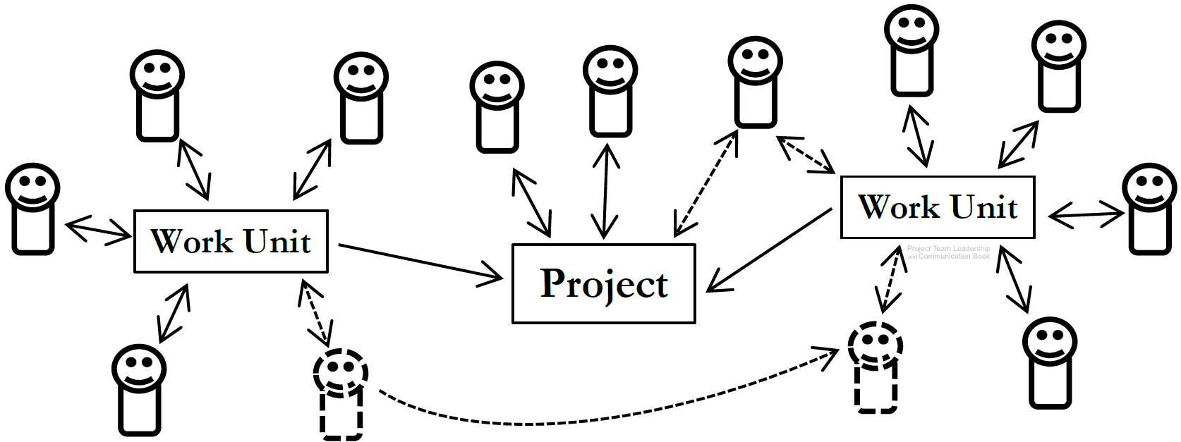
Common Team Structures (2 of 2)
Superstar-Support Teams
Like a surgical team: one member performs the most prominent work
Other team members perform supportive functions
‘Superstar’ must acknowledge importance of other team members
Large and Variable-Structure Teams
Teams can vary in size, structure, and stability
Difficult to organize and track efficiently
Moving or adding team members efficiently is also difficult
Diagrams: Malachowsky, Samuel. Project Team Leadership and Communication. Lintwood Press. 2018. p. 117.
Notes:
Corresponds to pages 116-118 of the Project Team Leadership and Communication book.

Slide 5
Common Team Roles
Leader – guides the team towards the goal
  Primary competencies: leadership, prioritization, and communication
Information Manager – takes ownership of the documentation and data
  Primary competencies: elicitation, organization, and reporting
Externally-Facing – intermediary between project team and external stakeholders
  Primary competencies: perception, communication, and negotiation
Problem-Solver – finds and works through difficult problems
  Primary competencies: evaluation, research, and implementation
Specialist – a ‘subject matter expert’ in one or more subject areas
  Primary competencies: evaluation, anticipation, and articulation
Notes:
Corresponds to pages 119-122 of the Project Team Leadership and Communication book.

Slide 6
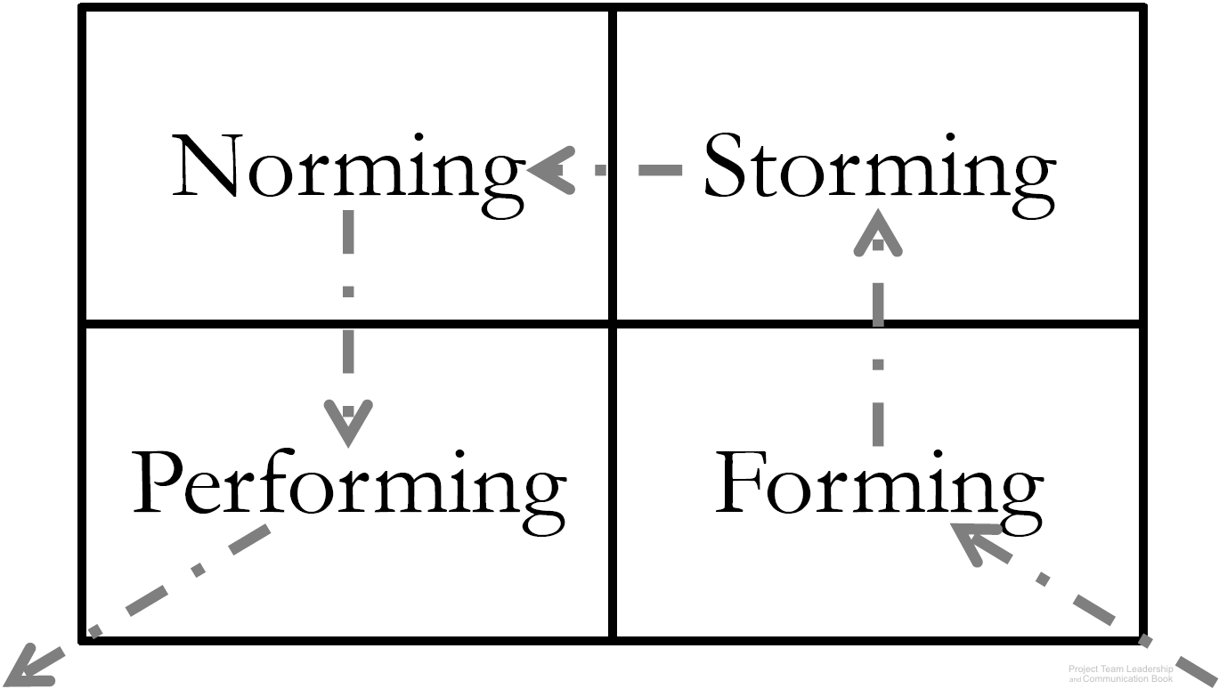
Team Development Stages
Dr. Bruce Tuckman articulates 4 stages which teams must
pass as they develop:
Forming – the team comes together, and the project gains
little benefit from the ‘team’ - productivity is similar to each
working independently
Storming – clashes and disagreements begin as the team tries to determine leadership and ‘rules’ for how they will work together. Productivity may drop
Norming – ‘storming’ is lessening and the ‘rules,’ or ‘norms’ for the group are rapidly developing. Productivity begins to increase, the group starts to identify as a team
Performing – The team reaches increasing efficiency, gaining the efficiencies of working together rather than separate. The team now focuses externally on the work at hand
Diagram: Malachowsky, Samuel. Project Team Leadership and Communication. Lintwood Press. 2018. p. 123.
Tuckman, Bruce. “Developmental sequence in small groups”. Psychological Bulletin. 63 (6). p. 384–99. 1965.
Notes:
Corresponds to section 4.3, pages 123-124 of the Project Team Leadership and Communication book.

Slide 7
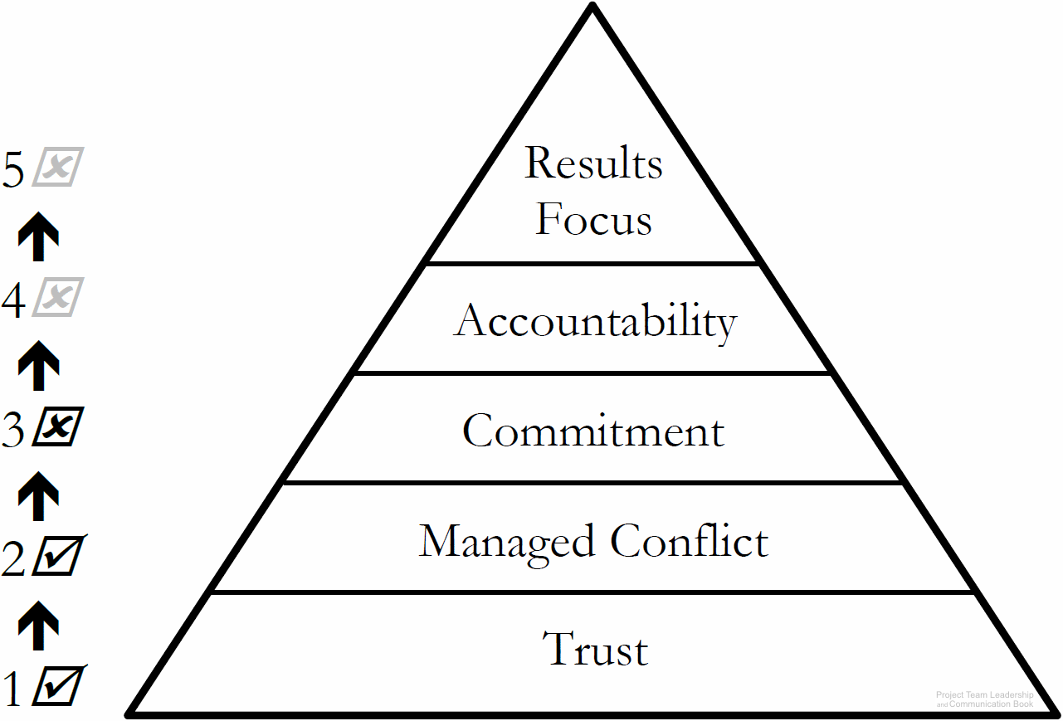
Team Needs
Similar to Maslow’s hierarchy of needs, teams have basic needs
  Needs at the bottom (such as trust) must be satisfied before those higher-up can be addressed
Diagram: Malachowsky, Samuel. Project Team Leadership and Communication. Lintwood Press. 2018. p. 124.
Lencioni, Patrick. The Five Dysfunctions of a Team: A Leadership Fable. San Francisco: Jossey-Bass. 2002.
Notes:
Corresponds to section 4.4, pages 124-125 of the Project Team Leadership and Communication book.

Slide 8

Building Trust
The foundation, the most vital to operate as a team
It takes time, requiring consistently positive interactions
Deeper trust requires vulnerability (difficult for many)
Needs to be maintained, rebuilt after damage
Leader must create and protect the ‘environment of trust’
  Take the lead in expressing trust-building vulnerability
  Seek and prevent trust-breaking actions such as bullying
Team-based personality tests and team-building activities are designed to build trust
Diagram: Malachowsky, Samuel. Project Team Leadership and Communication. Lintwood Press. 2018. p. 125.
Lencioni, Patrick. The Five Dysfunctions of a Team: A Leadership Fable. San Francisco: Jossey-Bass. 2002.
Notes:
Corresponds to section 4.5, pages 125-126 of the Project Team Leadership and Communication book.

Slide 9

Managing Conflict
Conflict isn’t bad – healthy debate means engaged, passionate team members and better decisions
Appropriate conflict requires rules, or norms to be clear to all involved. Examples:
  Focus on the primary decision to be made (not secondary debates)
  Avoid rhetoric, name-calling, or non-contributing statements, which erode trust
  Agree to reach consensus, with all parties pledging to support the outcome
Trust is the foundation of healthy conflict and debate
There are numerous conflict resolution tools and techniques
Diagram: Malachowsky, Samuel. Project Team Leadership and Communication. Lintwood Press. 2018. p. 126.
Lencioni, Patrick. The Five Dysfunctions of a Team: A Leadership Fable. San Francisco: Jossey-Bass. 2002.
Notes:
Corresponds to section 4.6, pages 126-130 of the Project Team Leadership and Communication book.
The next 6 slides are conflict-resolution techniques:
Confronting / Problem Solving
Compromising
Withdrawal / Avoidance
Smoothing / Accommodating
Collaborating
Forcing

Slide 10
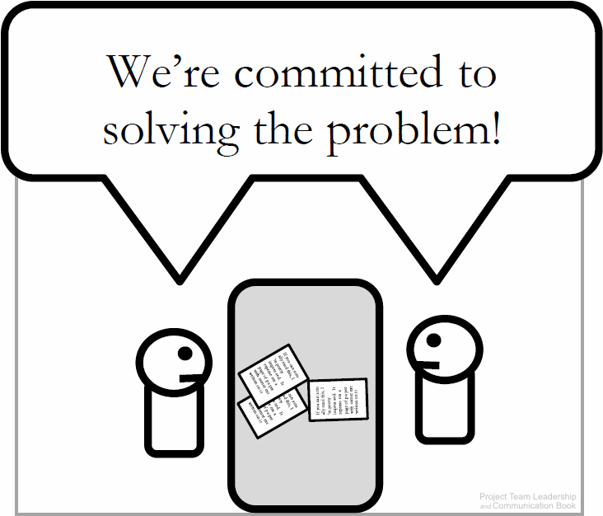
Confronting / Problem Solving
The optimal solution, following a standard problem-solving process:
  Define the real/root problem
  Analyze the problem
  Identify solutions
  Choose a solution (this can be difficult)
  Implement a solution
  Review the solution, and confirm that it solved the problem and repeat if necessary
Often takes the longest – not appropriate if deadlines are tight
Diagram: Malachowsky, Samuel. Project Team Leadership and Communication. Lintwood Press. 2018. p. 128.
Notes:
Corresponds to page 128 of the Project Team Leadership and Communication book.

Slide 11
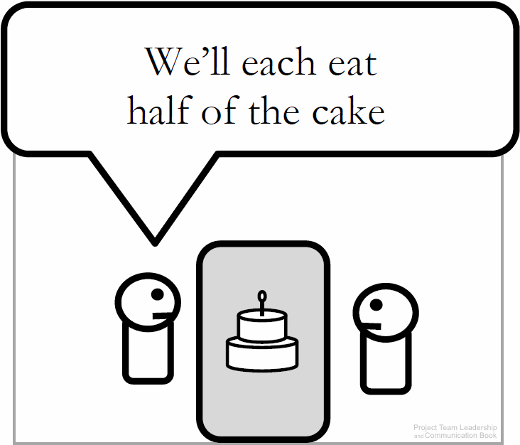
Compromising
Each party makes concessions to the other, and a mutually-accepted conclusion is reached
Works best with issues that can be divided
Is often the quickest solution
May result in a ‘lose-lose’ situation because everyone gets only a subset of what they want
Diagram: Malachowsky, Samuel. Project Team Leadership and Communication. Lintwood Press. 2018. p. 128.
Notes:
Corresponds to pages 128-129 of the Project Team Leadership and Communication book.

Slide 12
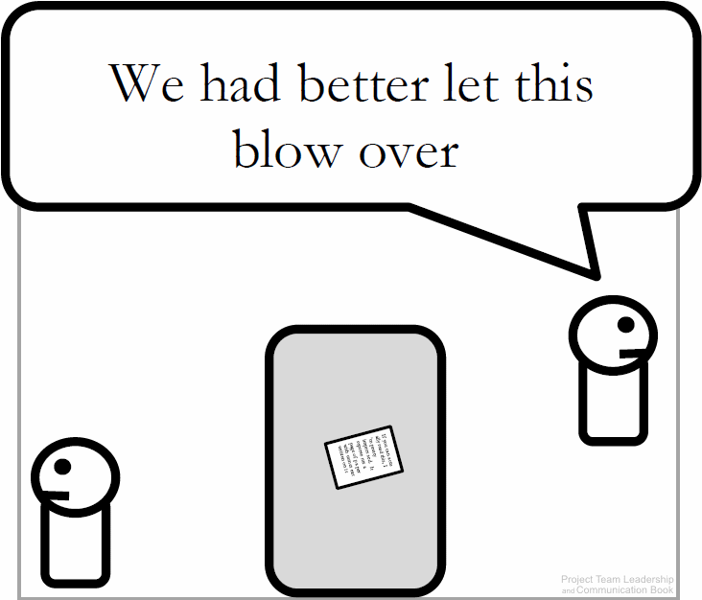
Withdrawal / Avoidance
One or more parties choose to withdraw from or avoid the other to end or delay the conflict
Useful when debate is trivial or emotions are high
May be needed until an authority can intervene
Often doesn’t directly solve the conflict
Diagram: Malachowsky, Samuel. Project Team Leadership and Communication. Lintwood Press. 2018. p. 129.
Notes:
Corresponds to page 129 of the Project Team Leadership and Communication book.

Slide 13
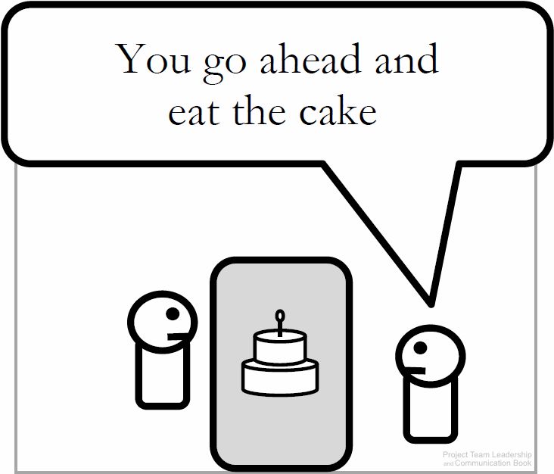
Smoothing / Accommodating
One party concedes, giving the other the ‘win’
Useful when the issue is clearly more important to one party or satisfying one party is important to the overall success of the project
Can delay conflict, as the accommodating party may change their mind and the disagreement still is in place
Potential for abuse of the situation is present
Diagram: Malachowsky, Samuel. Project Team Leadership and Communication. Lintwood Press. 2018. p. 129.
Notes:
Corresponds to page 129 of the Project Team Leadership and Communication book.

Slide 14
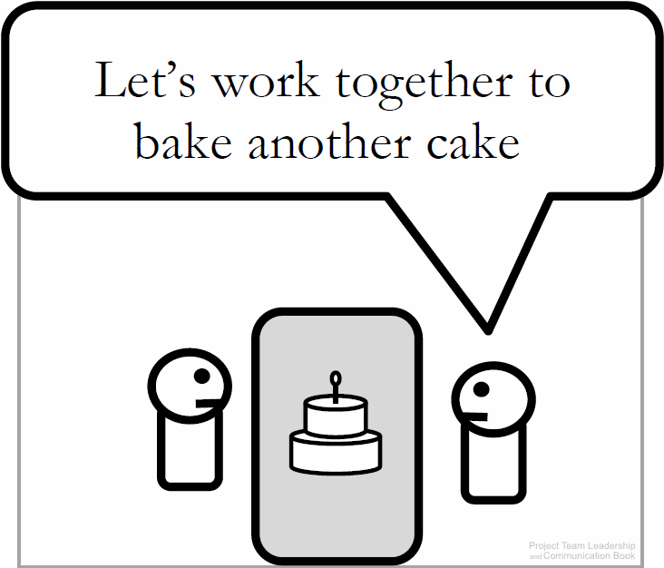
Collaborating
Parties work together to find a mutually-acceptable solution, often a previously-unconsidered third option
Considered to be an optimal solution to most conflicts
Takes longer than most techniques
If parties don’t trust each other, collaborating is nearly impossible
Diagram: Malachowsky, Samuel. Project Team Leadership and Communication. Lintwood Press. 2018. p. 129.
Notes:
Corresponds to pages 129-130 of the Project Team Leadership and Communication book.

Slide 15
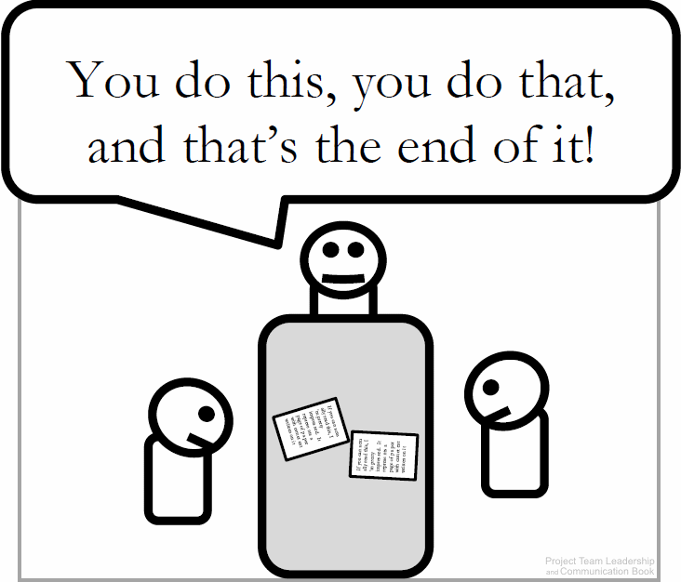
Forcing
Authority figure resolves the conflict/makes the decision, forcing all parties to end their conflict
Effective when the conflict is petty, unimportant, or one party’s opinion is unethical
Often used as a last-resort
May not resolve the conflict, which can reappear at another time in the future
Diagram: Malachowsky, Samuel. Project Team Leadership and Communication. Lintwood Press. 2018. p. 130.
Notes:
Corresponds to page 130 of the Project Team Leadership and Communication book.

Slide 16

Achieving Commitment
Commitment requires clarity – to commit to something, it must be clear exactly what you’re committing to
Each party or entity must commit to multiple others
  Leader → Team Team → Leader Individual → The Work They’re Assigned
  Leader → Project Team → Project Individual → Team
  Team → Being a Good Team
Leaders set the example, so an uncommitted leader can destroy a project / team
Teams must have a good structure, trust each other, and manage conflict properly
Individuals can fail to commit for multiple reasons (not motivated, personal issues, etc.)
Diagram: Malachowsky, Samuel. Project Team Leadership and Communication. Lintwood Press. 2018. p. 130.
Lencioni, Patrick. The Five Dysfunctions of a Team: A Leadership Fable. San Francisco: Jossey-Bass. 2002.
Notes:
Corresponds to section 4.7, pages 130-134 of the Project Team Leadership and Communication book.

Slide 17
Achieving Commitment
Commitment requires:
Leadership by example: the leader must show commitment to the project and team first
Trust and conflict management
Clear prioritization of multiple commitments
A healthy team and project; commitment requires fundamental issues to be solved
Good team structure
Strategies to gain commitment include:
Communicating expectations clearly
Seeking factors affecting noncommittal parties
Assigning leadership or ownership
Recognizing achievement (a primary motivator)
Engaging the creativity of individuals (another motivator)
Notes:
Corresponds to section 4.7, pages 130-134 of the Project Team Leadership and Communication book.

Slide 18
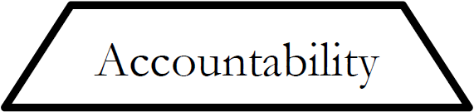
Embracing Accountability
Accountability is a readiness to accept responsibility for work or results
Each team member is accountable to:
  The leader – the most common and natural type of accountability
  Themselves – also known as self-discipline
  Their fellow team members – often the strongest with the most ‘paths’ of accountability
Accountability requires the ability to commit, as well as other’s ability to trust their word and actions
A great tool is the ‘RASCI” accountability matrix
Diagram: Malachowsky, Samuel. Project Team Leadership and Communication. Lintwood Press. 2018. p. 135.
Lencioni, Patrick. The Five Dysfunctions of a Team: A Leadership Fable. San Francisco: Jossey-Bass. 2002.
Notes:
Corresponds to section 4.8, pages 135-138 of the Project Team Leadership and Communication book.
The ‘RASCI” accountability matrix is detailed on the next slide

Slide 19
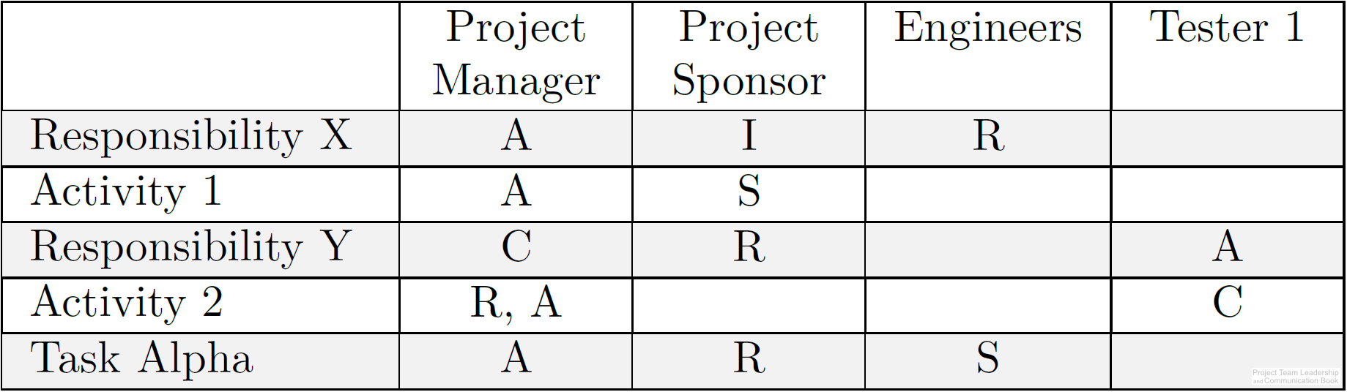
The ‘RASCI’ Accountability Matrix
An accountability matrix is a tool for effectively assigning and communicating levels of accountability for project tasks of functions
Each task or function must have at least
one “A” as well as other letters:
  “R” – Responsible. The party who is to
  complete the task or action
  “A” – Accountable. This party is ultimately
  answerable for the task or action’s completion
  “S” – Support. Similar to “R” but a secondary resource who may be called in if needed
  “C” – Consulted. A specialist or expert who may be called upon to provide vital input
  “I” – Informed. This party must be informed if the task/function is completed, behind schedule. Often the party who completes dependent tasks later in the timeline.
Diagram: Malachowsky, Samuel. Project Team Leadership and Communication. Lintwood Press. 2018. p. 137.
Notes:
Corresponds to pages 136-138 of the Project Team Leadership and Communication book.

Slide 20
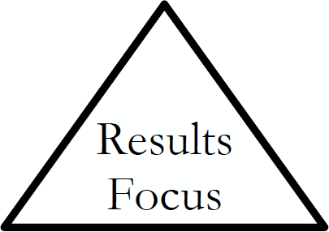
Focusing on Results
A results-focused team has solved issues related to trust, conflict, and commitment – it’s ready and willing to focus on the work at hand
Leadership and the team have new focuses:
  Clarity and priority – because the team working so well, it’s important that each team member knows what they’re working towards
  Visibility – understanding the bigger picture is more valuable for a team that is making decisions quickly and effectively
  Process – creating and documenting process can make the team even more efficient
Diagram: Malachowsky, Samuel. Project Team Leadership and Communication. Lintwood Press. 2018. p. 138.
Lencioni, Patrick. The Five Dysfunctions of a Team: A Leadership Fable. San Francisco: Jossey-Bass. 2002.
Notes:
Corresponds to section 4.9, pages 138-140 of the Project Team Leadership and Communication book.

Slide 21
Summary and Conclusions
Team success comes from many factors, such as effective leadership, good planning, and established goals
The structure and roles of a team are affected both by their work and the organization to which they belong. Additionally, structures and roles affect how teams complete their work
As teams mature, they progress through ‘forming,’ ‘storming,’ ‘norming,’ and ‘performing’ stages
Teams must meet core needs such as building trust and effectively managing conflict before they can commit, become accountable, and achieve results effectively.
Various tools and techniques are available for teams, such as various conflict management techniques (compromise, forcing, etc.) and the ‘RASCI’ accountability matrix.
Notes:
Corresponds to section 4.11, page 144 of the Project Team Leadership and Communication book. Summarizes chapter 4 and these slides.

Slide 22
Questions / Discussion
Notes:
Chapter 4 includes several additional support elements which could become classroom activities or discussion elements.
The chapter tool, “Evaluating Your Team’s Maturity” is designed to allow individuals and teams to evaluate themselves and have honest discussions about how to improve.
There are quite a few key terms defined on pages 145-146.
Review questions cover most of the chapter (page 146-147, answers on page 223).
The exercises on pages 147-148 are designed to allow readers to apply and extend what they’ve learned.

