Slide 1
Activity – Team Structures
For each of the descriptions on the right, which of the following team structures are the closest fit?
Top-down team
Interdisciplinary team
Superstar-support team
Large/variable-structure team
Decisions are typically made by the whole team
The leader is primarily accountable for project success
One individual performs most of the central tasks
‘Classic’ team with a traditional boss and subordinates
Can be difficult to know who’s on your team
Everyone must remember that each team member is needed for a successful project
Challenged by constantly shifting team members
Defined by consistent, mutual respect by all members
Requires appropriate planning, leadership, and communication to be successful
Tuckman, Bruce. “Developmental sequence in small groups”. Psychological Bulletin. 63 (6). p. 384–99. 1965.
Notes:
Corresponds to section 4.2, pages 114-122 of the Project Team Leadership and Communication book.
5 Minute activity
Learning Objective: Classify features of basic team structures
Can be a basic, instructor-lead reinforcement activity
Answers:
Interdisciplinary team
Top-down team
Superstar-support team
Top-down team
Large/variable-structure team
Superstar-support team
Large/variable-structure team
Interdisciplinary team
All types

Slide 2
Activity – Which Stage of Development?
Which of the following team development stages to the teams on the right seem to be experiencing?
Forming
Storming
Norming
Performing
There is quite a bit of conflict happening and team members seem unsure if the group will ever be effective
The team members seem courteous, but are acting as separate individuals working independently
The team feels a shared sense of purpose and identity, and outsiders recognize their ability to get things done
Most conflict has subsided and many of the ‘rules’ seem to be in place
The project seems to be benefitting from the efficiencies of team members working together
Some team members are dominating the ‘conversation’ and others are afraid to speak up
Tuckman, Bruce. “Developmental sequence in small groups”. Psychological Bulletin. 63 (6). p. 384–99. 1965.
Notes:
Corresponds to section 4.3, pages 123-124 of the Project Team Leadership and Communication book.
5 Minute activity
Learning Objective: Differentiate stages of team development by examining team actions
Can be a basic, instructor-lead reinforcement activity
Answers:
Storming
Forming
Performing
Norming
Performing
Storming

Slide 3
Activity – Trust and Commitment
Consider each of the following commitment relationships:
Leader ↔ Team Leader ↔ Individual Team ↔ Individual
What could each party do to build trust with the other?
What could they do to reduce or break trust?
For a successful project, what commitments must each party make?
What factors are important in those commitments?
Notes:
Corresponds to sections 4.5 and 4.7, pages 125-126 and 130-134 of the Project Team Leadership and Communication book.
10 Minute activity
Learning Objective: Propose strategies for building trust and commitment in a project team environment

Slide 4
Activity – Conflict Management
Consider the following scenario:
Finley and Blair have worked well together in the past, but the new project has increased stress levels significantly. The last week has been particularly difficult – the next phase is about to begin and their disagreement on which toolset to implement must be resolved – the choice will affect the entire 5-month phase!
For each conflict management technique (Confronting, Compromising, Withdrawal, Smoothing, Collaborating, and Forcing), answer the following questions:
How could the parties use the technique?
What are the potential advantages and positive outcomes of the technique?
What are potential disadvantages and negative outcomes of the technique?
Notes:
Corresponds to sections 4.6, pages 126-130 of the Project Team Leadership and Communication book.
10 Minute activity
Learning Objective: Apply conflict management techniques to a project team scenario

Slide 5
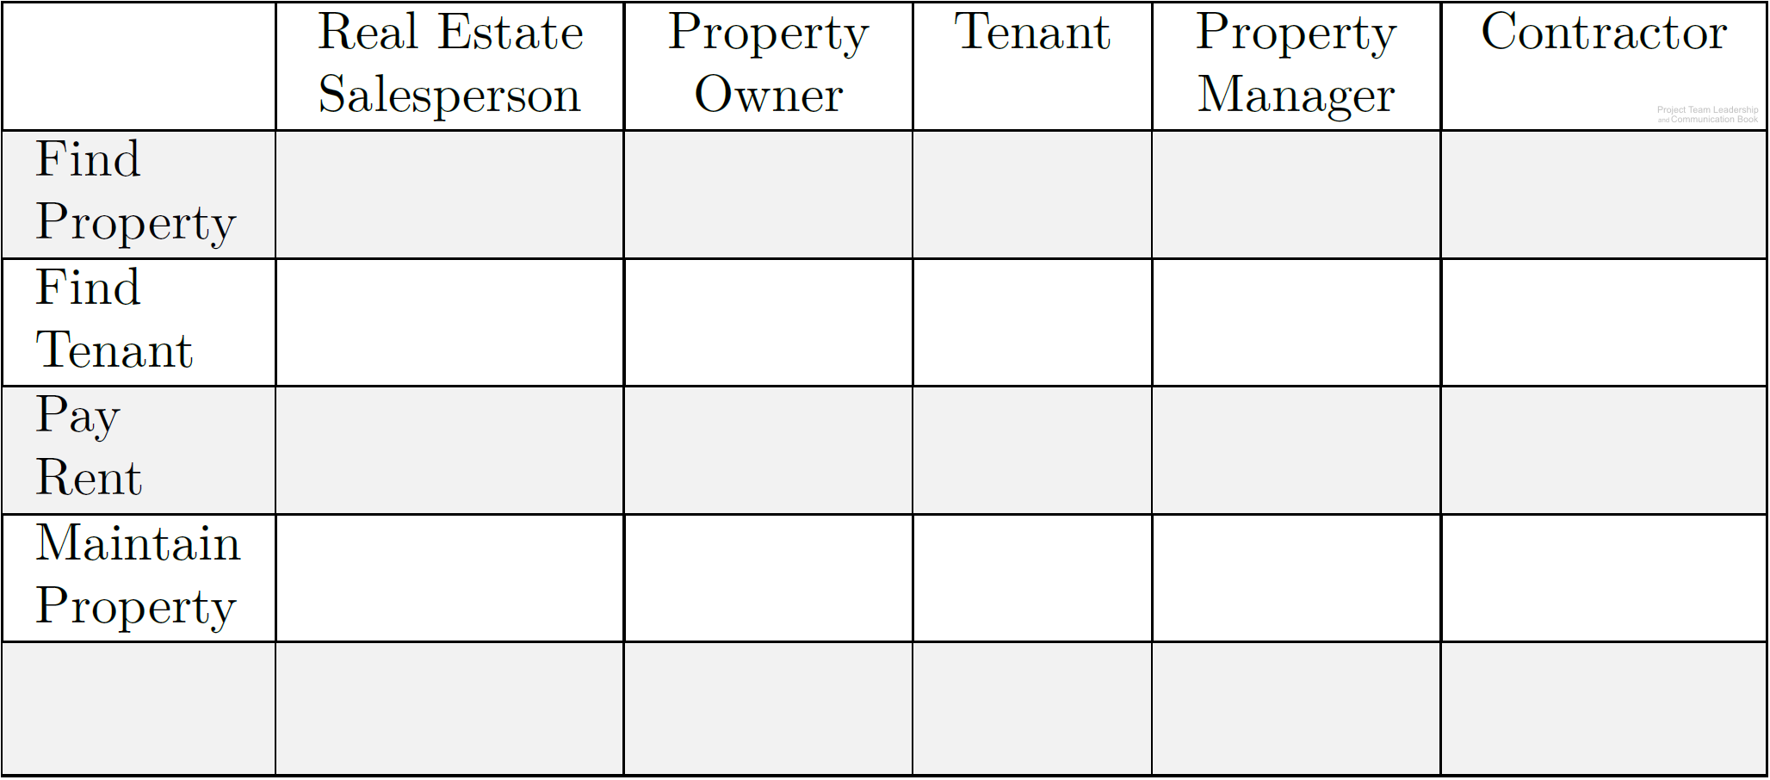
Activity – Building a ‘RASCI’ Accountability Matrix
In teams of 3-4:
Using the grid below, add the letters “R,” “A,” “S,” “C,” or “I” to denote the typical level of accountability each person has to each task.
Add at least two new tasks and add the letters as appropriate.
Diagram: Malachowsky, Samuel. Project Team Leadership and Communication. Lintwood Press. 2018. p. 138.
Notes:
Corresponds to section 4.8, pages 135-138 of the Project Team Leadership and Communication book.
This activity is based on the activity listed on pages 137-138.
10 minute activity
Learning Objective: Assemble a basic team accountability matrix

