Slide 1
Communication and
Expectation Management
Communication success for teams and stakeholders
Designed for chapter 5, pages 149-178 of Project Team Leadership and Communication by Samuel Malachowsky, ISBN 9781732378902, 9781732378919.
Notes:
Corresponds to chapter 5, pages 149-178 of the Project Team Leadership and Communication book. ISBN: 9781732378902 (Softcover), 9781732378919 (Hardcover). These slides may only be posted or used in conjunction with the book in a training or classroom environment. Key terms (page 176) are often italicized on the slides.
Outline:
Project Communication
Channels of Communication
Communication Concepts
Push / Pull / Hybrid Communication
Meetings
Meeting Issues
Meeting Success
Meeting Agenda
Ethical Communication
Communicating Metrics and Reports
Example Project Metrics (2 Slides)
Cycletime
Schedule or Cost Variance
Resource Utilication
Requirements / Specifications Volitility
Total Risk Exposure
Customer Satisfaction
Example Project Reports (3 Slides)
Status Reports
Trend / Forecasting Reports
Variance Reports
Earned Value Reports
Lessons Learned Reports
Stakeholder Expectation Management
Summary and Conclusions
Learning Objectives:
5.1 The Importance of Project Communication
Summarize the impacts and importance of modern project communication
5.2 Basic Communication Concepts
Relate the concept of communication channels and communication types in the context of project communication
Identify obvious and less obvious communication blockers in the context of project communication
5.3 Push/Pull Communication: A Hybrid Approach
Define push, pull, and interactive communication
Relate the concept of ‘hybrid communication’ as a beneficial strategy
5.4 Communications within the Team: Meeting Success
Identify common, negative aspects of team meetings
Give examples of rules and strategies for successful meetings
5.5 Ethics in Communication
Relate the importance of ethics in project environments
Identify 4 communication-related ethical considerations
5.6 Communicating with Metrics and Reports
Define ‘metrics’ and their 2 main categories
Describe multiple factors to consider when communicating metrics or reports
Relate 6 basic project metrics
Describe 5 project reports
5.7 Stakeholder Expectation Management
Define the concept of stakeholder expectation management
Identify 2 main types of stakeholders and factors of communication for each
Relate several factors that affect stakeholder expectations
5.8 Chapter Tool: The Quad Chart
Identify elements of a quad chart
Relate how to use a quad chart when communicating project status
Associated Class Activities: (Separate Slides)
Detecting Communication Blockers (5 minutes, section 5.2)
Propose potential communication blockers for communication channels
Planning and Holding a Meeting (10-15 minutes, section 5.4)
Create a published agenda, planning and participating in a basic team meeting
Ethical Communication (10 minutes, section 5.5)
Analyze several basic ethics scenarios and potential ramifications
Choosing a Metric or Report (5 minutes, section 5.6)
Classify project metrics and reports by fulfilled need
Setting Proper Expectations (10 minutes, section 5.7)
Assemble a basic communication strategy while considering stakeholder expectations

Slide 2
Project Communication
Important because:
Stakeholders affect projects whether you communicate or not
Because of technology, customers expect more interaction
Team members
  Leadership and motivation factors can have a huge effect on the project
  Often are split between multiple projects
Interactive communication is considered ideal (each party is able to respond, ask for clarification, etc.)
  This often is impossible or impractical, so one-way communication is used
Malachowsky, Samuel. Project Team Leadership and Communication. Lintwood Press. 2018. p. 149-150.
Notes:
Corresponds to pages 149-150 of the Project Team Leadership and Communication book.

Slide 3
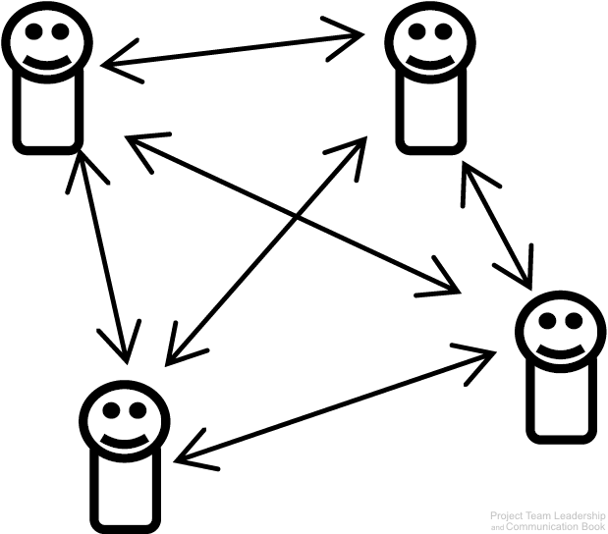
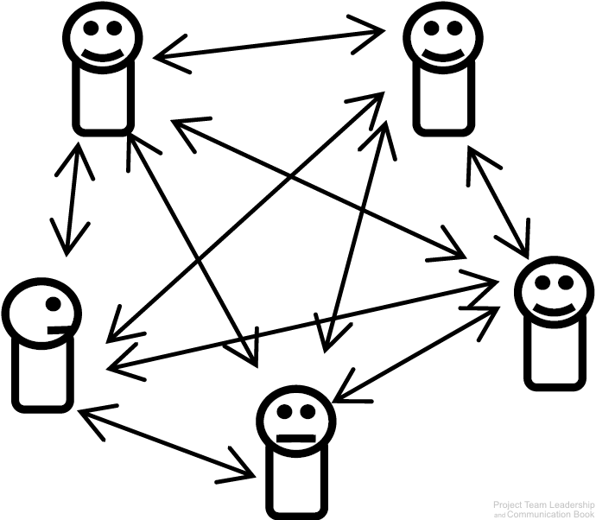
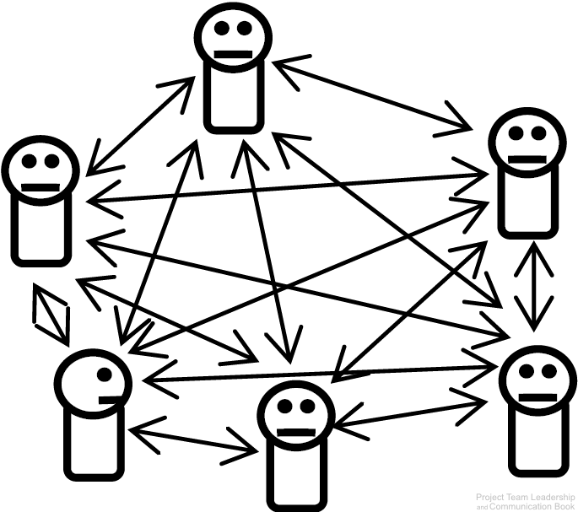
Channels of Communication
A communication channel is the path through which a communication must travel
Leaders and team members must maintain channels of communication with each other
As the number of team members increase, the number of channels increases much quicker
6 Channels
10 Channels
15 Channels
Diagrams: Malachowsky, Samuel. Project Team Leadership and Communication. Lintwood Press. 2018. p. 151.
Notes:
Corresponds to pages 150-152 of the Project Team Leadership and Communication book.

Slide 4
Communication Concepts
There are dozens of communication channels available at any given time:
Additionally there are types or categories of communication:
And there are potential blockers to communication efforts:
Face-to-Face
Message Boards
Social Media
Multi-Channel
Online Video Posts
Text Messages
Email
Video Conference
Postal Mail
Television
Print Media
Photo Sharing
Instant Messages
Written Notes
Advertisement
Telephone
Blogs
and many more
Internal / External
Formal / Informal
Vertical / Horizontal
Written / Oral
Verbal / Nonverbal / Paralingual
Language and Culture
Interruptions
Technical Issues
Distractions such as fatigue
Negativity or hostility
Context known by only one party
Incorrect assumptions
Receiver not actively listening
Malachowsky, Samuel. Project Team Leadership and Communication. Lintwood Press. 2018. p. 152.
Notes:
Corresponds to pages 152-153 of the Project Team Leadership and Communication book.
Blockers: Some of these are more obvious/detectable than others
Conclusion: communication is complicated and requires planning and constant attention

Slide 5
Push / Pull / Hybrid Communication
Interactive Communication is ideal, but not always available or practical
Push/Pull Communication share a weakness: Sender is only sure it was sent, not if it was received or understood
  Push Communication is one-way communication sent to one or more recipients
    Email, radio broadcasts, and postal main are common examples
  Pull Communication allows the recipient(s) to receive the communication at will
    Websites and bulletin boards are common examples
Hybrid Communication combines push and pull communication, capturing the strengths of both
  Sending an email which includes a link to a website or file storage area is a common example
  By pushing the communication which includes the ability for the recipient to pull in the future, the sender increases the chance that the recipient(s) will receive the message
Malachowsky, Samuel. Project Team Leadership and Communication. Lintwood Press. 2018. p. 155-158.
Notes:
Corresponds to section 5.3, pages 150-152 of the Project Team Leadership and Communication book.

Slide 6
Meeting Issues
Meetings have many common complaints:
  “My time could be better spent”
    Discussion or debate is out of control
    Facilitator unprepared
    Bad timing (time of day, week, business cycle)
  “Most of what was discussed wasn’t relevant to me”
    The subject isn’t appropriate for a meeting (“status meetings”)
    The wrong attendees
  “It felt disorganized”
    Attendees are unprepared
    Distractions / Poor timing
    Interpersonal issues
Malachowsky, Samuel. Project Team Leadership and Communication. Lintwood Press. 2018. p. 159-160.
Notes:
Corresponds to pages 159-160 of the Project Team Leadership and Communication book.

Slide 7
Meeting Success
Manage time properly
  Proper advanced notice, proper frequency of meetings
  Time management in the meeting so that topics are not over or under-discussed
Prepare beforehand
  Prepare and send agenda (many templates are available online or within organizations)
    Names, roles, location, date/time
    Objective / purpose for the meeting
    Schedule of topics with specific timeframes
  Ensure technology (projector, online meeting software, document storage) is all set
Document and follow up
  Record and publish clear meeting results, decisions, and action items
  Ensure that important stakeholders receive and acknowledge documentation
Malachowsky, Samuel. Project Team Leadership and Communication. Lintwood Press. 2018. p. 161-162.
Notes:
Corresponds to pages 161-162 of the Project Team Leadership and Communication book.

Slide 8
Meeting Agenda
Meeting Title / Subject |  | Date, Time, Location, Online/Telephone Details |  |  | Facilitator/Called By Name
Attendee Names and Titles |  |  | In-Meeting Roles (Presenter, Timekeeper, Notekeeper)
Start Time – End Time | Facilitator /Presenter Name(s) |  |  | Subject / Discussion Topic / Notes
Start Time – End Time | Facilitator /Presenter Name(s) |  |  | Subject / Discussion Topic / Notes
Start Time – End Time | Facilitator /Presenter Name(s) |  |  | Subject / Discussion Topic / Notes
Start Time – End Time | Facilitator /Presenter Name(s) |  |  | Subject / Discussion Topic / Notes
Where meeting minutes, actions, decisions, etc. are stored after the meeting

Slide 9
Ethical Communication
Communication presents the majority of ethical decisions for most individuals
Ethics focus on truthfulness
  Honesty before the project begins
    Ensuring that the project team and stakeholders are presented with an honest view of circumstances
  Trying to understand the truth
    Remember that perceptions can be inaccurate. Seek the whole truth
  Being truthful in all communications
    Stressful or less-than-ideal circumstances make this difficulty. Trust is built in the bad times, not the good
  Creating an environment where others tell the truth
    As a leader or peer, consistently telling the truth communicates to others that truthfulness is the only acceptable option
Malachowsky, Samuel. Project Team Leadership and Communication. Lintwood Press. 2018. p. 162-163.
Notes:
Corresponds to section 5.5, pages 162-163 of the Project Team Leadership and Communication book.

Slide 10
Communicating Metrics and Reports
Metrics are a useful quantitative representation of a project attribute, which help leaders or team members make decisions about the project
  Private metrics are known only to the team and risk misinterpretation if shared
  Public metrics are designed to be shared outside the team for comparison across projects
Reports are more complex representations of the project designed to be communicated to stakeholders and typically contain multiple metrics
Making metrics and reports useful requires attention to several aspects
  Level of detail as well as ethical and appropriate interpretation for stakeholders
  Choosing an appropriate communication channel
  Considering the role of the recipient, as well as their preferences
  An appropriate understanding of what the information is ultimately going to be used for
Malachowsky, Samuel. Project Team Leadership and Communication. Lintwood Press. 2018. p. 164-165.
Notes:
Corresponds to section 5.6, pages 164-165 of the Project Team Leadership and Communication book.

Slide 11
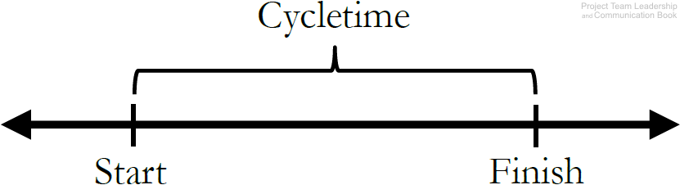
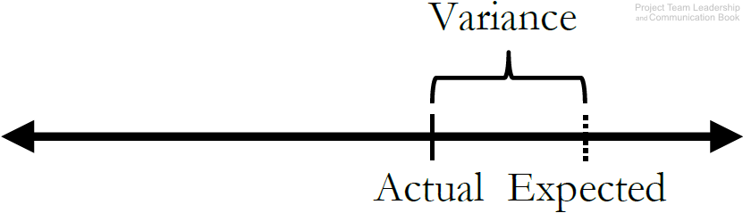
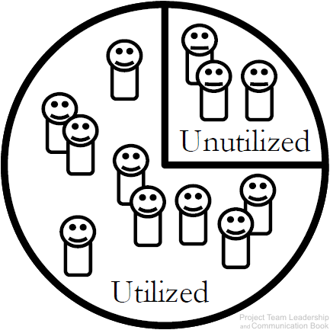
Example Project Metrics (1 of 2)
Cycletime measures the average amount of time it takes to complete a cycle. Defining a ‘cycle’ is up to the team – it can be a single phase or the entire project.
Schedule or Cost Variance demonstrates how far the expected value (baseline) is from the actual value. Related to a project’s Earned Value.
Resource Utilization tracks how effectively of the team’s available work hours are being utilized. A percentage significantly below 100% may indicate wasted time, and over 100% could lead to burn-out. Similar metrics exist for other (non-human) resources.
Diagrams: Malachowsky, Samuel. Project Team Leadership and Communication. Lintwood Press. 2018. p. 166.
Notes:
Corresponds to section 5.6, page 166 of the Project Team Leadership and Communication book.

Slide 12
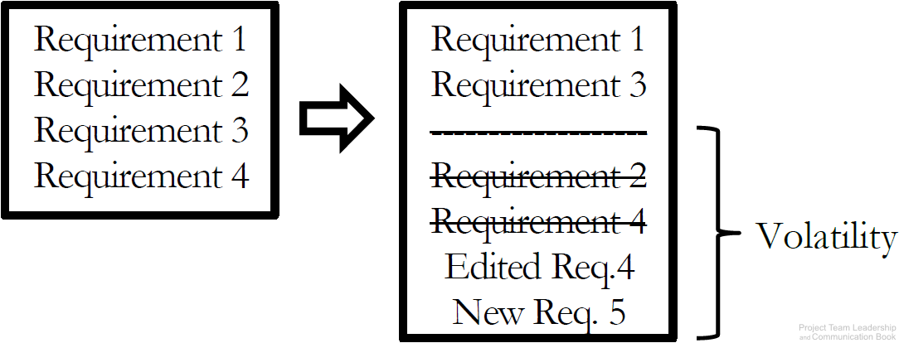
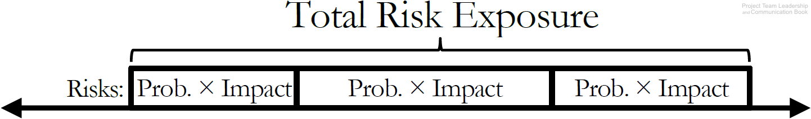
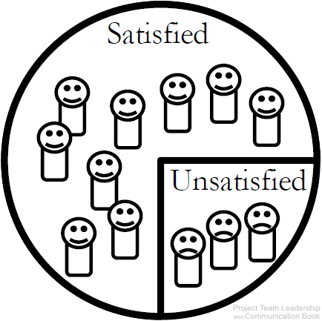
Example Project Metrics (2 of 2)
Requirements/Specifications Volatility measures the number of changes to requirements/specifications as the project proceeds. These changes often have significant impacts on the productivity of the team.
Total Risk Exposure is the sum of a project’s individual risk exposures. The result is the expected total impact to resources or schedule.
Customer Satisfaction is an important metric to many organizations. Measured in various ways (surveys, etc.). Understanding why customer satisfaction is where it is represents a much more difficult task.
Diagrams: Malachowsky, Samuel. Project Team Leadership and Communication. Lintwood Press. 2018. p. 166-167.
Notes:
Corresponds to section 5.6, pages 166-167 of the Project Team Leadership and Communication book.

Slide 13
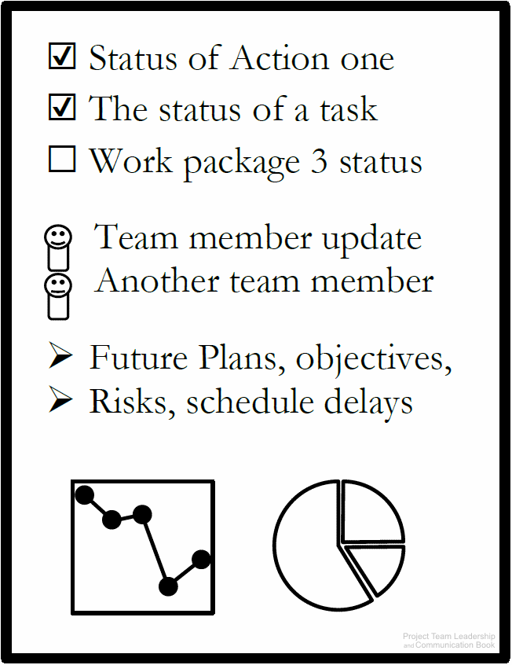
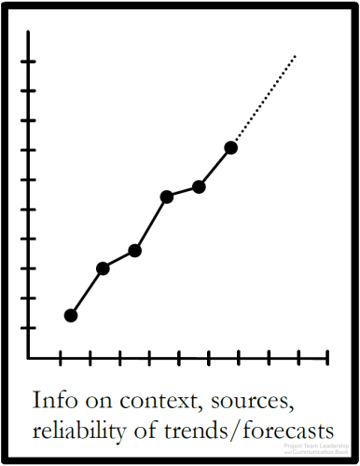
Example Project Reports (1 of 3)
Status Reports indicate the overall condition of a project.
  Overall health
  Schedule/budget status
  Issues/risks
Almost any relevant metric can be included
Trend/Forecasting Reports extrapolate important project data, giving insight into important factors of the project.
  Is performance improving or deteriorating?
  Will the data and its forecast factor into important decisions?
Sources, justifications, and expected ranges help make the report more relevant/readable
Automatically generated reports can be extremely useful here
Data/Metrics: Cycletime, Schedule, Cost, etc.
Quad Charts are a useful example of a status report
  Limited to one side of one page or one presentation slide
Completed Since Last Report | Plans For Current Period
Risks & Issues | Needs & Discussion
Diagrams: Malachowsky, Samuel. Project Team Leadership and Communication. Lintwood Press. 2018. p. 167-168.
Notes:
Corresponds to section 5.6 and 5.8, pages 167-168 and 173-174 of the Project Team Leadership and Communication book.

Slide 14
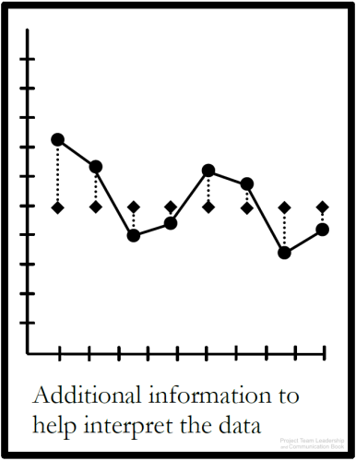
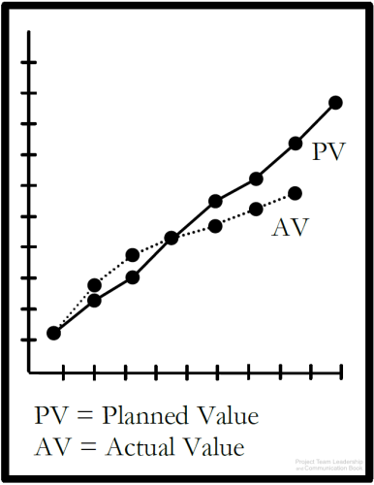
Example Project Reports (2 of 3)
Variance Reports measure how actual results compare to the expected value, or “baseline.”
Both overspending and “underspeinding” time or resources can represent a problem
Earned Value Reports are similar to Trend/Fore-casting and Variance Reports, but follow a specific method.
  Actual, or “Earned Value” are plotted against expected value.
  In an “ideal” project, both graphed lines would match perfectly. A gap indicates variance
Some project management software automatically generates this report
Data/Metrics: Earned Value, Planned Value
The expected values may not always be constant/linear. Projects often plan to work and spend resources at varying rates
Often, more data is included to provide clarity
Data/Metrics: Schedule Variance, Cost Variance, analysis/clarification where needed
Diagrams: Malachowsky, Samuel. Project Team Leadership and Communication. Lintwood Press. 2018. p. 169.
Notes:
Corresponds to section 5.6, page 169 of the Project Team Leadership and Communication book.
Note that Earned Value is covered more extensively in the chapter 3 slides as well as the book on pages 94-97 (section 3.6).

Slide 15
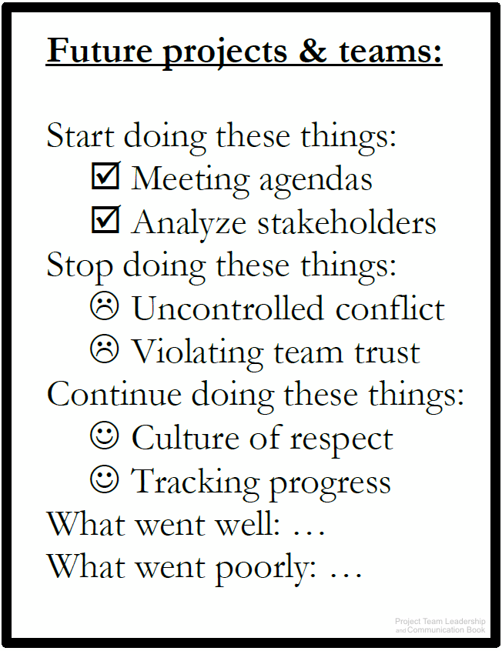
Example Project Reports (3 of 3)
Lessons Learned Reports present an opportunity for the project team to review, document, learn from, and communicate what went well and what went poorly throughout the project.
  Often three questions are asked:
    What should the team start doing?
    What should the team stop doing?
    What should the team continue doing?
  Also known as a “Postmortem,” which implies lessons learned activities are only completed at the end of a project. In reality, they should happen throughout, and team can benefit immediately
  Previous Lessons Learned reports can also benefit teams completing projects in the future
Diagram: Malachowsky, Samuel. Project Team Leadership and Communication. Lintwood Press. 2018. p. 170.
Notes:
Corresponds to section 5.6, page 170 of the Project Team Leadership and Communication book.

Slide 16
Stakeholder Expectation Management
Stakeholders fall into 2 groups
  Those who affect the project: often the most apparent to the team and the most demanding
  Those who are affected by the project: often easier to ignore
Expectations have a direct connection to perception, and perception is influenced by communication. Several factors can affect this:
  Stakeholders’ previous projects and experiences
  Patterns of communication and normal rhythms of the organizational environment
  Expectations of individual stakeholders: simply asking is often most effective here
  Previous commitments made by the project team. These should be carefully recorded and considered
  Hard data: numbers (metrics, reports, etc.) and appropriate context are extremely valuable
Malachowsky, Samuel. Project Team Leadership and Communication. Lintwood Press. 2018. p. 171-172.
Notes:
Corresponds to section 5.7, pages 171-172 of the Project Team Leadership and Communication book.

Slide 17
Summary and Conclusions
Teams may not give communication enough consideration because in general communication is a large part of everyday life
Communication requires careful planning, and should consider factors such as the appropriate channel and potential blockers.
Carefully consider whether interactive, push, pull, and hybrid communication types are appropriate
Team meetings, a major area of difficulty, should be properly planned/executed
External communication affects the expectations of stakeholders
Communication represents the majority of ethical considerations for project teams
When communicating with metrics and reports, special consideration must be given to how they are perceived. Provide appropriate interpretation and context
Notes:
Corresponds to section 5.9, pages 174-175 of the Project Team Leadership and Communication book. Summarizes chapter 5 and these slides.

Slide 18
Questions / Discussion
Notes:
Chapter 5 includes several additional support elements which could become classroom activities or discussion elements.
There are quite a few key terms defined on pages 176.
Review questions cover most of the chapter (page 177, answers on pages 223-224).
The exercises on pages 177-178 are designed to allow readers to apply and extend what they’ve learned.

