Slide 1
Mini-Module:
Defining Project Outcomes
Designed for chapter 2, section 2.5, pages 51-61 of Project Team Leadership and Communication by Samuel Malachowsky, ISBN 9781732378902, 9781732378919.
Notes:
Corresponds to chapter 2, section 2.5, pages 51-61 of the Project Team Leadership and Communication book. ISBN: 9781732378902 (Softcover), 9781732378919 (Hardcover). These slides may only be posted or used in conjunction with the book in a training or classroom environment. Key terms (pages 74-75) are often italicized on the slides.
Learning Objectives:
Relate the concept of project goals, including examples of such
Relate the concept of project scope statements, including examples of such
Relate the concept of project requirements/specifications, including examples of such
Describe ‘the layered approach’ to project outcome definition
Activity: Construct scenario-specific goals, scope statements, and specifications/requirements
Activity: Layering project outcomes (10-15 minutes)
Outline: (slides: 10 minutes, activity: 10-15 minutes)
Defining Project Outcomes
Project Goal Statements
Project Scope Statements
Project Requirements / Specifications
Activity – Layering Project Outcomes

Slide 2
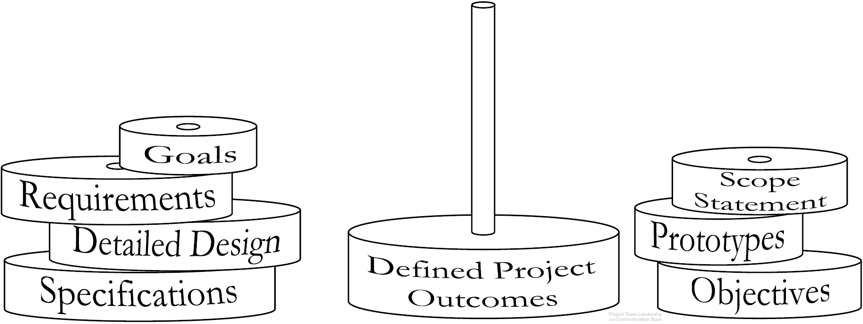
Defining Project Outcomes
Defining the projects outcomes, or deliverables often requires multiple artifacts (documents).
Artifacts are ‘stacked together’ to clarify all project outcomes
  Specific artifacts can vary by industry, organization, or team
Diagram: Malachowsky, Samuel. Project Team Leadership and Communication. Lintwood Press. 2018. p. 59.
Notes:
Corresponds to section 2.5, pages 51-61 of the Project Team Leadership and Communication book.
The book (page 53) and website contain an additional diagram which illustrates the abstract to exact nature of defining artifacts.
The next slide contains three artifact types.

Slide 3
Project Goal Statements
Goals – The overarching outcomes of the project
High-level: What the project is trying to achieve
Measurable: It should be clear when the goal is or isn’t met
Achievable: Within the capability of the resources/time available
“Increase pedestrian access to the
B-line subway by 50%”
“Create a connection platform that
will allow RB-8 tractors to power
the HST-4 jackhammer”
“Install a well that will provide potable drinking water for 300 residents”
Malachowsky, Samuel. Project Team Leadership and Communication. Lintwood Press. 2018. p. 52.
Notes:
Corresponds to section 2.5, pages 51-61 of the Project Team Leadership and Communication book.
Goals, pages 51-53. Sample goals on page 52.

Slide 4
Project Scope Statements
Scope Statements – What is and isn’t included in the project
A list of major delieverables
A basic strategy
Constraints, assumptions, and external dependencies
Often in the form of paragraphs with ‘bullets’
Project: PartCo RX-58 Installation
Scope Statement: This project will include installation, testing, and on-site training of the RX-58 stamping machine within PartCo’s Springtown manufacturing facility.
The project will not include electrical tie-in beyond an in-place power box, integration of the machine with upstream or downstream machines or processes, testing beyond basic functionality, training after the date of installation, or training for more than 10 employees of PartCo.
Malachowsky, Samuel. Project Team Leadership and Communication. Lintwood Press. 2018. p. 56.
Notes:
Corresponds to section 2.5, pages 51-61 of the Project Team Leadership and Communication book.
Scope Statements, pages 53-56. Sample scope statements on pages 55-56.

Slide 5
Project Requirements / Specifications
Requirements and/or Specifications – Details for what’s expected
Non-ambiguous
Reader should know exactly what’s needed
Functional (the outcomes) and non-functional (limits such as schedule, safety, etc.)
“All user-accessible web pages shall render properly on the latest major version of each of the top three mobile browsers”
“The secondary module casing shall be produced using 0.3 thick 304 grade stainless steel”
“The product in its entirety is to be delivered 45 business days after the Statement of Work is signed”
Notes:
Corresponds to section 2.5, pages 51-61 of the Project Team Leadership and Communication book.
Requirements and Specifications, pages 57-58. Sample requirements/specifications on page 57.

Slide 6
Activity – Layering Project Outcomes
Organize into teams of 3-4 and consider the following scenario:
You’re using the layered approach to define the outcomes of a playground project
for the local parks and recreation department.
Write 3 goals/objectives
Write a basic scope statement including what is and isn’t a part of the project
Write 3 specifications/requirements
Notes:
Corresponds to section 2.5, pages 51-61 of the Project Team Leadership and Communication book.
Similar to exercise 6 on pages 76-77
10-15 minute activity
Learning Objective: Construct scenario-specific goals, scope statements, and specifications/requirements
Scenario/product can be changed to more closely match the student’s field of study, though thinking outside of their field can be beneficial for understanding.

Slide 7
Questions / Discussion
Notes:
Chapter 2 includes several additional support elements which could become classroom activities or discussion elements.
There are quite a few key terms defined on pages 74-75.
Review questions cover most of the chapter (pages 75-76, answers on page 223).
The exercises on pages 76-77 are designed to allow readers to apply and extend what they’ve learned.

