Slide 1
Mini-Module:
Estimation Techniques
Designed for chapter 3, section 3.2, pages 80-83 of Project Team Leadership and Communication by Samuel Malachowsky, ISBN 9781732378902, 9781732378919.
Notes:
Corresponds to chapter 3, section 3.2, pages 80-83 of the Project Team Leadership and Communication book. ISBN: 9781732378902 (Softcover), 9781732378919 (Hardcover). These slides may only be posted or used in conjunction with the book in a training or classroom environment. Key terms (pages 107-108) are often italicized on the slides.
Objectives: Learn the basic steps for planning and prioritizing project work as well as 6 basic estimating techniques (10 minutes)
Activity: Which estimation technique? (5 minutes)
Outline:
Planning and Prioritizing Project Work
Estimation Techniques
Expert Judgement
Group Consensus
Top-Down
Bottom-Up
Comparison or Analogy
Other Methods
Activity – Which Estimation Technique?

Slide 2
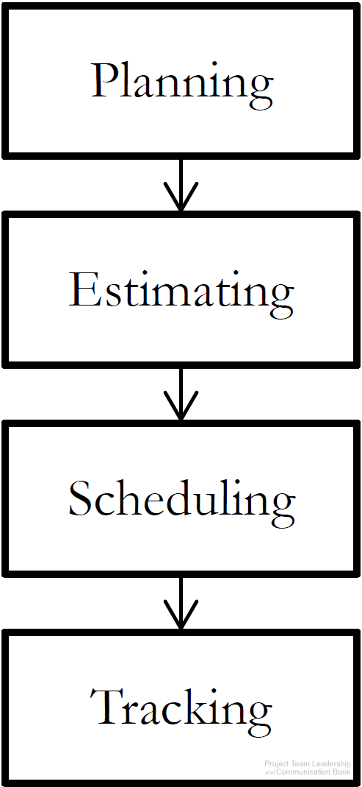
Planning and Prioritizing Project Work
Before work can be completed, three basic steps must take place:
  Planning takes place early in the project, and determines objectives to be completed, resources available, etc.
  Estimating is the process of determining how long or how many resources each planned element will take
  Scheduling is the ‘calandarization’ of estimated work
Once the work begins (execution of plans):
  Tracking must occur, comparing actual results with plans, estimates, and schedules
  If changes occur or results vary from plans, repeat the steps
Diagram: Malachowsky, Samuel. Project Team Leadership and Communication. Lintwood Press. 2018. p. 88.
Notes:
Corresponds to section 3.1, pages 79-80, and page 88 of the Project Team Leadership and Communication book.

Slide 3
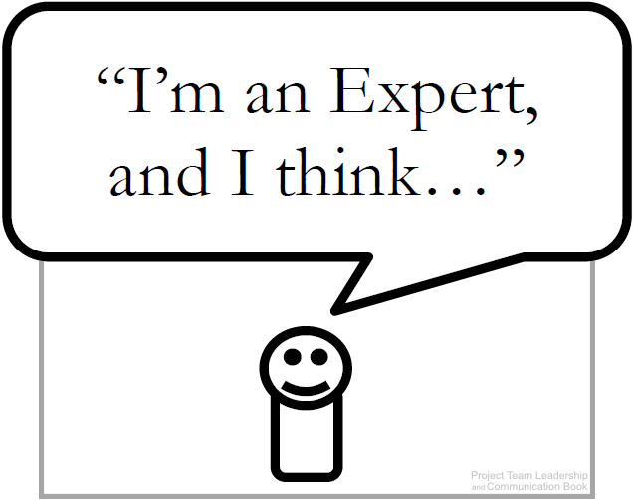
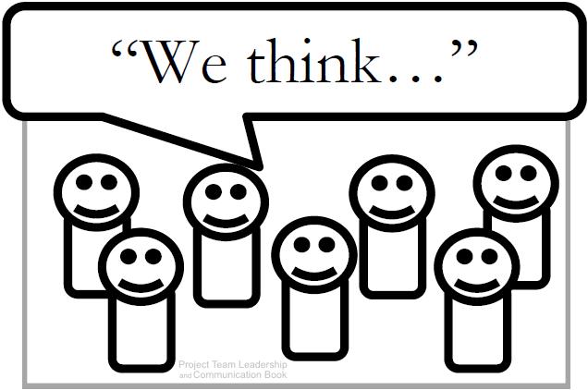
Estimation Techniques (1 of 3)
Expert Judgement: experience is used to estimate
The basis for all other techniques
Strengths: expert lends credibility to estimate
Weaknesses: one person’s ‘expertise’ may fail
Group Consensus: various techniques are used to poll the group and reach consensus
Strengths: group participation and ‘buy-in’
Weaknesses: bias and cultural issues manifest
Diagrams: Malachowsky, Samuel. Project Team Leadership and Communication. Lintwood Press. 2018. p. 80, 82.
Notes:
Corresponds to pages 80-81, and page 82 of the Project Team Leadership and Communication book.

Slide 4
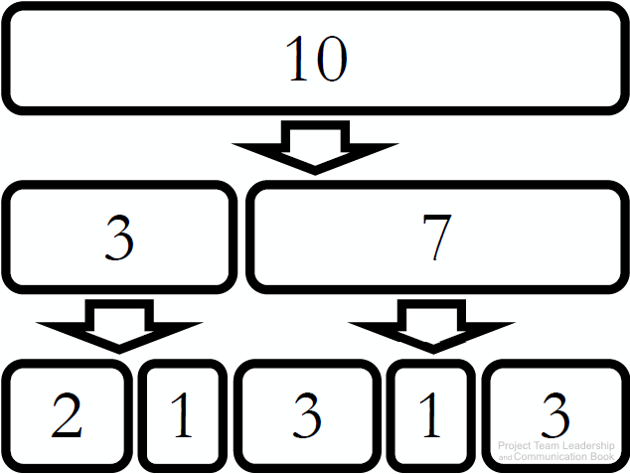
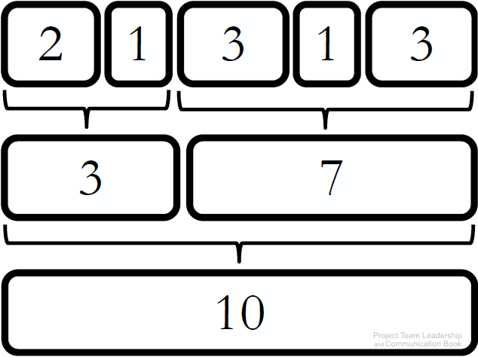
Estimation Techniques (2 of 3)
Top-Down: large units estimated then divided up
Strengths: usable when less detail is known
Weaknesses: inaccurate if major sections of the project aren’t considered
Bottom-Up: small units estimated then added together
Strengths: can be quite precise if used properly
Weaknesses: more time consuming than other techniques, changes to items can impact greatly
Diagrams: Malachowsky, Samuel. Project Team Leadership and Communication. Lintwood Press. 2018. p. 81.
Notes:
Corresponds to page 81 of the Project Team Leadership and Communication book.
The one-to-two rule, outlined on page 82, helps determine how granular estimates should get: the task should take 1-2 resources 1-2 weeks.

Slide 5

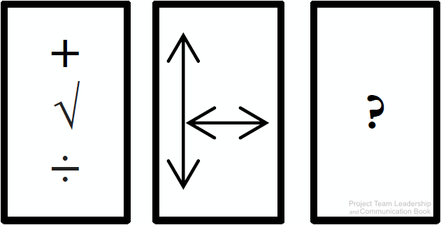
Estimation Techniques (3 of 3)
Comparison or Analogy: projects (or components) are compared to previous work
Strengths: based on actual results, increasing credibility and potentially accuracy
Weaknesses: all projects are unique, may be difficult to find comparisons, data may not exist
Other Methods: mathematical/statistical models, focusing on size rather than time, or industry-specific methods
Diagrams: Malachowsky, Samuel. Project Team Leadership and Communication. Lintwood Press. 2018. p. 81, 82.
Notes:
Corresponds to pages 81-82 and 82-83 of the Project Team Leadership and Communication book.

Slide 6
Activity – Which Estimation Technique?
Which of the following estimation techniques are most appropriate for each of the scenarios on the right?
Group Consensus
Top-Down
Bottom-Up
Comparison or Analogy
A project has dell-defined details and the team has the time to conduct a thorough estimation.
All members of the team are highly qualified professionals who have worked together on projects before.
Though this project is unique, the team has a large number of previous projects to draw information from.
The team is short on time and needs a starting point for assessing individual sections of the project.
Notes:
Corresponds to section 3.2, pages 80-83 of the Project Team Leadership and Communication book.
5 Minute activity
Answers:
Bottom-up
Group consensus
Comparison or analogy
Top-down

Slide 7
Questions / Discussion
Notes:
Chapter 3 includes several additional support elements which could become classroom activities or discussion elements.
There are quite a few key terms defined on pages 107-108.
Review questions cover most of the chapter (page 108, answers on page 223).
The exercises on pages 109-110 are designed to allow readers to apply and extend what they’ve learned.

