Slide 1
Mini-Module:
Estimating Honestly
Designed for chapter 3, section 3.3 and 3.4, pages 83-87 of Project Team Leadership and Communication by Samuel Malachowsky, ISBN 9781732378902, 9781732378919.
Notes:
Corresponds to chapter 3, section 3.3 and 3.4, pages 83-87 of the Project Team Leadership and Communication book. ISBN: 9781732378902 (Softcover), 9781732378919 (Hardcover). These slides may only be posted or used in conjunction with the book in a training or classroom environment. Key terms (pages 107-108) are often italicized on the slides.
Objectives: Demonstrate the basic difficulties that arise when teams allow estimates to become commitments as well as addressing issues with accuracy and precision (10 minutes)
Activity: Estimating, Not Committing (5-10 minutes)
Outline:
Estimates vs. Commitments
Accuracy vs. Precision
Activity – Estimating, Not Committing

Slide 2
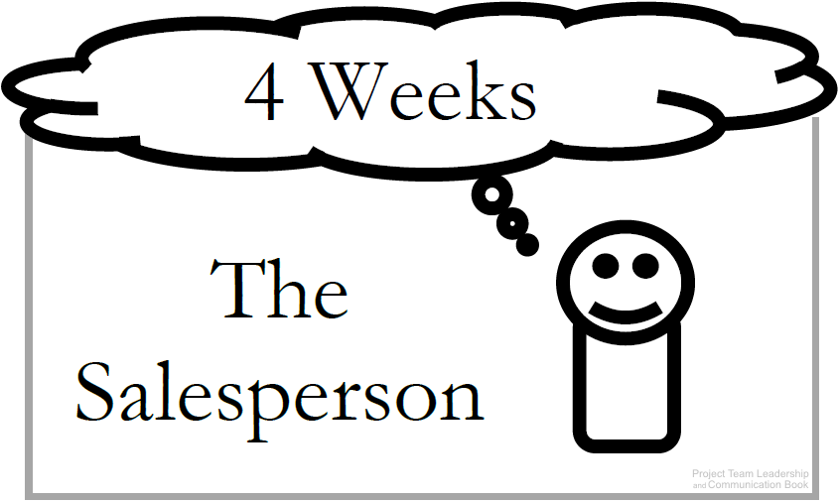
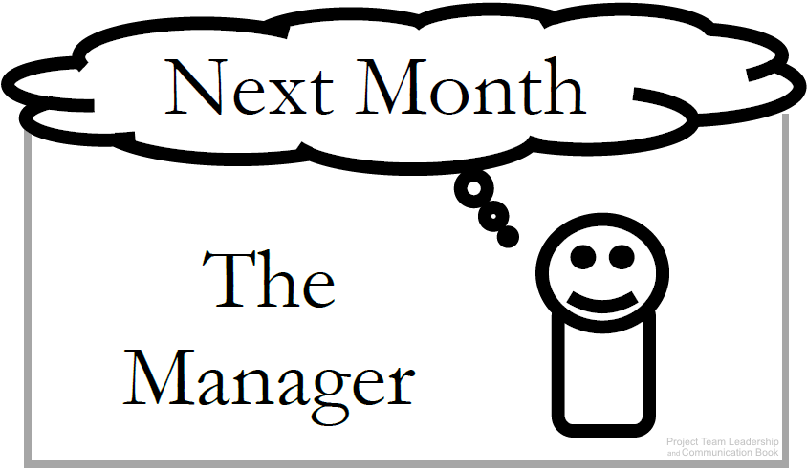
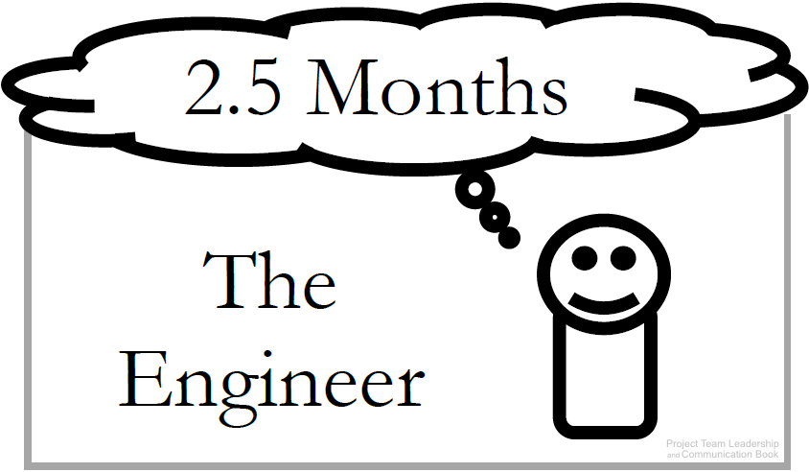
Estimates vs. Commitments
All parties must be careful not to confuse estimates with commitments
Commitments: Are deadlines ‘real’ or arbitrary?
Estimates: Presentation can be important: Ranges (6-8 Months), plus/minus qualifiers (7 Weeks +/– 1 Week), and Confidence factors (4 weeks: 30% chance, 5 weeks: 50% chance) can be helpful
Don’t confuse estimation with scheduling, which sets actual dates
Diagrams: Malachowsky, Samuel. Project Team Leadership and Communication. Lintwood Press. 2018. p. 84.
Notes:
Corresponds to pages 83-85 and 87 of the Project Team Leadership and Communication book.
When introducing this concept, read the scenario in section 3.3, pages 83-84. This will introduce the idea of differing perspectives when it comes to perspectives.

Slide 3
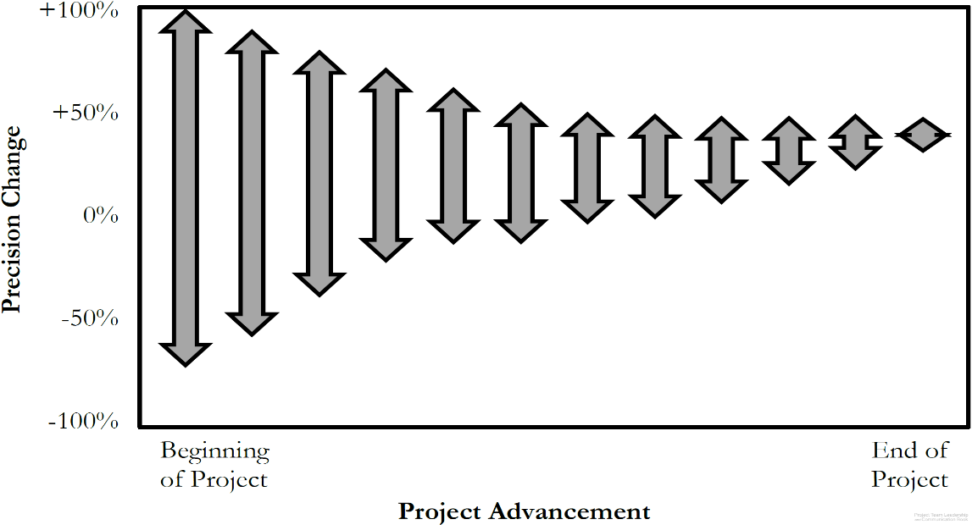
Accuracy vs. Precision
Accuracy is how true a value is
  ‘4-6’ is accurate if the actual # is 5.5
Precision is how exact a value is
  ‘4-6’ is less precise than ‘4.5-5.5’
Within a project communications
should always be as accurate as
possible (especially in estimating)
Because uncertainty is high at the beginning of a project, the only way to be accurate is to be less precise
As the project progresses, we can be more and more precise while remaining accurate throughout (ranges get smaller and smaller)
Diagram: Malachowsky, Samuel. Project Team Leadership and Communication. Lintwood Press. 2018. p. 86.
McConnell, Steve. Software Project Survival Guide: how to be sure your first important project isn’t your last. Redmond, WA: Microsoft Press. p. 31. 1998.
Notes:
Corresponds to section 3.4, pages 85-86 of the Project Team Leadership and Communication book.

Slide 4
Activity – Estimating, Not Committing
In teams of 3-4, consider the following scenario:
Your and your team of three have been tasked with moving the sales office to a new location 3.6 miles away. There are 43 employees who will be transferred, along with files, computing equipment, and at least one box of personal property per individual. The executive vice president has asked for a pretty exact estimate. You think it will take 11 days to complete the move, but haven't yet shared the estimate with her.
List at least 3 methods you can use to accurately share this estimate.
For each of the three methods chosen, list one advantage and one disadvantage associated with using it.
Notes:
Corresponds to section 3.3 and 3.4, pages 83-87 of the Project Team Leadership and Communication book. Methods of estimating imprecisely can be found on page 87.
5-10 Minute activity
Scenario/product can be changed to more closely match the student’s field of study, though thinking outside of their field can be beneficial for understanding.

Slide 5
Questions / Discussion
Notes:
Chapter 3 includes several additional support elements which could become classroom activities or discussion elements.
There are quite a few key terms defined on pages 107-108.
Review questions cover most of the chapter (page 108, answers on page 223).
The exercises on pages 109-110 are designed to allow readers to apply and extend what they’ve learned.

