Slide 1
Mini-Module:
Organizing & Sequencing Tasks
Designed for chapter 3, section 3.5, pages 88-90 of Project Team Leadership and Communication by Samuel Malachowsky, ISBN 9781732378902, 9781732378919.
Notes:
Corresponds to chapter 3, section 3.5, pages 88-90 of the Project Team Leadership and Communication book. ISBN: 9781732378902 (Softcover), 9781732378919 (Hardcover). These slides may only be posted or used in conjunction with the book in a training or classroom environment. Key terms (pages 107-108) are often italicized on the slides.
Objectives: Learn basic usage of work breakdown structures and precedence diagrams, become familiar with 'the one-to-two rule' (10 minutes)
Activity: Organizing and sequencing tasks (15 minutes)
Outline:
Organizing Tasks: The Work Breakdown Structure
The One-to-Two Rule
Sequencing and Scheduling Tasks
Activity – Organizing and Sequencing Tasks

Slide 2
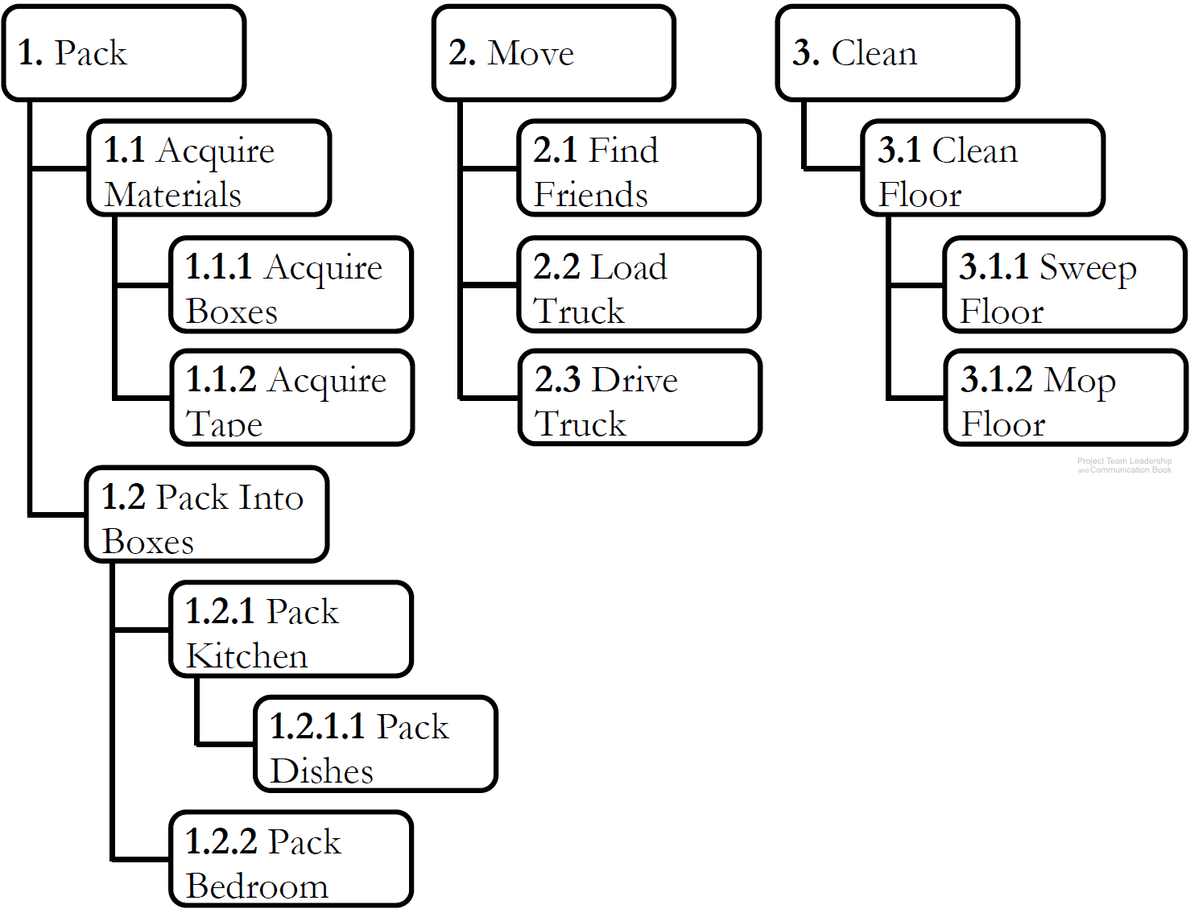
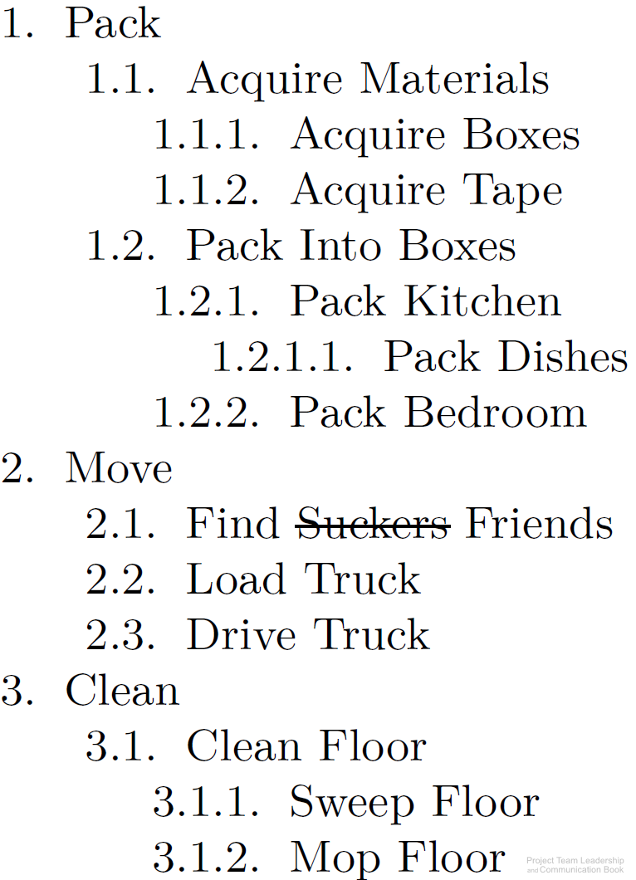
Organizing Tasks: The Work Breakdown Structure
Organizes elements with ‘sub-
numbers.’ 1.2.3 is part of 1.2
Two types: product & process
  Product divides by components
  Process divides by activities/tasks
Can be built ‘top down,’
‘bottom-up,’ or ‘rolling-wave’
A good way to organize brain-
storming efforts early in the project
Sequencing of tasks or components
isn’t needed until later in scheduling efforts
Diagrams: Malachowsky, Samuel. Project Team Leadership and Communication. Lintwood Press. 2018. p. 88.
Project Management Institute. A Guide to the Project Management Body of Knowledge – Fifth Edition. Project Management Institute Inc. p. 125-132. 2013.
Notes:
Corresponds to pages 88-89 of the Project Team Leadership and Communication book.
Exercise #4 on page 109 could be the basis for a whiteboard classroom activity (create a work breakdown structure from elements in a typical home)

Slide 3
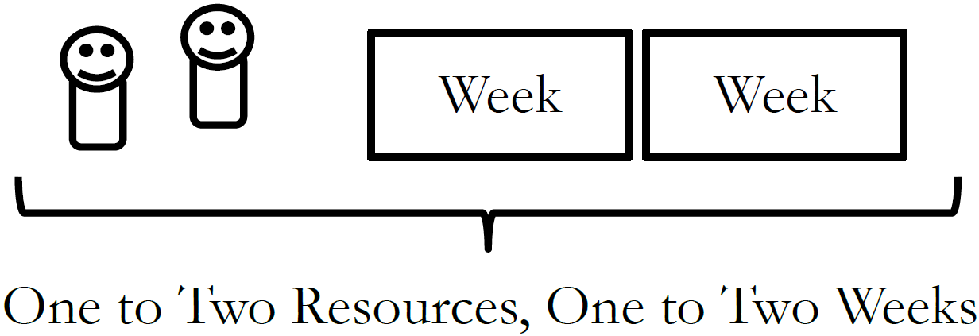
The One-to-Two Rule
How do you know when you’ve divided tasks into small enough ‘chunks’?
If tasks are too large, it becomes difficult to track progress
If tasks are too small, time is wasted micromanaging the project
Optimize with ‘The One-to-Two Rule,’
which states that tasks have been
divided enough when each requires
1-2 resources 1-2 weeks to complete it
Diagram: Malachowsky, Samuel. Project Team Leadership and Communication. Lintwood Press. 2018.
Notes:
Corresponds to page 83 of the Project Team Leadership and Communication book.

Slide 4
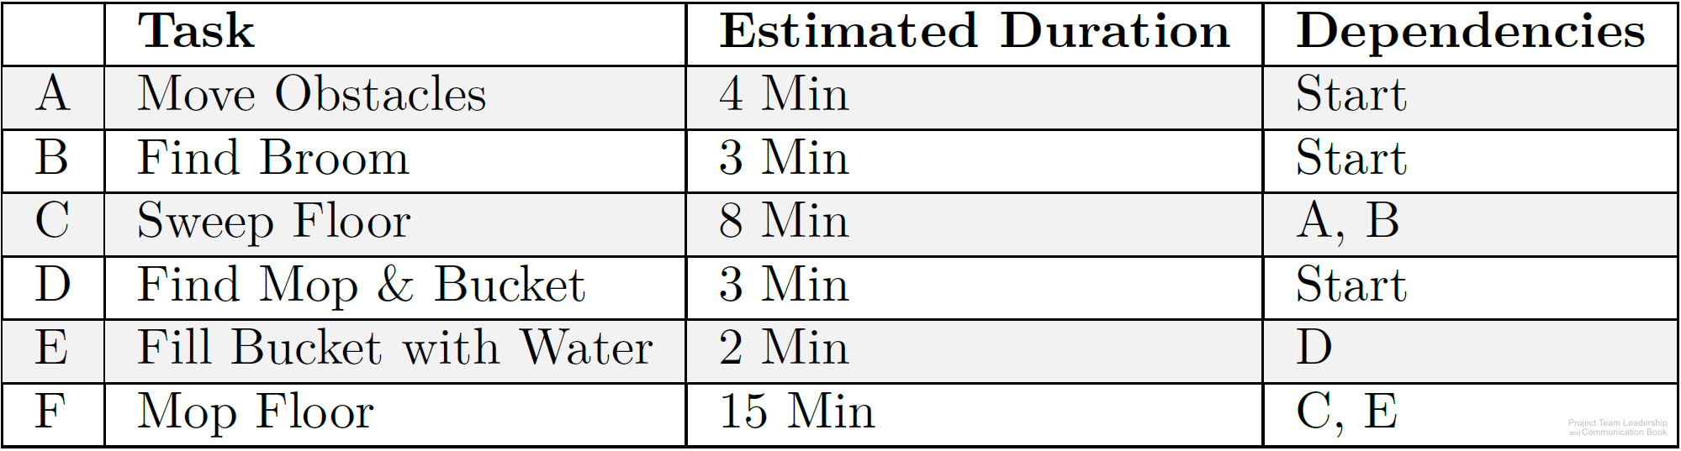
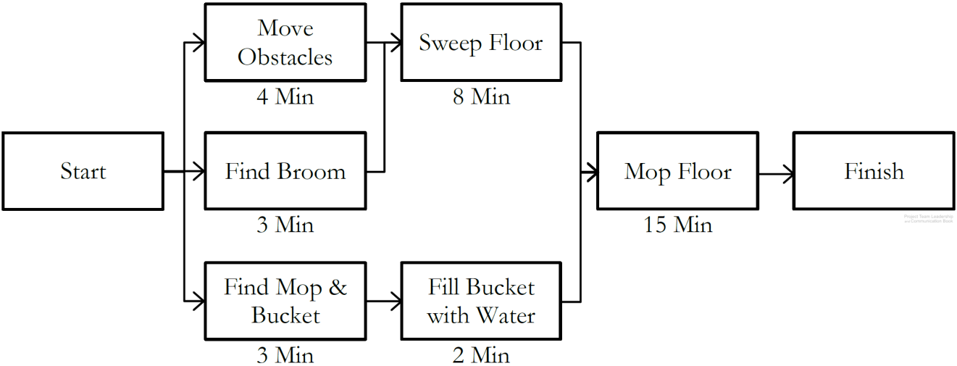
Sequencing and Scheduling Tasks
Predecessors or dependencies are determined for all tasks
Using this information, a precedence diagram is created
  The longest path, called the critical path, determines project length
  Slack time, the ability to delay starting without impacting the schedule, is available to some tasks which are not on the critical path
Tasks are then ‘calandarized,’ with actual dates based on resources available
Diagrams: Malachowsky, Samuel. Project Team Leadership and Communication. Lintwood Press. 2018. p. 89, 90.
Notes:
Corresponds to pages 89-90 of the Project Team Leadership and Communication book.
Exercise #6 on page 109 has another list of tasks, which could be the basis for a whiteboard classroom activity (create a precedence diagram, find the critical path, find the slack time of individual tasks)
Critical path: Start -> “Move Obstacles” -> “Sweep Floor” -> “Mop Floor” -> Finish
“Find Broom” has a slack time of 1 minute and is not on the critical path
“Sweep Floor” has a slack time of 0 minutes because it’s on the critical path

Slide 5
Activity – Organizing and Sequencing Tasks
Consider the following scenario:
One of your best friends is graduating from college and you’ve decided to throw her a big party. Her parents have volunteered to let you decorate and hold the event at their house, the food is to be catered, and you would like to invite as many of her friends and family as you can.
Create a basic work breakdown structure, listing 15 planning activities that must take place
After determining which activities must occur before others, create a precedence diagram with the activities and tasks outlined in your work breakdown structure
Notes:
Corresponds to section 3.5, pages 88-90 of the Project Team Leadership and Communication book. Methods of estimating imprecisely can be found on page 87.
15 minute activity
Can be instructor-lead (instructor creates work breakdown structure and precedence diagram via class input).

Slide 6
Questions / Discussion
Notes:
Chapter 3 includes several additional support elements which could become classroom activities or discussion elements.
There are quite a few key terms defined on pages 107-108.
Review questions cover most of the chapter (page 108, answers on page 223).
The exercises on pages 109-110 are designed to allow readers to apply and extend what they’ve learned.

