Slide 1
Mini-Module:
Tracking & Visualizing Progress
Designed for chapter 3, section 3.6, pages 94-97 of Project Team Leadership and Communication by Samuel Malachowsky, ISBN 9781732378902, 9781732378919.
Notes:
Corresponds to chapter 3, section 3.6, pages 94-97 of the Project Team Leadership and Communication book. ISBN: 9781732378902 (Softcover), 9781732378919 (Hardcover). These slides may only be posted or used in conjunction with the book in a training or classroom environment. Key terms (pages 107-108) are often italicized on the slides.
Objectives: Understand basic issues with project tracking, learn how to calculate earned value and basic scheduling/tracking visualization (10 minutes)
Activity: Tracking Project Progress (10 minutes, section 3.6)
Outline:
Tracking Progress
Tracking Earned Value
Scheduling/Tracking Tools and Visualizations
Activity – Tracking Project Progress

Slide 2
Tracking Progress
A main concern of project tracking is visibility. Often, the team isn’t aware of how far along they are due to long phases
Project Visibility is often only achieved when phases are started or completed
Diagram: Malachowsky, Samuel. Project Team Leadership and Communication. Lintwood Press. 2018. p. 94.
McConnell, Steve. Rapid Development: Taming Wild Software Schedules. Redmond, WA: Microsoft Press. p. 57. 1996.
Notes:
Corresponds to section 3.6, pages 94-97 of the Project Team Leadership and Communication book.

Slide 3
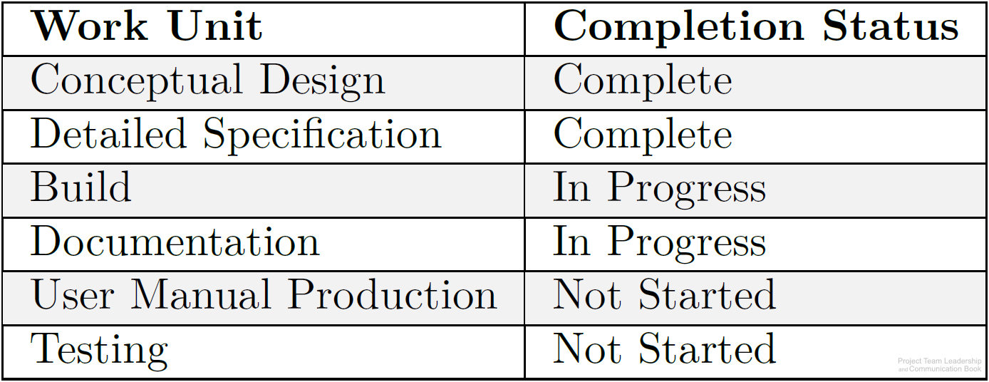
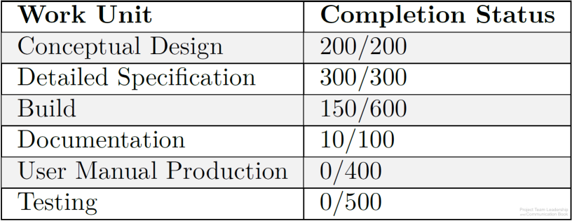
Tracking Earned Value
Tasks or groups of tasks are often tracked with little granularity (large chunks instead of small) and simple not-started / started / complete progress reporting
By giving each task a relative weight and assigning earned value to sub-tasks, the percentage of progress can be calculated (example: 660/2100=31% complete)
Calculated earned value can be compared to the time or resources expended
Diagrams: Malachowsky, Samuel. Project Team Leadership and Communication. Lintwood Press. 2018. p. 95.

Slide 4
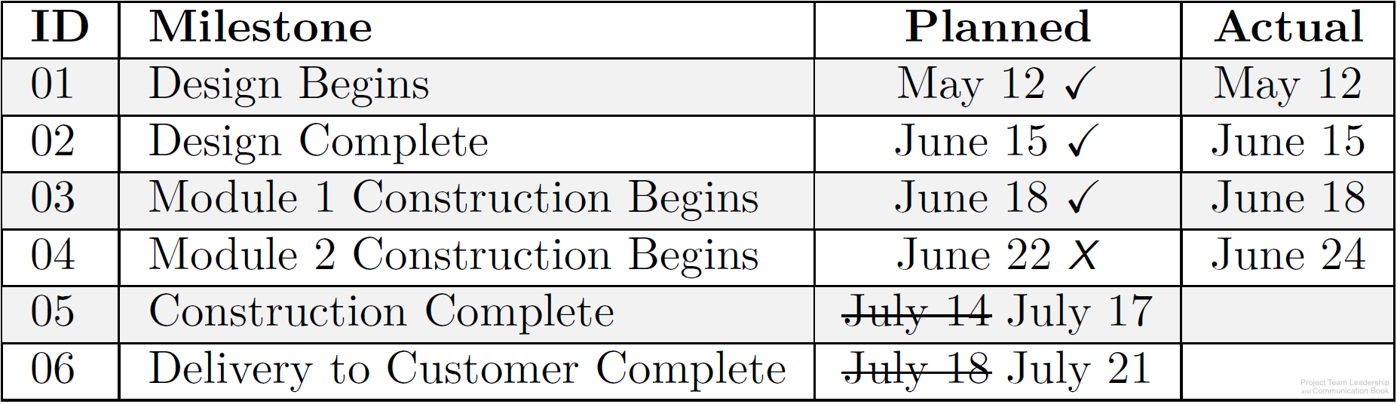
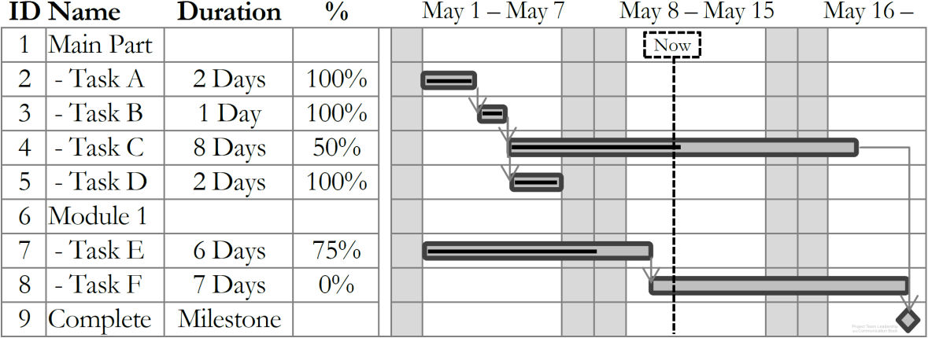
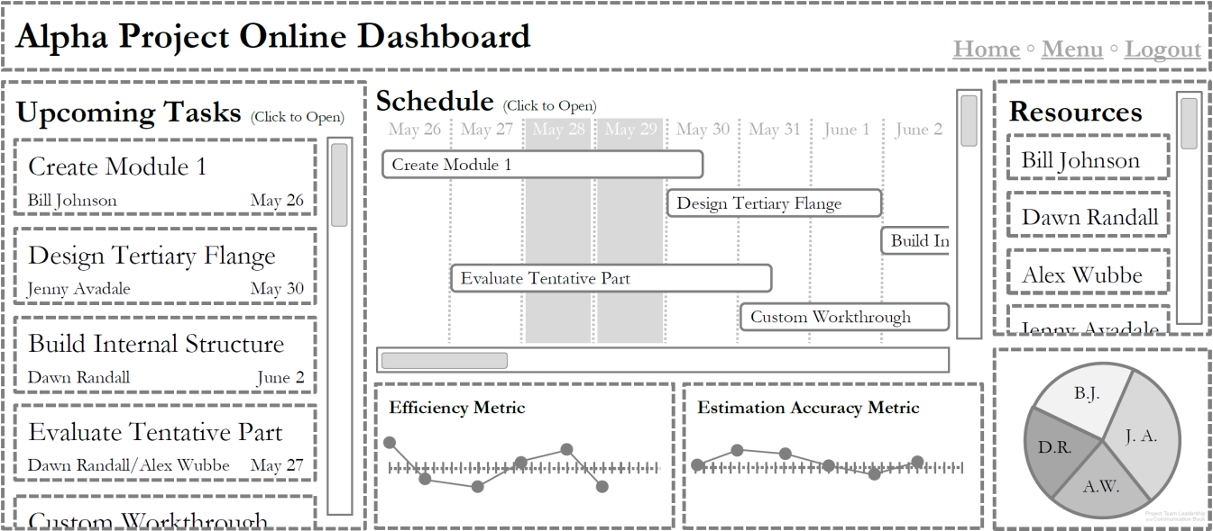
Scheduling/Tracking Tools and Visualizations
Milestone Charts list major points in time, or milestones, such as phases ending
Gantt Charts provide an easy-to-understand visualization of the schedule and progress
Many software packages and online tools are specifically designed for managing projects
Diagrams: Malachowsky, Samuel. Project Team Leadership and Communication. Lintwood Press. 2018. p. 92, 96.
Notes:
Corresponds to pages 90-92 and 96 of the Project Team Leadership and Communication book.
Microsoft Project is a commonly used software package which utilizes Gantt charts extensively.

Slide 5
Activity – Tracking Project Progress
Examine the following project status information:
In teams of 3-4:
Calculate the percentage complete, or earned value
Using a whiteboard or application, create a basic Gantt chart. Estimate the total time elapsed for the project
ID | Task | Units of Work | Units Complete | Days | Start Date
1 | Plow/cultivate soil | 15 | 15 | 5 | April 30
2 | Plant seeds | 25 | 25 | 8 | May 6
3 | Water, weed, and fertilize growing crops | 15 | 5 | 90 | May 15
4 | Initial harvest | 25 | 0 | 7 | August 20
5 | Water, weed, and fertilize growing crops | 5 | 0 | 21 | August 27
6 | Second harvest | 15 | 0 | 5 | September 20
Notes:
Corresponds to section 3.6, pages 94-97 of the Project Team Leadership and Communication book.
Earned value is 45 (45/100 = 45% complete with work). There are about 136 days in the project. Task ID 3 is about 33% complete, putting the current date as about June 14
10 minute activity

Slide 6
Questions / Discussion
Notes:
Chapter 3 includes several additional support elements which could become classroom activities or discussion elements.
There are quite a few key terms defined on pages 107-108.
Review questions cover most of the chapter (page 108, answers on page 223).
The exercises on pages 109-110 are designed to allow readers to apply and extend what they’ve learned.

