Slide 1
Mini-Module:
Team Development
Success Factors
Designed for chapter 4, sections 4.1, 4.3, and 4.4, pages 111-114 and 123-125 of Project Team Leadership and Communication by Samuel Malachowsky, ISBN 9781732378902, 9781732378919.
Notes:
Corresponds to chapter 4, sections 4.1, 4.3, and 4.4, pages 111-114 and 123-125 of the Project Team Leadership and Communication book. ISBN: 9781732378902 (Softcover), 9781732378919 (Hardcover). These slides may only be posted or used in conjunction with the book in a training or classroom environment. Key terms (pages 145-146) are often italicized on the slides.
Objectives: Introduce basic team development concepts such as success factors, development stages, and basic needs (10 minutes)
Activity: Which Stage of Development? (5 minutes)
Outline:
What Makes a Team Successful
Team Development Stages
Team Needs
Activity – Which Stage of Development?

Slide 2
What Makes a Team Successful
Successful teams include one or more ‘ingredients’:
  Complimentary skillsets
    Some overlap, but intentional, effective diversity of skills
  Common purpose and goals
    All team members are aware of why their project is important
  Good planning
    Plans are clearly laid-out ahead of time, and all team members can rely on each other to follow them
  Effective leadership
    Strong leaders that match the culture of the team and project
  Appropriate motivators
    Motivators that match the culture of the team as well as the individuals on it
  ‘Chemistry’
    Chemistry is hard to define, but you’ll know it when you see it
Notes:
Corresponds to section 4.1, pages 111-114 of the Project Team Leadership and Communication book.

Slide 3
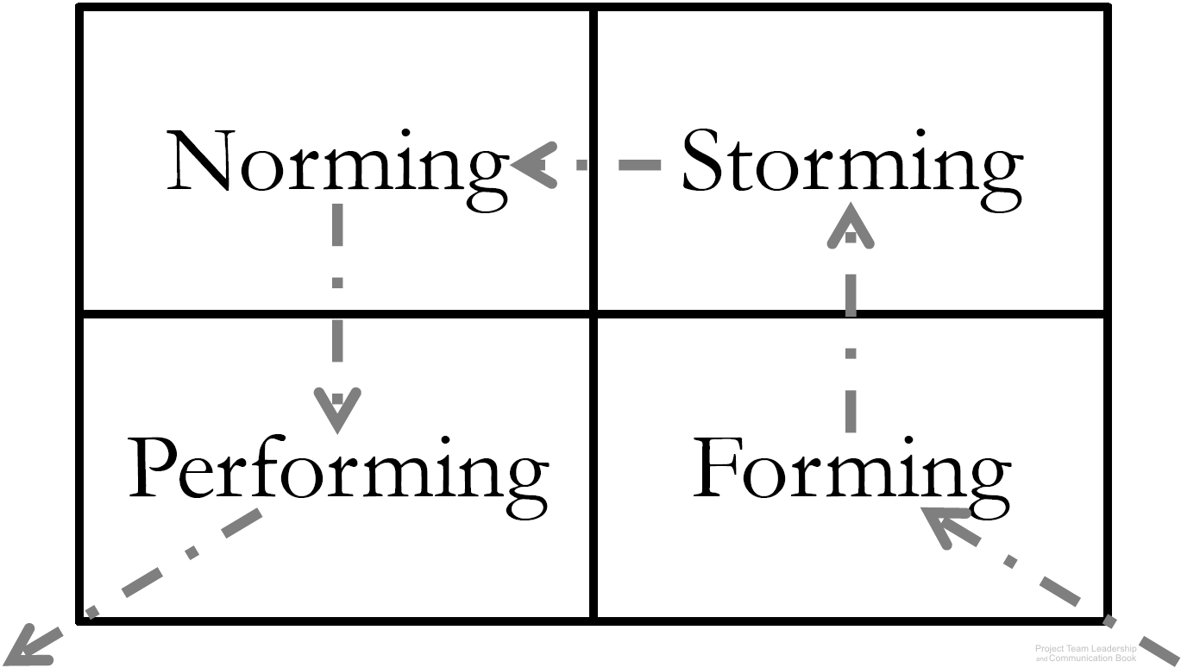
Team Development Stages
Dr. Bruce Tuckman articulates 4 stages which teams must
pass as they develop:
Forming – the team comes together, and the project gains
little benefit from the ‘team’ - productivity is similar to each
working independently
Storming – clashes and disagreements begin as the team tries to determine leadership and ‘rules’ for how they will work together. Productivity may drop
Norming – ‘storming’ is lessening and the ‘rules,’ or ‘norms’ for the group are rapidly developing. Productivity begins to increase, the group starts to identify as a team
Performing – The team reaches increasing efficiency, gaining the efficiencies of working together rather than separate. The team now focuses externally on the work at hand
Diagram: Malachowsky, Samuel. Project Team Leadership and Communication. Lintwood Press. 2018. p. 123.
Tuckman, Bruce. “Developmental sequence in small groups”. Psychological Bulletin. 63 (6). p. 384–99. 1965.
Notes:
Corresponds to section 4.3, pages 123-124 of the Project Team Leadership and Communication book.

Slide 4
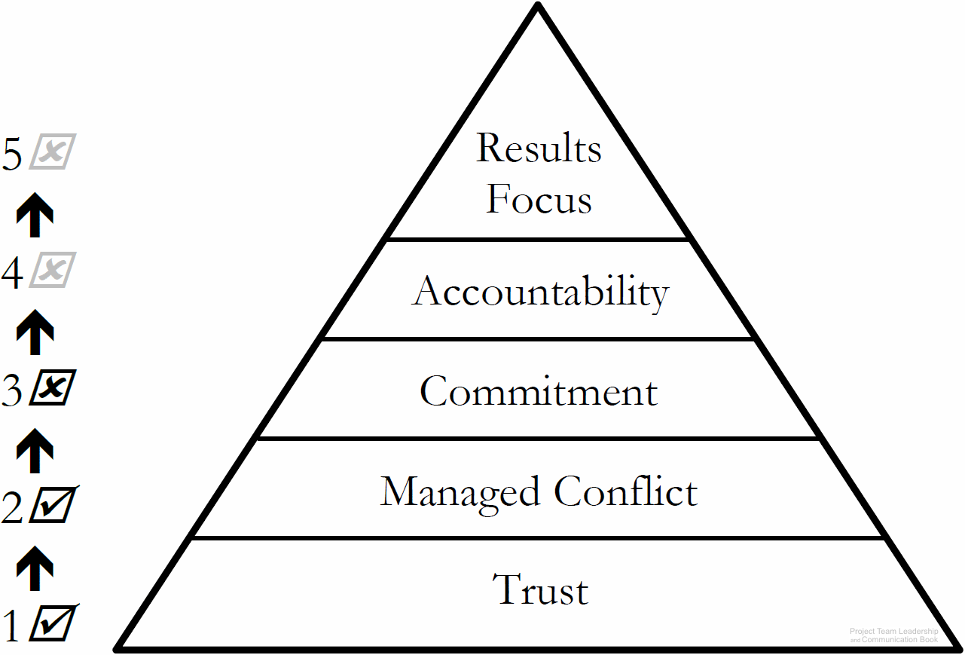
Team Needs
Similar to Maslow’s hierarchy of needs, teams have basic needs
  Needs at the bottom (such as trust) must be satisfied before those higher-up can be addressed
Diagram: Malachowsky, Samuel. Project Team Leadership and Communication. Lintwood Press. 2018. p. 124.
Lencioni, Patrick. The Five Dysfunctions of a Team: A Leadership Fable. San Francisco: Jossey-Bass. 2002.
Notes:
Corresponds to section 4.4, pages 124-125 of the Project Team Leadership and Communication book.
These are covered in more detail in the following Mini-Modules:
(#19) Managing Conflict (section 4.6)
(#20) Building Team Trust and Commitment (section 4.5, 4.7)
(#21) Building Accountability and Focusing on Results (sections 4.8 and 4.9)

Slide 5
Activity – Which Stage of Development?
Which of the following team development stages to the teams on the right seem to be experiencing?
Forming
Storming
Norming
Performing
There is quite a bit of conflict happening and team members seem unsure if the group will ever be effective
The team members seem courteous, but are acting as separate individuals working independently
The team feels a shared sense of purpose and identity, and outsiders recognize their ability to get things done
Most conflict has subsided and many of the ‘rules’ seem to be in place
The project seems to be benefitting from the efficiencies of team members working together
Some team members are dominating the ‘conversation’ and others are afraid to speak up
Tuckman, Bruce. “Developmental sequence in small groups”. Psychological Bulletin. 63 (6). p. 384–99. 1965.
Notes:
Corresponds to section 4.3, pages 123-124 of the Project Team Leadership and Communication book.
5 Minute activity
Can be a basic, instructor-lead reinforcement activity
Answers:
Storming
Forming
Performing
Norming
Performing
Storming

Slide 6
Questions / Discussion
Notes:
Chapter 4 includes several additional support elements which could become classroom activities or discussion elements.
There are quite a few key terms defined on pages 145-146.
Review questions cover most of the chapter (pages 146-147, answers on page 223).
The exercises on pages 147-148 are designed to allow readers to apply and extend what they’ve learned.

