Slide 1
Mini-Module:
Team Structure and Roles
Designed for chapter 4, section 4.2, pages 114-122 of Project Team Leadership and Communication by Samuel Malachowsky, ISBN 9781732378902, 9781732378919.
Notes:
Corresponds to chapter 4, section 4.2, pages 114-122 of the Project Team Leadership and Communication book. ISBN: 9781732378902 (Softcover), 9781732378919 (Hardcover). These slides may only be posted or used in conjunction with the book in a training or classroom environment. Key terms (pages 145-146) are often italicized on the slides.
Objectives: Learn 4 common team structures and 5 common team member roles (10 minutes)
Activity: Team Structures (5 minutes)
Outline:
Common Team Structures (2 slides)
Common Team Roles
Activity – Team Structures

Slide 2
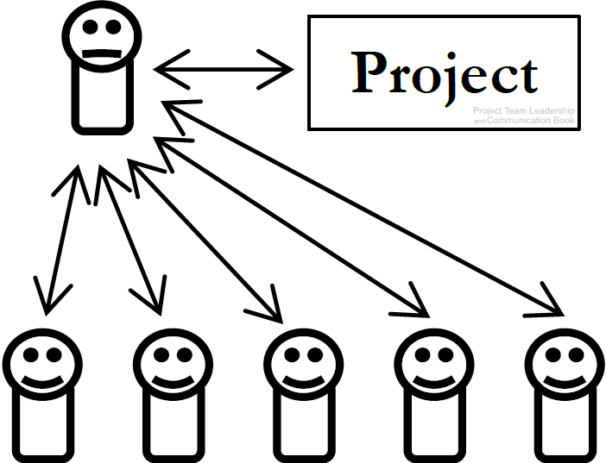
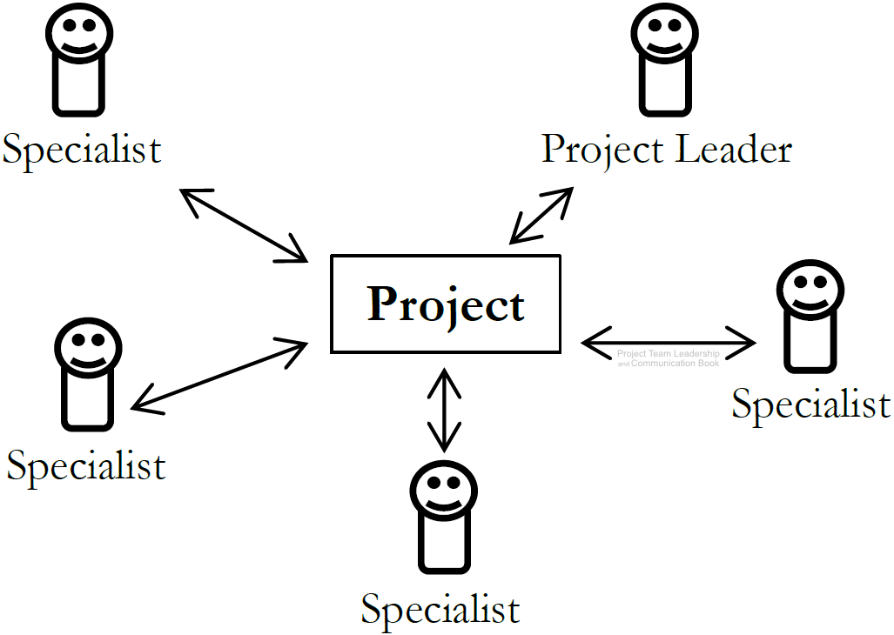
Common Team Structures (1 of 2)
Top-Down Teams
‘Classic’ team structure
Team members’ attachment is to the ‘boss’, who is primarily responsible for the success of the project (and can be singularly responsible for its failure)
Not necessarily an authoritarian style of leadership
Interdisciplinary Teams
Characterized by equal status of each team member, who are each concerned with the success of the project
Each team member has one or more specialties/skillsets
Decisions are often made at the group level
Leader is an equal with organizational/communication skillsets
Diagrams: Malachowsky, Samuel. Project Team Leadership and Communication. Lintwood Press. 2018. p. 114, 115.
Notes:
Corresponds to pages 114-116 of the Project Team Leadership and Communication book.
Team structures are influenced by the organizational culture, processes, and industry (pages 118-119)

Slide 3
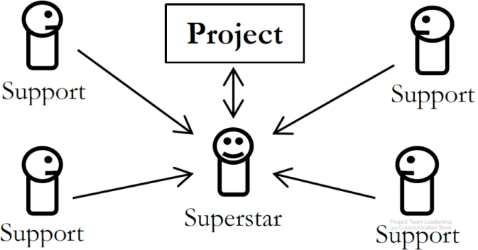
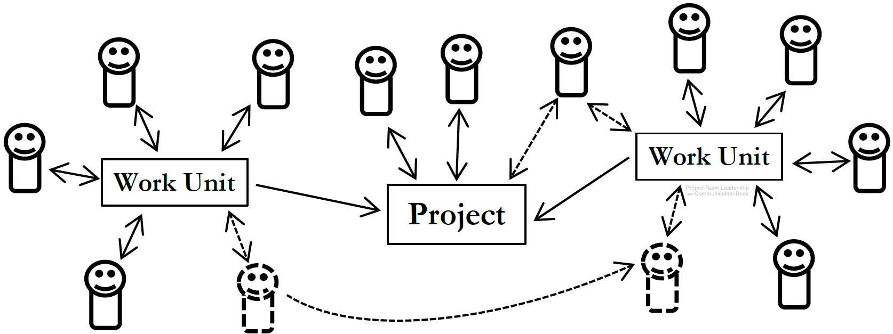
Common Team Structures (2 of 2)
Superstar-Support Teams
Like a surgical team: one member performs the most prominent work
Other team members perform supportive functions
‘Superstar’ must acknowledge importance of other team members
Large and Variable-Structure Teams
Teams can vary in size, structure, and stability
Difficult to organize and track efficiently
Moving or adding team members efficiently is also difficult
Diagrams: Malachowsky, Samuel. Project Team Leadership and Communication. Lintwood Press. 2018. p. 117.
Notes:
Corresponds to pages 116-118 of the Project Team Leadership and Communication book.

Slide 4
Common Team Roles
Leader – guides the team towards the goal
  Primary competencies: leadership, prioritization, and communication
Information Manager – takes ownership of the documentation and data
  Primary competencies: elicitation, organization, and reporting
Externally-Facing – intermediary between project team and external stakeholders
  Primary competencies: perception, communication, and negotiation
Problem-Solver – finds and works through difficult problems
  Primary competencies: evaluation, research, and implementation
Specialist – a ‘subject matter expert’ in one or more subject areas
  Primary competencies: evaluation, anticipation, and articulation
Notes:
Corresponds to pages 119-122 of the Project Team Leadership and Communication book.

Slide 5
Activity – Team Structures
For each of the descriptions on the right, which of the following team structures are the closest fit?
Top-down team
Interdisciplinary team
Superstar-support team
Large/variable-structure team
Decisions are typically made by the whole team
The leader is primarily accountable for project success
One individual performs most of the central tasks
‘Classic’ team with a traditional boss and subordinates
Can be difficult to know who’s on your team
Everyone must remember that each team member is needed for a successful project
Challenged by constantly shifting team members
Defined by consistent, mutual respect by all members
Requires appropriate planning, leadership, and communication to be successful
Tuckman, Bruce. “Developmental sequence in small groups”. Psychological Bulletin. 63 (6). p. 384–99. 1965.
Notes:
Corresponds to section 4.2, pages 114-122 of the Project Team Leadership and Communication book.
5 Minute activity
Can be a basic, instructor-lead reinforcement activity
Answers:
Interdisciplinary team
Top-down team
Superstar-support team
Top-down team
Large/variable-structure team
Superstar-support team
Large/variable-structure team
Interdisciplinary team
All types

Slide 6
Questions / Discussion
Notes:
Chapter 4 includes several additional support elements which could become classroom activities or discussion elements.
There are quite a few key terms defined on pages 145-146.
Review questions cover most of the chapter (pages 146-147, answers on page 223).
The exercises on pages 147-148 are designed to allow readers to apply and extend what they’ve learned.

