Slide 1
Mini-Module:
Leadership Styles
Designed for chapter 1, section 1.2, pages 2-5 of Project Team Leadership and Communication by Samuel Malachowsky, ISBN 9781732378902, 9781732378919.
Notes:
Corresponds to chapter 1, section 1.2, pages 2-5, of the Project Team Leadership and Communication book. ISBN: 9781732378902 (Softcover), 9781732378919 (Hardcover). These slides may only be posted or used in conjunction with the book in a training or classroom environment. Key terms (page 21) are often italicized on the slides.
Learning Objectives:
Describe 7 basic leadership styles
Recognize the importance of choosing an appropriate style
Identify common pitfalls related to appropriate leadership styles
Activity: Recommend basic leadership styles for basic team scenarios
Activity: Applying leadership styles (5 minutes)
Outline: (slides: 10 minutes, activity: 5 minutes)
Leadership Styles
Affiliative
Authoritarian / Commanding / Autocratic
Coaching
Democratic
Laissez-faire
Pacesetting
Transformational / Visionary
Activity – Applying Leadership Styles

Slide 2
Leadership Styles
Leadership style should be chosen based on the team’s features, what they are trying to achieve, and the individuals
Leaders have a ‘default’ style they prefer
  This may not be appropriate for their team
  Stress or circumstances can cause leaders to choose or revert to the wrong style
There are dozens (7 main styles covered here)
Goleman, Daniel. Primal Leadership: Realizing the Power of Emotional Intelligence. Boston, Mass. :Harvard Business School Press, 2002.
Notes:
Corresponds to section 1.2, pages 2-5 of the Project Team Leadership and Communication book.
The next 7 slides are the styles:
Affiliative
Authoritarian / Commanding / Autocratic
Coaching
Democratic
Laissez-faire
Pacesetting
Transformational / Visionary

Slide 3
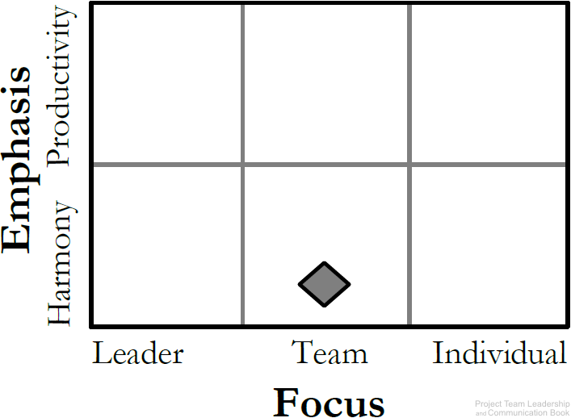
Affiliative Leadership Style
Emphasizes connection, harmony, and conflict resolution
Good for ‘hurting’ teams in need of a morale boost
Can be abused
Works best in combination with others
Diagram: Malachowsky, Samuel. Project Team Leadership and Communication. Lintwood Press. 2018. p. 3.
Goleman, Daniel. Primal Leadership: Realizing the Power of Emotional Intelligence. Boston, Mass. :Harvard Business School Press, 2002.
Notes:
Corresponds to page 3 of the Project Team Leadership and Communication book.
Emphasis is either on harmony or productivity, focus is on the leader, team, or individual.
The Affiliative Leadership Style emphasizes harmony and focuses on the team.

Slide 4
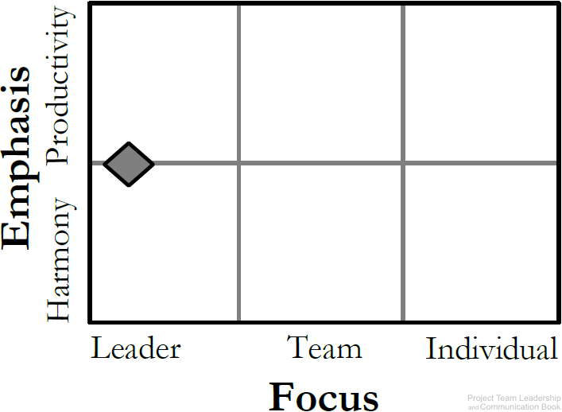
Authoritarian / Commanding / Autocratic Leadership Style
‘Classic’ leadership structure
Strong, dominating leader(s)
Can cause poor morale if teams aren’t used to it
Good for emergencies/crisis situations
Diagram: Malachowsky, Samuel. Project Team Leadership and Communication. Lintwood Press. 2018. p. 3.
Goleman, Daniel. Primal Leadership: Realizing the Power of Emotional Intelligence. Boston, Mass. :Harvard Business School Press, 2002.
Notes:
Corresponds to page 3 of the Project Team Leadership and Communication book.
Emphasis is either on harmony or productivity, focus is on the leader, team, or individual.
The Authoritarian / Commanding / Autocratic Leadership Style focuses heavily on the leader.

Slide 5
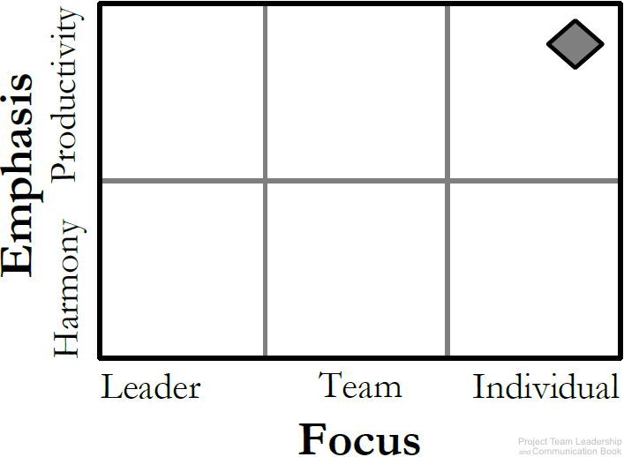
Coaching Leadership Style
About connecting the goals of the team/project with individuals
Best for teams who have the desire to succeed and are motivated
Can lead to micromanagement
Diagram: Malachowsky, Samuel. Project Team Leadership and Communication. Lintwood Press. 2018. p. 3.
Goleman, Daniel. Primal Leadership: Realizing the Power of Emotional Intelligence. Boston, Mass. :Harvard Business School Press, 2002.
Notes:
Corresponds to page 3 of the Project Team Leadership and Communication book.
Emphasis is either on harmony or productivity, focus is on the leader, team, or individual.
The Coaching Leadership Style emphasizes productivity and focuses on the individuals.

Slide 6
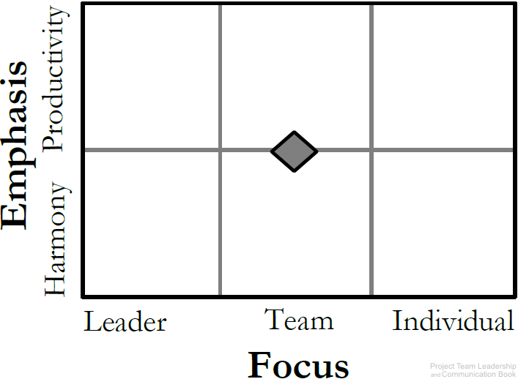
Democratic Leadership Style
Relies on the skills and knowledge of team members
Group makes decisions collectively
Can be time consuming and difficult for indecisive teams
Diagram: Malachowsky, Samuel. Project Team Leadership and Communication. Lintwood Press. 2018. p. 3.
Goleman, Daniel. Primal Leadership: Realizing the Power of Emotional Intelligence. Boston, Mass. :Harvard Business School Press, 2002.
Notes:
Corresponds to page 3 of the Project Team Leadership and Communication book.
Emphasis is either on harmony or productivity, focus is on the leader, team, or individual.
The Democratic Leadership Style focuses heavily on the team.

Slide 7
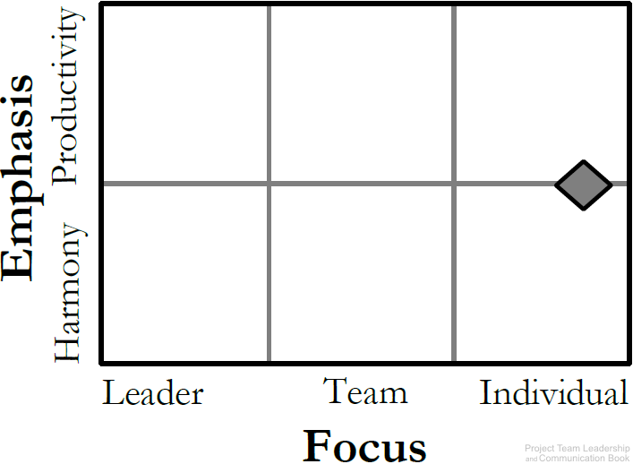
Laissez-faire Leadership Style
The ‘hands-off’ approach
Management trusts the team members to make decisions and meaningful progress
Leaders support rather than control
Requires self-motivated, hard-working, honest team members
Diagram: Malachowsky, Samuel. Project Team Leadership and Communication. Lintwood Press. 2018. p. 4.
Goleman, Daniel. Primal Leadership: Realizing the Power of Emotional Intelligence. Boston, Mass. :Harvard Business School Press, 2002.
Notes:
Corresponds to page 4 of the Project Team Leadership and Communication book.
Emphasis is either on harmony or productivity, focus is on the leader, team, or individual.
The Laissez-faire Leadership Style focuses heavily on the individual.

Slide 8
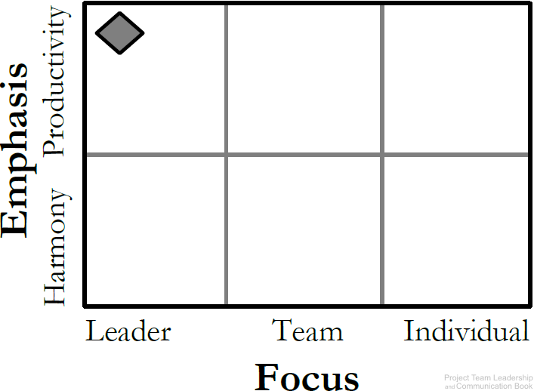
Pacesetting Leadership Style
This is ‘lead by example’
Leader is highly focused on performance and expects the same of the team
Works best with teams that already perform at a high level
Team members can feel as they’ll never ‘measure up,’ lowering moralle
Diagram: Malachowsky, Samuel. Project Team Leadership and Communication. Lintwood Press. 2018. p. 4.
Goleman, Daniel. Primal Leadership: Realizing the Power of Emotional Intelligence. Boston, Mass. :Harvard Business School Press, 2002.
Notes:
Corresponds to page 4 of the Project Team Leadership and Communication book.
Emphasis is either on harmony or productivity, focus is on the leader, team, or individual.
The Pacesetting Leadership Style emphasizes productivity and focuses on the leader.

Slide 9
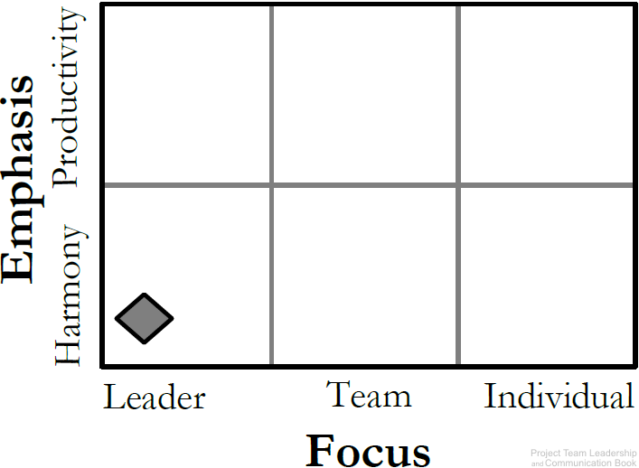
Transformational / Visionary Leadership Style
The leader focuses on setting a positive vision for the future
Team members are infused with a sense of purpose and excitement
Good for teams that have recently experienced failure
Can become unrealistic and overly optimistic
Diagram: Malachowsky, Samuel. Project Team Leadership and Communication. Lintwood Press. 2018. p. 4.
Goleman, Daniel. Primal Leadership: Realizing the Power of Emotional Intelligence. Boston, Mass. :Harvard Business School Press, 2002.
Notes:
Corresponds to page 3 of the Project Team Leadership and Communication book.
Emphasis is either on harmony or productivity, focus is on the leader, team, or individual.
The Transformational / Visionary Leadership Style emphasizes harmony and focuses on the leader.

Slide 10
Activity – Applying Leadership Styles
For each of the following situations, which leadership style or styles might be appropriate?
A team has recently suffered a rather demoralizing project failure
Having worked together many times in the past, a team has very competent members with varied skillsets
A team considers themselves to be high-performance, and morale is at its highest when they’re achieving at that level
A group of equals, the team loves the empowerment of making their own decisions
Individuals on the team are interested in growing in their expertise – it’s expected that as individuals improve, the team will improve
A recent crisis and some disagreement within their ranks means has created a situation where someone needs to ‘take control’ in order to meet their objectives
Notes:
Corresponds to section 1.2, pages 2-5 of the Project Team Leadership and Communication book. Uses resources from the entirety of chapter 1.
5-minute activity
Learning Objective: Recommend basic leadership styles for basic team scenarios
Possible answers (may be different based on the participant’s viewpoints or assumptions:
Affiliative or Transformational / Visionary
Laissez-faire
Pacesetting
Democratic or Laissez-faire
Coaching
Authoritarian / Commanding / Autocratic

Slide 11
Questions / Discussion
Notes:
Chapter 1 includes several additional support elements which could become classroom activities or discussion elements.
The chapter tool, entitled Chapter Tool: Who We Are as Leaders (section 1.8, pages 17-20) is designed to help readers explore their own motivators, influencers, and stakeholder experiences. Students could rate the accuracy of the test with their own perceptions, compare results, and have discussions about each element.
There are several key terms defined on page 21.
Review questions cover most of the chapter (pages 21-22, answers on page 223).
The exercises on page 22 are designed to allow readers to apply and extend what they’ve learned.

