Slide 1
Mini-Module:
Building Accountability and Focusing on Results
Designed for chapter 4, sections 4.8 and 4.9, pages 135-140 of Project Team Leadership and Communication by Samuel Malachowsky, ISBN 9781732378902, 9781732378919.
Notes:
Corresponds to chapter 4, sections 4.8 and 4.9, pages 135-140 of the Project Team Leadership and Communication book. ISBN: 9781732378902 (Softcover), 9781732378919 (Hardcover). These slides may only be posted or used in conjunction with the book in a training or classroom environment. Key terms (pages 145-146) are often italicized on the slides.
Objectives: Understand the basic team needs of embracing accountability and focusing on results, and learn/use a basic team accountability tool (10 minutes)
Activity: Building a ‘RASCI’ Accountability Matrix (10 minutes)
Outline:
Embracing Accountability
The ‘RASCI’ Accountability Matrix
Focusing on Results
Activity – Building a ‘RASCI’ Accountability Matrix

Slide 2

Embracing Accountability
Accountability is a readiness to accept responsibility for work or results
Each team member is accountable to:
  The leader – the most common and natural type of accountability
  Themselves – also known as self-discipline
  Their fellow team members – often the strongest with the most ‘paths’ of accountability
Accountability requires the ability to commit, as well as other’s ability to trust their word and actions
A great tool is the ‘RASCI” accountability matrix
Diagram: Malachowsky, Samuel. Project Team Leadership and Communication. Lintwood Press. 2018. p. 135.
Lencioni, Patrick. The Five Dysfunctions of a Team: A Leadership Fable. San Francisco: Jossey-Bass. 2002.
Notes:
Corresponds to section 4.7, pages 130-134 of the Project Team Leadership and Communication book.
The ‘RASCI” accountability matrix is detailed on the next slide

Slide 3
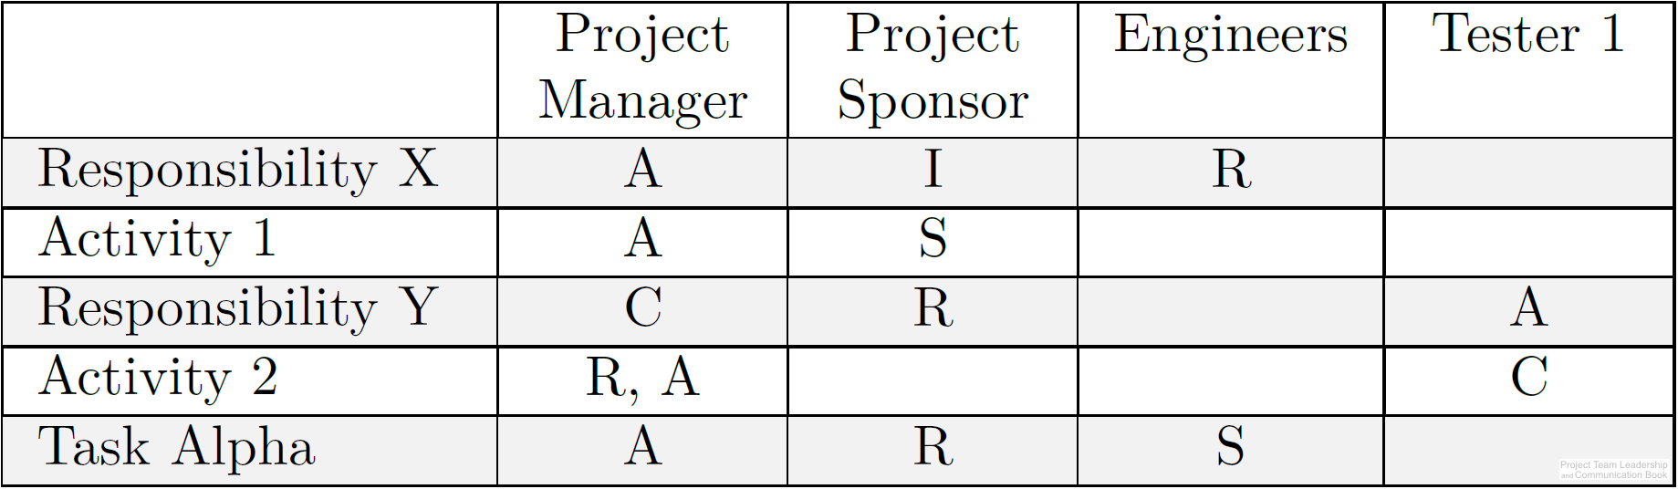
The ‘RASCI’ Accountability Matrix
An accountability matrix is a tool for effectively assigning and communicating levels of accountability for project tasks of functions
Each task or function must have at least
one “A” as well as other letters:
  “R” – Responsible. The party who is to
  complete the task or action
  “A” – Accountable. This party is ultimately
  answerable for the task or action’s completion
  “S” – Support. Similar to “R” but a secondary resource who may be called in if needed
  “C” – Consulted. A specialist or expert who may be called upon to provide vital input
  “I” – Informed. This party must be informed if the task/function is completed, behind schedule. Often the party who completes dependent tasks later in the timeline.
Diagram: Malachowsky, Samuel. Project Team Leadership and Communication. Lintwood Press. 2018. p. 137.
Notes:
Corresponds to pages 136-138 of the Project Team Leadership and Communication book.

Slide 4

Focusing on Results
A results-focused team has solved issues related to trust, conflict, and commitment – it’s ready and willing to focus on the work at hand
Leadership and the team have new focuses:
  Clarity and priority – because the team working so well, it’s important that each team member knows what they’re working towards
  Visibility – understanding the bigger picture is more valuable for a team that is making decisions quickly and effectively
  Process – creating and documenting process can make the team even more efficient
Diagram: Malachowsky, Samuel. Project Team Leadership and Communication. Lintwood Press. 2018. p. 138.
Lencioni, Patrick. The Five Dysfunctions of a Team: A Leadership Fable. San Francisco: Jossey-Bass. 2002.
Notes:
Corresponds to section 4.7, pages 130-134 of the Project Team Leadership and Communication book.
The ‘RASCI” accountability matrix is detailed on the next slide

Slide 5
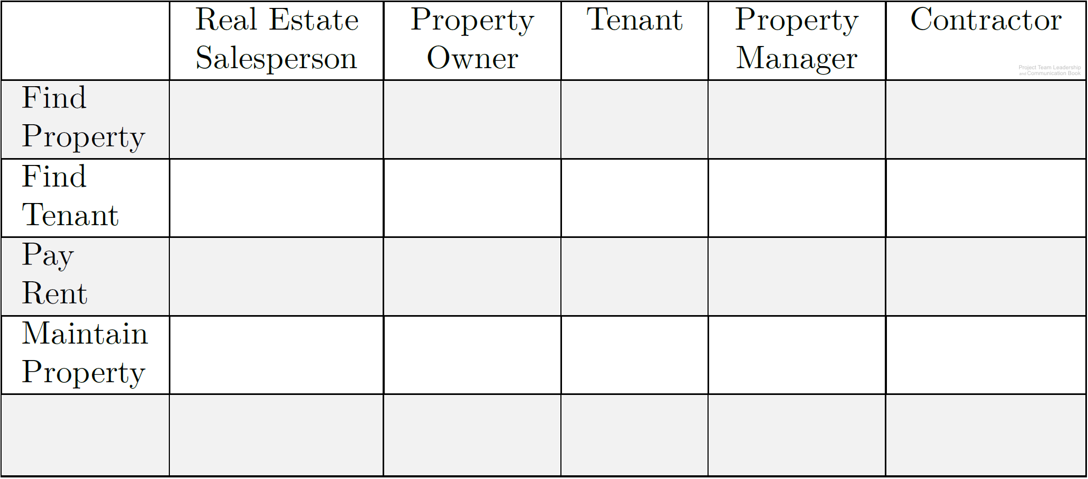
Activity – Building a ‘RASCI’ Accountability Matrix
In teams of 3-4:
Using the grid below, add the letters “R,” “A,” “S,” “C,” or “I” to denote the typical level of accountability each person has to each task.
Add at least two new tasks and add the letters as appropriate.
Diagram: Malachowsky, Samuel. Project Team Leadership and Communication. Lintwood Press. 2018. p. 138.
Notes:
Corresponds to section 4.8, pages 135-138 of the Project Team Leadership and Communication book.
This activity is based on the activity listed on pages 137-138.
10 minute activity

Slide 6
Questions / Discussion
Notes:
Chapter 4 includes several additional support elements which could become classroom activities or discussion elements.
There are quite a few key terms defined on pages 145-146.
Review questions cover most of the chapter (pages 146-147, answers on page 223).
The exercises on pages 147-148 are designed to allow readers to apply and extend what they’ve learned.

