Slide 1
Mini-Module: Basic Communication Concepts
Designed for chapter 5, sections 5.1, 5.2, and 5.3, pages 149-158 of Project Team Leadership and Communication by Samuel Malachowsky, ISBN 9781732378902, 9781732378919.
Notes:
Corresponds to chapter 5, sections 5.1, 5.2, and 5.3, pages 149-158 of the Project Team Leadership and Communication book. ISBN: 9781732378902 (Softcover), 9781732378919 (Hardcover). These slides may only be posted or used in conjunction with the book in a training or classroom environment. Key terms (pages 145-146) are often italicized on the slides.
Objectives: Objectives: Complete an overview of communication as it relates to project teams and communication. Introduces the concept of Hybrid Communication. Does not replace a communication general-education class (10 minutes)
Activity: Detecting Communication Blockers (5 minutes)
Outline:
Project Communication
Channels of Communication
Communication Concepts
Push / Pull / Hybrid Communication
Activity – Detecting Communication Blockers

Slide 2
Project Communication
Important because:
Stakeholders affect projects whether you communicate or not
Because of technology, customers expect more interaction
Team members
  Leadership and motivation factors can have a huge effect on the project
  Often are split between multiple projects
Interactive communication is considered ideal (each party is able to respond, ask for clarification, etc.)
  This often is impossible or impractical, so one-way communication is used
Notes:
Corresponds to pages 149-150 of the Project Team Leadership and Communication book.

Slide 3
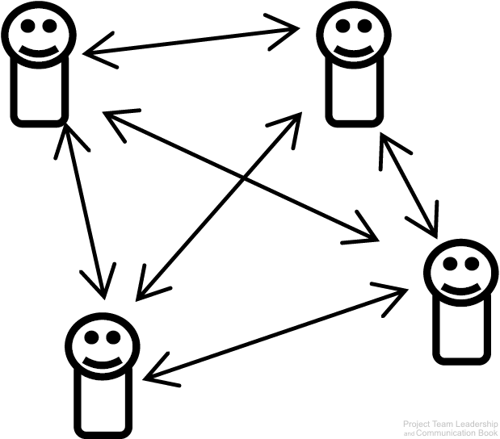
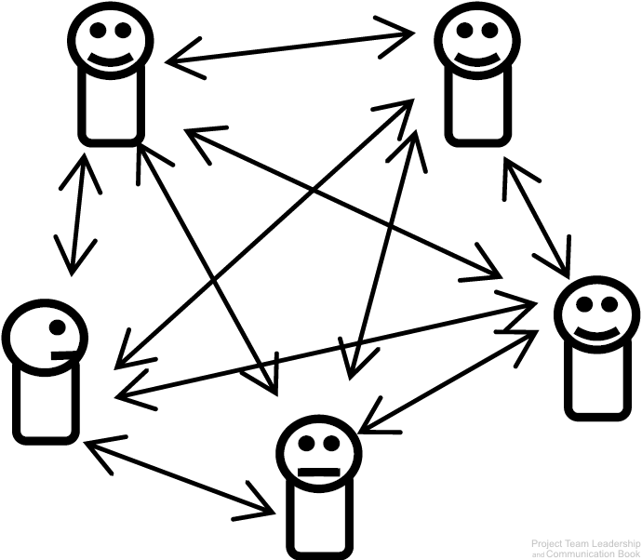
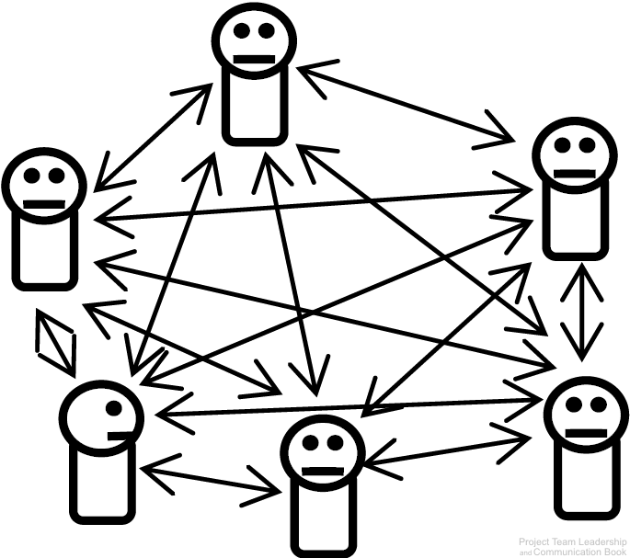
Channels of Communication
A communication channel is the path through which a communication must travel
Leaders and team members must maintain channels of communication with each other
As the number of team members increase, the number of channels increases much quicker
6 Channels
10 Channels
15 Channels
Diagrams: Malachowsky, Samuel. Project Team Leadership and Communication. Lintwood Press. 2018. p. 151.
Notes:
Corresponds to pages 150-152 of the Project Team Leadership and Communication book.

Slide 4
Communication Concepts
There are dozens of communication channels available at any given time:
Additionally there are types or categories of communication:
And there are potential blockers to communication efforts:
Face-to-Face
Message Boards
Social Media
Multi-Channel
Online Video Posts
Text Messages
Email
Video Conference
Postal Mail
Television
Print Media
Photo Sharing
Instant Messages
Written Notes
Advertisement
Telephone
Blogs
and many more
Internal / External
Formal / Informal
Vertical / Horizontal
Written / Oral
Verbal / Nonverbal / Paralingual
Language and Culture
Interruptions
Technical Issues
Distractions such as fatigue
Negativity or hostility
Context known by only one party
Incorrect assumptions
Receiver not actively listening
Malachowsky, Samuel. Project Team Leadership and Communication. Lintwood Press. 2018. p. 152.
Notes:
Corresponds to pages 152-153 of the Project Team Leadership and Communication book.
Blockers: Some of these are more obvious/detectable than others
Conclusion: communication is complicated and requires planning and constant attention

Slide 5
Push / Pull / Hybrid Communication
Interactive Communication is ideal, but not always available or practical
Push/Pull Communication share a weakness: Sender is only sure it was sent, not if it was received or understood
  Push Communication is one-way communication sent to one or more recipients
    Email, radio broadcasts, and postal main are common examples
  Pull Communication allows the recipient(s) to receive the communication at will
    Websites and bulletin boards are common examples
Hybrid Communication combines push and pull communication, capturing the strengths of both
  Sending an email which includes a link to a website or file storage area is a common example
  By pushing the communication which includes the ability for the recipient to pull in the future, the sender increases the chance that the recipient(s) will receive the message
Notes:
Corresponds to section 5.3, pages 150-152 of the Project Team Leadership and Communication book.

Slide 6
Activity – Detecting Communication Blockers
Consider each of the following communication channels:
For each, which communication blockers are most likely to go undetected? Which would be the most obvious?
Face-to-Face
Social Media
Text Messages
Email
Video Conference
Postal Mail
Instant Messages
Telephone
Language and Culture
Interruptions
Technical Issues
Distractions such as fatigue
Negativity or hostility
Context known by only one party
Incorrect assumptions
Notes:
Corresponds to section 5.2, pages 150-155 of the Project Team Leadership and Communication book.
5 Minute activity
Can be a basic, instructor-lead reinforcement activity

Slide 7
Questions / Discussion
Notes:
Chapter 5 includes several additional support elements which could become classroom activities or discussion elements.
There are quite a few key terms defined on page 176.
Review questions cover most of the chapter (page 177, answers on page 223).
The exercises on pages 177-178 are designed to allow readers to apply and extend what they’ve learned.

