Slide 1
Mini-Module:
Metrics and Reports
Designed for chapter 5, sections 5.6 and 5.8, pages 164-170 and 173-174 of Project Team Leadership and Communication by Samuel Malachowsky, ISBN 9781732378902, 9781732378919.
Notes:
Corresponds to chapter 5, sections 5.6 and 5.8, pages 164-170 and 173-174 of the Project Team Leadership and Communication book. ISBN: 9781732378902 (Softcover), 9781732378919 (Hardcover). These slides may only be posted or used in conjunction with the book in a training or classroom environment. Key terms (page 176) are often italicized on the slides.
Learning Objectives:
Define ‘metrics’ and their 2 main categories
Describe multiple factors to consider when communicating metrics or reports
Relate 6 basic project metrics
Describe 5 project reports
Activity: Classify project metrics and reports by fulfilled need
Activity: Activity – Choosing a Metric or Report (5 minutes)
Outline: (10 minutes)
Communicating Metrics and Reports
Example Project Metrics (2 Slides)
Cycletime
Schedule or Cost Variance
Resource Utilication
Requirements / Specifications Volitility
Total Risk Exposure
Customer Satisfaction
Example Project Reports (3 Slides)
Status Reports
Trend / Forecasting Reports
Variance Reports
Earned Value Reports
Lessons Learned Reports
Activity – Ethical Communication

Slide 2
Communicating Metrics and Reports
Metrics are a useful quantitative representation of a project attribute, which help leaders or team members make decisions about the project
  Private metrics are known only to the team and risk misinterpretation if shared
  Public metrics are designed to be shared outside the team for comparison across projects
Reports are more complex representations of the project designed to be communicated to stakeholders and typically contain multiple metrics
Making metrics and reports useful requires attention to several aspects
  Level of detail as well as ethical and appropriate interpretation for stakeholders
  Choosing an appropriate communication channel
  Considering the role of the recipient, as well as their preferences
  An appropriate understanding of what the information is ultimately going to be used for
Notes:
Corresponds to section 5.6, pages 164-165 of the Project Team Leadership and Communication book.

Slide 3
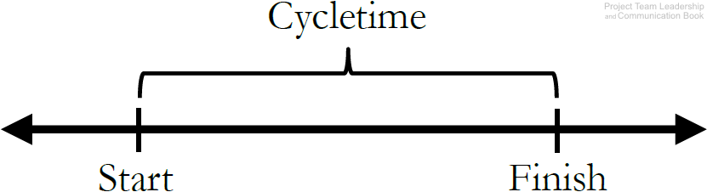
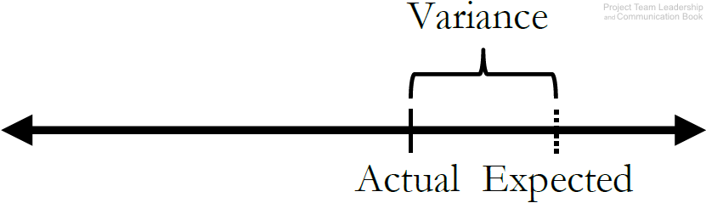
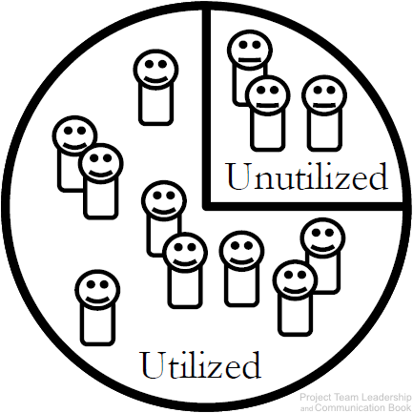
Example Project Metrics (1 of 2)
Cycletime measures the average amount of time it takes to complete a cycle. Defining a ‘cycle’ is up to the team – it can be a single phase or the entire project.
Schedule or Cost Variance demonstrates how far the expected value (baseline) is from the actual value. Related to a project’s Earned Value.
Resource Utilization tracks how effectively of the team’s available work hours are being utilized. A percentage significantly below 100% may indicate wasted time, and over 100% could lead to burn-out. Similar metrics exist for other (non-human) resources.
Diagrams: Malachowsky, Samuel. Project Team Leadership and Communication. Lintwood Press. 2018. p. 166.
Notes:
Corresponds to section 5.6, page 166 of the Project Team Leadership and Communication book.

Slide 4
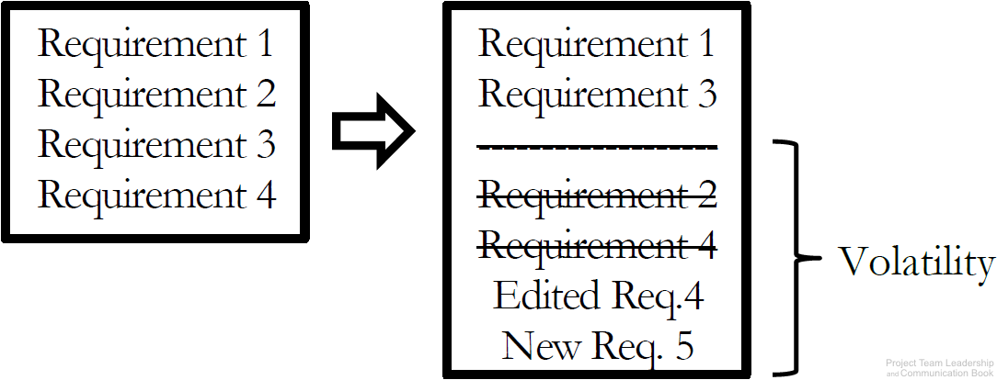
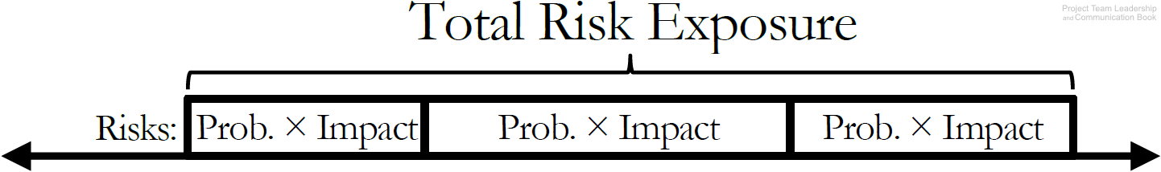
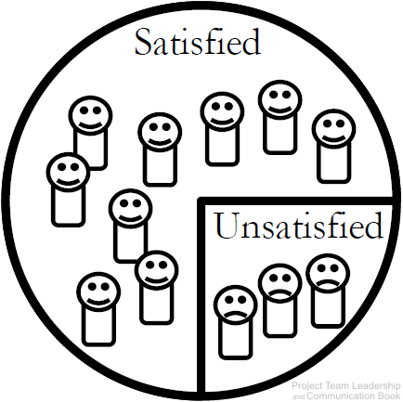
Example Project Metrics (2 of 2)
Requirements/Specifications Volatility measures the number of changes to requirements/specifications as the project proceeds. These changes often have significant impacts on the productivity of the team.
Total Risk Exposure is the sum of a project’s individual risk exposures. The result is the expected total impact to resources or schedule.
Customer Satisfaction is an important metric to many organizations. Measured in various ways (surveys, etc.). Understanding why customer satisfaction is where it is represents a much more difficult task.
Diagrams: Malachowsky, Samuel. Project Team Leadership and Communication. Lintwood Press. 2018. p. 166-167.
Notes:
Corresponds to section 5.6, pages 166-167 of the Project Team Leadership and Communication book.

Slide 5
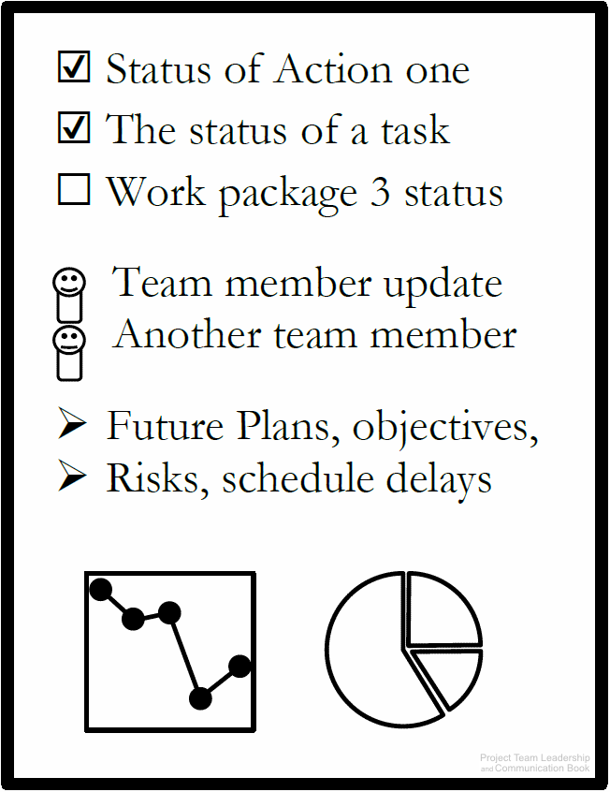
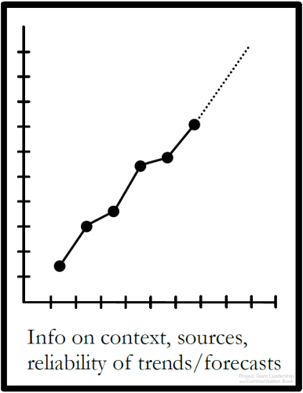
Example Project Reports (1 of 3)
Status Reports indicate the overall condition of a project.
  Overall health
  Schedule/budget status
  Issues/risks
Almost any relevant metric can be included
Trend/Forecasting Reports extrapolate important project data, giving insight into important factors of the project.
  Is performance improving or deteriorating?
  Will the data and its forecast factor into important decisions?
Sources, justifications, and expected ranges help make the report more relevant/readable
Automatically generated reports can be extremely useful here
Data/Metrics: Cycletime, Schedule, Cost, etc.
Quad Charts are a useful example of a status report
  Limited to one side of one page or one presentation slide
Completed Since Last Report | Plans For Current Period
Risks & Issues | Needs & Discussion
Diagrams: Malachowsky, Samuel. Project Team Leadership and Communication. Lintwood Press. 2018. p. 167-168.
Notes:
Corresponds to section 5.6 and 5.8, pages 167-168 and 173-174 of the Project Team Leadership and Communication book.

Slide 6
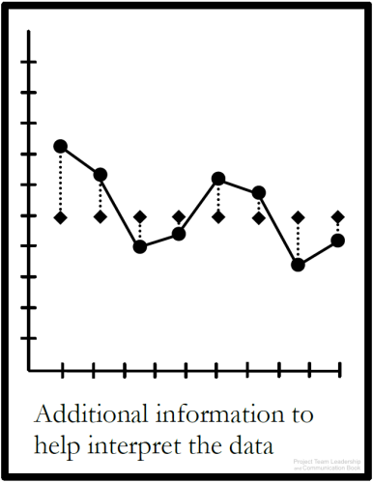
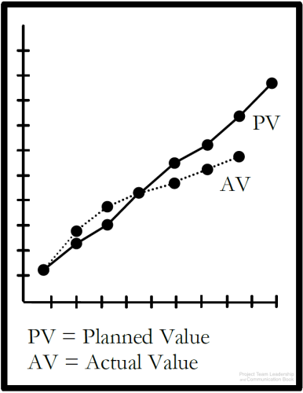
Example Project Reports (2 of 3)
Variance Reports measure how actual results compare to the expected value, or “baseline.”
Both overspending and “underspeinding” time or resources can represent a problem
Earned Value Reports are similar to Trend/Fore-casting and Variance Reports, but follow a specific method.
  Actual, or “Earned Value” are plotted against expected value.
  In an “ideal” project, both graphed lines would match perfectly. A gap indicates variance
Some project management software automatically generates this report
Data/Metrics: Earned Value, Planned Value
The expected values may not always be constant/linear. Projects often plan to work and spend resources at varying rates
Often, more data is included to provide clarity
Data/Metrics: Schedule Variance, Cost Variance, analysis/clarification where needed
Diagrams: Malachowsky, Samuel. Project Team Leadership and Communication. Lintwood Press. 2018. p. 169.
Notes:
Corresponds to section 5.6, page 169 of the Project Team Leadership and Communication book.
Note that Earned Value is covered more extensively in the chapter 3 slides as well as the book on pages 94-97 (section 3.6).

Slide 7
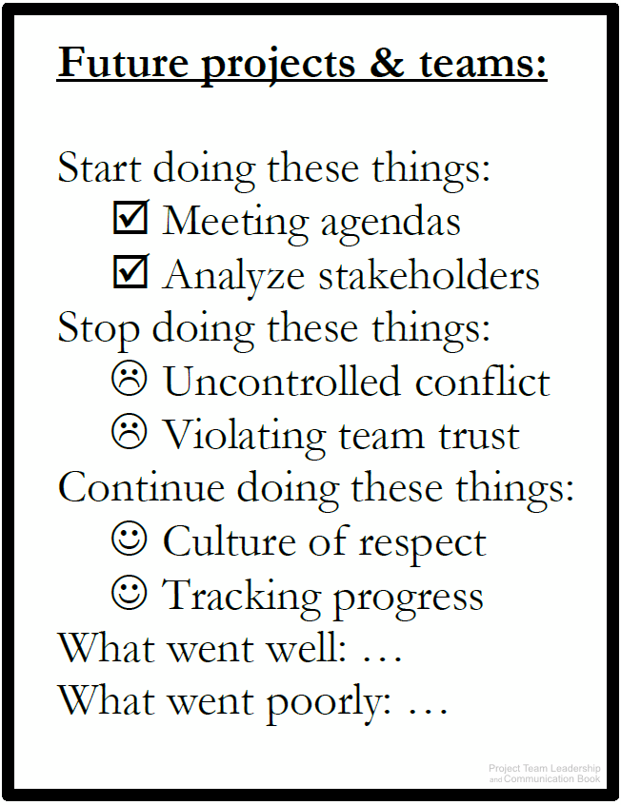
Example Project Reports (3 of 3)
Lessons Learned Reports present an opportunity for the project team to review, document, learn from, and communicate what went well and what went poorly throughout the project.
  Often three questions are asked:
    What should the team start doing?
    What should the team stop doing?
    What should the team continue doing?
  Also known as a “Postmortem,” which implies lessons learned activities are only completed at the end of a project. In reality, they should happen throughout, and team can benefit immediately
  Previous Lessons Learned reports can also benefit teams completing projects in the future
Diagram: Malachowsky, Samuel. Project Team Leadership and Communication. Lintwood Press. 2018. p. 170.
Notes:
Corresponds to section 5.6, page 170 of the Project Team Leadership and Communication book.

Slide 8
Activity – Choosing a Metric or Report
For each question, which metric/report is most appropriate to find or communicate the answer?
Overall, what’s happening with the project?
How can future project’s learn from this one?
How far from the expected plan are we?
How efficiently are we applying the project’s employees?
How much time should be set aside for problems?
In real numbers, how much is our work of far worth?
How happy are our users with the project’s results?
How long does each project phase typically take?
Metrics
Cycletime
Schedule Variance
Resource Utilization
Requirements Volatility
Total Risk Exposure
Customer Satisfaction
Reports
Status Report
Trend/Forecasting Report
Variance Report
Earned Value Report
Lessons Learned Report
Notes:
Corresponds to section 5.6, pages 164-170 of the Project Team Leadership and Communication book.
5 Minute activity
Learning Objective: Classify project metrics and reports by fulfilled need

Slide 9
Questions / Discussion
Notes:
Chapter 5 includes several additional support elements which could become classroom activities or discussion elements.
There are quite a few key terms defined on page 176.
Review questions cover most of the chapter (page 177, answers on page 223).
The exercises on pages 177-178 are designed to allow readers to apply and extend what they’ve learned.

