Slide 1
Mini-Module:
Stakeholders
Designed for chapter 1, section 1.3. pages 5-7, and chapter 3, section 3.8, pages 102-105 of Project Team Leadership and Communication by Samuel Malachowsky, ISBN 9781732378902, 9781732378919.
Notes:
Corresponds to chapter 1, section 1.6, pages 12-13 and chapter 3, section 3.8, pages 102-105 of the Project Team Leadership and Communication book. ISBN: 9781732378902 (Softcover), 9781732378919 (Hardcover). These slides may only be posted or used in conjunction with the book in a training or classroom environment. Key terms (page 21, 107-108) are often italicized on the slides.
Learning Objectives:
Define 'stakeholder' in the context of a project effort
Identify 3 common groups of project stakeholders
Relate the basic structure of a ‘stakeholder register’
Describe a technique for identifying which of 4 basic stakeholder management techniques are appropriate
Activity: Propose a list of stakeholders, analyze them, and propose a management strategy for each
Activity: Finding and analyzing stakeholders (15 minutes)
Outline: (slides: 5 minutes, activity: 15 minutes)
Stakeholders
Prioritizing Stakeholders
Activity – Finding and Analyzing Stakeholders

Slide 2
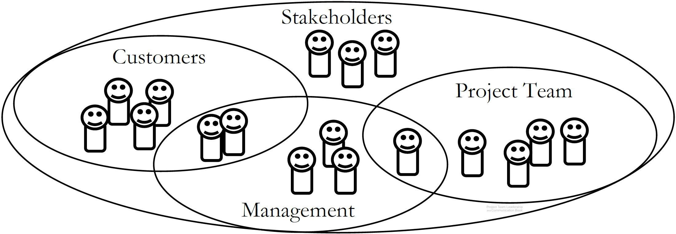
Stakeholders
Stakeholders are people who can affect or are affected by the execution or outcome of a project
Diagram: Malachowsky, Samuel. Project Team Leadership and Communication. Lintwood Press. 2018. p. 12.
Notes:
Corresponds to chapter 1, section 1.6, pages 12-13 of the Project Team Leadership and Communication book.
The Venn diagram illustrates how there are major stakeholder groups, but they can overlap. Each requires specific considerations and strategies.
Stakeholders are covered further in other chapters/slides, especially section 3.8 (pages 102-105) and 5.7 (pages 171-172).

Slide 3
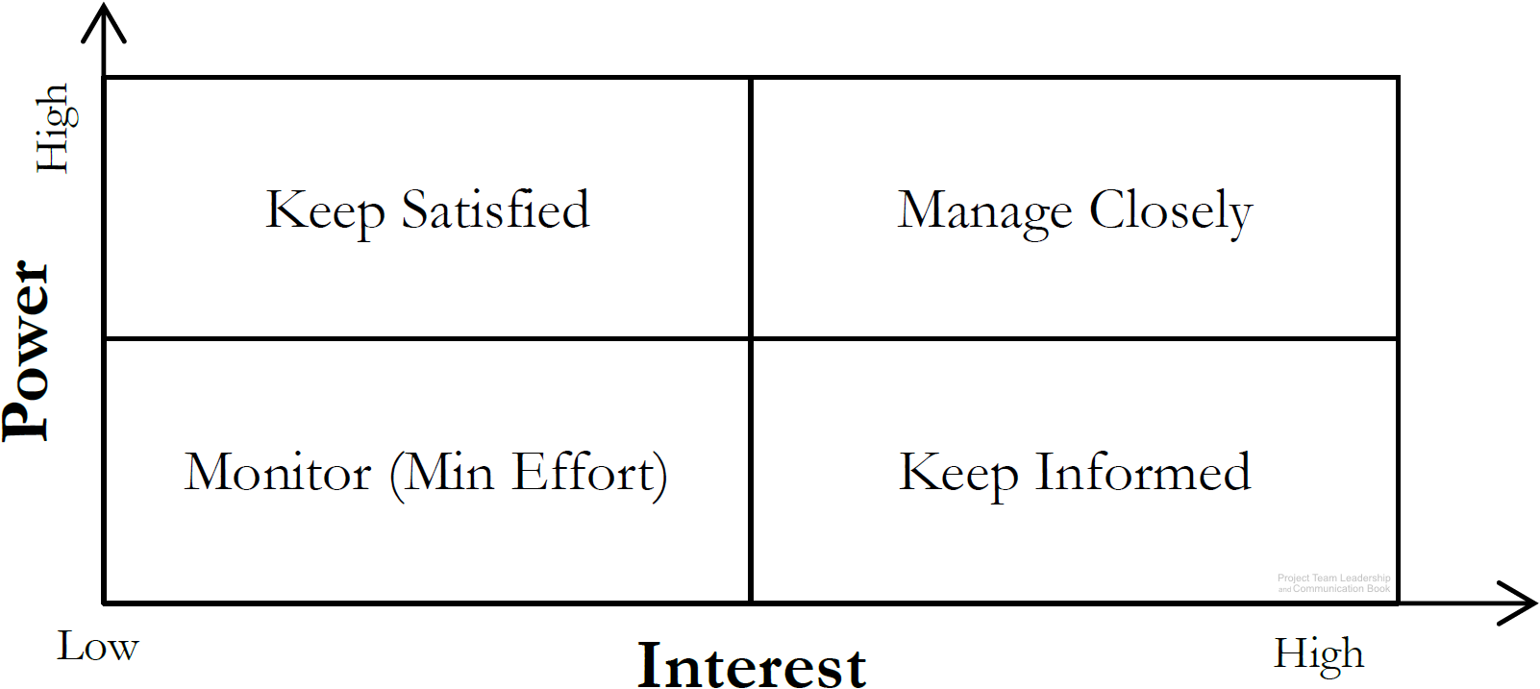
Prioritizing Stakeholders
Everyone should be involved in identifying stakeholders
  Stakeholders can be groups
Once identified, they should be analyzed
  High or low power, or ability to affect the project
  High or low interest, or how they’re affected by
  the projects positive or negative outcome
All information should be recorded/tracked
in a stakeholder register
ID | Name | Title | Info | Notes | Power | Interest | Strategy
1 | Casey Johnson | Sales Lead | cjohnson@co.com | Initiated the contract | Low | High | Keep Informed
2 | Jordan Baker | Team Specialist | 555-1532 |  | High | High | Manage Closely
Diagram: Malachowsky, Samuel. Project Team Leadership and Communication. Lintwood Press. 2018. p. 104.
Project Management Institute. A Guide to the Project Management Body of Knowledge – Fifth Edition. Project Management Institute Inc. p. 395-397. 2013.
Notes:
Corresponds to chapter 3, section 3.8, pages 102-105 of the Project Team Leadership and Communication book.
The definition of stakeholders was previously covered in chapter 1 slides

Slide 4
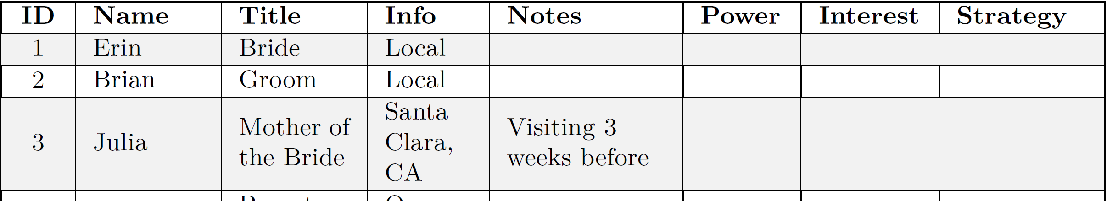
Activity – Finding and Analyzing Stakeholders
Consider the stakeholders in a typical wedding. Remember that stakeholders with a similar stake can be listed as groups.
In teams of 3-4 list 15 stakeholders/stakeholder groups on a whiteboard.
For each, analyze their level of interest and power as it pertains to the wedding planning and execution.
Determine each stakeholder’s management strategy (monitor, keep informed, etc.)
Diagram: Malachowsky, Samuel. Project Team Leadership and Communication. Lintwood Press. 2018. p. 104.
Notes:
Corresponds to section 3.8, pages 102-105 of the Project Team Leadership and Communication book. Methods of estimating imprecisely can be found on page 87.
15 minute activity
Learning Objective: Propose a list of stakeholders, analyze them, and propose a management strategy for each
Can be instructor-lead (instructor writes stakeholders via class input, analyzes via class input).

Slide 5
Questions / Discussion
Notes:
Chapters 1 and 3 include several additional support elements which could become classroom activities or discussion elements.
The chapter 1 tool, entitled Chapter Tool: Who We Are as Leaders (section 1.8, pages 17-20) is designed to help readers explore their own motivators, influencers, and stakeholder experiences. Students could rate the accuracy of the test with their own perceptions, compare results, and have discussions about each element.
There are several key terms defined on page 21 and 107-108.
Review questions cover most of the chapter (pages 21-22 and 108 answers on page 223).
The exercises on page 22 and 109-110 are designed to allow readers to apply and extend what they’ve learned.

