Slide 1
Mini-Module:
What Makes Work a “Project”?
Designed for chapter 2, section 2.1. pages 25-30 of Project Team Leadership and Communication by Samuel Malachowsky, ISBN 9781732378902, 9781732378919.
Notes:
Corresponds to chapter 2, section 2.1, pages 25-30 of the Project Team Leadership and Communication book. ISBN: 9781732378902 (Softcover), 9781732378919 (Hardcover). These slides may only be posted or used in conjunction with the book in a training or classroom environment. Key terms (pages 74-75) are often italicized on the slides.
Learning Objectives:
Define 'project,' identifying 2 defining features
List 4 project phases and 1 additional element
Recognize the interactions between projects/phases and the product lifecycle
Activity: Propose multiple projects within a single product’s life cycle
Activity: One product, multiple projects (10 minutes)
Outline: (slides: 10 minutes, activity: 10 minutes)
What is a Project?
Project Phases
Project Functions
Projects Can Vary in Size and Scale
Activity – One Product, Multiple Projects

Slide 2
What is a Project?
Based on a business need or opportunity
Often explored and initiated by the Project Sponsor(s), who writes or approves the Project Charter
Has the following features:
  A defined beginning and end
  Unique goals and outcomes
  Typically requires team members with varied skills
Contrasts with Operational Work, which is repetitive ‘business as usual’
Project Management Institute. A Guide to the Project Management Body of Knowledge – Fifth Edition. Project Management Institute Inc. p. 3. 2013.
Notes:
Corresponds to section 2.1, pages 25-30 of the Project Team Leadership and Communication book.

Slide 3
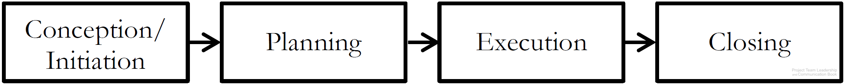
Project Phases
Conception/Initiation Phase
  Research conducted, leadership chosen, goals and requirements established
Planning Phase
  Detailed plans drafted and documented
Execution Phase
  Plans are implemented, intended result of project takes shape
Closing Phase
  Results handed off, lessons learned collected
Diagram: Malachowsky, Samuel. Project Team Leadership and Communication. Lintwood Press. 2018. p. 27.
Project Management Institute. A Guide to the Project Management Body of Knowledge – Fifth Edition. Project Management Institute Inc. p. 42. 2013.
Notes:
Corresponds to pages 27-28 of the Project Team Leadership and Communication book.

Slide 4
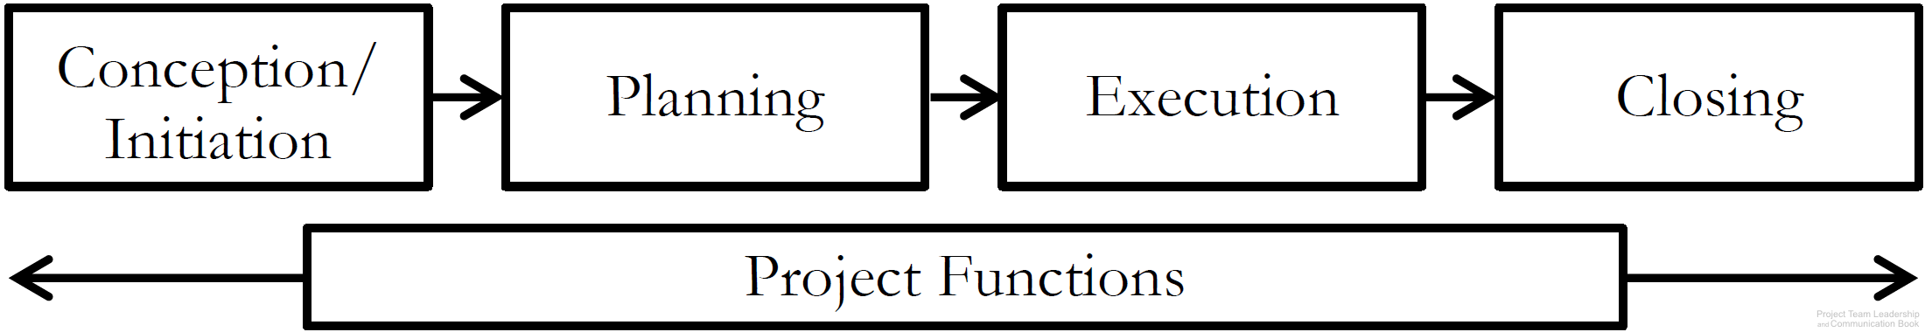
Project Functions
Unlike individual phases, Project Functions don’t occur at one point in time – they require continuous attention and/or action
  Risk and Issue Management
  Quality Management
  Communications Management
  Project Management itself!
Diagram: Malachowsky, Samuel. Project Team Leadership and Communication. Lintwood Press. 2018. p. 28.
Project Management Institute. A Guide to the Project Management Body of Knowledge – Fifth Edition. Project Management Institute Inc. p. 42. 2013.
Notes:
Corresponds to pages 28-29 of the Project Team Leadership and Communication book.
Risk and issue management is covered in the book on page 97.
Quality Management/Assurance is covered in the book in this chapter, page 43.
Communications Management is the subject of chapter 5, pages 149-178.

Slide 5
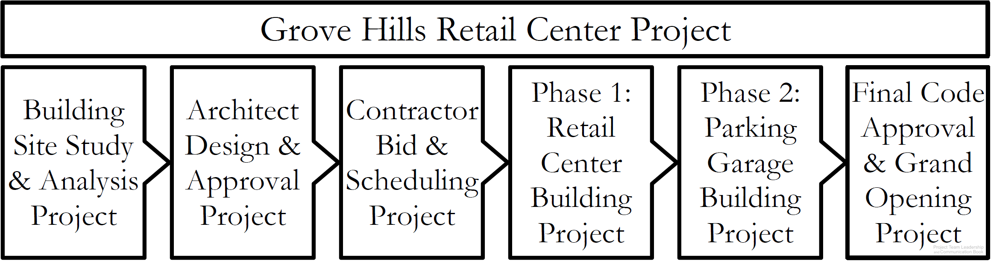
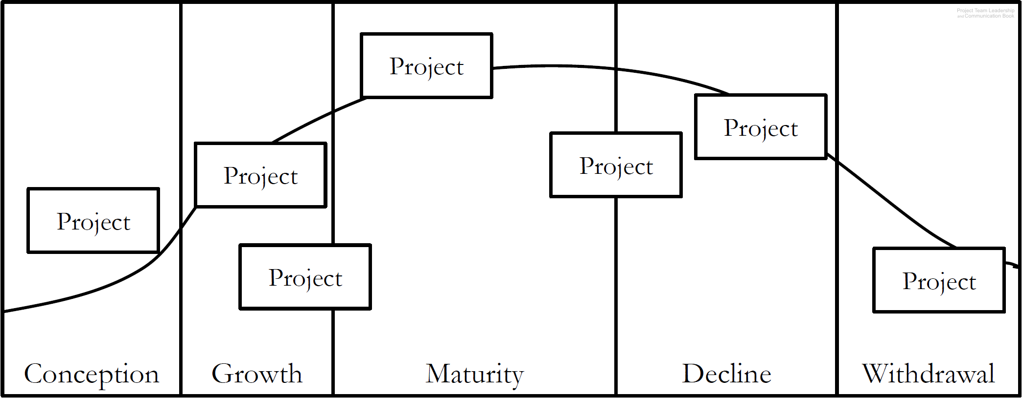
Projects Can Vary in Size and Scale
A large project can have multiple sub-projects
A product life cycle includes projects in every phase
Diagrams: Malachowsky, Samuel. Project Team Leadership and Communication. Lintwood Press. 2018. p. 29, 30.
Project Management Institute. A Guide to the Project Management Body of Knowledge – Fifth Edition. Project Management Institute Inc. p. 42. 2013.
Notes:
Corresponds to pages 29-30 of the Project Team Leadership and Communication book.
Product life cycle project examples: Marketing, setting up machinery, ramping up production, etc.

Slide 6

Activity – One Product, Multiple Projects
Consider the following scenario:
Your team is overseeing the design, production, and marketing of a new type of non-stick frying pan.
List 10 projects that might be a part of this product's life cycle. Be sure to include at least 1 from each phase (conception, growth, maturity, decline, withdrawal)
Diagram: Malachowsky, Samuel. Project Team Leadership and Communication. Lintwood Press. 2018. p. 30.
Notes:
Corresponds to pages 29-30 of the Project Team Leadership and Communication book.
Exercise #2 on page 76 is a similar question.
10 minute activity
Learning Objective: Propose multiple projects within a single product’s life cycle
Scenario/product can be changed to more closely match the student’s field of study, though thinking outside of their field can be beneficial for understanding.

Slide 7
Questions / Discussion
Notes:
Chapter 2 includes several additional support elements which could become classroom activities or discussion elements.
There are quite a few key terms defined on pages 74-75.
Review questions cover most of the chapter (pages 75-76, answers on page 223).
The exercises on pages 76-77 are designed to allow readers to apply and extend what they’ve learned.

