Slide 1
Mini-Module:
Organizational Culture and Structure
Designed for chapter 1, section 1.5. pages 10-12, and chapter 2, section 2.2, pages 30-35 of Project Team Leadership and Communication by Samuel Malachowsky, ISBN 9781732378902, 9781732378919.
Notes:
Corresponds to chapter 1, section 1.5. pages 10-12, and chapter 2, section 2.2, pages 30-35 of the Project Team Leadership and Communication book. ISBN: 9781732378902 (Softcover), 9781732378919 (Hardcover). These slides may only be posted or used in conjunction with the book in a training or classroom environment. Key terms (pages 74-75) are often italicized on the slides.
Learning Objectives:
Define ‘culture’ in the context of a project, team, and organization
Recognize contexts that affect and are affected by culture
Identify 3 types of organizations in the context of how projects are organized
Recognize strengths and weaknesses of each of the 3 organizational types
Activity: Analyze the cultural norms and organizational structures of multiple industries
Activity: Organizational culture and structure (10 minutes)
Outline: (slides: 10 minutes, activity: 10 minutes)
Organizational Culture
Functional Organizational Structure
Project-Focused Organizational Structure
Matrix Organizational Structure
Activity – Organizational Culture and Structure

Slide 2
Organizational Culture
The set of behaviors or beliefs that determine how an organization or team interacts or carries out work
Awareness of culture and different circumstances/attitudes is key
Influenced by:
  The industry, environment, customers, organizational practices
  Personalities, values, principles, etc. of the organization, leader, and team
Influences:
  Decision making, risk tolerance, decisiveness, orderliness, competitiveness
  Level of attention to detail, amount of process, emphasis on achievement
  Supportiveness, reward/punishment, team vs. individual contribution
O’Reilly, C. A. III, Chatman, J. A., and Caldwell, D. F. People and organizational culture: A profile comparison approach to assessing person-organization fit.
Academy of Management Journal, September 1991. p. 502, 516. 1991.
Notes:
Corresponds to section 1.5, pages 10-12 of the Project Team Leadership and Communication book.

Slide 3
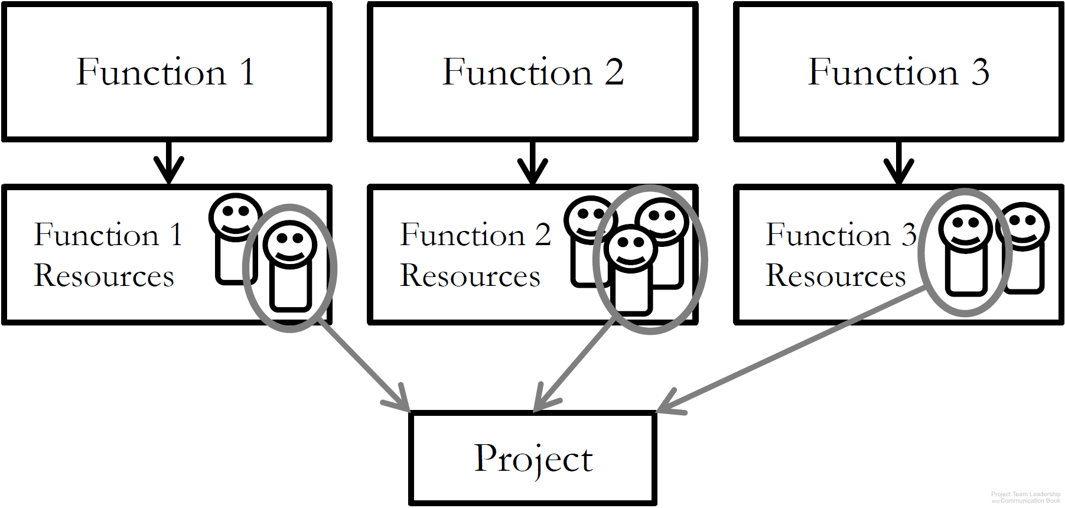
Functional Organizational Structure
‘Classic’ organizational structure
Organization made up of functional
‘silos’ (HR, Sales, Marketing, etc.)
Project teams consist of resources
from multiple departments
Strengths: resource redundancy
Weaknesses: resources don’t report to project leader, functional managers may not be supportive of project
Diagram: Malachowsky, Samuel. Project Team Leadership and Communication. Lintwood Press. 2018. p. 31.
Project Management Institute. A Guide to the Project Management Body of Knowledge – Fifth Edition. Project Management Institute Inc. p. 21-22. 2013.
Notes:
Corresponds to pages 30-32 of the Project Team Leadership and Communication book.

Slide 4
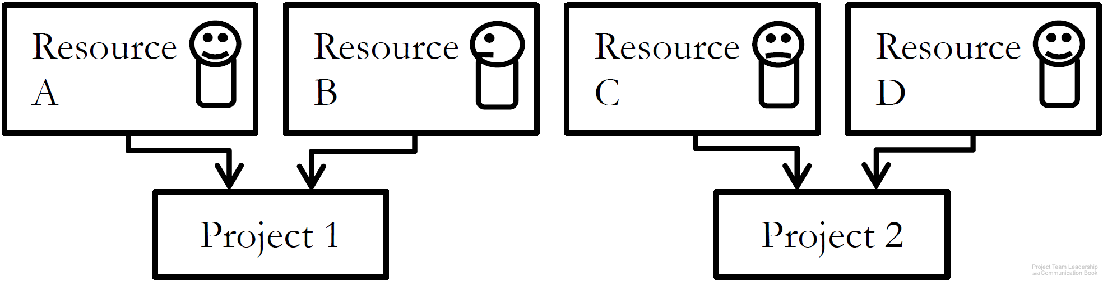
Project-Focused Organizational Structure
‘Flat’ organizational structure
Organization made of project
leads and resources, with few ‘layers’
Project teams consist of resources
specifically recruited/assigned to that project
Strengths: Autonomy/freedom/self-direction, no functional managers
Weaknesses: Resources are tempted to join other projects ‘jump ship’ to retain employment, projects must ‘stand on their own’, competition between projects for resources
Diagram: Malachowsky, Samuel. Project Team Leadership and Communication. Lintwood Press. 2018. p. 33.
Project Management Institute. A Guide to the Project Management Body of Knowledge – Fifth Edition. Project Management Institute Inc. p. 21-22. 2013.
Notes:
Corresponds to pages 33-34 of the Project Team Leadership and Communication book.

Slide 5
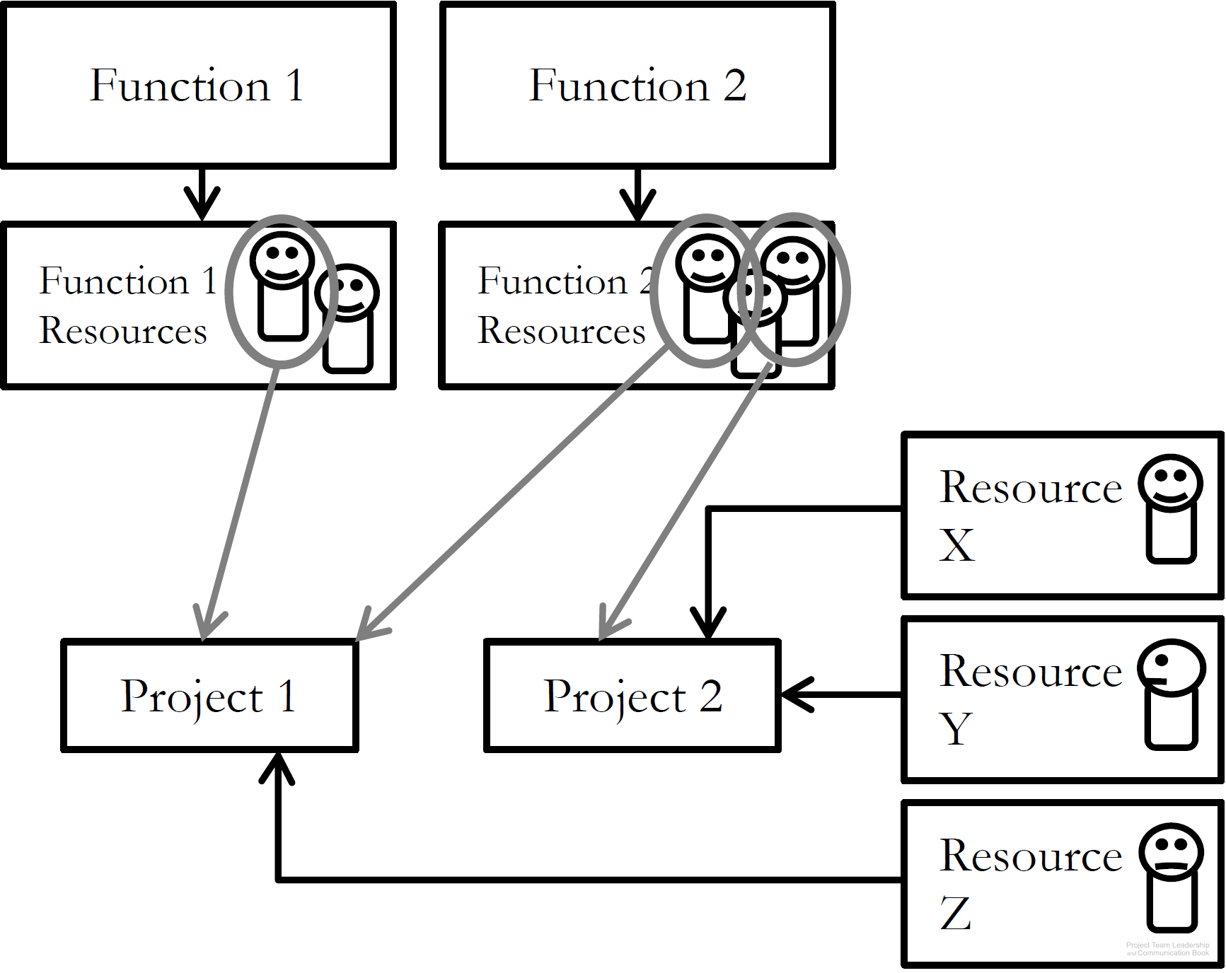
Matrix Organizational Structure
‘Strong’ or ‘weak’ matrix depending on ratio of Functional to Project-Focused aspects
Resources are often external contractors
Strengths: compatible with older, ‘classic’ orgs, can be adjusted as needed
Weaknesses: some resources may feel more detached from project than others, significant increase in number of stakeholders
Diagram: Malachowsky, Samuel. Project Team Leadership and Communication. Lintwood Press. 2018. p. 35.
Project Management Institute. A Guide to the Project Management Body of Knowledge – Fifth Edition. Project Management Institute Inc. p. 21-22. 2013.
Notes:
Corresponds to pages 34-35 of the Project Team Leadership and Communication book.

Slide 6
Activity – Organizational Culture and Structure
For each of the industries listed below, answer the following questions:
In 3 words or less, what cultural value is commonly held by the average organization in the industry?
Which organizational structure (functional, project-focused, matrix) are organizations in the industry most likely to follow?
Automobile Manufacturing Agriculture Banking Software Development Defense Contractors Canned Food Manufacturing | Health Care Microbrewing Music Production Publishing/Printing University Education Venture Capital and Investment
Notes:
Corresponds to section 1.5, pages 10-12, and section 2.2, pages 30-35 of the Project Team Leadership and Communication book.
10-15 minute activity
Learning Objective: Analyze the cultural norms and organizational structures of multiple industries

Slide 7
Questions / Discussion
Notes:
Chapter 2 includes several additional support elements which could become classroom activities or discussion elements.
There are quite a few key terms defined on pages 74-75.
Review questions cover most of the chapter (pages 75-76, answers on page 223).
The exercises on pages 76-77 are designed to allow readers to apply and extend what they’ve learned.

