Slide 1
Mini-Module:
The Basics of Process
Designed for chapter 2, section 2.3, pages 36-43 of Project Team Leadership and Communication by Samuel Malachowsky, ISBN 9781732378902, 9781732378919.
Notes:
Corresponds to chapter 2, section 2.3, pages 36-43 of the Project Team Leadership and Communication book. ISBN: 9781732378902 (Softcover), 9781732378919 (Hardcover). These slides may only be posted or used in conjunction with the book in a training or classroom environment. Key terms (pages 74-75) are often italicized on the slides.
Learning Objectives:
Recall factors influencing the values and needs of a project, team, or organization
List 3 fundamental process models and summarize the strengths and weaknesses of each
Recognize varying levels of detail/abstraction in documented processes
Activity: Analyze a scenario and construct a basic process
Activity: ‘Rolling your own’ process (15-20 minutes)
Outline: (slides: 10 minutes, activity: 15-20 minutes)
Organizational Values and Needs
Plan-Focused Process Models
Cyclical Process Models
Change-Focused Process Models
Process in Organizations
Activity – ‘Rolling Your Own’ Process

Slide 2
Organizational Values and Needs
Similar to the concept of culture, organizations have defining characteristics:
  How customers are treated (input, visibility into inner workings)
  Risk tolerance and preferred schedule certainty
  Experience level of personnel and management
And these can highlight certain needs. For example:
  The need for extremely clear requirements/specifications vs. the need for stakeholder input (prototypes, revisions, etc.)
  The need for a clear schedule vs. the need for a responsive project
  The need for many or few project artifacts (documentation)
Notes:
Corresponds to pages 36-37 of the Project Team Leadership and Communication book.
The next 3 slides cover 3 basic process structures each of which emphasize certain needs over others.

Slide 3
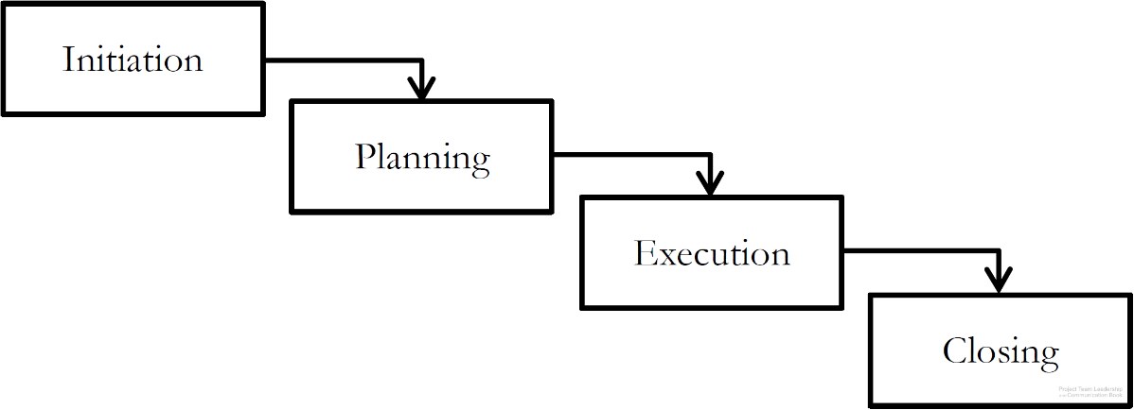
Plan-Focused Process Models
Each step must be
completely done before
the next can be begun
Plans are made for each step, then
executed ‘waterfall’ style
Strengths: high, schedule certainty, easy to understand, straightforward, time-tested
Weaknesses: does not handle uncertainty/change well, stakeholder visibility can be poor (only changes of phase)
Diagram: Malachowsky, Samuel. Project Team Leadership and Communication. Lintwood Press. 2018. p. 37.
Project Management Institute. A Guide to the Project Management Body of Knowledge – Fifth Edition. Project Management Institute Inc. p. 44-46. 2013.
Notes:
Corresponds to pages 37-38 of the Project Team Leadership and Communication book.
The book (page 38) and website contain additional diagrams such as a ‘sub-projects’ illustration and a standardized (between the three types) graphic of strengths and weaknesses.

Slide 4
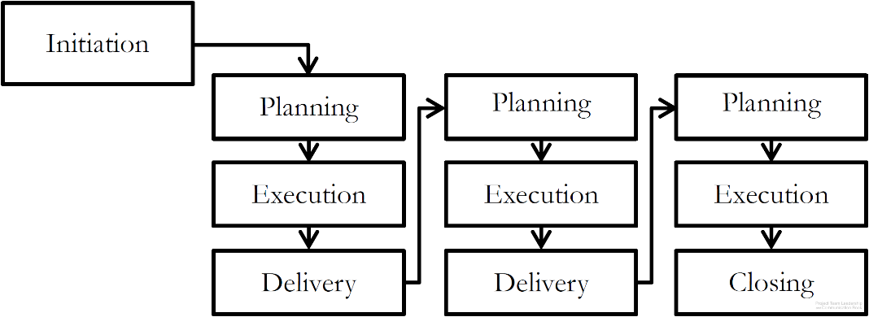
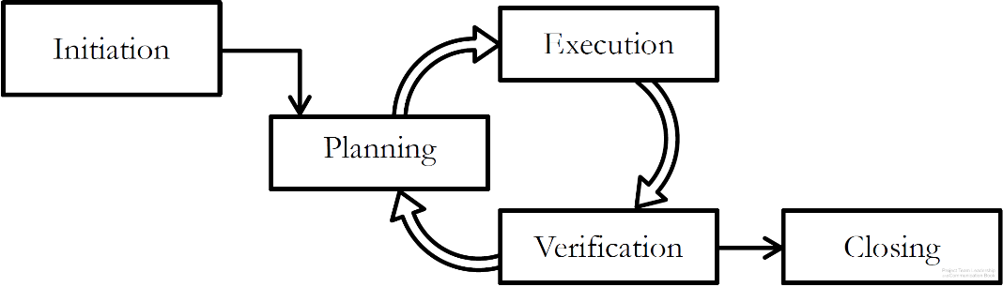
Cyclical Process Models
Projects cycle through delivery or feedback phases
Plans are made a little-at-a-time
Strengths: stakeholder visibility is often higher than Plan-Focused
Weaknesses: can be difficulty to know when to stop, requires strong disciplined leadership or can get out of control
Incremental Process Model
Iterative Process Model
Diagrams: Malachowsky, Samuel. Project Team Leadership and Communication. Lintwood Press. 2018. p. 39.
Project Management Institute. A Guide to the Project Management Body of Knowledge – Fifth Edition. Project Management Institute Inc. p. 44-46. 2013.
Notes:
Corresponds to pages 38-40 of the Project Team Leadership and Communication book.
The book (page 40) and website contain an additional diagram, a standardized (between the three types) graphic of strengths and weaknesses.

Slide 5
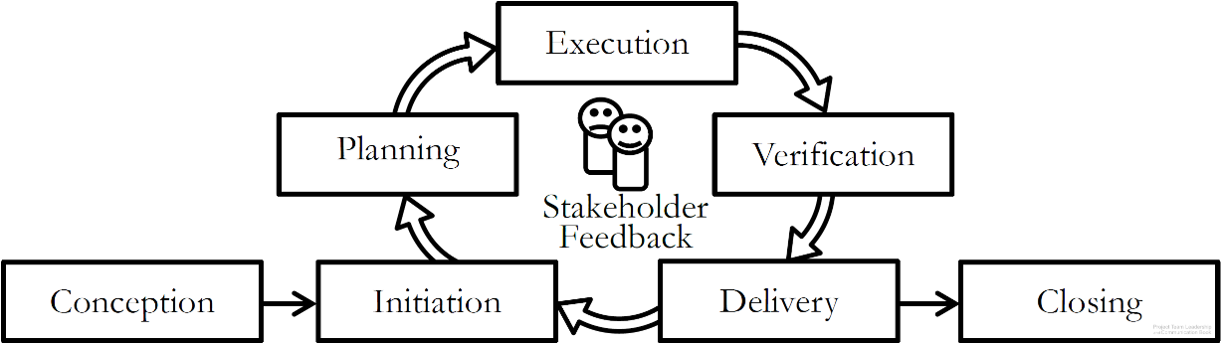
Change-Focused Process Models
Responsiveness to change and
stakeholder input is the most
important aspect
Similar to Cyclical Process Models
Requires experienced, disciplined leaders and team members
Strengths: stakeholder visibility is high (they’re consulted frequently), responds well to changing market conditions or circumstances
Weaknesses: can ‘go on forever’ if stakeholders are uncertain or conditions keep changing, requires frequent customer interactions
Diagram: Malachowsky, Samuel. Project Team Leadership and Communication. Lintwood Press. 2018. p. 40.
Project Management Institute. A Guide to the Project Management Body of Knowledge – Fifth Edition. Project Management Institute Inc. p. 44-46. 2013.
Notes:
Corresponds to pages 40-41 of the Project Team Leadership and Communication book.
The book (page 41) and website contain an additional diagram, a standardized (between the three types) graphic of strengths and weaknesses.
The appendix of the book (Agile: The Future of Projects?, pages 195-222) covers the most well-known change focused process models: Agile/Scrum.

Slide 6
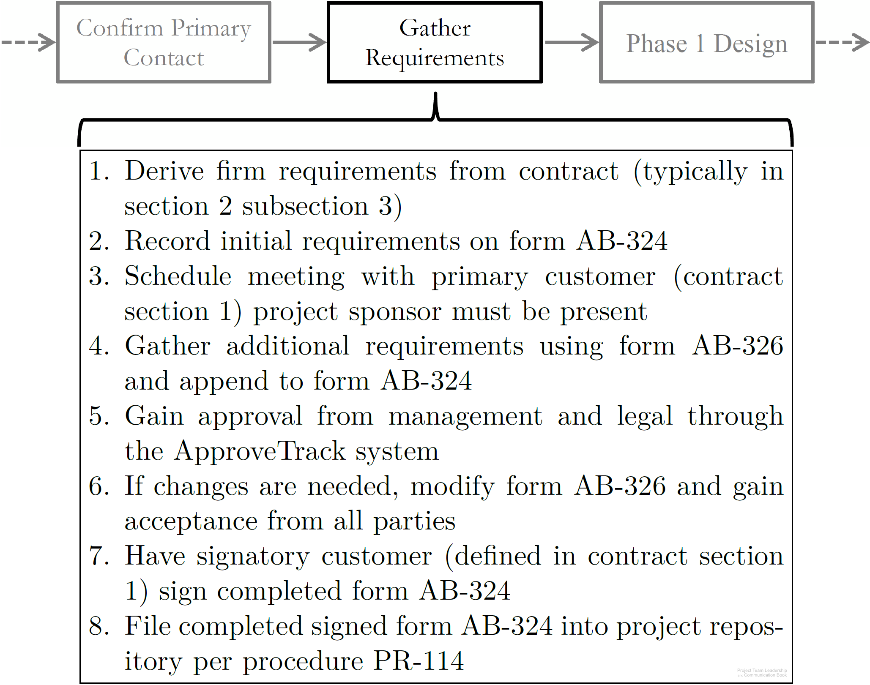
Process in Organizations
Process are actually much less abstract (they’re more exact) in organizations
Steps in some processes may be other processes
Standardization allows simplification, learning from experience of others, and cost savings
ISO 9001 is a process certification
Diagram: Malachowsky, Samuel. Project Team Leadership and Communication. Lintwood Press. 2018. p. 42.
Notes:
Corresponds to pages 42-43 of the Project Team Leadership and Communication book.

Slide 7
Activity – ‘Rolling Your Own’ Process
In teams of 3-4, consider the following scenario:
Management at Austere Engineering, Inc. has recently come to the realization that there is no formal onboarding (hiring, orientation, training, etc.) process for new engineering team members.
Look at the values and needs listed on page 36. As a group, decide how important each of these elements are to Austere Engineering, Inc.
Considering the models illustrated on pages 37-41, create a basic process for onboarding a new engineer
Notes:
Corresponds to section 2.3, pages 36-43 of the Project Team Leadership and Communication book.
15-20 minute activity
Learning Objective: Analyze a scenario and construct a basic process
Scenario/product can be changed to more closely match the student’s field of study, though thinking outside of their field can be beneficial for understanding.

Slide 8
Questions / Discussion
Notes:
Chapter 2 includes several additional support elements which could become classroom activities or discussion elements.
There are quite a few key terms defined on pages 74-75.
Review questions cover most of the chapter (pages 75-76, answers on page 223).
The exercises on pages 76-77 are designed to allow readers to apply and extend what they’ve learned.

