Slide 1
Mini-Module:
Project Quality
Designed for chapter 2, section 2.4, pages 43-50, and section 2.7, pages 69-72 of Project Team Leadership and Communication by Samuel Malachowsky, ISBN 9781732378902, 9781732378919.
Notes:
Corresponds to chapter 2, section 2.4, pages 43-50, and section 2.7, pages 69-72 of the Project Team Leadership and Communication book. ISBN: 9781732378902 (Softcover), 9781732378919 (Hardcover). These slides may only be posted or used in conjunction with the book in a training or classroom environment. Key terms (pages 74-75) are often italicized on the slides.
Learning Objectives:
Define 'quality,' identifying 4 main aspects/concerns
Give examples of elements that are 'cost of quality' and 'cost of poor quality' in a project
Label the project triangle's 4 components
Relate examples of each project triangle component and the relationships between them
Relate basic steps for determining a project’s quality objectives
Activity: Develop scenario-specific quality-related elements of consideration
Activity: Understanding quality (10-15 minutes)
Outline: (slides: 10 minutes, activity: 10-15 minutes)
Project Quality
Product and Process Quality
Quality is a Balancing Act
Projects are a Balancing Act, The Project Triangle
Activity – Understanding Quality

Slide 2
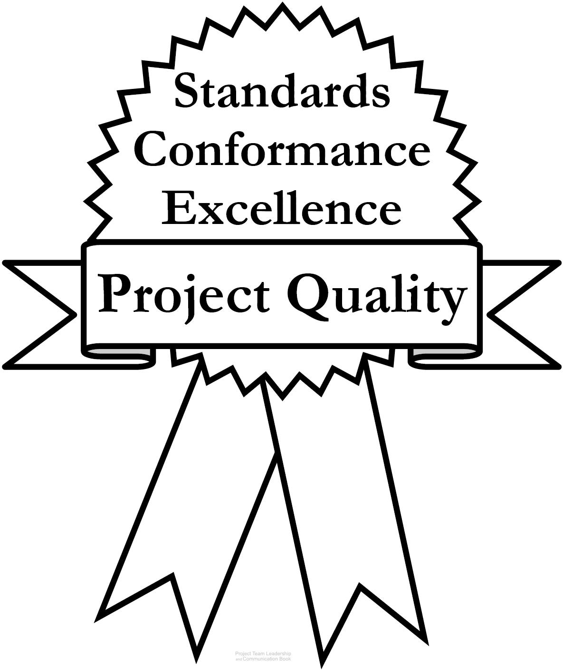
Project Quality
Quality is hard to define; most agree there are
three main aspects:
  Standards defined by the industry, organization, or team
  Conformance to the requirements, specifications, and
  commitments inherent to the project
  Excellence, the need to go beyond strictly meeting basic
  requirements/specifications. Thinking about elements such
  as the user’s perspective, maintenance, long-term cost, etc.
A fourth element can’t be ignored, though:
  Perception – do stakeholders have an appropriate, well-informed view of the project? Are communications appropriate? Is the team acting professionally?
Diagram: Malachowsky, Samuel. Project Team Leadership and Communication. Lintwood Press. 2018. p. 44.
Crosby, P.B. Completeness: Quality for the 21st century. Plume. p. 45. 1992.
Notes:
Corresponds to pages 43-45 of the Project Team Leadership and Communication book.
The chapter tool, entitled Planning Project Quality includes a step-by-step process for determining what aspects of quality are important to a project or organization. Elements from this are present on the next slide.

Slide 3
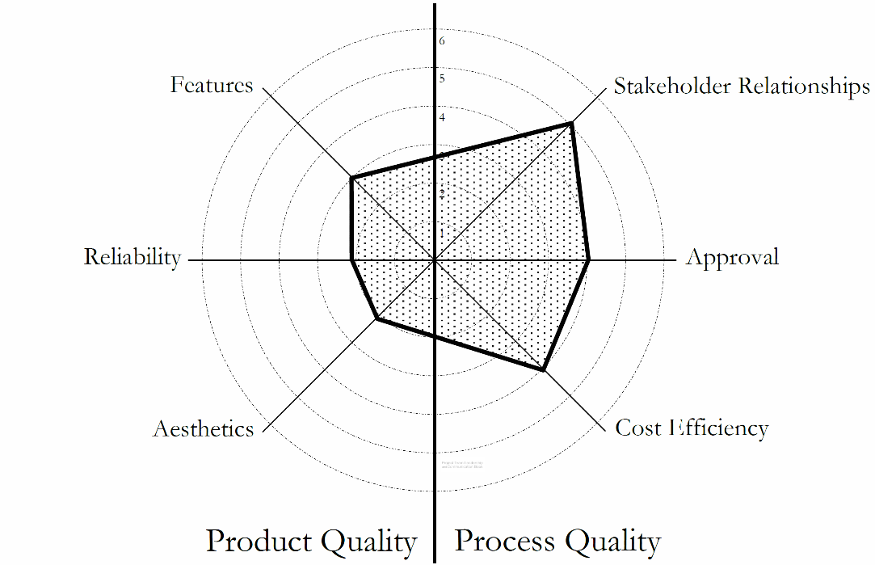
Product and Process Quality
Product Quality relates to what the project is trying to produce
  Examples include: Features, performance, durability, reliability, resources consumed
Process Quality relates to the team’s planning and execution of the project
  Examples include: Timeliness, safety, compliance, responsiveness to customer
Both must be addressed, balance must be achieved
‘Radar Chart’ Showing Balance/Prioritization of Quality in a Project
Diagram: Malachowsky, Samuel. Project Team Leadership and Communication. Lintwood Press. 2018. p. 71.
Notes:
Corresponds to section 2.7, pages 69-72 of the Project Team Leadership and Communication book.

Slide 4
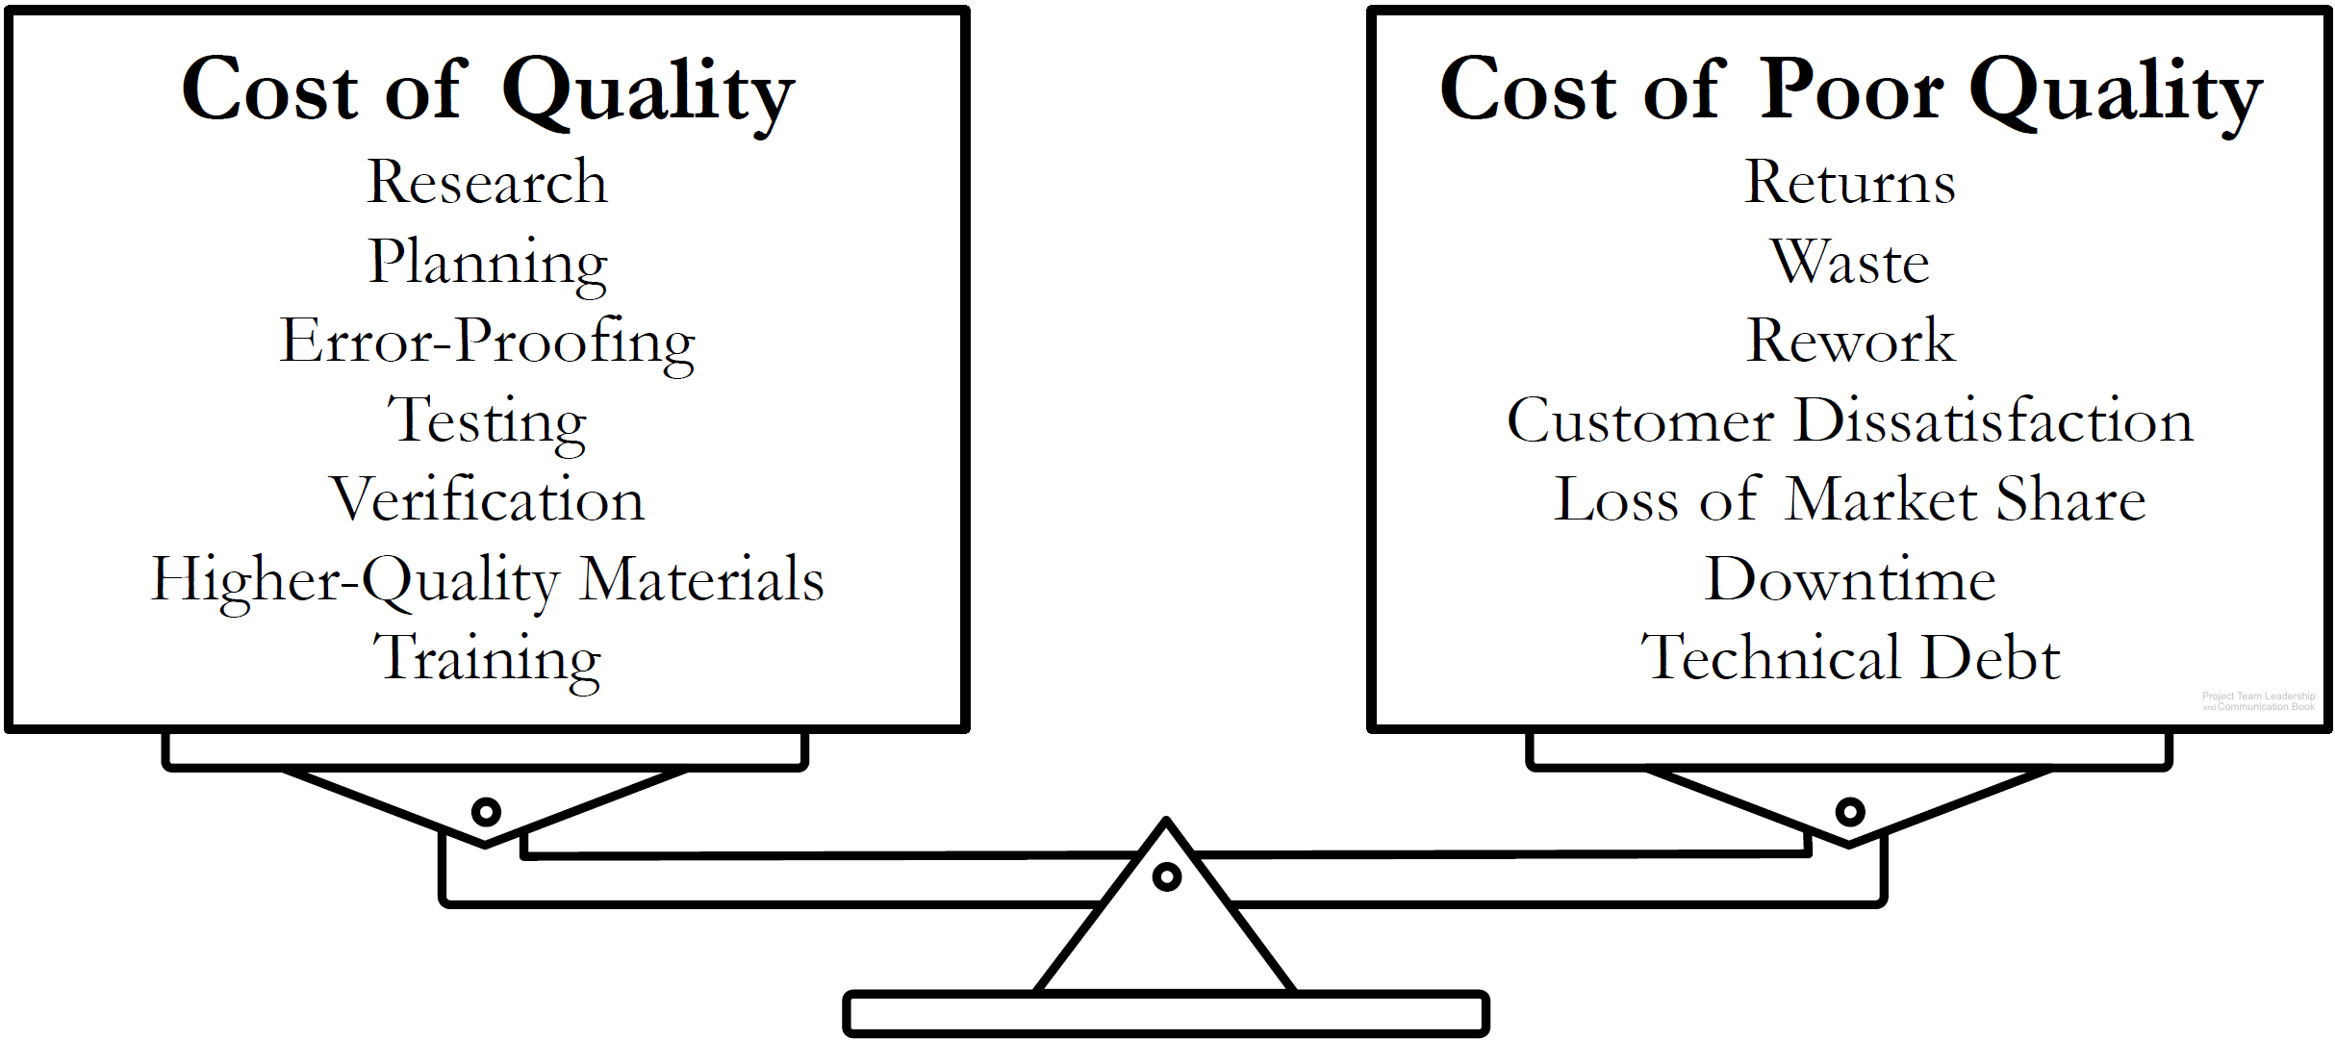
Quality is a Balancing Act
Projects must balance the cost of quality with the cost of poor quality
Determining where that balance lies requires teams to think about future implications of their actions
Diagram: Malachowsky, Samuel. Project Team Leadership and Communication. Lintwood Press. 2018. p. 46.
Feigenbaum, Armand V. Total Quality Control, Harvard Business Review November 1956, p. 34.
Notes:
Corresponds to pages 45-46 of the Project Team Leadership and Communication book.
The chapter tool, entitled Planning Project Quality includes a step-by-step process for determining what aspects of quality are important to a project or organization.
Technical debt is explained on page 46.

Slide 5
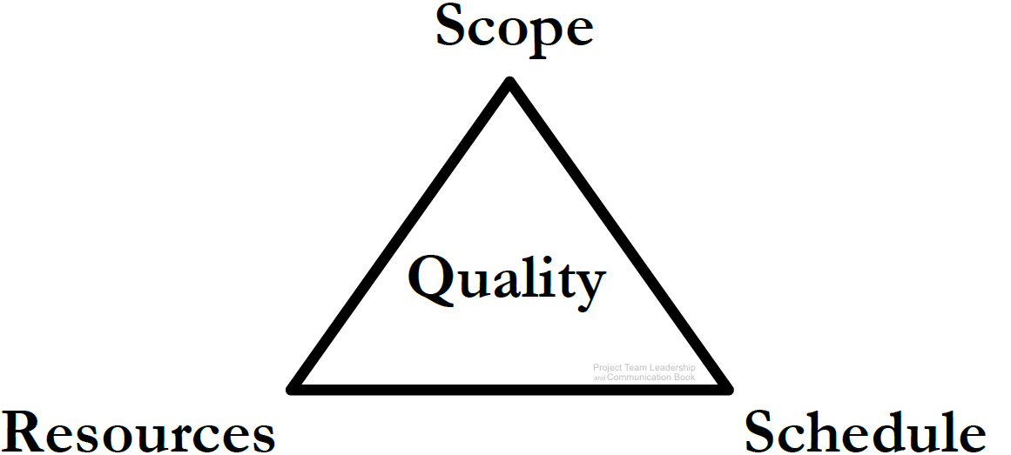
Projects are a Balancing Act, The Project Triangle
Resources: The budget, materials, wages, etc.
Schedule: The time expended
Scope: What is and isn’t included in the project outcomes
Quality can relate to any or all of the three
Balance: More scope requires more resources, more schedule, or both. Faster project means less scope/more resources, etc.
Diagram: Malachowsky, Samuel. Project Team Leadership and Communication. Lintwood Press. 2018. p. 46.
Notes:
Corresponds to pages 46-50 of the Project Team Leadership and Communication book.

Slide 6
Activity – Understanding Quality
Organize into teams of 3-4 and consider the following scenario:
Your team is developing a ladder that is 30% lighter than most competing products. Recent tests have indicated that there are quality problems with both the design of the ladder and manufacturing process used to create it.
For each of the 4 quality concerns listed on pages 44-45 (standards, conformance, excellence, and perception), describe factors teams might examine when considering each aspect of quality (OSHA and ANSI standards, for instance)
Using a template similar to the balance-scales on page 46, list at least 5 scenario-specific costs of quality and 5 scenario-specific costs of poor quality.
Notes:
Corresponds to pages 44-46 of the Project Team Leadership and Communication book.
10-15 minute activity
Learning Objective: Develop scenario-specific quality-related elements of consideration
Scenario/product can be changed to more closely match the student’s field of study, though thinking outside of their field can be beneficial for understanding.

Slide 7
Questions / Discussion
Notes:
Chapter 2 includes several additional support elements which could become classroom activities or discussion elements.
There are quite a few key terms defined on pages 74-75.
Review questions cover most of the chapter (pages 75-76, answers on page 223).
The exercises on pages 76-77 are designed to allow readers to apply and extend what they’ve learned.

