Slide 1
Security Risk Assessment
Engineering Secure Software

Slide 2
Why do we study risk?
Many outcomes are possible, not all are probable
Enumeration
Prioritization
Discussion

Slide 3
Naïve Security Risk Assessment
The naïve approach
  Write down your worst fears for the system
  Try to avoid those things
Cons
  Requires a big “bag of tricks”
  Easily overwhelming for security

Slide 4
What is risk?
p(occurrence)*impact
The risk associated with an event is the probability that the event will happen times the impact magnitude of the event
For the math-oriented… expected value
Matches how people generally think
  Low p(occ), high impact
  … terrorist attacks, struck by lightning
  High p(occ), low impact
  … credit card theft, keeping my old truck unlocked

Slide 5
What is security risk?
p(exploit)*value of an asset
p(exploit)
  The probability that an exploit will occur on your system
Asset
  A [tangible or intangible] resource of the system that has value in confidentiality, integrity, availability

Slide 6
p(exploit)
Increased by more vulnerabilities
Increased by a far-reaching vulnerability
Increased by discoverable vulnerabilities
…although you cannot rely on security through obscurity alone …
Increased by scope of the project
…although sometimes that is unavoidable…
Other factors that we cannot control
  Market share → exposure
  New malicious actors (e.g. activism spike)
  Many, many other factors that we must ignore for the sake of simplicity
Thus, we generally assume p(vulnerability) is proportional to p(exploit)

Slide 7
Assets
Every software system has assets
  Domain-specific e.g. patient records
  Domain-independent e.g. passwords
  Intangible properties e.g. availability
These can be identified at the requirements and design stages
Assets exist in the deployed system, so source code is not (necessarily) an asset

Slide 8
Places where assets live
Database tables
User-supplied data
Configuration files
Configuration consoles
File systems
Security feature inputs
Logs
Sandboxing features
Built-in examples
Network traffic
Cookies
User interfaces

Slide 9
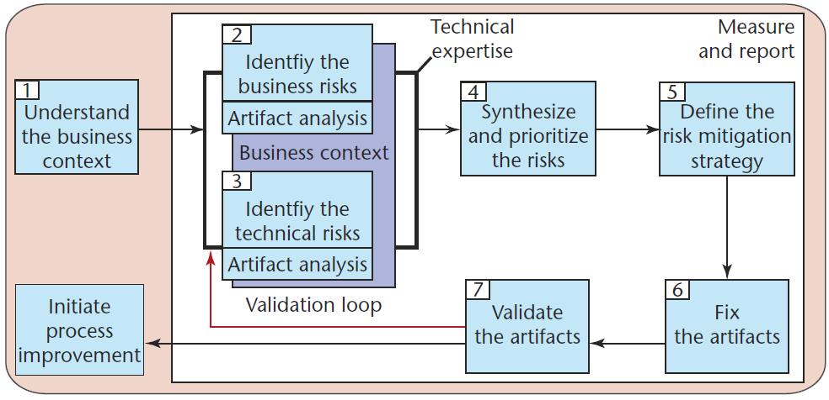
Risk Assessment in Process
From: http://www.cigital.com/papers/download/bsi3-risk.pdf

Slide 10
The Planning > The Plan
One of the most important elements of risk analysis is the process itself
  Discussions that are brought up
  Fighting over the mitigation strategies
Communication is very important at this stage
Assessing the change in risk is more sound than the final numbers
  New assets?
  Increased p(exploit)?

Slide 11
Abuse Cases vs. Risk Assessment
Abuse & Misuse Cases
  Involves planning
  Potentially infinite
  Emphasize domain
  Scenario-driven
  Originates from abusing functionality
  What if?
Risk Assessment
  Involves planning
  Potentially infinite
  Emphasize all risks
  Quantitative
  Originates from CIA, assets, p(exploit)
  What might?

Slide 12
Protection Poker
A combination of product & process risk
  Trace stories to assets
  Quantify the risk for prioritization
    Ease of attack
    Value of the asset
  Discuss the elements of the risk
Originally designed for agile processes
  Assumes we are in a sprint
  Not comprehensive, but just-in-time

Slide 13
Story Points Estimation
In PP, we use story points
  Dimensionless (unit-less)
  Should not translate to hours, effort, etc.
Limited to a few choices
  Why argue over 51 vs. 50?
  Exponential in scale (~Fibonacci)
Ease of attack ~ p(vulnerability)

Slide 14
Protection Poker in Action
Identify some assets
Calibrate your asset values
Calibrate your ease of attack
For each item
  Trace the item to the assets affected
  Vote on affected asset values, as needed
  Vote on ease of attack
Examine two rankings
  Ease*Max(value)
  Ease*Sum(value)

