Slide 1
Threat Modeling
Engineering Secure Software

Slide 2
Uses of Risk Thus Far
Start with the functionality
  Use cases → abuse/misuse cases
  p(exploit), p(vulnerability)
Start with what to protect
  Goals → High-level Risks → Indicators → Tests
  Assets
  Domain, domain, domain
Today: start with threats

Slide 3
STRIDE
Spoofing
Tampering
Repudiation
Information disclosure
Denial of Service
Elevation of privilege
I am Spartacus.
Looks like Johnny got an A!
Didn’t Johnny have a B?
Johnny’s SSN is…
Please try again later.
sudo rm –rf /home/johnny

Slide 4
STRIDE ~> Security Properties
Kind of the inverse of security properties, but not fully
  Tampering → Integrity violation
  Repudiation → Integrity of the history violation
  Information Disclosure → Confidentiality violation
  Denial of service → Availability violation
Spoofing
  Violating authentication
  You are not who you say you are
  (e.g. session hijacking, guessing passwords)
Elevation of privilege
  Violating authorization
  You can access things you should not be allowed to access
  (e.g. permissions, network access)

Slide 5
Repudiation
A threat to the belief that integrity was preserved
Didn’t Johnny have a B?
Provenance
  Logs
  Hash (digest) algorithms
  Third-party verification
  e.g. artwork, copyright registration
Ultimately, another type of integrity violation
  …but not exactly a tampering threat
  Protect against tampering? Filter access, etc.
  Protect against repudiation? Keep a reliable history

Slide 6
Architectural Risk Analysis
Discuss security risk once most of the architecture is settled
Motivation: a few good early decisions goes a long way
  e.g. incorporating encryption
  e.g. authentication & access control concerns
  e.g. choice of technologies used
Must-haves vs. Nice-to-haves at the design level
Emphasis of design flaws over code-level vulnerabilities
Note: “Risk Analysis” is not necessarily “Modeling”

Slide 7
Threat Modeling
Architectural risk analysis tool
  Built at Microsoft, on top of Visio
  STRIDE concept
Methodology:
  Define architecture elements
    Processes
    External interactors
    Data store
  Connect with data flows
  Define trust & machine boundaries
  Map STRIDE to each element & relationship

Slide 8
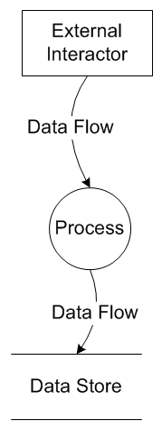
Primitives
External interactors
  e.g. clients, other systems, dependencies
Process
  Architecture-centered functionality
  e.g. dispatcher, input validator
Data store
  e.g. database, file system
Data flow
  Domain & Design-specific explanation of data
  e.g. “HTTP Login Requests”

Slide 9
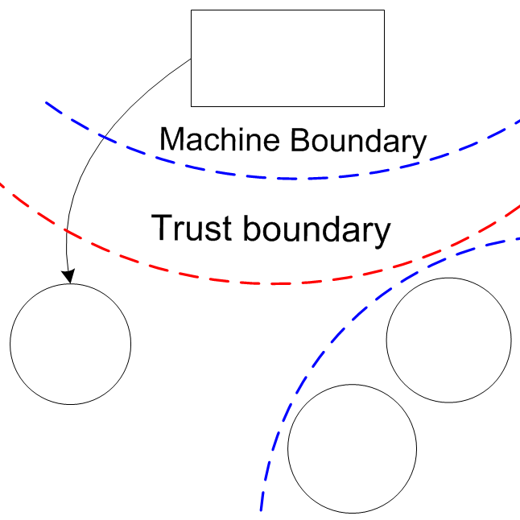
Boundaries
Machine boundaries
  Same physical machine
Trust boundaries
  If the input can be trusted

Slide 10
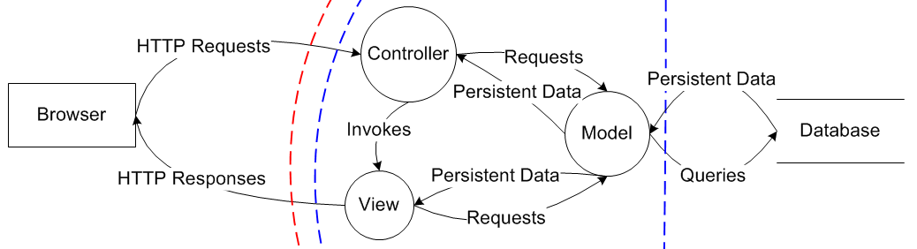
e.g. Generic Webapp with MVC
Note: example is typically more domain-specific
e.g. How will we prevent spoofing of the browser?
e.g. How will we prevent tampering of queries?
e.g. How do we avoid persistent data from the DB being disclosed?
E.g. How will we avoid repudiation of the database?

Slide 11
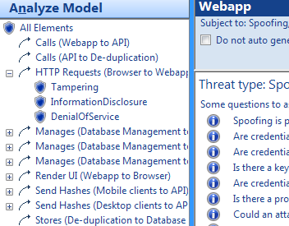
Analysis
What the tool does…
  Eliminates categories of threats
  Forces you describe mitigations
  Helps record assumptions
  Go directly to file a bug
Threats arise when…
  Flows cross boundaries
  More processes
  Forgetting what to trust

Slide 12
Tips for Threat Modeling
Be honest with the process
  Make sure the model represents reality (or what you really believe reality will be)
  Consider all types of threats –
  code-level vulns are just a “for example”
As with all modeling, use appropriate complexity
  Overly-simplified?
    Departs from reality
    You get exactly what you put into it – no new knowledge
  Overly-complicated?
    Too much to analyze
    “Check it off the list” syndrome
Test your model
  Think of a specific security concern, then try to see where it fits in your threat model

Slide 13
Today’s Activity
Groups of 2-3
  Go through the Threat Modeling activity
  Tool: c:\Program Files (x86)\Microsoft\SDL Threat Modeling\SDLTM.exe
For attendance, find me to check you off for today before leaving

