Slide 1
White Box testing & Inspections
Engineering Secure Software

Slide 2
The Power of Source Code
White box testing
  Testers have intimate knowledge of the specifications, design,
  Often done by the original developers
  Security consultants often get source code access too
Code Inspections
  aka “Technical Reviews”, “Code Reviews”
  Stepping through code with security in mind
Test & inspect the threats
  Enumerated by abuse cases, threat models, architectural risks
  Defensive coding concerns
Testing → Failure-finding technique
Inspection → Fault-finding technique

Slide 3
What to test for?
Test & inspect the security mitigations
  Bug in your mitigation → vulnerability
  Bug in your security feature → vulnerability
Test for both types of vulnerabilities
  Low-level coding mistakes
  High-level design flaws
Test at every scope
  Unit, integration, system
  Try to keep an equal effort emphasis on each
  Unit tests → bugs in mitigations & features
  Integration → interaction vulnerabilities

Slide 4
Who’s at the code inspection?
Author
  Made significant contributions to the code recently
  Can answer any specific questions, or reveal blind spots
People with readability, but objectivity
  e.g. close colleagues
  e.g. developer working on a similar feature on the same project, but different team
  e.g. system architect
People experienced with security
  Consultants, if any
  Developers on previous vulnerabilities in this system

Slide 5
Make an Inspection Checklist
What will you talk about?
  Keep a running checklist for the meeting
  Adapt the checklist for future inspection meetings
At the meeting, briefly identify the following that are pertinent to this code
  Assets from risk analysis
  Threats from your threat models
  Malicious actors from your requirements
  Abuse and misuse cases from your requirements
Walk through the functionality of the code
  Look for missing code more than wrong code
  “If they missed this, then they probably missed that”

Slide 6
More for the checklist
Look for too much complexity
  Both structural and cognitive complexity
  Too much responsibility in one place
Look for common defensive coding mistakes
Look for opportunities to build security into the design
  e.g. repeated input validation? Make input validation the default
  e.g. file canonicalization is done all in one place
  e.g. using a third-party library

Slide 7
The Prioritization Problem
What should we inspect?
  Can’t inspect everything
  Reacting to inspections can take some time
  Can be too repetitive
Inspect what probably has vulnerabilities
Three approaches:
  Code coverage – what have we not tested?
  Static analysis – what tools say is vulnerable
  Prediction – what history says is vulnerable

Slide 8
Code Coverage
What has been executed as a result of our tests?
  e.g. have exceptions been tested?
  e.g. have we tested this input?
Use a tool to record what code has been executed
  Levels: package, class, line, branch
  80% is a common threshold for line coverage
Benefits
  Reveals what testers forgot
  Relatively simple to deploy and execute
Disadvantages
  Unit test coverage != well-tested
  (add system tests to your coverage!)
  Test coverage != security test coverage

Slide 9
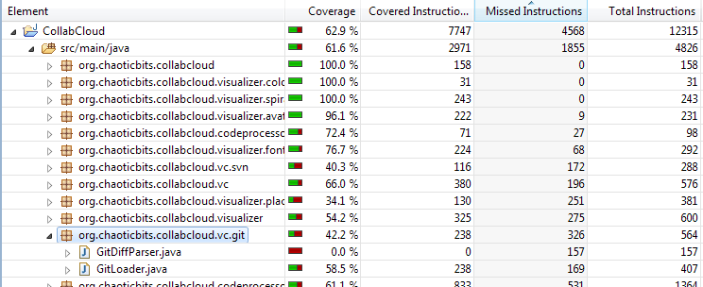
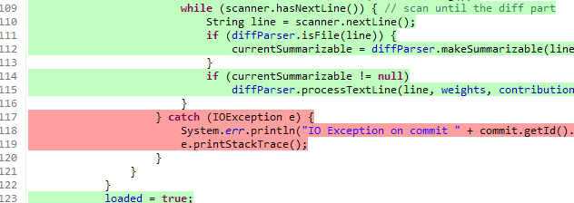
eclEMMA

Slide 10
Automated Static Analysis
Static analysis
  Analyzing code without executing it
  Manual static analysis == code inspection
  Think: sophisticated compiler warnings
Automated Static Analysis tools
  Provide warnings of common coding mistakes
  Use a variety of methods
    Fancy grep searches
    Symbolic execution & model checking
    Data flow analysis
Tools
  Non-security: FindBugs, PMD
  Security: Fortify, Coverity, JTest

Slide 11
ASA Benefits & Drawbacks
Benefits
  Quick and easy
  Knowledge transfer from experts behind the tool
  Provides a specific context in the code to drive the discussion
Drawbacks
  Huge false positive rates: >90% are FP in many cases
  Fault-finding → exploitable?
  Biased to code-level vulnerabilities
  Cannot possibly identify domain-specific risks
  Better for inspections than tests

Slide 12
Prediction-Based Prioritization
Vulnerabilities are rare
  Typically, about 1% to 5% of source code files will require a post-release patch for a vulnerability
Prediction is possible
  Good metrics
  Trained machine-learning models
Many metrics are correlated with vulnerabilities
  Files with previous vulnerabilities
  Files with high code churn
  Files committed to by many developers
    e.g. 10+ developers coordinating on a single file? Improbable.
  Large files (==high cyclomatic complexity)

