Slide 1
Linux Permissions
Engineering Secure Software

Slide 2
Linux File Permissions
Each file and directory has bits for..
  Read, Write, Execute: rwx
  Files: works as it sounds
Directories:
  r → “can list files in a directory” (but not read a given file)
  x → “read a file if you know the name” (easy if directory also has read)
  w → “can create, change, delete files in directory”
Thus, you may only read a file IFF you:
  Have read permissions to the file AND
  Have execute permissions to that file’s directory
Files & Directories have 3 levels:
  Owner, Group, and Everyone Else
  aka. User, Group, Other: ugo

Slide 3
List permissions of a file: ls –l
with some info removed from below in [...]
drwx--x--- […] andy faculty […] .
drwx------ […] andy faculty […] ..
-rwxrwxrwx […] andy faculty […] allopen
drwx------ […] andy faculty […] mydir
-rw------- […] andy faculty […] myfile
-rwx------ […] andy faculty […] myprog
drwxrwx--- […] andy faculty […] ourdir
-rwxrwx--- […] kenn faculty […] ourprog
Can kenn execute myprog?
No, because of file permissions.
Can both andy and kenn execute ourprog?
Yes. Everyone in faculty can read and execute myprog
Can kenn read ourprog?
Yes. Directory has group x, file has group r
Can kenn list to find ourprog?
No. Directory listing is off.

Slide 4
chmod
Command to change permissions
  Set (=), Add (+), Remove (-)
  Set user to rw, not x: chmod u=rw .
  Set user, groups to only rw: chmod ug=rw .
  Set ug to only rx, recursively: chmod –R ug=rx .
  Add “groups can rw”: chmod g+rw .
  Add “others can rw”: chmod o+rw .
  Add “everyone can read”: chmod a+r .
  Remove write from group: chmod g-w .
Octal notation
  e.g. chmod 755 file.txt
  Good for setting, not adding/removing
  1,2,3 are never used
rwx | --- | --x | -w- | -wx | r-- | r-x | rw- | rwx
Binary | 000 | 001 | 010 | 011 | 100 | 101 | 110 | 111
Decimal | 0 | 1 | 2 | 3 | 4 | 5 | 6 | 7

Slide 5
umask
When a file is created…
  User mask (umask) is consulted for permissions
  Owner = user who created the file
  Subtract octally
    from 666 for files
    from 777 for directories
    e.g. 666-022=644, or rw-r--r--
  nitron.se.rit.edu default: rw------- (or 077)
  Common default: rw-r--r– (or 022)
  Common umask shared group stuff: rw-rw-r– (or 007)
Programs can change their own umask
  Blessing for good developers
  Curse for system administrators

Slide 6
setuid, setgid
When executing, ordinarily…
  OS ignores the owner of the program
  Runs the program as you
  (assuming you have permissions, of course)
  e.g. prog.sh owned by root gets run as you
setuid and setgid bits on files
  chmod ug+s ./prog.sh
  “If you can execute this, it’s executed as the owner’s rights, not as the executing user’s rights”
  Files owned by root should never have this set
  Different from the “sticky bit” (not covered here)
setuid and setgid bits on directories
  setuid on directories is ignored in Linux
  setgid means new files inherit the group ID (like umask)

Slide 7
For Example
larry$ umask
077
larry$ mkdir dir
larry$ ls –l dir/
drwx------ … larry stooges … dir
larry$ touch dir/file.sh
larry$ ls –la dir/
-rwx------ … larry stooges … . [./dir]
-rwx------ … larry stooges … .. [./dir/..]
-rw------- … larry stooges … file.sh
larry$ ./dir/file.sh
bash: ./dir/file.sh: Permission denied
larry$ chmod –R ug+x .
curly$ ./dir/file.sh
[Success!]
curly$ ls –l ./dir
bash: ./dir/: Permission denied

Slide 8
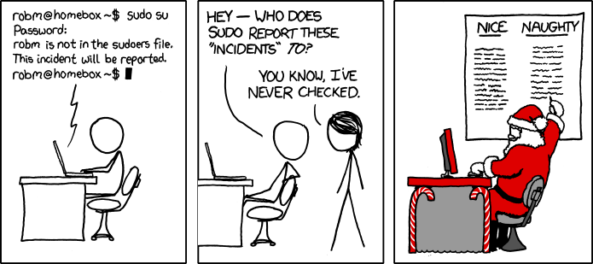
Beware of sudo
He sees you when you're sleeping, he knows when you're awake, he's copied on /var/spool/mail/root, so be good for goodness' sake.
Source: http://xkcd.com/838

