Slide 1
Applied
Cryptography
Engineering Secure Software

Slide 2
Networks, Crypto, & You.
Most application developers…
  Don’t implement networking protocols
  Don’t implement encryption algorithms
Knowing how to safely deploy them, however, is paramount
  Different situations call for different techniques
    Types of Authentication
    One-way digests (hashes)
    Symmetric-key vs. Public-key
    Trusting public keys
  Know Thy Algorithms instead of “just use crypto”

Slide 3
The Basic Problems
The internet is a scary, scary place
  Anyone can join
  Anyone can sniff
BUT! “distrust everything all the time” is not feasible
Authentication: are you who you say your are?
  Trust must be built somehow
Encryption: can someone else listen in?
Authentication & Encryption overlap in techniques
  How do we encrypt data for someone we do not trust?
  How do we know nobody else has the key?
  How do authenticate this machine?

Slide 4
Multi-Factor Authentication
Security experts recommend that we utilize three types of authentication…
Something you know
  e.g. passwords
  Can be guessed, though
Something you have
  Maybe a physical item
  Maybe a one-time randomly generated key
  e.g. both: pre-seeded secure PRNG key fob
Something you are
  Biometrics? Tons of false positives
  Easier for humans, at least right now
  (e.g. face recognition)

Slide 5
Hash Digests
Problem: sensitive data needs to be identified only by the original user, nobody else
  e.g. user wants to authenticate, but we don’t want to store passwords in plain text in case an attacker breaks in
Solution: hash digest algorithms
  Compute a very large number based on a chunk of data
    The more numbers it can map to, the better (e.g. 2¹²⁸)
    Similar chunks of data should not compute to the same hash
  Same number? Highly probable it’s the same data

Slide 6
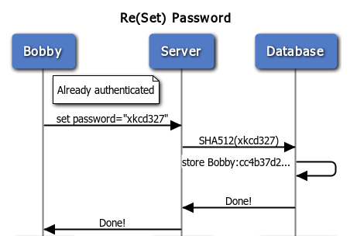
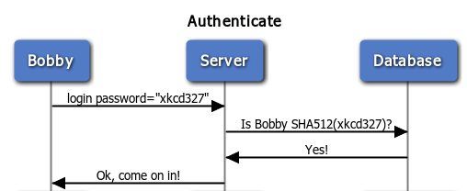
Authentication with Hashes
Use Case: (re)set password
  User inputs password
  Server hashes pw
  Stores the hash
Abuse Case: Break-in
  Attacker steals plaintext passwords from Database
  Harm done: can authenticate as any user
  Mitigation: can’t reverse the hashes
Use Case: Authenticate
  User inputs password
  Server computes hash
  Checks the hashes
Notes:
title Re(Set) Password
note right of Bobby: Already authenticated
Bobby->Server: set password="xkcd327"
Server->Database: SHA512(xkcd327)
Database->Database: store Bobby:cc4b37d2...
Database->Server: Done!
Server->Bobby: Done!
title Authenticate
Bobby->Server: login password="xkcd327"
Server->Database: Is Bobby SHA512(xkcd327)?
Database->Server: Yes!
Server->Bobby: Ok, come on in!

Slide 7
Abuse Case: Rainbow Tables
What if an attacker steals the hashes?
  common passwords + common digests = common hashes
  Thus, attackers have large databases of pre-computed hashes called rainbow tables
Solution: hashing with salt
  Today’s VotD

Slide 8
Hash Collisions
By definition, hash digests cannot uniquely map data to a hash
  Thus, many pieces of data map to the same hash
  A collision is two known pieces of data that map to the same hash number
  Can be used to “spoof” a password
MD4, MD5 & SHA1 now considered “broken”
  Colliding digests can be manufactured
  http://www.phreedom.org/research/rogue-ca/
  Still cannot be reversed, and probably won’t be

Slide 9
Symmetric-Key Cryptography
Encrypt key == Decrypt key
  So keep that key a secret!!
  Traditional arrangement
Modern algorithms
  AES
  Blowfish
  3DES
Traditional usage
  Encryption of data storage: backups, hard drives, etc.
  Not typically for networking situations
    Both parties need the same key
    Can’t send that key in the open over the wire
    Could hard-code the keys ahead of time, but what if we need to change the key??

Slide 10
Public-Key Cryptography
Encrypt key is public,
Decrypt key is private
  Anyone in the world can encrypt data and send it do you
  But they can’t decrypt any other messages sent to you
Most popular modern algorithm: RSA
  Factorization of two prime numbers
  Public/private keys generated from computing two very large prime numbers
RSA has never been cracked, although…
  The algorithms for generating very large primes have been cracked/poorly implemented many times
  Result of poor PRNG practices (bad algorithms & bad seeds)
Traditional usage: networking (SSH, SSL, PGP)

Slide 11
Public-key Authentication
E[..] is “encrypt” (public)
D[..] is “decrypt” (private)
  D[E[m]]=m is encrypt then decrypt m (normal usage)
  D[m] is use the decryption on plain text m (strange, but legal)
Scenario: Adam and Eve
  Adam’s public and private: E_{Adam}[..] and D_{Adam}[..]
  Eve’s public and private: E_{Eve}[..] and D_{Eve}[..]
  They know each others’ public keys
    Adam has access to E_{Eve}[..]
    Eve has access to E_{Adam}[..]
Adam wants to ensure Eve that the message came from him,
  So he does: m=“This should be bubbles: D_{Adam}[bubbles]”
  Sends E_{Eve}[m] to Eve – only Eve can read the message with D_{Eve} [m]
  Eve checks E_{Adam}[D_{Adam}[bubbles]]=bubbles so that the message came from Adam, and not, say, her son Cain.

Slide 12
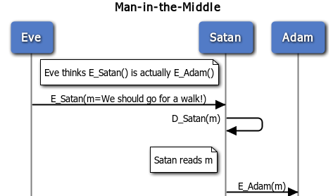
Drawbacks of Public Key
Implementation issues
  Tends to be slower than traditional symmetric key
  Generating primes with 50+ digits is hard
How do we trust the public key?
  What if Eve confuses E_{Adam} with E_{Satan}?
  Man-in-the-middle attack
    Satan intercepts it
    Decrypts it
    Reads it
    Re-encrypts it properly
    Sends it off to Adam
Notes:
title Man-in-the-Middle
note right of Eve: Eve thinks E_Satan() is actually E_Adam()
Eve->Satan: E_Satan(m=We should go for a walk!)
Satan->Satan: D_Satan(m)
note left of Satan: Satan reads m
Satan->Adam: E_Adam(m)

Slide 13
SSH
Secure Shell
  Used for remote access into machines
  Ubiquitous for Unix-like systems
  Uses passwords by default
SSH and public keys
  Key pairs have a one-time PRNG built in
  Private key
    Encrypted with a symmetric cipher
    Requires a “passphrase” to unlock
  Trust the public keys? authorized_keys
  Trust the host? known_hosts

Slide 14
e.g. SSH Key pairs
me@client$ ssh-keygen –t rsa
Generating public/private rsa1 key pair...
Enter file in which to save the key (~/.ssh/identity):
Enter passphrase:
Enter same passphrase again:
Your public key has been saved in ~/.ssh/id_rsa.pub
Your private key has been saved in ~/.ssh/id_rsa
The key fingerprint is: 22:bc:0b:fe:f5:06:1d:c0:05:ea:59:09:e3:07:8a:8c
Untrusted public keys?
  SSH-enabled servers don’t trust any public keys initially
  Need to copy your public key to the authorized_keys file on the server
me@client$ scp ~/id_rsa.pub me@server.edu:~
me@client$ ssh me@server.edu
me@server$ cat id_rsa.pub >> ~/.ssh/authorized_keys

Slide 15
SSH and known_hosts
When I SSH into nitron, how do I know that this isn’t a malicious server who changed his network address?
Answer: your known_hosts file
  Every server has a unique fingerprint
  First time you sign in, trust the key and add the key to your known_hosts cache
  Host changes? You’ll get a warning like this:
  @@@@@@@@@@@@@@@@@@@@@@@@@@@@@@@@@@@@@@@@@@@@@@@@@@@@@@@@@@@ @ WARNING: REMOTE HOST IDENTIFICATION HAS CHANGED! @ @@@@@@@@@@@@@@@@@@@@@@@@@@@@@@@@@@@@@@@@@@@@@@@@@@@@@@@@@@@ IT IS POSSIBLE THAT SOMEONE IS DOING SOMETHING NASTY! Someone could be eavesdropping on you right now (man-in-the-middle attack)! It is also possible that the RSA host key has just been changed. The fingerprint for the RSA key sent by the remote host is 8b:ff:a1:b5:08:2f:8f:fd:2e:2f:67:80:9e:ba:8d:ff. Please contact your system administrator. Add correct host key in /home/bob/.ssh/known_hosts to get rid of this message. Offending key in /home/bob/.ssh/known_hosts:2 RSA host key for 192.168.1.100 has changed and you have requested strict checking. Host key verification failed.

Slide 16
Next time…
More common algorithms
  Public key: SSL
  Combination of Public and Symmetric: PGP
Some common cryptanalysis techniques

