Slide 1
Insider Threat
Engineering Secure Software

Slide 2
Lottery Story
Notes:
At a lottery agency, a manager was able to turn losing tickets into winners.
He would buy the ticket, then modify the database
Stole $63,000 over a year and a half
Suspect happened to be on vacation when it was discovered, otherwise he would have been chosen to investigate the incident
They disabled his physical access, but forgot to inform his employees. He asked them to delete the logs and backups. Organization lost most of its evidence against him.

Slide 3
A Threat We Can’t Ignore
Documented incidents are prevalent
  Carnegie Melon’s SEI has studied over 700 cybercrimes originating from insider threat since 2000
Many more occurring
  In 2007, the Secret Service et al. conducted a survey of law enforcement officials & security execs
    31% of electronic crimes involved an insider
    49% of respondents experienced insider threat in the past year
Wikileaks, anyone?

Slide 4
What is insider threat?
Actors
  Current employees
  Former employees (esp. “recently former”)
  Contractors
Intentionally exceeded or misused an authorized level of access
Affected the security of the organization
  Data
  Intellectual property
  Daily business operations

Slide 5
Double Threat to SE
Insider threat affects SE in two ways
  Insider users for the system that we release
    e.g. hospital administrators
  Insiders developers to our own software development company
    e.g. disgruntled developers
Liability considerations
  Will our software facilitate insider threat?
  Bring this up in your requirements elicitation meeting
    Audit mechanisms
    Deployment mechanisms
  For everything else: hire some lawyers for a sneaky EULA

Slide 6
Types of Insiders
Pure insider
  e.g. system administrator, developer
Insider associate
  e.g. developer, but on a different project
Outside affiliate
  e.g. outsourced contractor

Slide 7
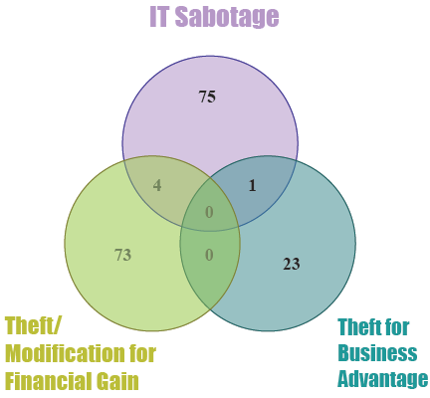
Classes of Threats
IT sabotage
Personal financial gain
Business advantage
(e.g. industrial espionage)
Miscellaneous

Slide 8
Some considerations
Majority of the attacks required significant planning ahead of time
Majority of insider attacks took place physically on the premise
Majority of insider attacks faced criminal charges
  And in most cases, the insiders were aware that they would face charges

Slide 9
Prevention vs. Detection
Prevention is extraordinarily hard
  Work environment
  Predicting human nature
  Deterrents are only somewhat effective
Detection is much more feasible
  Usually by someone using common sense
  Audits of access logs
  In most cases, live network detection was not involved
  Drawback: reactive

Slide 10
Developer Insiders
“Security through obscurity alone” is really not an option
  Insider would know what servers to go to
  Insider knows the attack surface
Access to production servers should be limited
  Non-release changes to production need to be documented
  Forces you to document your deployment process anyway
On introducing backdoors
  Very rarely introduced in the development phase
  Most often in the maintenance phase

Slide 11
General Suggestions
Be aware of the threat
  Keep up with the latest stories
  Apply those situations to yours
“Buddy” system
  Nobody should be left physically alone with important resources
Logging and auditing
  Everything is logged
  Audits should actually happen

Slide 12
More Suggestions
Job termination policies
  Have one.
  Be prepared to disable accounts quickly
Archives & offsite backups
  Mitigate tampering and destruction of backups
Rotate duties
  Better detection of anomalies
  Better knowledge transfer anyway
Holistic approach
  People, data, technology, procedures, policies

Slide 13
Some Resources
SEI’s CERT Insider Threat group
  Definitive resource
  http://www.cert.org/insider_threat/
  http://www.cert.org/archive/pdf/ecrimesummary07.pdf
The Insider Threat: Combatting the Enemy Within, by Clive Blackwell
  ISBN 9781849280112
  Available via RIT library electronically for free

Slide 14
We More Need Stories
…so that’s today’s activity
  5 groups
  Assigned sectors for CERT case studies
  Make a 5 minute presentation
    Tell us stories of insider threat
    Statistics
    Some lessons learned

