Slide 1
Tips for SUCCESSFUL Enrollment in SIS
SWEN-101 Tips and Tricks from your advisors

Slide 2
Starring ….

Slide 3
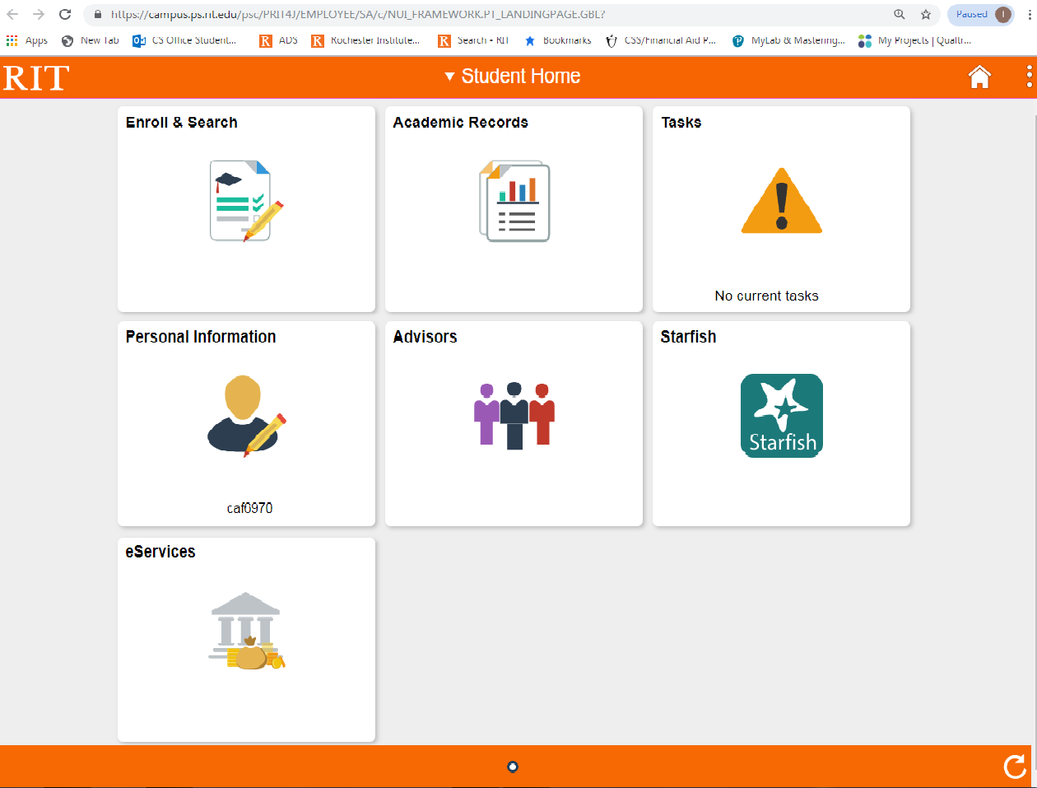
Agenda
Please review this presentation as a slide show so you can see and hear the videos. There is captioning for the videos.
Introduction
CS SE Curriculum/Flowchart
Immersion
Classes to Take/AAR
SIS
Shopping Cart/Enrollment Dates
Navigating Shopping Cart
Restrictions and Prerequisites in SIS
Enrolling
Dropping a Class
Waitlists
Swaps
Full-Time Status

Slide 4
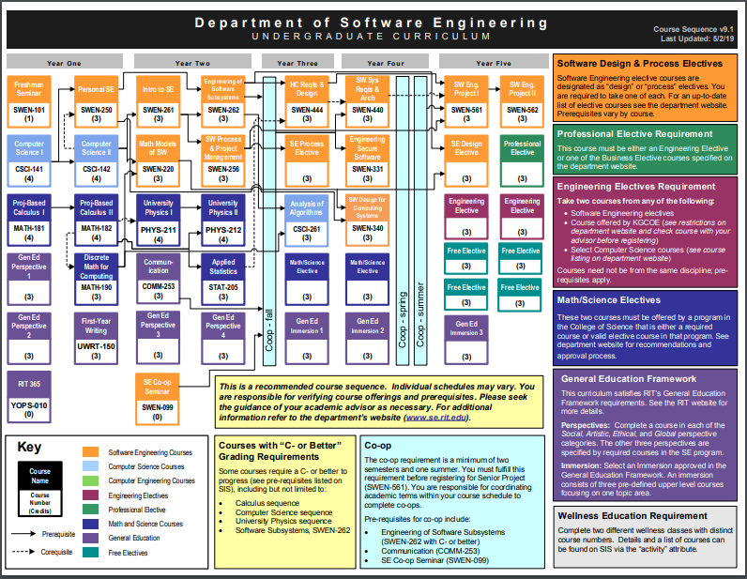
2019-2020 Flowchart

Slide 5
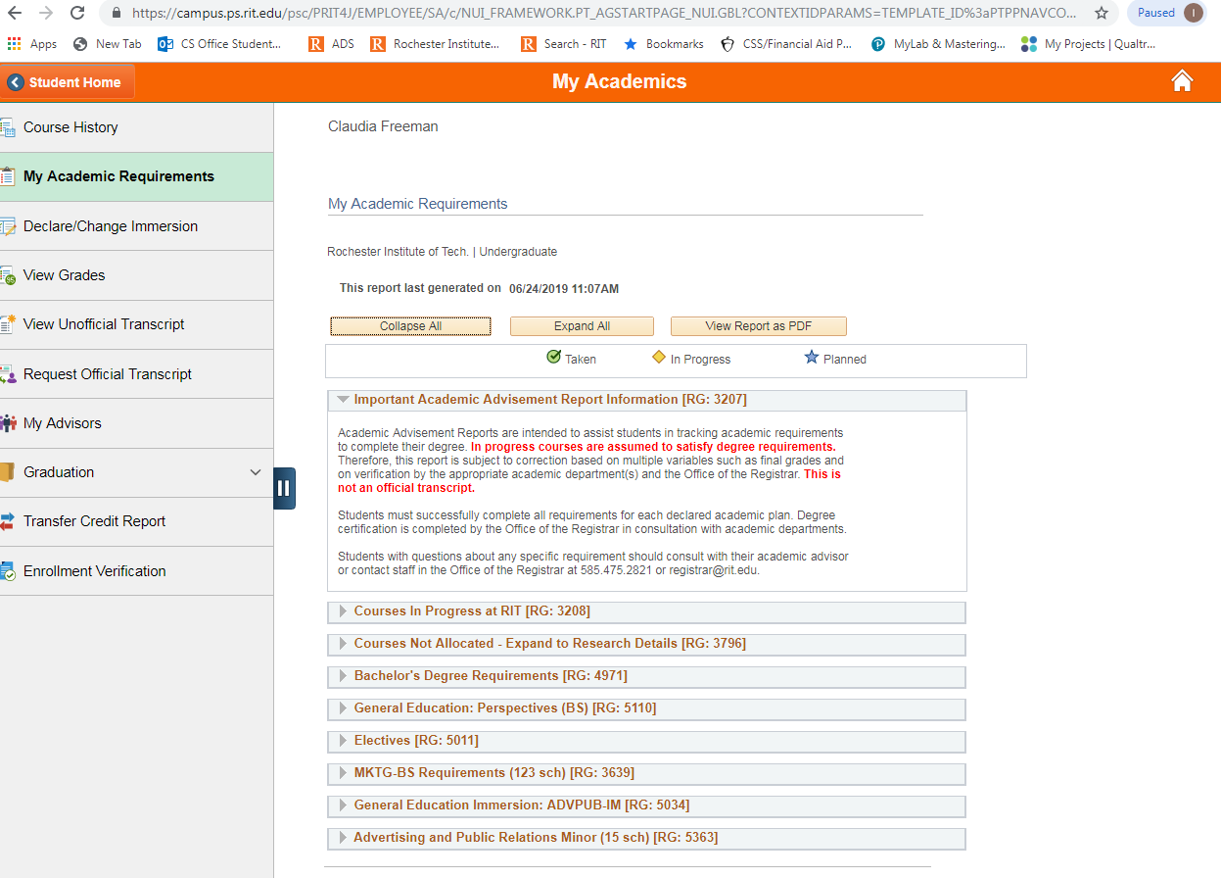
Academic Advising Report (AAR)
SIS
Academic Records
My Academic Requirements

Slide 6
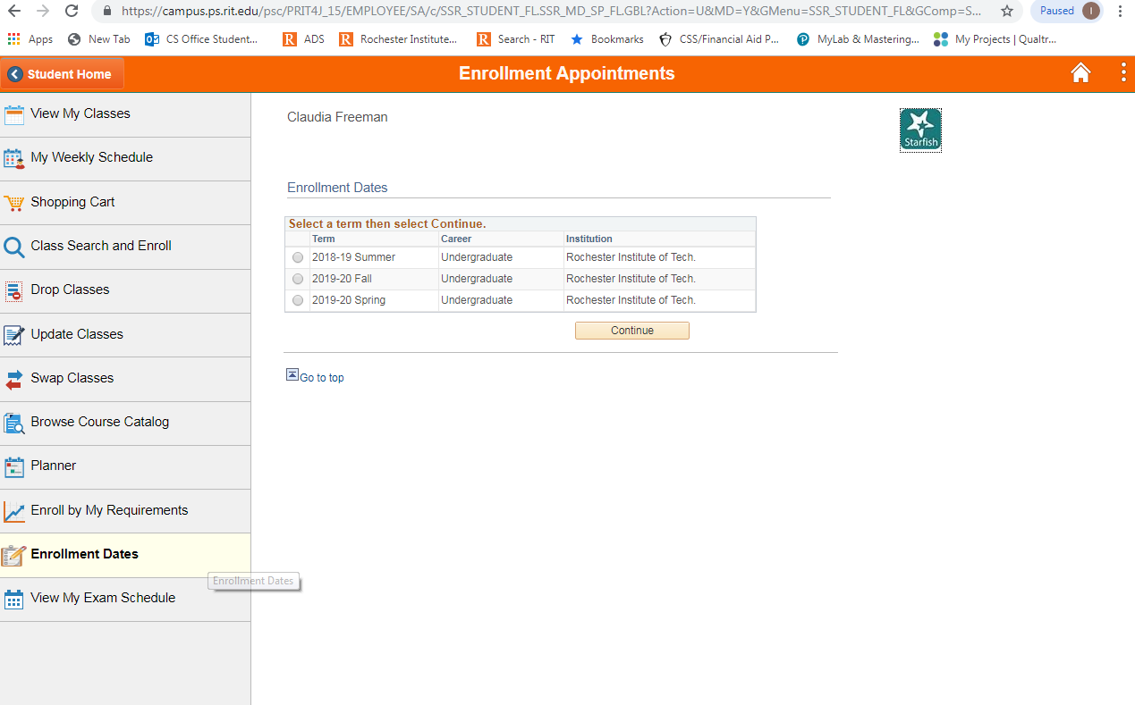
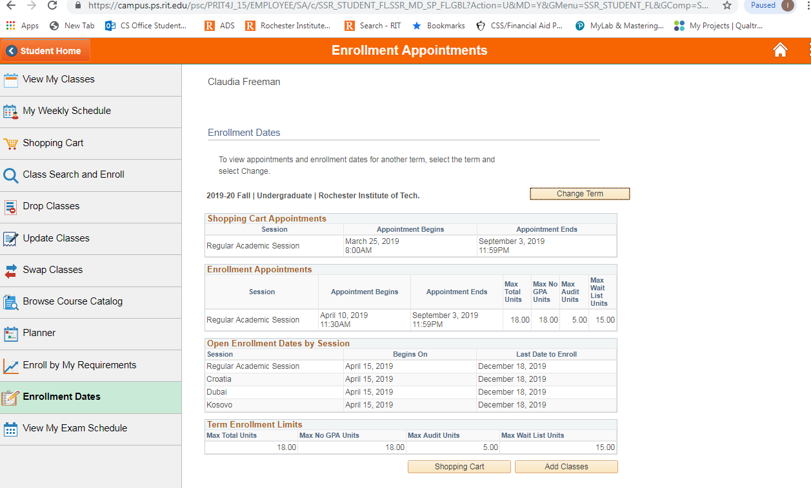
Shopping Cart Opens
Login to SIS
Select Enroll and Search
Before your enrollment appointment begins, your shopping cart allows you to create a list of classes you would like to take for the next semester.
Select Enrollment Dates on left side
Select Term
View Dates

Slide 7
Enrollment date
SIS
Enroll and Search
All matriculated students are assigned an online enrollment appointment, a specific date and time when you can begin enrolling in classes for the next semester.
Enrollment Dates
Select Term
Continue
Note: Early Enrollment Appointments are noted in SIS for Honors, Cross-registered students, and Varsity Athletes.
Be prepared to enroll on that date.

Slide 8
Navigating Shopping Cart
Viewing Course Info
Please click to learn more
↓
Login to sis, click enroll and search, on the left hand side click class search and enroll, select the term you’re planning on enrolling in, type in whatever class you’re looking for, in this case its csci 101 select
we can find enrollment requirements if there were any, class availability, and textbook information, in this case there isn’t a textbook provided yet but eventually there will be, and this is where you would find it.
the class, this will bring us to our options, we have three we can select the one that you’re interested in, here you can view class details, it shows you meeting information again, enrollment information, which is where

Slide 9
Adding Classes to shopping cart
Please click to learn more
↓
This time we are going to actually add the course to our shopping cart so it’s going to start off the same by typing in the course and selecting csci 101, we are then gonna look for the class that first best to us, at
this point well hit next in the top right corner, we do want to add it to the waitlist if the class is full, we’ll hit accept, we want to hit add to shopping cart because
we aren’t quite ready to enroll yet, hit next, review the information and click submit, hit yes, and now csci 101, principles of computing is in our shopping cart.

Slide 10
How to drop a class
Please click to learn more
↓
So if you change your mind and want to get out of the class that you’re already enrolled in, you’re going to hit enroll and search, look for drop classes, select the term, you’re gonna select the class that you
would like to drop, select next, review the information and hit drop classes, hit yes, and you have successfully dropped that class

Slide 11
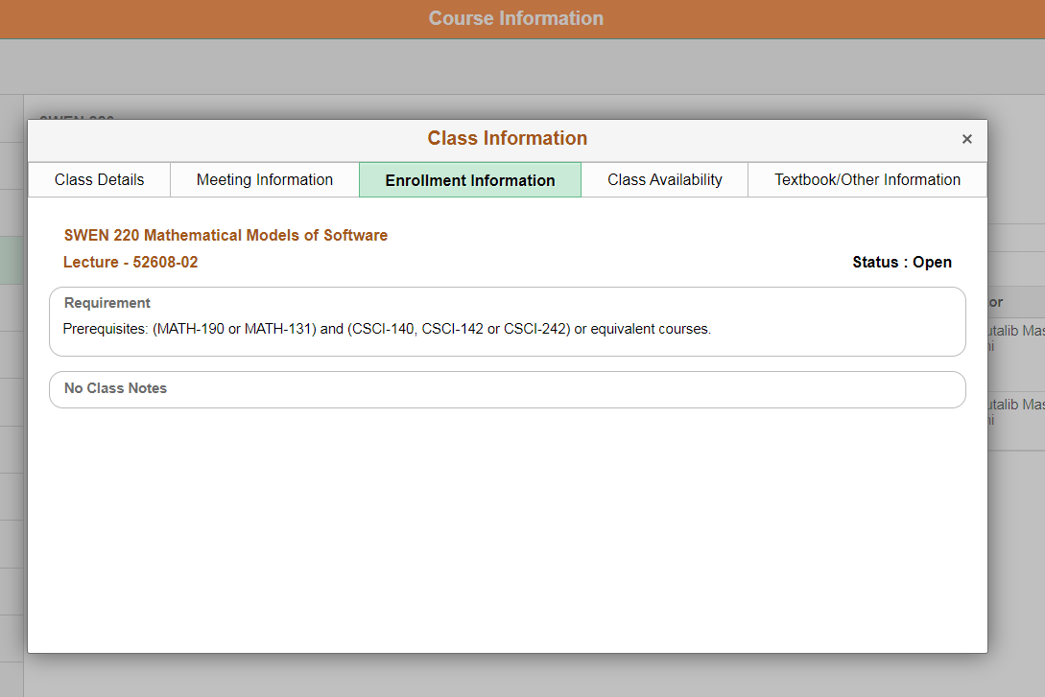
PREREQUISITES
SIS
Enroll and Search
Class Search and Enroll
Select Term
Search Class
Select the Class
Enrollment Info
This shows you need to take MATH-190 or MATH-131 AND CSCI-140, 142, or 242 before you are allowed to enroll in SWEN-220.
NOTE: SIS automatically enforces pre-requisites for ALL courses. It is your responsibility to check the pre-requisites for ALL courses at RIT. You will be dropped from courses that you no longer meet the pre-requisites for after grades post for the current term

Slide 12
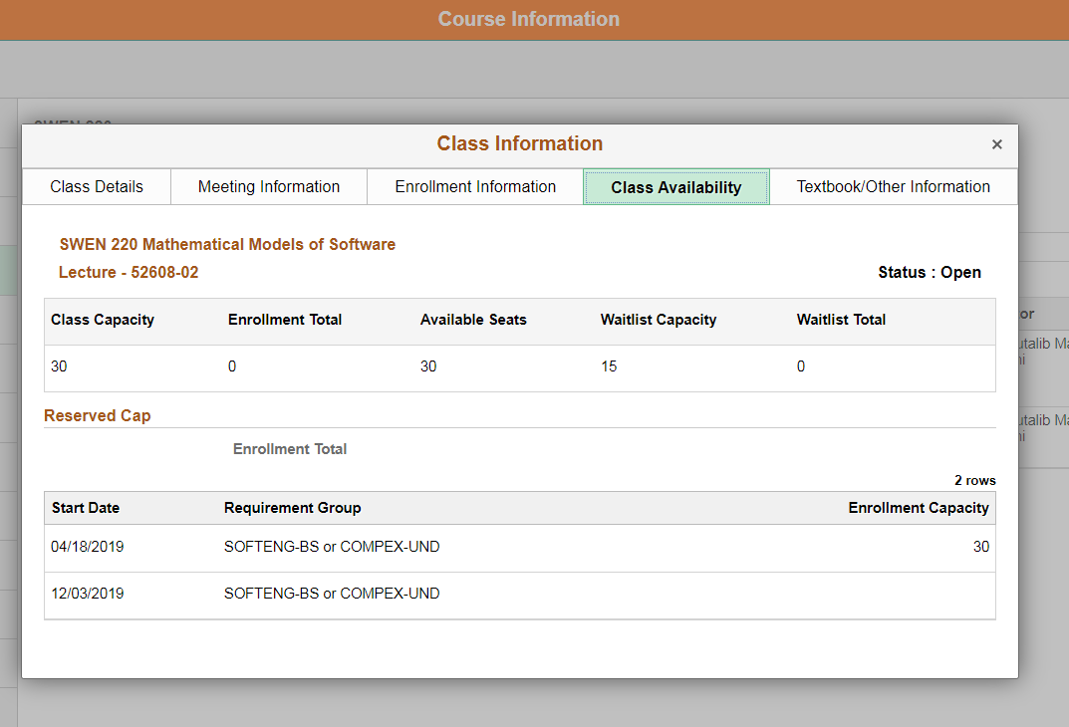
RESTRICTIONS
You are SOFTENG-BS!
All SE courses are initially restricted to SE students and other programs that require certain SE courses. Please be sure to enroll and secure your seat in SE courses as soon as you can before restrictions lift and seats are opened up to non-majors.

Slide 13
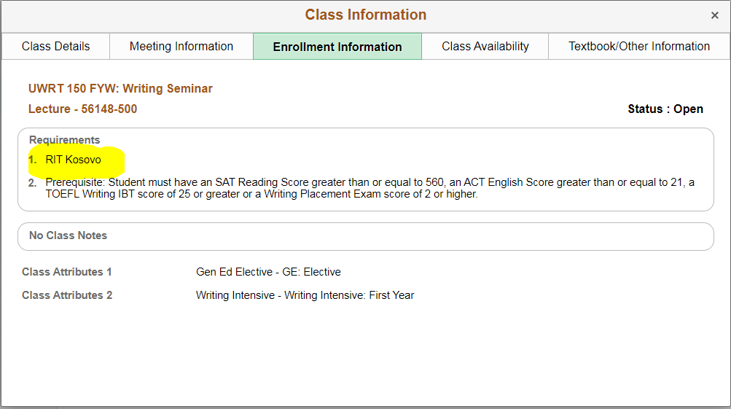
Other restrictions
RIT Global Campuses

Slide 14
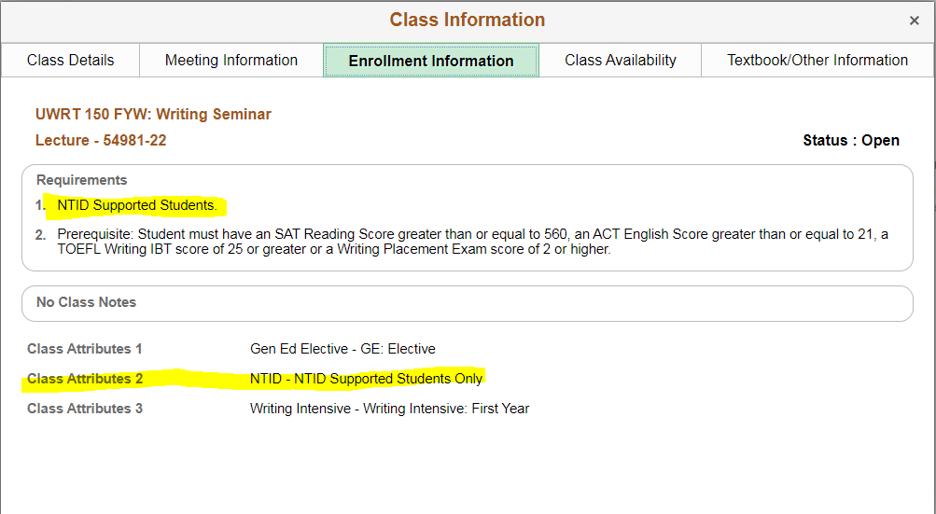
Other restrictions
NTID Supported Students only

Slide 15
How to Enroll
Please click to learn more
↓
Start of by selecting enroll and search, on the left hand side select shopping cart, select the class you want to add to your schedule, hit enroll, hit yes, and you have successfully put that class on your schedule

Slide 16
WAITLISTS
If a class is full, you may be able to add yourself to a wait list in case seats become available in the future, as long as the particular course has an active wait list that is not yet full.
When you enroll in a class, select the Wait List Class if Full checkbox when adding a class to your shopping cart. You will be assigned a number that shows your position on the wait list.
If you are going to add yourself to the wait list for a course, please be sure that you have cleared all time conflicts and maximum course units allowed*, otherwise the wait list cannot automatically enroll you should you be the next in line for an open seat.
Placing your name on a wait list does not guarantee you will be enrolled in that class, but it helps your chances.
We recommend enrolling in a back-up class and then using the swap feature to waitlist your preferred class. You cannot set up a swap once you are already on a waitlist without losing your place in line.

Slide 17
WAITLISTS
Reasons a waitlist will not work:
You are already enrolled in the SAME course number
You have a time conflict
Adding this course would exceed 18 credit hours
If you are going to add yourself to the wait list for a course, please be sure that you have cleared all time conflicts and maximum course units allowed*, otherwise the wait list cannot automatically enroll you should you be the next in line for an open seat.

Slide 18
SIS
Enroll and Search
Swap Classes
Select Term
Under Swap This Class, select the class you no longer want to take that you are currently enrolled in.
Under With This Class you have three options:
*Select a class that is in your shopping cart
*Search for a class to add to your shopping cart
(Select waitlist if class is full!!)
*Enter the 5-digit class ID if you know it.
Click the button to the right of the new class to continue the swap.
This brings you to the confirmation page where you can click either Finish Swapping to confirm or Cancel if you no longer want to swap.
SWAPS:
NOTE:
After you click Finish Swapping, you may receive a message confirming the class has been replaced successfully. However, if the class has a wait list, the message will indicate your position in the wait list line. If the class is closed or you do not have the prerequisites, the message will indicate that you cannot make the swap.
If the swap was made, your updated schedule will be displayed when you click My Class Schedule. If you set up a swap to a class with a wait list, it will show you are still enrolled in the original class and on the wait list for the new class.

Slide 19
Full time status:
Undergraduate students, full-time is between 12-18 credits.
If you do not have enough credits to be full-time, utilize Wait Lists and Swaps.
It is important to be full-time to stay in status, to work and live on campus, and for Financial Aid and Scholarships to post.

Slide 20
TRUST THE PROCESS

