Slide 1
Version (Source Code) Control
SWEN-250

Slide 2
Overview
Motivation – why is version control useful?
Key concepts
Variations on the basic theme
Example version control systems
Notes:
Appeals to the controlled and confident experimentation.

Slide 3
Motivation
Progress, far from consisting in change, depends on retentiveness. Those cannot remember the past are condemned to repeat it.
- George Santayana
Notes:
Talk about having to chuck everything and start over.
Aren’t there times when are least some shreds of work from the past could have been used?

Slide 4
Motivation Scenario: I think this will work
Often we want to try out a change
  Trying a new algorithm or data structure
  Reorganizing code for clarity
  Experimenting with a half-cocked idea
  Seeing if the language works like you expect
It’s a lot easier if you can perform such experiments confidently.
  That is, you can get back to where you started
  VCS can provide a virtual trail of breadcrumbs
  If you botch things, you can return to a stable state
Notes:
Appeals to the controlled and confident experimentation.

Slide 5
Motivation Scenario: How did I get here?
Like waypoints on a GPS system.
  Allows you to track progress
  You can see how your program evolved and grew, step-by-step
  You can see where you made mistakes and how long it took you to find and fix them
The fancy software engineering term is traceability.
  Important for scheduling, tracking, and planning
  Allows you to go back to a previous version (“hey, what did we ship for version 1.5.2.9.5?”)
Notes:
Appeals to the ability to see how the system evolved, and to retrieve stuff from previous versions that are useful.

Slide 6
Motivation Scenario: Reconstruct the Past
Teacher: “So, show me – what was the code like before you made this change?”
You: “Ummm...”
Notes:
Point here is to be able to discuss and show changes easily with others.

Slide 7
Motivation: Pragmatic Programmers
Tip 23
Always Use Source Code Control
So let it be written …
So let it be done!

Slide 8
Key Concepts*
A repository is a designated disk location (directory) where the files and “breadcrumbs” for a project are kept.
The work area is a location (directory) where the activities of editing, compiling, testing, etc. take place.
Files are periodically checked in to the repository from the work area, creating a new version.
Files can be checked out of the repository (to start work on existing project, or to restore the state of the work area to a previous state).
* Terminology slightly different with git

Slide 9
Check a File into a Repository
Repository
Working Area
File.txt
The quick brown
fox jumped over
the lazy dog.
check File.txt into the Repository
Repository
Working Area
File.txt (1)
File.txt
The quick brown
fox jumped over
the lazy dog.
The quick brown
fox jumped over
the lazy dog.

Slide 10
Check a Changed File into a Repository
Repository
Working Area
File.txt (1)
File.txt
The quick brown
fox jumped over
the lazy dog.
The quick black
fox jumped over
the lazy cat.
check File.txt into the Repository
Repository
Working Area
File.txt (1)
File.txt (2)
File.txt
The quick brown
fox jumped over
the lazy dog.
The quick black
fox jumped over
the lazy cat.
The quick black
fox jumped over
the lazy cat.
Notes:
Changed brown to black and dog to cat. This shows the logical changes; a few slides on discusses the notion of deltas.

Slide 11
Revert to a Previous Version in a Repository
Repository
Working Area
File.txt (1)
File.txt
The quick brown
fox jumped over
the lazy dog.
The quick black
fox jumped over
the lazy cat.
check version 1 of File.txt out to the Work Area
Repository
Working Area
File.txt (1)
File.txt (2)
File.txt
The quick brown
fox jumped over
the lazy dog.
The quick black
fox jumped over
the lazy cat.
The quick brown
fox jumped over
the lazy dog.

Slide 12
A Potential Problem
We’ll have multiple copies of File.txt that are almost the same –won’t this waste space?
Yes – unless we use deltas.
  Usually changes from version to version are small.
  We can save space by only saving the changes (deltas).
  Basically, we need additions, deletions, changes.
Example: a lno appended_text
d lno
c lno start length new_text
With smart differences and compression, deltas become very small.
Notes:
“a” says place appended_text after line number lno
“d” says delete line number lno
“c” says change text at position start for length characters on line lno to new_text

Slide 13
Check in a Changed File (w/deltas)
Repository (version 1)
Working Area
File.txt (1)
File.txt
The quick brown
fox jumped over
the lazy dog.
The quick black
fox jumped over
the lazy cat.
check File.txt into the Repository (using deltas)
Repository (version 2)
Working Area
File.txt (1)
File.txt (2)
File.txt
The quick brown
fox jumped over
the lazy dog.
c 1 11 5 black
c 3 10 3 cat
The quick black
fox jumped over
the lazy cat.

Slide 14
File vs. Repository Versioning
Versioning by file:
  Each file in repository has its own version number.
  Frequently changed files have higher numbers than stable files.
  May be difficult to find all the individual files representing one logical version.
Versioning by repository:
  Any changes update the version number of the entire repository.
  Easy to find all files comprising a given system version.
  Harder to find specific version of a given file.
Notes:
I added this because GIT and CVS, the systems used in 250 and CS3, respectively, use different approaches.

Slide 15
Centralized vs. Distributed Repositories
Centralized:
  One master directory.
  All changes (by any team member) are applied to the master.
  Difficult for individuals to leave bread crumbs for their own experiments.
Distributed:
  Every developer has own repository.
  Changes are done to local repository.
  If working on a team, periodically PUSH local changes to designated central repository.
Notes:
I added this because GIT and CVS, the systems used in 250 and CS3, respectively, use different approaches.

Slide 16
Sample of Version Control Systems
CVS – Concurrent Versioning System
  Centralized
  File versioning
  Used in CS3
git – from Linus Torvalds, creator of Linux
  Decentralized
  Repository versioning
  Used in this course
Some others you may encounter
  SVN – Subversion: Centralized, repository versioned
  TFS – Team Foundation Services: Centralized & Distributed, file and repo versions
  RCS – Revision Control System: Centralized, file versioned
  SCCS – Source Code Control System: Centralized, file versioned
Notes:
Do you think we need something on VCS’s in a team environment?
I (MJL) don’t think so, as it will lead to brain overload.
But that means we must revisit VC again in 361/261 to discuss the team aspects (e.g., locking, concurrent changes with conflict detection / resolution, etc.).

Slide 17
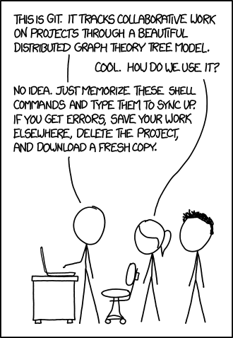
Git
Understanding the machinery to whittle away the uncertainty
Been here before? (web comic by XKCD)

Slide 18
Git vocabulary
repository: a place for storing things aka repo. With Git, this means your code folder
clone: Copy all files from a repo to your local drive
head: A “pointer” to the latest code you were working on
add: An action to ask Git to track a file
commit: An action to save the current state to prepare for next step (e.g. push to repo)
remote: A repository that isn’t local. Can be in another folder or in the cloud (for example: Github or gitlab): helps other people to easily collaborate, as they don’t have to get a copy from your system — they can just get it from the cloud. Also, ensures you have a backup in case you break your laptop
pull: An action to get updated code from the remote
push: An action to send updated code to the remote
merge: An action to combine two different versions of code
status: Displays information about current repository status
log: Show the history of the repo actions

Slide 19
Where is everything?
$ tree .git/
.git/
├── HEAD
├── config
├── description
├── hooks
│ ├── applypatch-msg.sample
│ ├── commit-msg.sample
│ ├── post-update.sample
│ ├── pre-applypatch.sample
│ ├── pre-commit.sample
│ ├── pre-push.sample
│ ├── pre-rebase.sample
│ ├── pre-receive.sample
│ ├── prepare-commit-msg.sample
│ └── update.sample
├── info
│ └── exclude
├── objects
│ ├── info
│ └── pack
└── refs
├── heads
└── tags
8 directories, 14 files
Introducing the magic controlled by a hidden folder: .git/
In every git repository, you’ll see something like this

Slide 20
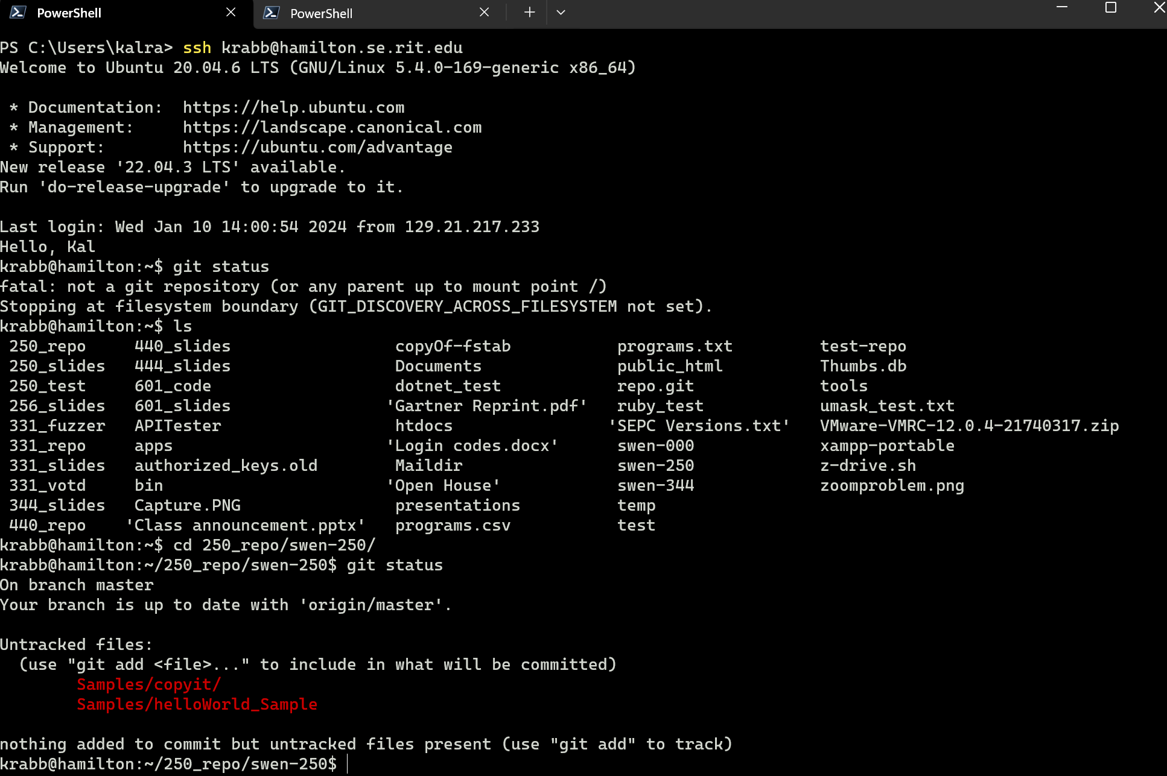
A terminal session …
ssh to server
Wrong directory!
Unix commands
Correct directory

Slide 21
Remember these commands
git status
git add . (IF you have new files)
git commit –m”a useful commit comment”
git push

Slide 22
A good reference
https://medium.freecodecamp.org/how-not-to-be-afraid-of-git-anymore-fe1da7415286

