Slide 1
SWEN-250 Personal SE
Introduction to C

Slide 2
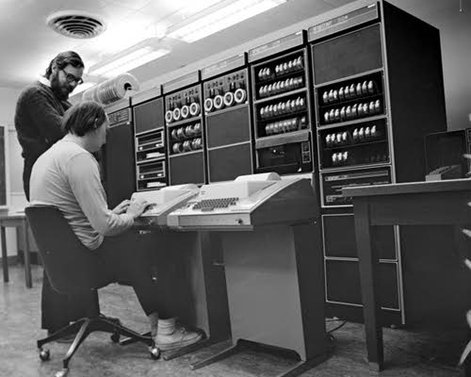
In the beginning …
Notes:
http://ics.upjs.sk/~jirasek/arp/history.htm
DEC PDP-11 - A 16-bit successor to the PDP-8 also utilizing byte addressable memory. The PDP series was an extremely popular computer due to low cost and good performance. Its 16-bit address space caused it to decline in popularity as large memories became cheaply available with the introduction of VSLI technology. This picture is of Dennis Ritchie and Kenneth Thompson, creators of the UNIX operating system, at a PDP-11. (1970)

Slide 3
A Bit of History
Developed in the early to mid 70s
  Dennis Ritchie as a systems programming language.
  Adopted by Ken Thompson to write Unix on a the PDP-11.
At the time:
  Many programs written in assembly language.
  Most systems programs (compilers, etc.) in assembly language.
  Essentially ALL operating systems in assembly language.
Proof of Concept
  Even small computers could have an OS in a HLL.
  Small: 64K bytes, 1μs clock, 2 MByte disk.
  We ran 5 simultaneous users on this base!
Notes:
Dennis Ritchie and Brian Kernighan; that version is generally referred to as "K&R" C

Slide 4
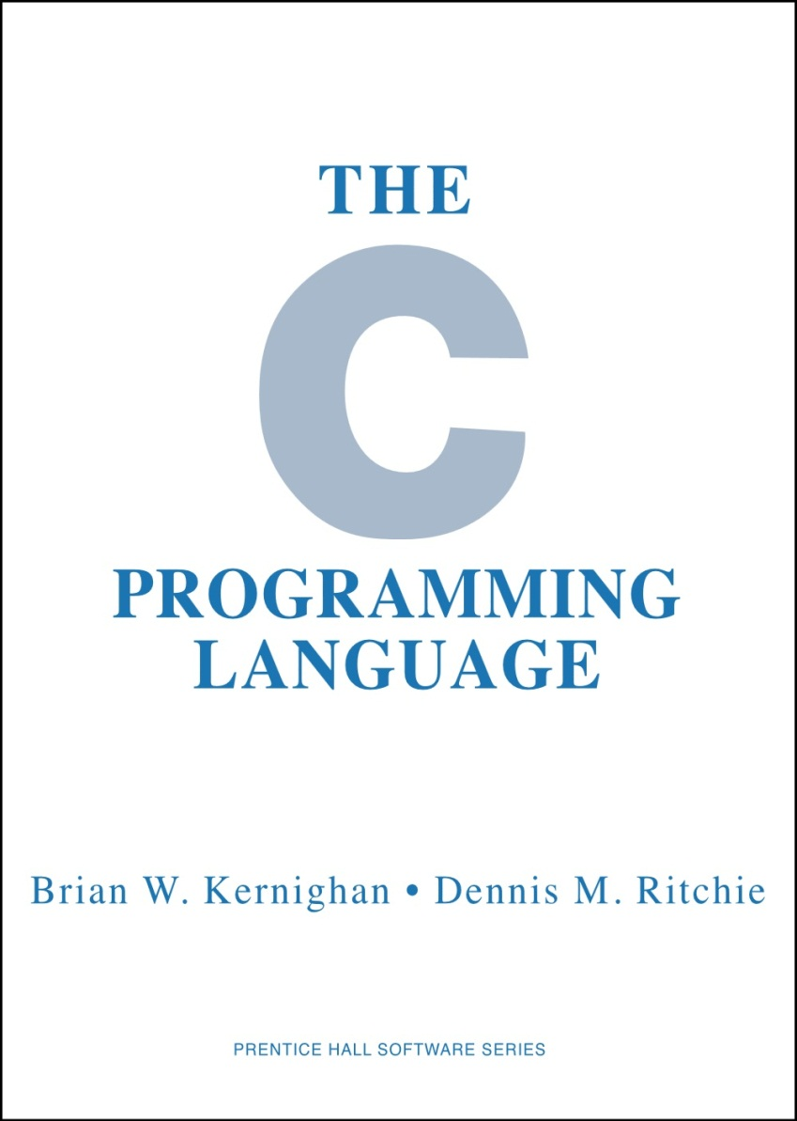

Slide 5
But Efficiency Wasn't Cheap in the 70s
Code written in assembly
High level languages in their infancy
Desire to write programs with fewer lines of code, but retain control
C as a consequence:
  Has types (but they can be easily ignored).
  Has no notion of objects (just arrays and structs)
    OO was a mostly a research topic
  Permits pointers to arbitrary locations in memory (
  Has no garbage collection – it's the programmer's job to manage memory.
C was a major advancement from FORTRAN, MACRO ASSEMBLER, BUT:
  Very powerful and doesn't get in your way.
  Very dangerous and you can cut off your fingers.

Slide 6
Most languages have borrowed from C
{ and } for grouping.
Prefix type declaration (e.g., int i vs. i : int).
Control structures (mostly)
  if, switch
  while, for
Arithmetic (numeric) operations:
  ++ and -- (prefix and suffix)
  op= (e.g. += *=, etc.)
  + - * / %
Relational & boolean operators:
  < > <= >= != ==
  ! || &&
C++
Java
C#
Javascript
PHP
…

Slide 7
Things Uniquely C vs. Interpreted languages
Today
  No classes – just functions & data.
  Characters are just small integers.
  No booleans. *
  Limited visibility control via #include and separate compilation.
  Simple manifest constants via #define
Later
  Array size fixed at compile time.
  Strings are just constant arrays.
  Simple data aggregation via structures (struct)
  And, last but not least – POINTERS!!!
*In the C99 version, there is ‘_Bool’. However C99 is not universally adopted.

Slide 8
Compiled vs. Interpreted
Short version
  Compiled languages are converted to CPU specific binary code and then run (C/ C++/ FORTRAN/ Eiffell, PL-I …)
  Interpreted languages are converted to intermediate ‘bytecode’ and run within a runtime library which is specific to each CPU/ OS (Java, C#, Ruby, …)

Slide 9
Compiled vs. interpreted languages
C\C++
Language
Language
Java/ C#
Pre-Processor
Parser
Parser
Compiler
IDL
OS/ CPU specific
Assembler
Binary/ Executable
Runtime Libraries
CPU
CPU
For ‘C’, you will need to execute a command like
gcc –o <outputfile> <inputfile.c>

Slide 10

C is powerful, but …
C

Slide 11
Basics: 2 file approach
.h file (header)
.c/ .cpp file on Windows
.c/ .cc file on *nix
Definition file
Implementation file
‘include’ this file to reference:
Variables
Functions
Classes
Your implementation code goes here
In very, very trivial programs (i.e. just a few line of code in ‘main’, you may get away with not adding a ‘.h file)

Slide 12
stdin and stdout
You will typically work from the command line (console)
stdin is ‘standard in(put)’
  This is where C will assume any incoming data is ‘input’ from. Usually the command line, but often used via redirection from a file
stdout is ‘standard out(put)’
  Normally output (from printf or puts) goes to the console, but can also be redirected

Slide 13
Functions & Data
C functions – like methods free from their class.
The most important function: main
Example: Hello, world
#include <stdlib.h>
#include <stdio.h>
int main( ) {
puts( "Hello, world!" ) ;
return 0 ;
}

Slide 14
Functions & Data
C functions – like methods free from their class.
The most important function: main
Example: Hello, world
Includes interface information to other modules
Similar to import in Java
But done textually!!
#include <stdlib.h>
#include <stdio.h>
int main( ) {
puts( "Hello, world!" ) ;
return 0 ;
}

Slide 15
Functions & Data
C functions – like methods free from their class.
The most important function: main
Example: Hello, world
stdlib
atoi, atol, atof
memory allocation
abort, exit, system, atexit
qsort, bsearch [advanced]
#include <stdlib.h>
#include <stdio.h>
int main( ) {
puts( "Hello, world!" ) ;
return 0 ;
}

Slide 16
Functions & Data
C functions – like methods free from their class.
The most important function: main
Example: Hello, world
stdio
getchar, fgetc, putchar, fputc
printf, fprintf, sprintf
gets, puts, fgets, fputs
scanf, fscanf, sscanf
#include <stdlib.h>
#include <stdio.h>
int main( ) {
puts( "Hello, world!" ) ;
return 0 ;
}

Slide 17
Functions & Data
C functions – like methods free from their class.
The most important function: main
Example: Hello, world
Every C program has a main function – the first function called.
main returns exit status.
0 = ok
anything else = abnormal.
#include <stdlib.h>
#include <stdio.h>
int main( ) {
puts( "Hello, world!" ) ;
return 0 ;
}

Slide 18
Functions & Data
C functions – like methods free from their class.
The most important function: main
Example: Hello, world
puts, from stdio, prints a string and appends a newline ('\n').
Strings are simpler in C than Java.
C strings are just arrays of characters.
#include <stdlib.h>
#include <stdio.h>
int main( ) {
puts( "Hello, world!" ) ;
return 0 ;
}

Slide 19
Comments
#include <stdlib.h>
#include <stdio.h>
/*This is a comment*/
int main( ) {
puts( "Hello, world!" ) ;
return 0 ;
}

Slide 20
Printing to the console
The ‘C’ function printf can also be used to print strings or other data
  printf("Hello printf world\n");
  printf("%s\n","Hello %s");
  int i = 5;
  printf("Value of i is %d\n",i);
  Note the special characters for \n and %s, %d
  Note that variables are declared with the data type! (int i;)

Slide 21
Flow control and iteration
Simple for loops look like this
for (int i = 0; i < 5; i++)
{
printf(“I = %d\n”, i);
}
OR
for (int i = 0; i < 22; i+=2)
{
printf(“I = %d\n”, i);
}
Flow control in ‘C’ uses normal ‘if then else’ syntax
if (value > 5)
{
printf(“It’s big\n”);
}
else
{
printf(“It’s small\n”);
}
Watch for compiler differences. You may need to declare your loop variable OUTSIDE the for loop!

Slide 22
Characters are ASCII Bytes
Consider the following C constants"
  'a' 97(decimal) 0141(octal) 0x61(hex)
In C they are all the same value – a small positive integer.
That is, character constants are just small integers.
  Use the notation that expresses what you are doing:
  If working with numbers, use 97 (or 0141 / 0x61 if bit twiddling).
  If working with letters, use 'a'.
  Question: what is 'a' + 3?
  Question: if ch holds a lower case letter, what is ch - 'a'?
Escape sequences with backslash:
  '\n' == newline, '\t' == tab, '\r' == carriage return
  '\ddd' == character with octal code ddd (the d's are digits 0-7).
  '\0' == NUL character (end of string in C).

Slide 23
Integer Types in C
char
unsigned char
short
unsigned short
int
unsigned int = unsigned
long
unsigned long
long long
unsigned long long
one byte = 8 bits - possibly signed
one byte unsigned
two bytes = 16 bits signed
two bytes unsigned
"natural" sized integer, signed
"natural" sized integer, unsigned
four bytes = 32 bits, signed
four bytes, unsigned
eight bytes = 64 bits, signed
eight bytes, unsigned

Slide 24
Another Example – Count Punctuation
#include <stdlib.h>
#include <stdio.h>
#include <ctype.h>
int main( ) {
int tot_punct = 0 ; // declare & init. a local variable
int nchar ; // next character read
while( (nchar = getchar()) != EOF ) {
if( ispunct(nchar) ) {
tot_punct++ ;
}
}
printf( "%d punctuation characters\n", tot_punct ) ;
return 0 ;
}

Slide 25
Another Example – Count Punctuation
ctype
isalnum, isalpha, isdigit, iscntrl
islower, isupper, ispunct, isspace
isxdigit, isprint
toupper, tolower
#include <stdlib.h>
#include <stdio.h>
#include <ctype.h>
int main( ) {
int tot_punct = 0 ; // declare & init. a local variable
int nchar ; // next character read
while( (nchar = getchar()) != EOF ) {
if( ispunct(nchar) ) {
++tot_punct ;
}
}
printf( "%d punctuation characters\n", tot_punct ) ;
return 0 ;
}

Slide 26
Another Example – Count Punctuation
Next character from standard in.
Why int and not char?
Because EOF is negative!
#include <stdlib.h>
#include <stdio.h>
#include <ctype.h>
int main( ) {
int tot_punct = 0 ; // declare & init. a local variable
int nchar ; // next character read
while( (nchar = getchar()) != EOF ) {
if( ispunct(nchar) ) {
++tot_punct ;
}
}
printf( "%d punctuation characters\n", tot_punct ) ;
return 0 ;
}

Slide 27
Another Example – Count Punctuation
Common C idiom:
Get & assign value
Compare to control flow
= vs. == can kill you here.
#include <stdlib.h>
#include <stdio.h>
#include <ctype.h>
int main( ) {
int tot_punct = 0 ; // declare & init. a local variable
int nchar ; // next character read
while( (nchar = getchar()) != EOF ) {
if( ispunct(nchar) ) {
++tot_punct ;
}
}
printf( "%d punctuation characters\n", tot_punct ) ;
return 0 ;
}

Slide 28
Another Example – Count Punctuation
EOF defined in stdio.h as (-1)
Not a legal character.
Signals end-of-file on read.
#include <stdlib.h>
#include <stdio.h>
#include <ctype.h>
int main( ) {
int tot_punct = 0 ; // declare & init. a local variable
int nchar ; // next character read
while( (nchar = getchar()) != EOF ) {
if( ispunct(nchar) ) {
++tot_punct ;
}
}
printf( "%d punctuation characters\n", tot_punct ) ;
return 0 ;
}
Wait, what file??

Slide 29
Another Example – Count Punctuation
Helper function from ctype
True iff nchar is punctuation.
#include <stdlib.h>
#include <stdio.h>
#include <ctype.h>
int main( ) {
int tot_punct = 0 ; // declare & init. a local variable
int nchar ; // next character read
while( (nchar = getchar()) != EOF ) {
if( ispunct(nchar) ) {
++tot_punct ;
}
}
printf( "%d punctuation characters\n", tot_punct ) ;
return 0 ;
}

Slide 30
Another Example – Count Punctuation
Formatted output to standard out.
printf = print formatted
1st argument is format string
Remaining arguments are printed
according to the format.
#include <stdlib.h>
#include <stdio.h>
#include <ctype.h>
int main( ) {
int tot_punct = 0 ; // declare & init. a local variable
int nchar ; // next character read
while( (nchar = getchar()) != EOF ) {
if( ispunct(nchar) ) {
++tot_punct ;
}
}
printf( "%d punctuation characters\n", tot_punct ) ;
return 0 ;
}

Slide 31
Short Digression on Printf
Format string printed as is except when encounters '%'
  %d print integer as decimal
  %f print floating point (fixed point notation)
  %e print floating point (exponential notation)
  %s print a string
  %c print integer as a character
  %o / %x print integer as octal / hexadecimal
Format modifiers - examples
  %n.mf at least n character field with m fractional digits
  %nd at least n character field for a decimal value.
Example:
  printf("%d loans at %5.2f%% interest\n",nloans, pct) ;
See the stdio.h documentation for more on format control.

Slide 32
Boolean = Integer
There is no boolean type in C.*
0 is false, everything else is true.
  False: 0 0.0 '\0' NULL (0 pointer).
  True: 1 'a' 3.14159
The result of a comparison operator is 0 or 1.
Many programmers define symbolic constants:
  #define TRUE (1)
  #define FALSE (0)
Pet Peeve:
GOOD PRACTICE
int result = FALSE;
if ( value < limit )
result = TRUE ;
return result;
VERY BAD
return value < limit;
SLOPPY
if ( value < limit )
return TRUE;
else
return FALSE;
*In the C99 version, there is ‘_Bool’. However C99 is not universally adopted.
Notes:
VERY BAD: Indeterminant result i.e. you don’t know for sure what the return value wil be
SLOPPY: Two return paths
GOOD: Clean

Slide 33
static
Variables normally have the scope of the function they are declared
  Except for static
Static variables are declared and initialized once, and their values do not get reset each time the function uses it
void rememberMe()
{
static int myStatic = 0;
myStatic++;
printf(“value=%d\n”, myStatic);
}
main()
{
rememberMe();
rememberMe();
}
Notes:
First time – value=1; second time = value = 2;

Slide 34
Compilation
Our systems use the GNU C compiler (gcc)
The compilation process with two files (main.c, foo.c)
gcc –o myprog main.c foo.c
main.c
Pre-Processor
Parser/ Compiler
Assembler
foo.c
main.o
myprog
Linker
foo.o

Slide 35
Compilation
Problems can occur all along the line:
  Unterminated comments can throw off the lexer.
  Syntax errors are detected by the parser.
  The code generator / optimizer can generate bad code (highly unlikely).
  The linker may not be able to resolve all the external references.
Notes on linking:
  Every object file has a table of contents.
  Some of the names are defined in the file (e.g., main).
  Some are needed from another file (e.g., printf).
  The linker tries to resolve these BUT:
    It may not be able to find a symbol it needs (missing file?)
    It may find two definitions of a symbol (name conflict).

