Slide 1
psql
Command line interface for postgresql
Commands start with ‘\’
SQL statements end with ‘;’
Handy commands:
psql –U username //to login
\dt //list all tables
\q //quit
\i filename.sql //execute a file with sql instructions
SELECT * FROM myTable; //Just what it says!

Slide 2
PostgreSQL
GUI for Postgres
Useful for some things like initial DB creation or creating users
You should see the SQL server here

Slide 3
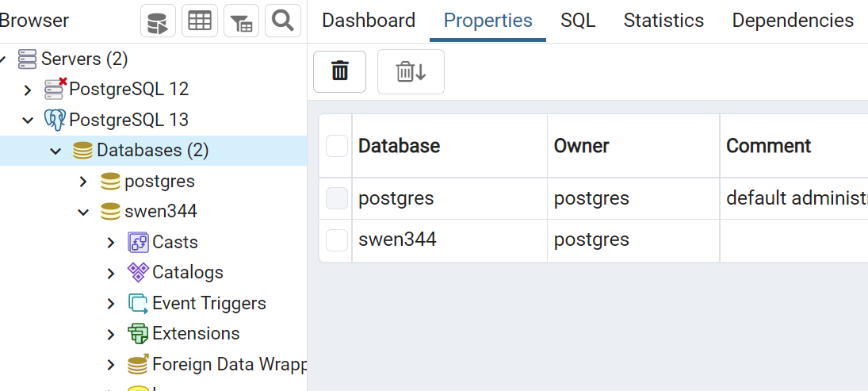
Expanding the server will show the database(s)

Slide 4
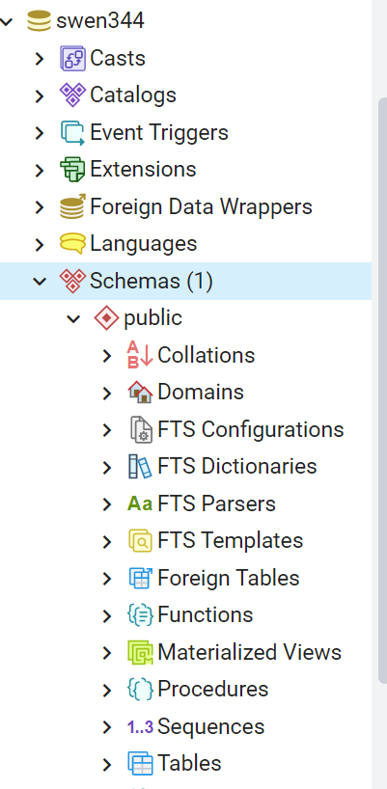
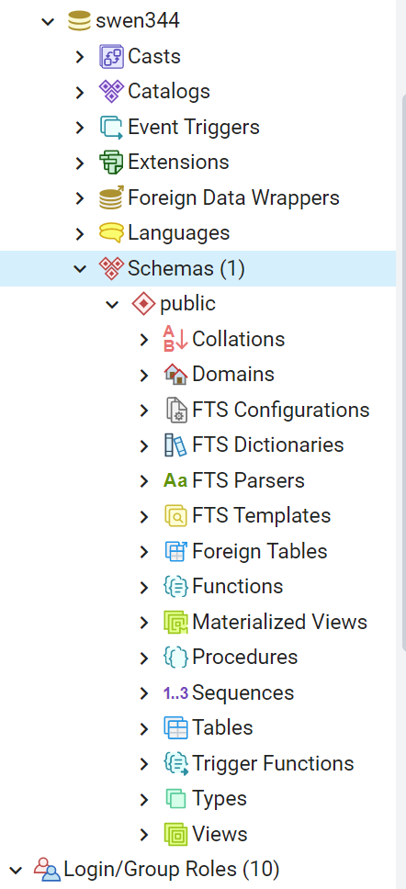
Logins and users? Way down here …
Tables are way down here (or use psql)

Slide 5
Running a single unittest
python -m unittest tests.test_generic.TestChat.test_loading
path
Module name
Class name
Method name
Notes:
py -m unittest tests.test_generic.TestChat._test_simple_query

Slide 6
git and branching
You can create branches either from the gitlab GUI, or command line (doesn’t matter)
I like using command line
e.g.
> git checkout –b new-branch > git push –u origin new-branch
Or – switching branches
>git branch
db-utils
*main > git checkout db-utils

Slide 7
git and branching
You can create merge requests from the GUI or command line
I actually prefer doing it from the GUI

Slide 8
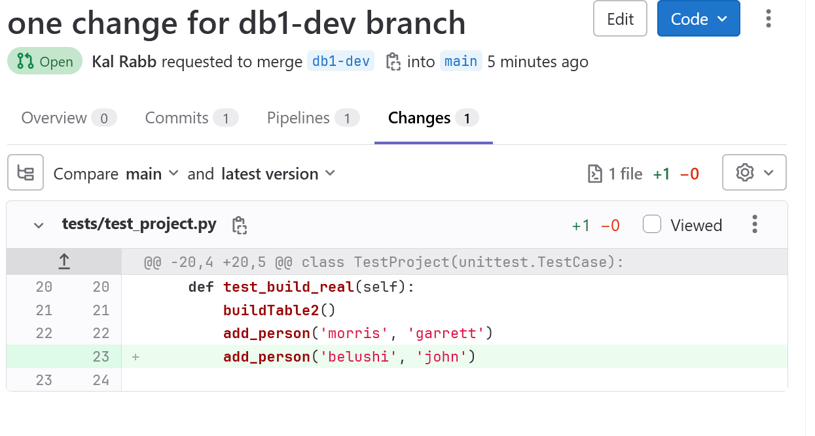
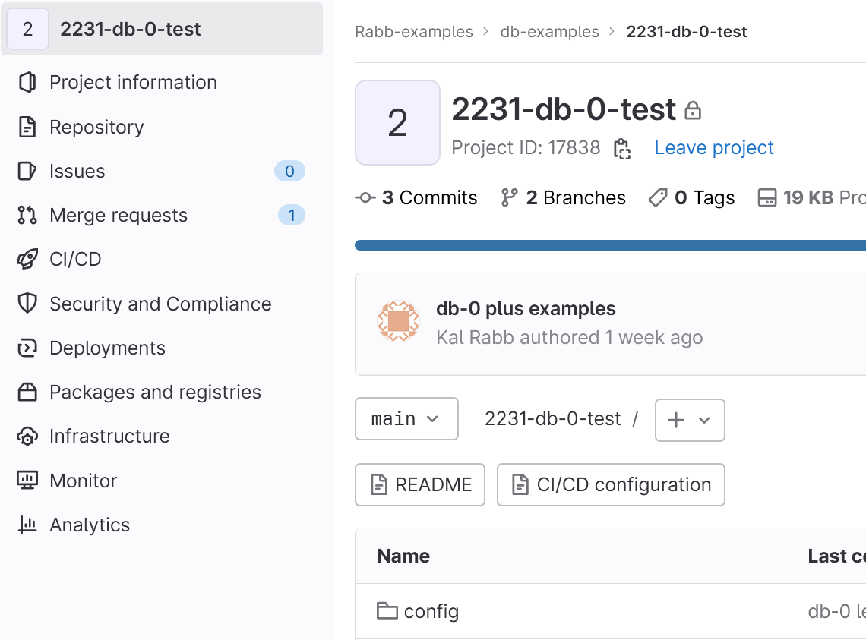
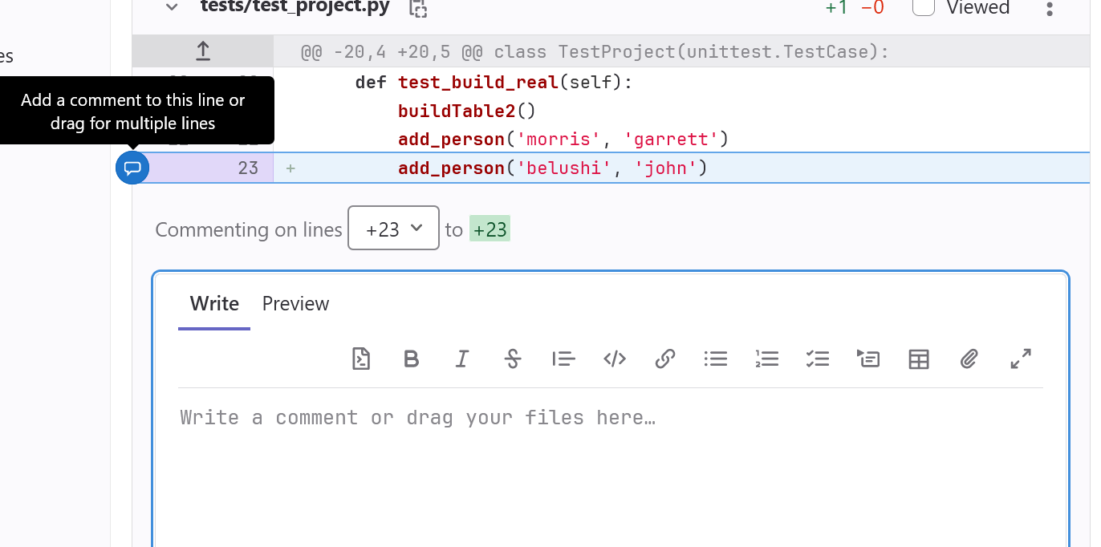
Gitlab GUI for commenting

Slide 9
Other points
If you have a PK defined SERIAL PRIMARY KEY …
If you do manual INSERTS and specify the PRIMARY KEY (INSERT INTO my_table (id,data ) VALUES (1,’something’) then
The DB no longer knows which PK to use next (since you bypassed it)
To RESET that sequence use:
ALTER SEQUENCE my_table_id_seq RESTART 2;
tablename_column_seq

Slide 10
Forcing a table reference
CREATE TABLE T_ITEMS
(
ID SERIAL PRIMARY KEY, ITEM_CODE CHAR(6) NOT NULL, ITEM_DESC VARCHAR(128)
);
CREATE TABLE T_TRACK (ID SERIAL PRIMARY KEY, NUM DECIMAL(6,0) NOT NULL, ITEM_ID INTEGER NOT NULL REFERENCES T_ITEMS
);
INSERT INTO T_ITEMS (ITEM_CODE, ITEM_DESC) VALUES ('AA', 'AA DESC');
INSERT INTO T_TRACK (NUM, ITEM_ID) VALUES (2.0, 1);
Now try DROP TABLE T_ITEMS;
Now try DROP TABLE T_ITEMS CASCADE;

Slide 11
Forcing a table reference (2)
CREATE TABLE T_ITEMS
(
ID SERIAL PRIMARY KEY, ITEM_CODE CHAR(6) NOT NULL, ITEM_DESC VARCHAR(128)
);
CREATE TABLE T_TRACK (ID SERIAL PRIMARY KEY, NUM DECIMAL(6,0) NOT NULL, ITEM_ID INTEGER NOT NULL REFERENCES T_ITEMS ON DELETE CASCADE
);
INSERT INTO T_ITEMS (ITEM_CODE, ITEM_DESC) VALUES ('AA', 'AA DESC');
INSERT INTO T_ITEMS (ITEM_CODE, ITEM_DESC) VALUES ('BB', 'BB DESC');
INSERT INTO T_TRACK (NUM, ITEM_ID) VALUES (2.0, 1);
INSERT INTO T_TRACK (NUM, ITEM_ID) VALUES (3.0, 2);
Now try DELETE FROM T_ITEMS WHERE ID=1;

Slide 12
No concatenation
As our website says
As a matter of security, you shall NEVER concatenate SQL query strings using user data. This is called a SQL injection vulnerability. Instead, use prepared statements with binding variables. Psycopg2 explains how to do this
This means
DON’T do sqlString = “GET * FROM table WHERE col=“ + myVariable
Do sqlString = “GET * FROM table WHERE col=%s”
exec_get_all(sqlString,(myVariable,))
See my examples in gitlab as well …

