Slide 1
Performance of Relational DBs
SWEN-344 Web Engineering

Slide 2
The life of an SQL query
Starts as a string in another language, e.g. Python
Compilation:
  string gets tokenized into a list of tokens SELECT username, pw_hash FROM users
  token list gets converted to parse tree, a custom tree data structure
Query rewrite
  Convert from parse tree to logical query plan
  Plenty of optimizations & intelligent decision-making in this step.
  Decisions driven by database schema
  e.g. “I need to do loop over this table and look in this column for that item”
Physical plan generation
  Convert logical query plan to physical query plan
  Decision driven by disk I/O, caching in RAM, network I/O, size of the table, arrangement of the records in the table
  e.g. “When we loop through this table, cache it in RAM because we’ll probably need it again”
“Query optimizer” is the general term for those last two steps

Slide 3
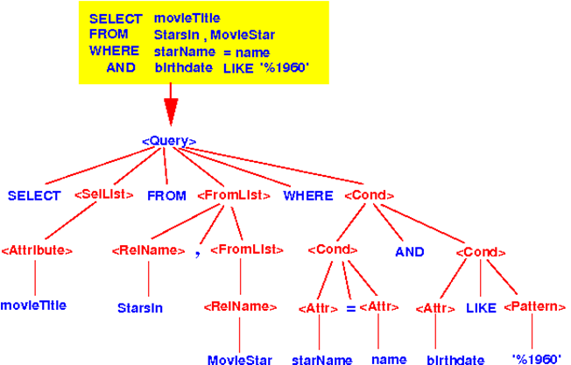
Example Parse Tree
Notes:
■From: http://www.mathcs.emory.edu/~cheung/Courses/554/Syllabus/5-query-opt/FIGS/parseTree01.gif

Slide 4
Let’s do some optimization. Do this join.
For this exercise,
  Think of each table as a giant CSV file
  How would you do this in your favorite language without any SQL?
  comments table has 2,000 rows, posts have 100 rows
SELECT comments.*
FROM comments
INNER JOIN posts ON posts.id=comments.post_id
WHERE posts.date < ‘2020-02-02’
Joins need to do the cross-product
... so nested loops!

Slide 5
Options for “Do this join”
comments: 2,000 rows posts: 100 rows
SELECT comments.*
FROM comments
INNER JOIN posts
ON posts.id=comments.post_id
WHERE posts.date < ‘2020-02-02’
Option 1: comments first
  Loop through all comments
    Loop through all posts
      Check: does comments.post_id=post.id?
      Check: posts.date < ‘2020-02-02’
  How many checks? ~2000 x 100 = ~200k checks! (ouch)
Option 2:
  Loop through posts
    Does the post qualify? posts.date < ‘2020-02-02’ (suppose that 30 qualify)
      If so, loop through comments, checking comments.post_id=post.id
  How many checks?
...more options?

Slide 6
Options for “Do this join” (2)
comments: 2,000 rows posts: 100 rows
SELECT comments.*
FROM comments
INNER JOIN posts
ON posts.id=comments.post_id
WHERE posts.date < ‘2020-02-02’
Option 3:
  Let’s assume RAM is cheap and we can store as much as we want
  (note: not always possible, servers prefer constant footprints!)
  Loop through posts, checking all of them and storing relevant post_ids.
  Then, loop through comments, keeping all that match one of those stored post_ids in RAM
  2100 checks!
  But… what if 90% of the table matches our query and the table is bigger than RAM?
Lessons:
  Doing joins requires nested loops.
  Size of your tables matters.
  Looping over tables is slow.
  The choice of your inner and outer loop matters greatly.
  The distribution of your data according to WHERE criteria matters greatly.

Slide 7
On RAM & Disk Usage
Accessing volatile RAM is orders of magnitude faster than any persistent storage (e.g. HDD, SSD, NVME, etc) ...but...
  Volatility hurts Durability (D in ACID)
  RAM is expensive
  Filling up RAM causes the OS to start using persistent storage, called “thrashing”
  (e.g. pagefile.sys on Windows)
Also: writing LOTS of data to disk at once is faster than one small write
DBMS servers need to keep RAM footprint constant, prevent thrashing
  Caching: store data in RAM that we commonly use
  Paging: keep data in chunks, “pages”. 8kb fixed-size in Postgres.
  Page fault: try to look up a page in RAM, not found, read from disk
  Fun fact: to change the 8kb size, you need to recompile Postgres.
RAM Disks are common for ephemeral databases
  OS’s support creating a “drive” that acts like a file system but is stored in RAM
  Linux: /dev/shm

Slide 8
EXPLAIN and ANALYZE
All DBMSs can tell your their query plans
  EXPLAIN - tell me your plan without executing
  ANALYZE - actually run the query and keep stats
e.g. a PostgreSQL explain:
EXPLAIN SELECT *
FROM tenk1 t1, tenk2 t2
WHERE t1.unique1 < 10 AND t1.unique2 = t2.unique2;
QUERY PLAN
--------------------------------------------------------------------------------------
Nested Loop (cost=4.65..118.62 rows=10 width=488)
-> Bitmap Heap Scan on tenk1 t1 (cost=4.36..39.47 rows=10 width=244)
Recheck Cond: (unique1 < 10)
-> Bitmap Index Scan on tenk1_unique1 (cost=0.00..4.36 rows=10 width=0)
Index Cond: (unique1 < 10)
-> Index Scan using tenk2_unique2 on tenk2 t2 (cost=0.29..7.91 rows=1 width=244)
Index Cond: (unique2 = t1.unique2)

Slide 9
Indexes
Still picture yourself scanning through CSVs
  Need to loop through
  Check for what you need at each row.
Now imagine you know which byte number to jump to for any given row
  Trade the loops for random-access!
  That’s an index!
  How should the index work?

Slide 10
Analogy Example: Books
The index at the back of a book
  Key: word, value: page number
  Words are listed alphabetically
  ... so you can binary-search to find the word quickly, then read page #
What if all we need is the page number?
  We don’t even need the book! → index-only scan
  aka a covering index
What if we only index words that start with “b”?
  Smaller index! Easier on our RAM caching system
  Called a → partial index

Slide 11
Analogy Example: Books(2)
What if the book never re-used a word in the whole book?
  That’d be a big index. (Also, impressive writing!)
  Lesson: over-indexing leads to big indexes and performance hits
What if we change the book?
  We’d have to update the index, too.
  What if multiple people are updating a table? concurrency concerns
What if we index by Chapter+Section? i.e. table of contents
  Chapter is a unique key, but a big record
  Section is a smaller record . Combination of the two is unique
  Multi-column index

Slide 12
CREATE INDEX examples in Postgres
Primary key lookup
CREATE UNIQUE INDEX players_id_idx ON players(id);
Non-unique key lookup
CREATE INDEX players_name_idx ON players(name);
Multi-column index
CREATE INDEX players_name_idx ON players(first_name, last_name);
CREATE INDEX players_player_id_team_id_idx ON played_for(player_id, team_id);
Partial index
CREATE INDEX players_player_id_team_id_idx
ON played_for(player_id, team_id) WHERE year > 2000;
Specify physical location of index
CREATE INDEX players_id_idx ON players(id) TABLESPACE indexspace;

Slide 13
DB index as a data structure
Similar interface as a hashtable/dictionary:
  Keys and values
  …but implementation can vary to all kinds of methods
  ...but more generalized
Common operations:
  Lookup a single value given a unique key
  Lookup multiple values given a non-unique key
  Lookup multiple values given a range of keys via inequalities(e.g. timestamps)
  Return results in sorted order
  Bulk load, e.g. add an index to an existing table and get tons of data at once
Common implementations:
  This class: hashtable, B-tree
  Many others! Often tree-based data structures
Most important: unique indexes are always faster

Slide 14
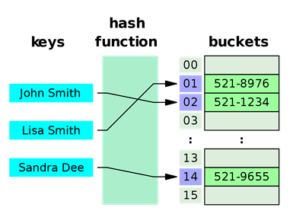
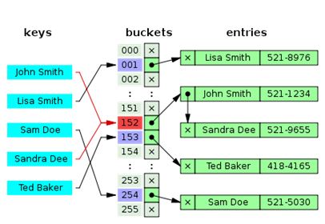
Hash Table as Index
Essentially, array of linked lists with a hashing function
  Given a key, provide the disk location of the row
  Key → hash(key) → index of the array → traverse linked list
  Hash tables provide provably constant time lookup, i.e. O(1)
Hash tables are memory-friendly
  Linked lists can be malloc’d at random
  Scaling & rebuilding is not very expensive
But! Hashes are generally only good for single, unique lookups
  Can’t speed up ORDER BY
  Can’t search for inequalities
Most DBMS’s default to B-tree anyway
Images from Wikipedia

Slide 15
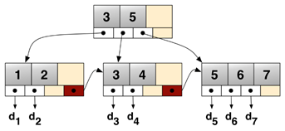
B-trees are not binary trees
NOT the same thing as binary tree,
  ...rather an n-ary tree, a generalization of a binary tree
  Most common implementation for databases: B+Tree
  A commonly-used, all-purpose indexing algorithm
  High branching factor b, so high fanout
Structure of a B+tree
  Single root node
  Multiple layers of intermediate nodes, with pivots
  One layer of leaf nodes
  Leaves maintain a sorted linked list for quick traversal
  Maintain rules about how many children per node and how many items per node
Images from Wikipedia

Slide 16
B-tree Search
Find 7
  Do binary search on root node.
  Is 7 less than 6? No. Go to child.
  Do binary search on node.
  Start with median. Found 7!
Return all records for keys between 5 and 7
  Find min of the range, i.e. 5
  Get the 5 record.
  Are we done? No.
  Is the next record in this node? No.
  Follow the pointer to the next node.
  Get the 6 record.
  Is the next record in this node? Yes
  Get the 7 record.
  Are we done? Yes
Bulk load 5,2,1,8,7,6 into empty B-tree
  Sort them: 1,2,5,6,7,8
  Split into even nodes.
  Promote medians.
5
6
1
2
5
6
7
8

Slide 17
B-tree Insertion
Insert 5
  Is the first slot empty? Yes!
  Put 5 there.
Next, insert 8
  Root node: first spot empty? No.
  Less than 5? No.
  Second spot empty? Yes!
  Put 8 there.
Next, insert 1
  Is there room for 1? Yes!
  Root node: first spot empty? No.
  Less than 5? Yes!
  Shift everyone over. Put 1 there.
5
5
8
1
5
8

Slide 18
B-tree Insertion
Next, insert 6
  Space for 6? No.
  Less than 1? No.
  Less than 5? No.
  Less than 8? Yes!
  5 is median, make it a new pivot
  5 has no parent, new root!
  1 and 8 become new nodes
  Try again: put 6 in its leaf
Next, insert 2
  Less than 5? Yes.
  Does 5’s node have a child? Go to child.
  Less than 1? No.
  Enough space? Yes.
  Put 2 in its leaf.
1
5
8
5
1
5
6
8
5
1
2
5
6
8

Slide 19
B-tree Insertion
5
Finally, insert 7
Find its spot: in the 5-leaf
Enough space? No. Split!
6 gets promoted to pivot.
5 and 6,8 split into new nodes
Space for 6 in parent? Yes.
Promote 6 to pivot in parent node
1
2
5
6
8
5
6
1
2
5
6
7
8

Slide 20
B-trees in Practice
Intermediate nodes can also store pointers to their records
Nodes are usually a byte-sized array
  A 3-level B-tree handles 255³=16.6 million records
  You can usually cache the root and first layer anyway, so most reads only involve 1-2 disk reads
B-tree pages are cached in RAM just like data itself

Slide 21
Tips for DB Indexing, etc.
Small, unique indexes are best
  Fewer page faults on the index
  Use partial indexes to achieve this
Covering indexes are great too
  Enable index-only lookups
  Bug if you go too far, you’re duplicating data
When should I use multi-column indexes?
  When your ANALYZE shows that it’s actually being used!
  When many-many has lots of additional data on the linking table you’re looking up
  Linking tables with just keys are often cached anyway
Should I be choosing index algorithms myself?
  Probably not.
  Only after thorough experimentation on realistic data.

Slide 22
Tips for DB Indexing (2)
Index what needs to be sorted
  Look for ORDER BY queries on your big tables
  Make an index on what the columns in ORDER BY clause
Periodic maintenance:
  CLUSTER: physically organize a table, pages according to index of your choosing
  ANALYZE: recompute table statistics, e.g. table size, uniqueness of a column, distribution
  VACUUM: rearrange rows across pages, removing dead rows
Automated testing!
  Performance can be tracked easier this way
  Your handcrafted seed data is not a realistically-sized workload.
  Can generate separate data for realistic benchmark workloads
Know your page size
  e.g. 8kb
  Avoid rows larger than page size if possible.
  Know that fields bigger than 8kb will get their own special storage internally

