Slide 1
Document-Oriented DBs
SWEN-344 Web Engineering

Slide 2
Consider H-Scaling an RDMBS
e.g. how would you horizontally scale a PostgreSQL server of Amazon.com?
products, reviews, specifications, etc.
Move tables to their own servers?
  Delegate read-query execution to their own places
  “Reviews” server has the “likes” table
  “Products” server has the product data when you look up a product
  A given “thing” is split up across lots of places
One table across servers?
  RDBMS’s have always had H-Scaling features like this (e.g. Postgres’ replication)
  Query execution on different servers
  Indexes are all partial indexes via keys like “date” or region
    … but having queries hit many servers at once is VERY expensive
    … “which tables are on which server” turns into a hard problem

Slide 3
Consider H-Scaling an RDBMS (2)
Refactor app to many, small, separate API interfaces
  So everyone gets their own persistence implementations
  Basically a “microservices” approach… more on this later…
Use a multi-tenant approach
  Same (or similar) database schema
    ...but many databases deployed across many servers
    Use subdomains to map: “http://bobthecustomer.yourcompany.com”
  Great for when your business has big customers or very regional
    e.g. A Rochester-based network (e.g. craigslist), or salesforce
    …but now you’re managing LOTs of db’s
How do you stay ACID-compliant, performant, and scalable?
  Answer: it’s difficult, but absolutely possible

Slide 4
Not all persistence is relational
Pros & Cons of the relational model
  Pro: ACID compliance (Atomic, Consistent, Isolated, Durable)
  Pro: enables very complex queries
  Con: changing schema is expensive
  Con: one entity is split across many places
Back to Amazon example:
  People shop through related products
  One product has disparate data
    Product reviews,
    Specifications are different for various products
  H-scaled: a “book server” and a “hardware server”
    One hit!
    No joins!
This is called a document-oriented approach
aka NoSQL

Slide 5
What is Document-Oriented?
In this case, a “document” refers to a specific type of data structure
  Dictionaries-of-dictionaries
  Key-value approach
  JSON, YML, TOML are all common formats for this
  Arrays, too, but arrays are just integer-keyed dictionaries
Goal: group similar data together into a collections of documents
Note: your data still needs structure
  “Schema design” still happens in Document-Oriented approaches, just at a different time
  The database assumes no schema up front...BUT...
  ...any query assumes you know where to find the data
Popular document-oriented DBMSs: MongoDB, Apache CouchDB, Redis (sorta)

Slide 6
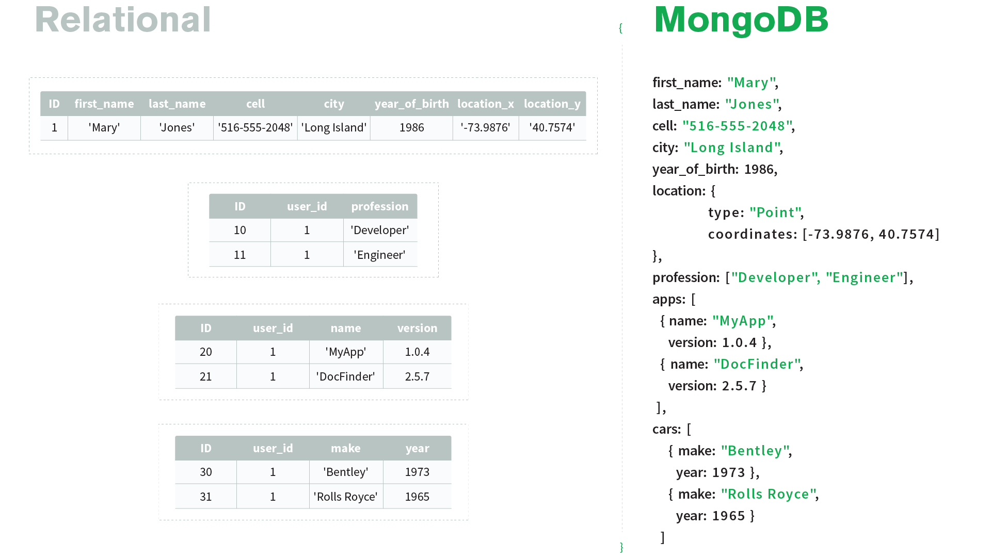
From: https://www.mongodb.com/document-databases

Slide 7
NoSQL has no SQL equivalent
There is no standard language for interacting with document-oriented databases
  Each document-oriented DBMS has its own APIs in every programming language
  Very similar approaches, however
Instead of “tables” we have “collections”
e.g. MongoDB insert into “inventory” collection:
db.inventory.insertOne(
{ "item" : "canvas",
"qty" : 100,
"tags" : ["cotton"],
"size" : { "h" : 28, "w" : 35.5, "uom" : "cm" }
}
)
# Adds an "_id" field if it doesn’t exist
Notes:
Example from: https://docs.mongodb.com/guides/server/insert/

Slide 8
Reading in MongoDB
Get all products:
db.inventory.find( {} )
Get a products by status:
db.inventory.find( { status: "D" } )
Get products with status “A” and qty<30:
db.inventory.find( { status: "A", qty: { $lt: 30 } } )
Get products with status “A” AND (qty<30 OR item starts with “p”)
db.inventory.find( {
status: "A",
$or: [ { qty: { $lt: 30 } }, { item: /^p/ } ]
} )
Notes:
From: https://docs.mongodb.com/guides/server/read/

Slide 9
More SQL-like operations in MongoDB
Aggregation:
db.zipcodes.aggregate( [
{ $group: { _id: { state: "$state", city: "$city" }, pop: { $sum: "$pop" } } },
{ $group: { _id: "$_id.state", avgCityPop: { $avg: "$pop" } } }
] )
Technically, you can do joins
  $lookup allows you to hit multiple collections at once
  But this is a “left outer join”, not a traditional inner join. DIY from there.

Slide 10
H-Scaling MongoDB via Sharding
Horizontal scaling in MongoDB is achieved through sharding, a method of distributing data across multiple servers, known as shards. This approach allows MongoDB to handle large datasets and high-throughput operations by spreading the workload and storage capacity across a cluster of machines.
Two methods: hash-based or range-based
  Move the data to separate chunks on other servers
  Some duplication across shards may happen underneath
Hash-based
  A document’s ID will “randomly” be assigned a shard
  It’s a giant hashmap. Same exact implementation except shards are the buckets
Range-based
  Range-based sharding involves dividing data into contiguous ranges determined by the shard key values
    Large Shard Key Cardinality → many possible different values
    Low Shard Key Frequency → even distribution across ranges
    Non-Monotonically Changing Shard Keys → ever-increasing is bad
  Good examples: locale, category, community

Slide 11
Document-Oriented encourages data duplication
Document-oriented approaches encourage very denormalized datasets
  Fast reads, slow mass updates, fast “snowflake” updates
  Need separate jobs to periodically find duplicate data
Counterpoint:
  Relational DBs also have duplication… in backups
  NoSQL DBs don’t really need separate “backup” systems
E.g. “tags” on a product
  Relational approach
    Have a “tags” table which is the authority on all things tags
    Want to add more fields to a tag? Easy! Add a column
    Want to add more fields to a single tag? Add a column, but then TONS of nulls
  Document-oriented approach
    Just keep an array of tags we’ll aggregate later
    Want to add more fields to a tag? Hard. Update ALL documents.
    Want to add more fields to a single tag? Add to the document’s tag array

Slide 12
The “No Schema Design” Fallacy
“Document-oriented is more productive because you don’t do schema design”
  Eh.... I don’t agree.
  Changing your schema is not as painful as it sounds with unit testing, scripts, version control
  If you change your document structure, you’ll need to update all your queries anyway
If you are inconsistent with your document structure...
  ...you can’t make useful indexes
  ...your queries get real complicated real quick
  ...you can’t do sharding without a consistent shard key
  ...you’ll still need to do maintenance to fix things
Avoiding structuring your data is a form of technical debt
  Schema design forces your data into a structure
  Changing data structure mid-stream leads to inconsistent documents, which still requires maintenance.

Slide 13
So which is better?
Wrong question. Seriously.
  Which is faster? Your bike or your car? ...depends on terrain
  Which is faster? Your phone or your desktop? ...depends on where you’re standing
NoSQL costs us a lot to gain this flexible paradigm
  We don’t have joins
    Developers are essentially implementing a join by themselves
    This can be fine for simple join-and-lookup-in-index operations
  Common practice leads to lots of duplicate data (e.g. “tags”)
  We don’t have ACID compliance
    NoSQL often relies upon sacrificing data de-duplication
    Atomicity is somewhat supported, but not the default
    Durability is not guaranteed
    Isolation and Consistency are sacrificed: you can read something from a database and have it be out-of-date
    Some NoSQL systems today have kept ACID compliance, but are largely not in use (according to Meneely’s 2020 Unscientific Survey)
  Entertaining read: http://www.sarahmei.com/blog/2013/11/11/why-you-should-never-use-mongodb/

Slide 14
SQL and NoSQL peacefully co-exist
“NoSQL is going to kill SQL” -people in 2010
“They each have their place” -people in 2020
NoSQL cache in front of an SQL cache
  SQL: complex queries and analytics
  NoSQL: delivering data quickly, caching, duplication, sharding
  Stay tuned for RESTful APIs!
JSON columns in SQL
  Postgres and others support documents in a database row
  Reduces schema updates
  Allows for adding “spice” to a row that is less rigid
  e.g. a Products table would have a “specifications” JSON column
  Allows for querying, aggregating, and indexing just like document-oriented

