Slide 1
psql
Command line interface for postgresql
Commands start with ‘\’
SQL statements end with ‘;’
Handy commands:
  Login: psql –U <username>
  Help: \?
  List all tables: \dt
  Quit: \q
  Execute a file with SQL instructions: \i <filename.sql>
  Select everything from a table: SELECT * FROM myTable;

Slide 2
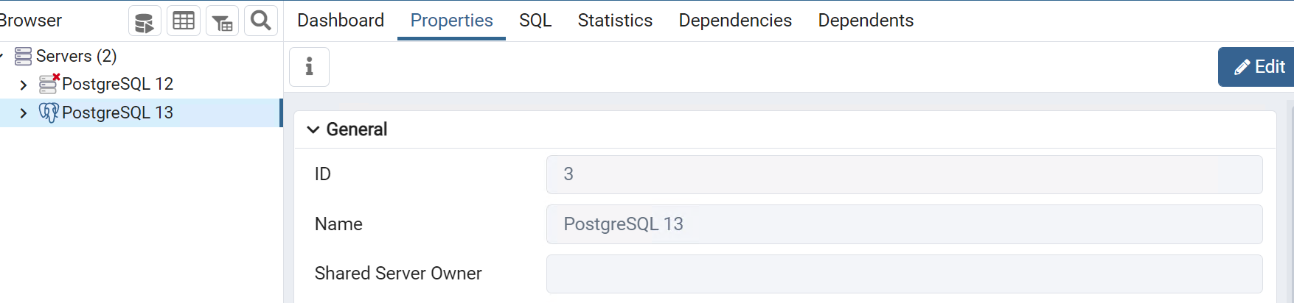
PostgreSQL
GUI for Postgres
  Useful for some things like initial DB creation or creating users
You should see the SQL server here

Slide 3
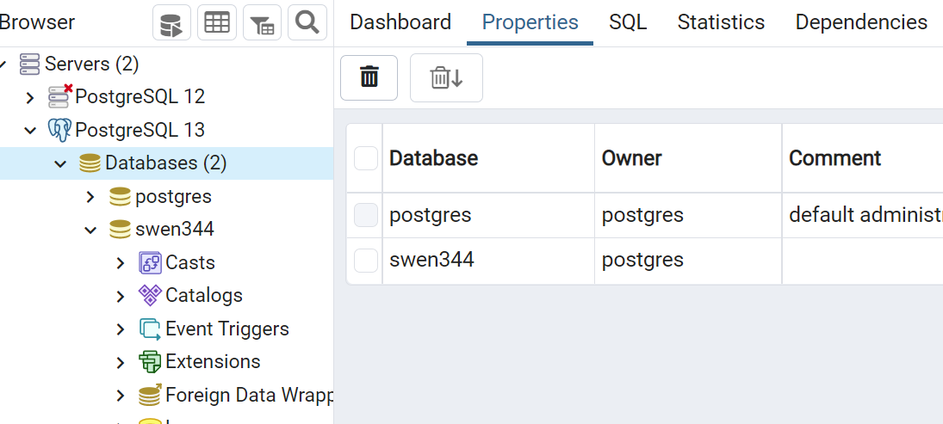
Expanding the server will show the database(s)

Slide 4
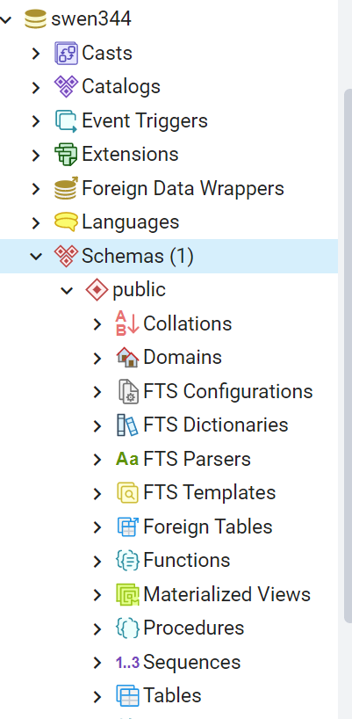
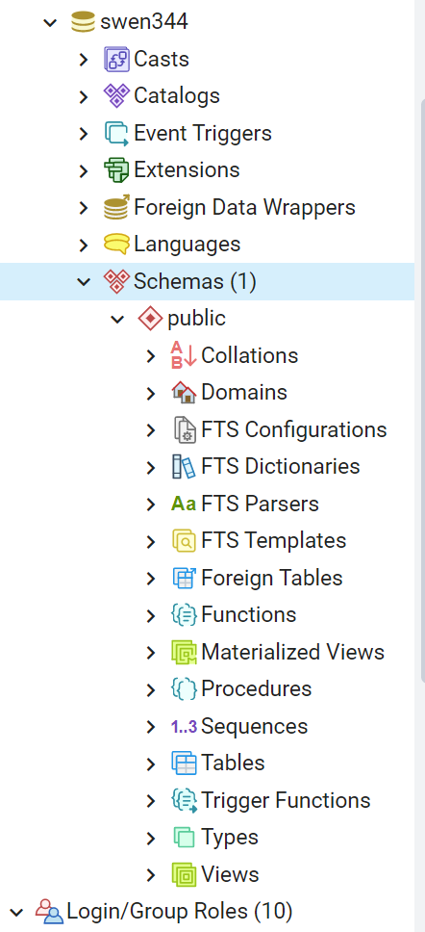
Logins and users? Way down here …
Tables are way down here (or use psql)

Slide 5
Running a single unittest
python -m unittest tests.test_generic.TestChat.test_loading
path
Module name
Class name
Method name
Notes:
py -m unittest tests.test_generic.TestChat._test_simple_query

Slide 6
git and branching
You can create branches either from the gitlab GUI, VSCode/IDE, or command line (doesn’t matter)
  Create the branch on local (command line), push to remote (gitlab)
    > git checkout –b <new-branch> # Creates and switches to the new branch locally
    > git push –u origin <new-branch> # Pushes the branch to the remote
  Create the branch on remote (gitlab), fetch to local (command line)
    > git fetch origin # Updates your local copy of remote branches
    > git checkout <new_branch> # Pushes the branch to the remote
Switching branches (* = active/checked-out branch)
  > git branch
  db-utils
  *main
  > git checkout db-utils
Be sure to keep the local and remote branches in sync

Slide 7
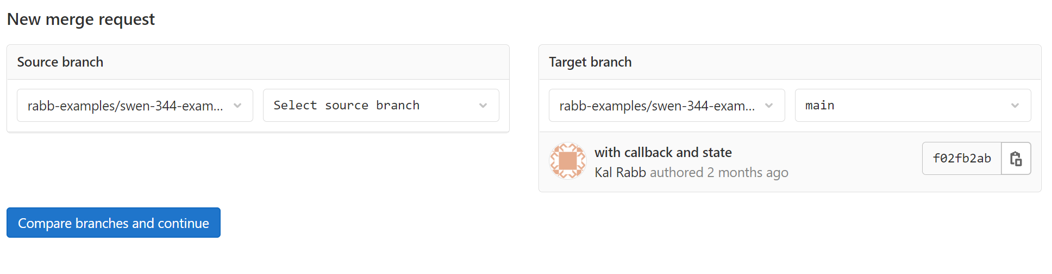
git and branching
You can create merge requests from the GUI or command line
  I actually prefer doing it from the GUI

Slide 8
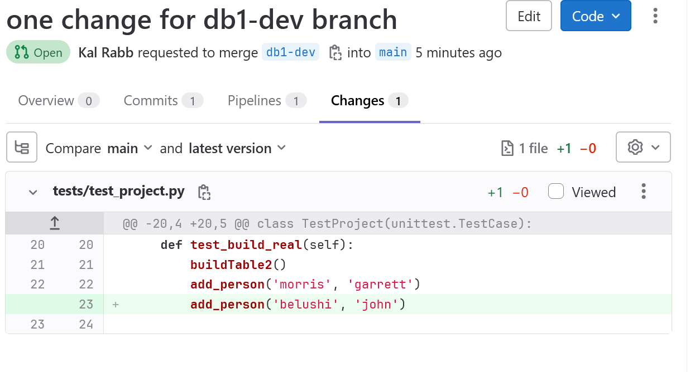
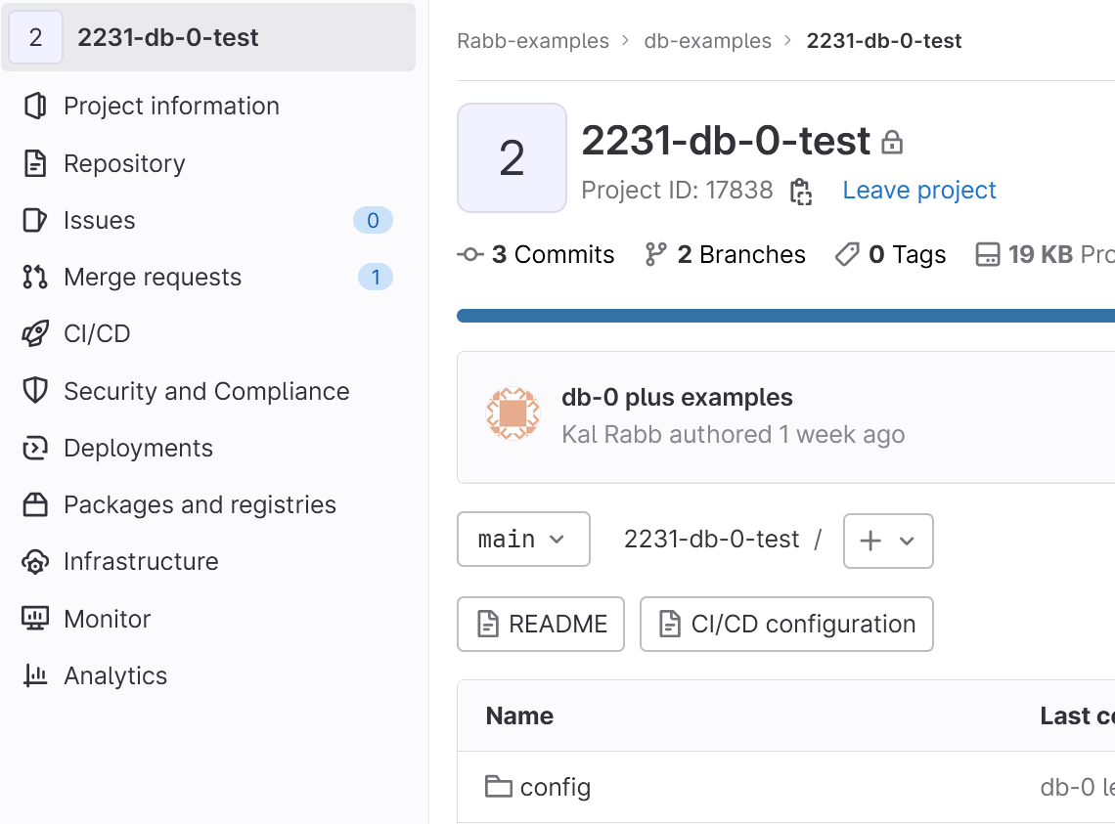
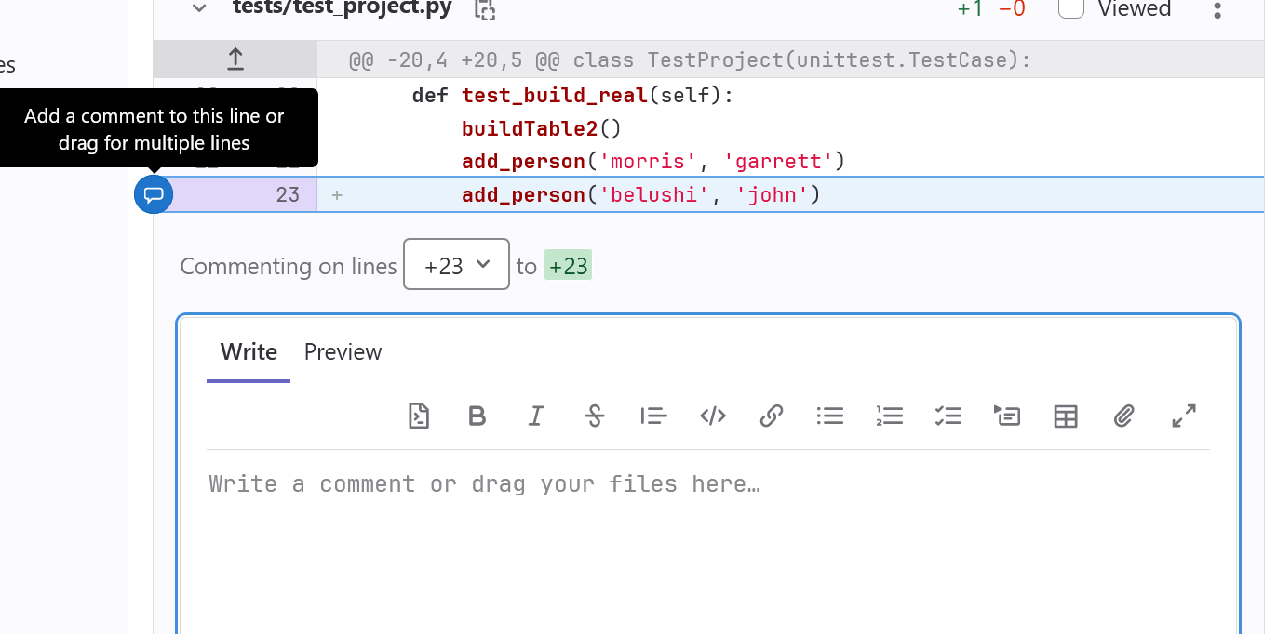
Gitlab GUI for commenting

Slide 9
Other points
If you have a PK defined SERIAL PRIMARY KEY …
If you do manual INSERTS and specify the PRIMARY KEY (INSERT INTO my_table (id,data ) VALUES (1,’something’)) then
The DB no longer knows which PK to use next (since you bypassed it)
To RESET that sequence use:
  ALTER SEQUENCE my_table_id_seq RESTART 2;
tablename_column_seq

Slide 10
No concatenation
As our website says
  As a matter of security, you shall NEVER concatenate SQL query strings using user data. This is called a SQL injection vulnerability. Instead, use prepared statements with binding variables. Psycopg2 explains how to do this
This means
  DON’T do
    sqlString = “GET * FROM table WHERE col=“ + myVariable
  DON’T do
    sqlString = f”GET * FROM table WHERE col={myVariable}”
  Do
    sqlString = “GET * FROM table WHERE col=%s”
    exec_get_all(sqlString,(myVariable,))
See my examples in gitlab as well …

Slide 11
Things you may have noticed …
Dealing with an apostrophe (single quote)
  “Huey, Dewey, and Louie’s uncle Donald”
  In python, use backslash
    myString = “Huey, Dewey, and Louie\’s uncle Donald”
  In postgres use an extra single quote (Note that is it ‘ ‘ , not “)
    INSERT (sentence) INTO myTable
    VALUES (‘Huey, Dewey, and Louie’’s uncle Donald')
Python unittest does NOT run in the order you wrote the code …
  It runs in some sort of alphabetical order, but even that is not consistent and alpha sorting differs on various Operating Systems!
  So … DO NOT rely on order. Unit tests are supposed to be self contained
  Group actions together into one unittest is there are dependencies! Use helper functions as needed.

Slide 12
Forcing a table reference
CREATE TABLE T_ITEMS(
ID SERIAL PRIMARY KEY,
ITEM_CODE CHAR(6) NOT NULL,
ITEM_DESC VARCHAR(128)
);
CREATE TABLE T_TRACK(
ID SERIAL PRIMARY KEY,
NUM DECIMAL(6,0) NOT NULL,
ITEM_ID INTEGER NOT NULL REFERENCES T_ITEMS
);
INSERT INTO T_ITEMS (ITEM_CODE, ITEM_DESC)
VALUES ('AA', 'AA DESC');
INSERT INTO T_TRACK (NUM, ITEM_ID)
VALUES (2.0, 1);
Now try DROP TABLE T_ITEMS;
Now try DROP TABLE T_ITEMS CASCADE;

Slide 13
Forcing a table reference (2)
CREATE TABLE T_ITEMS (
ID SERIAL PRIMARY KEY,
ITEM_CODE CHAR(6) NOT NULL,
ITEM_DESC VARCHAR(128)
);
CREATE TABLE T_TRACK (
ID SERIAL PRIMARY KEY,
NUM DECIMAL(6,0) NOT NULL,
ITEM_ID INTEGER NOT NULL REFERENCES T_ITEMS ON DELETE CASCADE
);
INSERT INTO T_ITEMS (ITEM_CODE, ITEM_DESC)
VALUES ('AA', 'AA DESC');
INSERT INTO T_ITEMS (ITEM_CODE, ITEM_DESC)
VALUES ('BB', 'BB DESC');
INSERT INTO T_TRACK (NUM, ITEM_ID) VALUES (2.0, 1);
INSERT INTO T_TRACK (NUM, ITEM_ID) VALUES (3.0, 2);
Now try DELETE FROM T_ITEMS WHERE ID=1;

