Slide 1
Performance of Relational DBs
SWEN-344 Web Engineering

Slide 2
The life of an SQL query
Starts as a string in another language, e.g. Python
Compilation:
String gets tokenized into a list of tokens SELECT username, pw_hash FROM users
Soken list gets converted to parse tree, a custom tree data structure
Query rewrite
Convert from parse tree to logical query plan
Plenty of optimizations & intelligent decision-making in this step.
Decisions driven by database schema
e.g. “I need to do loop over this table and look in this column for that item”
Physical plan generation
Convert logical query plan to physical query plan
Decision driven by disk I/O, caching in RAM, network I/O, size of the table, arrangement of the records in the table
e.g. “When we loop through this table, cache it in RAM because we’ll probably need it again”
“Query optimizer” is the general term for those last two steps

Slide 3
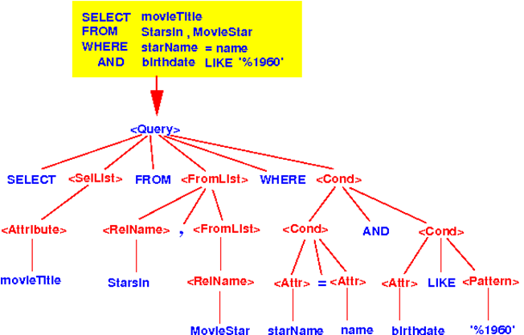
Example Parse Tree
Notes:
■From: http://www.mathcs.emory.edu/~cheung/Courses/554/Syllabus/5-query-opt/FIGS/parseTree01.gif

Slide 4
Let’s do some optimization. Do this join.
For this exercise,
Think of each table as a giant CSV file
How would you do this in your favorite language without any SQL?
comments table has 2,000 rows, posts have 100 rows
SELECT comments.* FROM comments INNER JOIN posts ON posts.id=comments.post_id WHERE posts.date < ‘2020-02-02’
Joins need to do the cross-product ... so nested loops!

Slide 5
Options for “Do this join”
comments: 2,000 rows posts: 100 rows
SELECT comments.* FROM comments INNER JOIN posts ON posts.id=comments.post_id WHERE posts.date < ‘2020-02-02’
Option 1: comments first
Loop through all comments
Loop through all posts
Check: does comments.post_id=post.id?
Check: posts.date < ‘2020-02-02’
How many checks?
Option 2:
Loop through posts
Does the post qualify? posts.date < ‘2020-02-02’ (suppose that 30 qualify)
If so, loop through comments, checking comments.post_id=post.id
How many checks?
...more options?
~2000 x 100 = ~200k checks! (ouch)
100 x 30 = 3k checks!

Slide 6
Options for “Do this join” (2)
comments: 2,000 rows posts: 100 rows
SELECT comments.* FROM comments INNER JOIN posts ON posts.id=comments.post_id WHERE posts.date < ‘2020-02-02’
Option 3:
Let’s assume RAM is cheap and we can store as much as we want (note: not always possible, servers prefer constant footprints!)
Loop through posts, checking all of them and storing relevant post_ids.
Then, loop through comments, keeping all that match one of those stored post_ids in RAM
2.1k checks! But… what if 90% of the table matches our query and the table is bigger than RAM?
Lessons:
Doing joins requires nested loops.
Size of your tables matters.
Looping over tables is slow.
The choice of your inner and outer loop matters greatly.
The distribution of your data according to WHERE criteria matters greatly.

Slide 7
On RAM & Disk Usage
Accessing volatile RAM is orders of magnitude faster than any persistent storage (e.g. HDD, SSD, NVME, etc) ...but...
Volatility hurts Durability (D in ACID)
RAM is expensive
Filling up RAM causes the OS to start using persistent storage, called “thrashing” (e.g. pagefile.sys on Windows)
Also: writing LOTS of data to disk at once is faster than one small write
DBMS servers need to keep RAM footprint constant, prevent thrashing
Caching: store data in RAM that we commonly use
Paging: keep data in chunks, “pages”. 8kb fixed-size in Postgres.
Page fault: try to look up a page in RAM, not found, read from disk
Fun fact: to change the 8kb size, you need to recompile Postgres.
RAM Disks are common for ephemeral databases
OS’s support creating a “drive” that acts like a file system but is stored in RAM
Linux: /dev/shm

Slide 8
EXPLAIN and ANALYZE
All DBMSs can tell your their query plans
EXPLAIN - tell me your plan without executing
ANALYZE - actually run the query and keep stats
e.g. a PostgreSQL explain:
EXPLAIN SELECT * FROM tenk1 t1, tenk2 t2 WHERE t1.unique1 < 10 AND t1.unique2 = t2.unique2; QUERY PLAN -------------------------------------------------------------------------------------- Nested Loop (cost=4.65..118.62 rows=10 width=488) -> Bitmap Heap Scan on tenk1 t1 (cost=4.36..39.47 rows=10 width=244) Recheck Cond: (unique1 < 10) -> Bitmap Index Scan on tenk1_unique1 (cost=0.00..4.36 rows=10 width=0) Index Cond: (unique1 < 10) -> Index Scan using tenk2_unique2 on tenk2 t2 (cost=0.29..7.91 rows=1 width=244) Index Cond: (unique2 = t1.unique2)

Slide 9
Indexes
Still picture yourself scanning through CSVs
Need to loop through
Check for what you need at each row.
Now imagine you know which byte number to jump to for any given row
Trade the loops for random-access!
That’s an index!
How should the index work?

Slide 10
Analogy Example: Books
The index at the back of a book
Key: word, value: page number
Words are listed alphabetically
... so you can binary-search to find the word quickly, then read page #
What if all we need is the page number?
We don’t even need the book! → index-only scan
aka a covering index
What if we only index words that start with “b”?
Smaller index! Easier on our RAM caching system
Called a → partial index

Slide 11
Analogy Example: Books(2)
What if all words in the book were unique?
That’d be a big index. (Also, impressive writing!)
Lesson: over-indexing leads to big indexes and performance hits
What if we change the book?
We’d have to update the index, too.
What if multiple people are updating a table? concurrency concerns
What if we index by Chapter+Section? i.e. table of contents
Chapter is a unique key, but a big record
Section is a smaller record . Combination of the two is unique
Multi-column index

Slide 12
CREATE INDEX examples in Postgres
Primary key lookup CREATE UNIQUE INDEX players_id_idx ON players(id);
Non-unique key lookup CREATE INDEX players_name_idx ON players(name);
Multi-column index CREATE INDEX players_name_idx ON players(first_name, last_name); CREATE INDEX players_player_id_team_id_idx ON played_for(player_id, team_id);
Partial index CREATE INDEX players_player_id_team_id_idx ON played_for(player_id, team_id) WHERE year > 2000;
Specify physical location of index CREATE INDEX players_id_idx ON players(id) TABLESPACE indexspace;

Slide 13
DB index as a data structure
Similar interface as a hashtable/dictionary:
Keys and values
…but implementation can vary to all kinds of methods
...but more generalized
Common operations:
Lookup a single value given a unique key
Lookup multiple values given a non-unique key
Lookup multiple values given a range of keys via inequalities(e.g. timestamps)
Return results in sorted order
Bulk load, e.g. add an index to an existing table and get tons of data at once
Common implementations:
This class: hashtable, B-tree
Many others! Often tree-based data structures
Most important: unique indexes are always faster

Slide 14
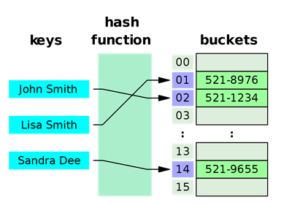
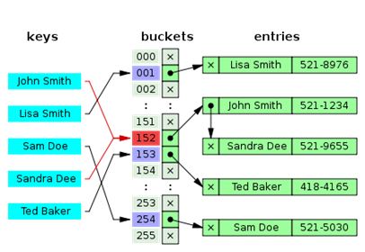
Hash Table as Index
Essentially, array of linked lists with a hashing function
Given a key, provide the disk location of the row
Key → hash(key) → index of the array → traverse linked list
Hash tables provide provably constant time lookup, i.e. O(1)
Hash tables are memory-friendly
Linked lists can be malloc’d at random
Scaling & rebuilding is not very expensive
But! Hashes are generally only good for single, unique lookups
Can’t speed up ORDER BY
Can’t search for inequalities
Most DBMS’s default to B-tree anyway
Images from Wikipedia

Slide 15
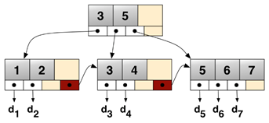
B-trees are not binary trees
NOT the same thing as binary tree,
...rather an n-ary tree, a generalization of a binary tree
Most common implementation for databases: B+Tree
A commonly-used, all-purpose indexing algorithm
High branching factor b, so high fanout
Structure of a B+tree
Single root node
Multiple layers of intermediate nodes, with pivots
One layer of leaf nodes
Leaves maintain a sorted linked list for quick traversal
Maintain rules about how many children per node and how many items per node
Images from Wikipedia

Slide 16
B-tree Search
Find 7
Do binary search on root node.
Is 7 less than 6? No. Go to child.
Do binary search on node.
Start with median. Found 7!
Return all records for keys between 5 and 7
Find min of the range, i.e. 5
Get the 5 record.
Are we done? No.
Is the next record in this node? No.
Follow the pointer to the next node.
Get the 6 record.
Is the next record in this node? Yes
Get the 7 record.
Are we done? Yes
Bulk load 5,2,1,8,7,6 into empty B-tree
Sort them: 1,2,5,6,7,8
Split into even nodes.
Promote medians.
5
6
1
2
5
6
7
8

Slide 17
B-tree Insertion
Insert 5
Is the first slot empty? Yes!
Put 5 there.
Next, insert 8
Root node: first spot empty? No.
Less than 5? No.
Second spot empty? Yes!
Put 8 there.
Next, insert 1
Is there room for 1? Yes!
Root node: first spot empty? No.
Less than 5? Yes!
Shift everyone over. Put 1 there.
5
5
8
1
5
8

Slide 18
B-tree Insertion
Next, insert 6
Space for 6? No.
Less than 1? No.
Less than 5? No.
Less than 8? Yes!
5 is median, make it a new pivot
5 has no parent, new root!
1 and 8 become new nodes
Try again: put 6 in its leaf
Next, insert 2
Less than 5? Yes.
Does 5’s node have a child? Go to child.
Less than 1? No.
Enough space? Yes.
Put 2 in its leaf.
1
5
8
5
1
5
6
8
5
1
2
5
6
8

Slide 19
B-tree Insertion
5
Finally, insert 7
Find its spot: in the 5-leaf
Enough space? No. Split!
6 gets promoted to pivot.
5 and 6,8 split into new nodes
Space for 6 in parent? Yes.
Promote 6 to pivot in parent node
1
2
5
6
8
5
6
1
2
5
6
7
8

Slide 20
B-trees in Practice
Intermediate nodes can also store pointers to their records
Nodes are usually a byte-sized array
A 3-level B-tree handles 255³=16.6 million records
You can usually cache the root and first layer anyway, so most reads only involve 1-2 disk reads
B-tree pages are cached in RAM just like data itself

Slide 21
Tips for DB Indexing, etc.
Small, unique indexes are best
Fewer page faults on the index
Use partial indexes to achieve this
Covering indexes are great too
Enable index-only lookups
Bug if you go too far, you’re duplicating data
When should I use multi-column indexes?
When your ANALYZE shows that it’s actually being used!
When many-many has lots of additional data on the linking table you’re looking up
Linking tables with just keys are often cached anyway
Should I be choosing index algorithms myself?
Probably not.
Only after thorough experimentation on realistic data.

Slide 22
Tips for DB Indexing (2)
Index what needs to be sorted
Look for ORDER BY queries on your big tables
Make an index on what the columns in ORDER BY clause
Periodic maintenance:
CLUSTER: physically organize a table, pages according to index of your choosing
ANALYZE: recompute table statistics, e.g. table size, uniqueness of a column, distribution
VACUUM: rearrange rows across pages, removing dead rows
Automated testing!
Performance can be tracked easier this way
Your handcrafted seed data is not a realistically-sized workload.
Can generate separate data for realistic benchmark workloads
Know your page size
e.g. 8kb
Avoid rows larger than page size if possible.
Know that fields bigger than 8kb will get their own special storage internally

