Slide 1
SQL and git tips
SWEN-344 Web Engineering

Slide 2
Why Postgres
Top 4 worldwide
Oracle, MySQL, SQL Server, Postgres (and Snowflake gets an honorable mention)
Scales like crazy
Millions of rows? No sweat. It grows with you.
Fast — and honest about it
When it's slow, it tells you why.
More than just tables
Relational and non-relational both live happily here.
Why we picked it for class: industrial-strength, free, used last year, and great docs.
Notes:
https://db-engines.com/en/ranking

Slide 3
What is psql?
The Postgres command line. Two rules: psql commands start with \, SQL statements end with ;.
psql -U <user>
Log in as that user
\?
Show every psql command
\dt
List the tables in this DB
\q
Quit psql
\i <file.sql>
Run all SQL in a file
SELECT * FROM t;
Read every row in a table
Pro tip: forget a command? Type \? — your built-in cheat sheet.

Slide 4
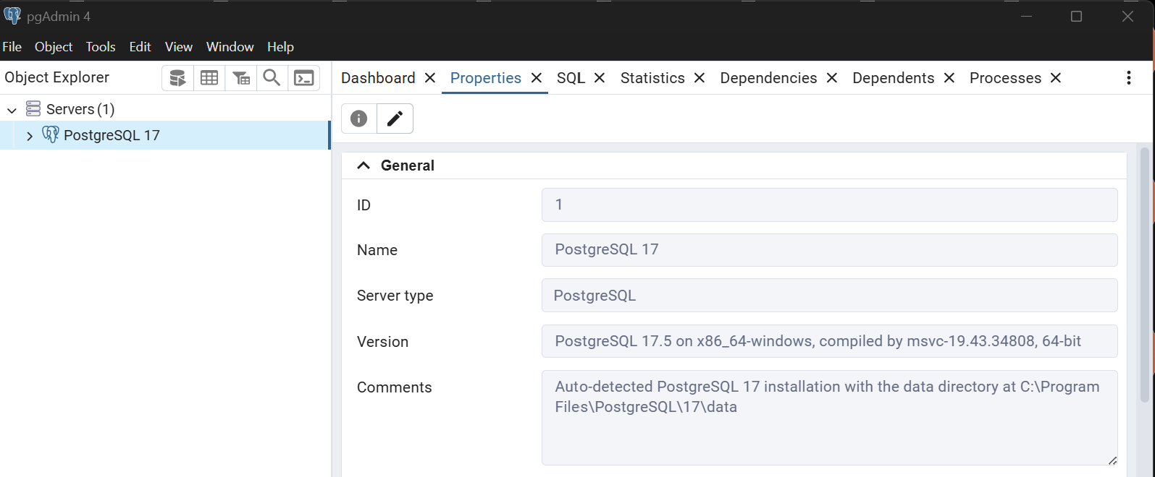
Meet pgAdmin
The GUI for Postgres. Handy for one-time setup — creating databases, adding users, poking around.
Your PostgreSQL server lives here

Slide 5
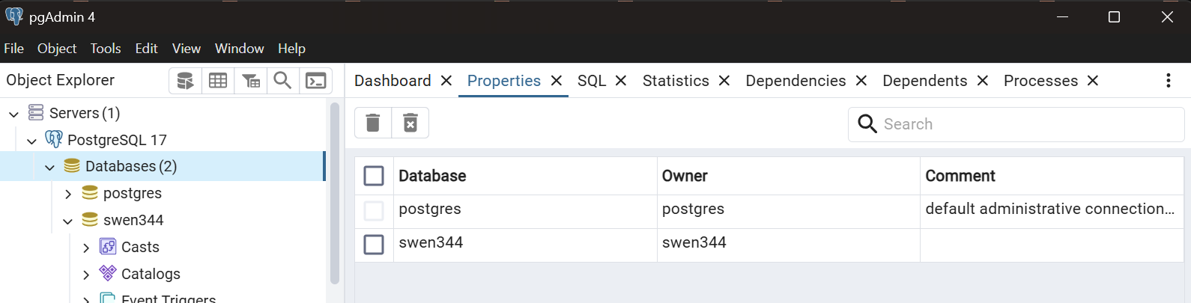
Drilling in: databases
Expand the server to see its databases

Slide 6
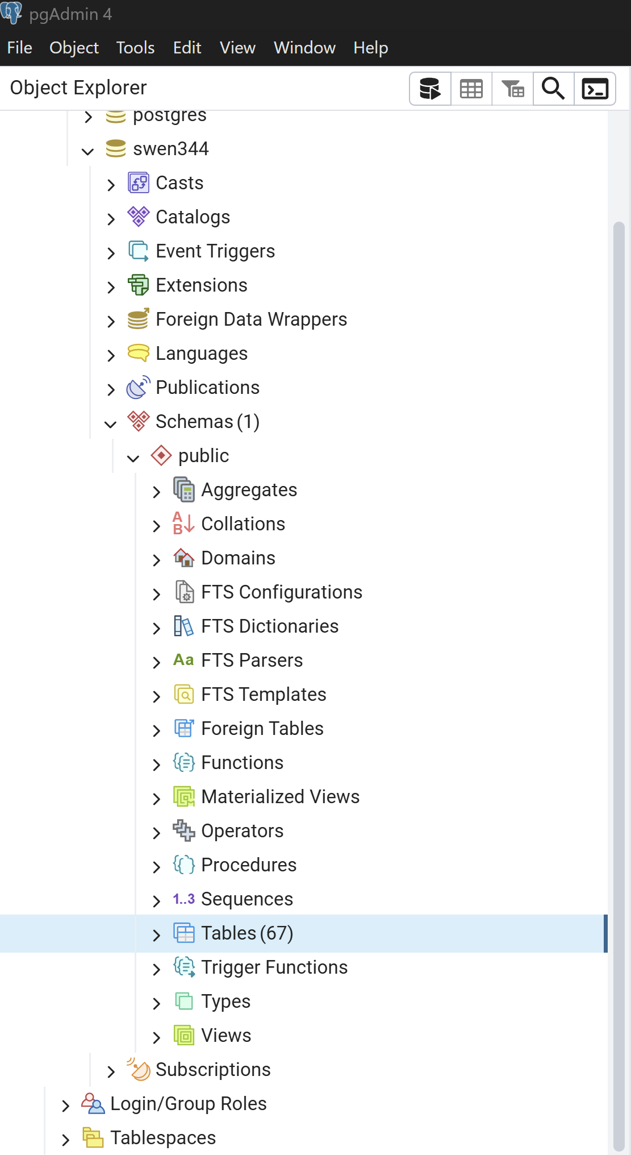
Finding things in pgAdmin
Tables are way down here
(or use psql)
Logins and users?
Way down here…

Slide 7
Running a single unittest
python -m unittest tests.test_generic.TestChat.test_loading
path
module
class
method
Why run just one test?
When you're hunting a single failure, running the whole suite is slow.
Drop any segment from the right to widen the scope — keep tests to run them all.
Notes:
py -m unittest tests.test_generic.TestChat._test_simple_query

Slide 8
unittest doesn't run in your order
Tests don't run top-to-bottom — write each one so it stands on its own.
What actually happens
Python runs tests in roughly alphabetical order by method name — and that's not even consistent across operating systems.
Each test_* method is supposed to be self-contained — set up its own state, assert, tear down.
If steps genuinely depend on each other, group them inside one test method, or factor shared setup into a helper.
DO NOT rely on test order.
A test that only passes when another one ran first is a flaky test waiting to happen.

Slide 9
git and branching
Creating a branch
GitLab GUI, VS Code, or command line — pick one.
Local first → push to remote
# create and switch locally
> git checkout -b <new-branch>
# push to the remote
> git push -u origin <new-branch>
Remote first → fetch to local
# update local copy of remote branches
> git fetch origin
# check out the branch you fetched
> git checkout <new-branch>
Switching branches
The * marks the active branch.
List your branches
> git branch
db-utils
* main
Jump to another branch
> git checkout db-utils
# now on db-utils
VS Code shows the current branch in the bottom-left corner — handy sanity check.
Heads-up: keep local and remote branches in sync — a stale local will bite you.

Slide 10
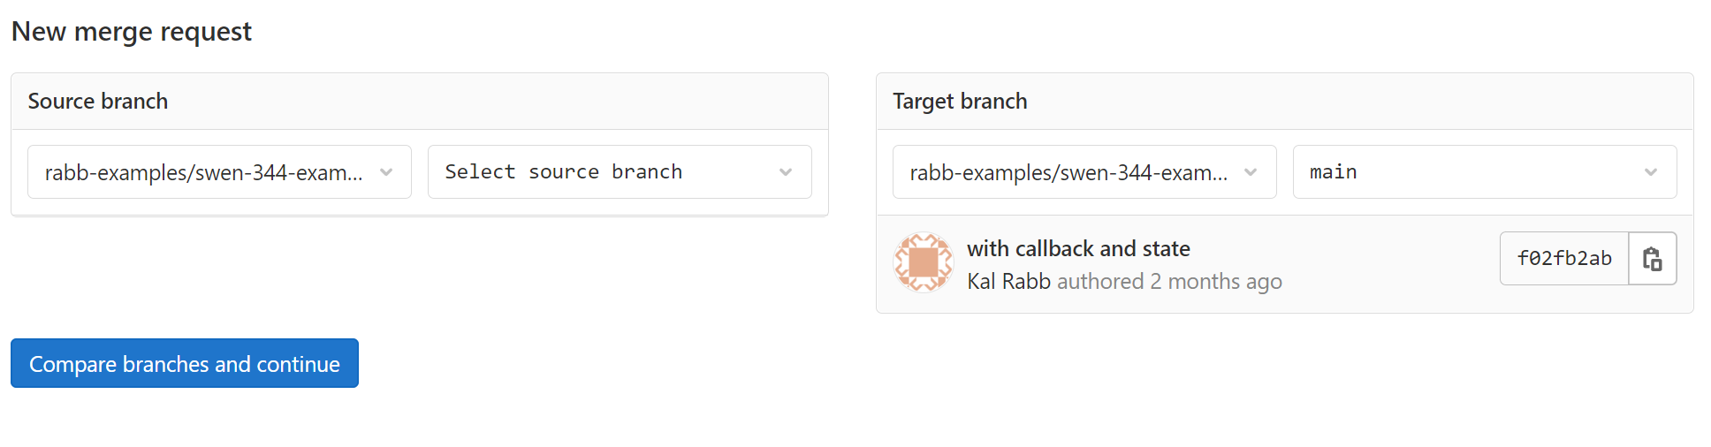
Merge requests
Two ways to open one
GitLab GUI — point, click, write a description. My pick — it's faster and the diff view is right there.
Command line — after git push, GitLab prints a one-line URL — just paste it in your browser.

Slide 11
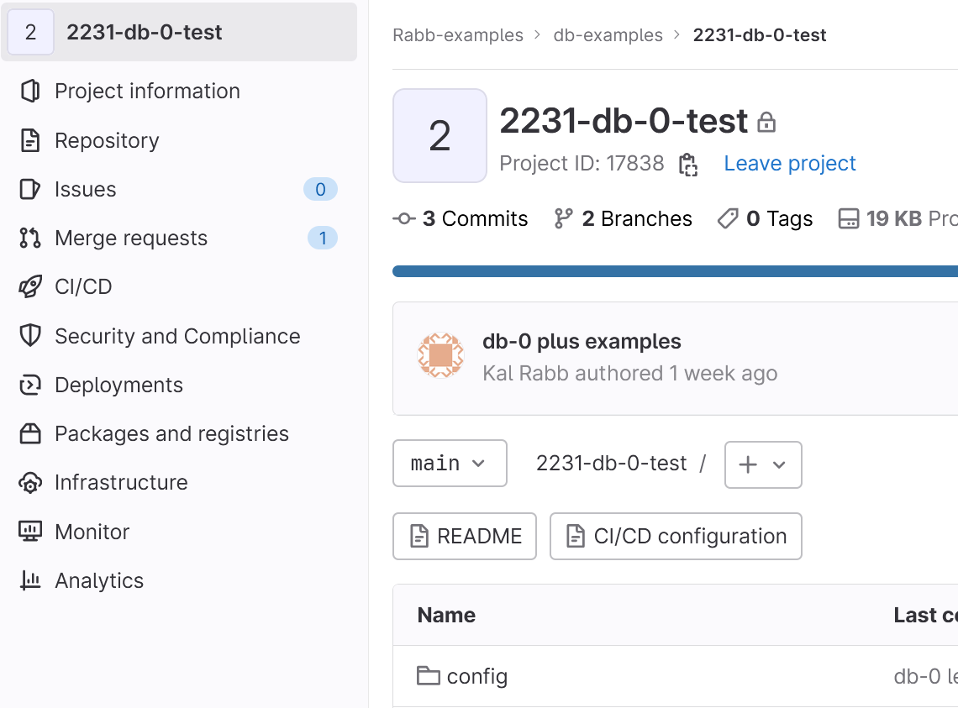
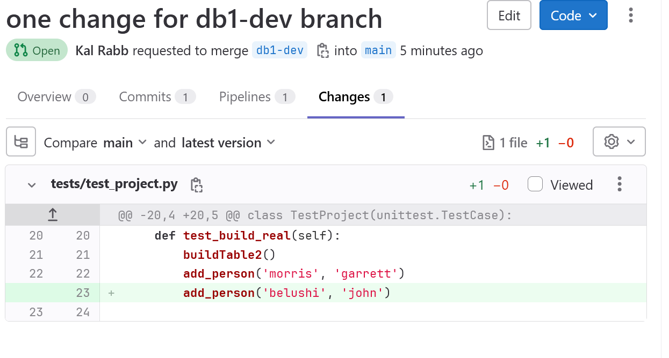
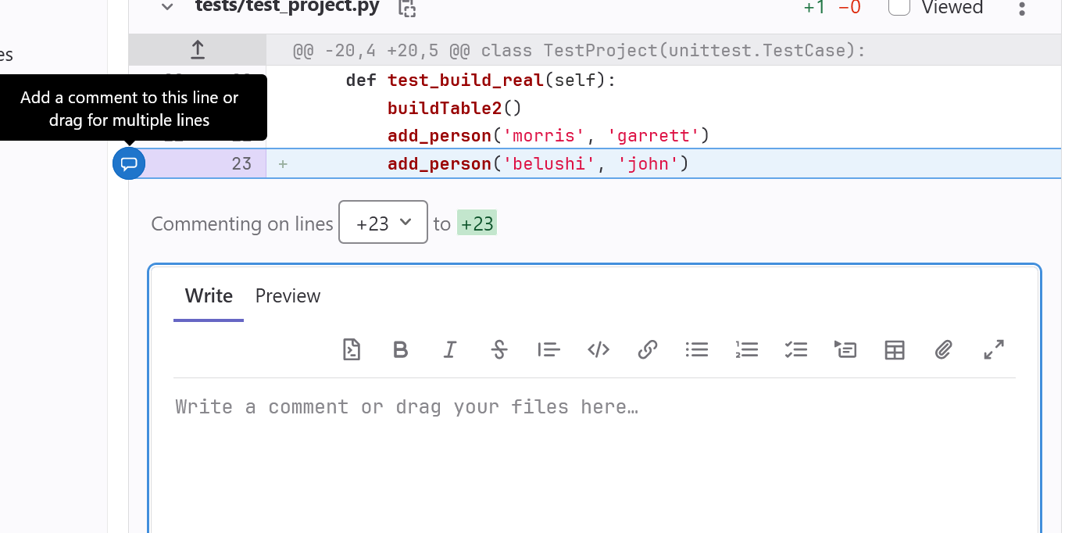
GitLab GUI for commenting
1
Find the Merge Request
2
Open Changes tab
3
Hover a line and comment

Slide 12
SERIAL PKs and the sequence trap
If your auto-incrementing PKs start colliding, it's almost always this.
The problem
You declared a column SERIAL PRIMARY KEY so Postgres assigns the next id for you.
Then you run a manual INSERT and supply the id yourself:
INSERT INTO my_table (id, data)
VALUES (1, 'something');
The sequence didn't move — so the next auto-insert tries id=1 again and collides.
The fix
Reset the sequence so the next id is what you expect:
ALTER SEQUENCE my_table_id_seq RESTART 2;
Sequence naming
Postgres names it for you:
<table>_<column>_seq
So a users table with PK id → users_id_seq.

Slide 13
Never concatenate user input into SQL
String-glued SQL is a SQL injection vulnerability. Use binding variables instead.
DON'T USE string concatenation
query = "GET * FROM table WHERE col=" + myVar
DO use binding variables
query = """
GET *
FROM pets
WHERE name=%s" AND age=%s
"""
args = (pet_name, 5)
exec_get_all(sqlString, args)
Why this works
The driver escapes the value for you, so a malicious string can't break out and become SQL.
Psycopg2 docs — how to bind variables
DON'T USE f-strings either
query = f"GET * FROM table WHERE col={myVar}"
Seriously, don't do either of the above!

Slide 14
Apostrophes in strings
Same string, two different escape rules — make sure you use the right one for the language.
Example: "Huey, Dewey, and Louie's uncle Donald"
Python — escape with \
One backslash in front of the apostrophe.
myString = 'Huey, Dewey,
and Louie\'s uncle Donald'
Postgres — double the '
Two single quotes — not a double quote.
INSERT INTO myTable (sentence)
VALUES ('Huey, Dewey,
and Louie''s uncle Donald');
Better still: don't escape — use bind variables.
The driver handles escaping (and SQL injection) for you. See the previous slide.

Slide 15
Psycopg2 query results
Results are returned in different data structures depending on if you ask for one row or all rows
Each element in a tuple positionally aligns with the SELECT's field list
exec_get_one() — a single tuple
One row back, or None if nothing matched.
query = """
SELECT name, species FROM pets
WHERE age = %s
"""
args = 5
row = exec_get_one(query, args)
row -> ('Fido', 'dog')
exec_get_all() — a list of tuples
Always a list — even if 0 or 1 row are returned.
query = """
SELECT age, species, name FROM pets
WHERE age = %s
"""
rows = exec_get_all(sql)
rows -> [(5,'dog','Fido'), (2,'cat','Gus')]
Common bug: treating a list result as one row, or a single row as a list.
Check which function you called before you index into the result.

Slide 16
Forcing a table reference
Now try
DROP TABLE T_ITEMS;
Fails — T_TRACK still references it.
CREATE TABLE T_ITEMS (
ID SERIAL PRIMARY KEY,
ITEM_CODE CHAR(6) NOT NULL,
ITEM_DESC VARCHAR(128)
);
CREATE TABLE T_TRACK (
ID SERIAL PRIMARY KEY,
NUM DECIMAL(6,0) NOT NULL,
ITEM_ID INTEGER NOT NULL REFERENCES T_ITEMS
);
INSERT INTO T_ITEMS (ITEM_CODE, ITEM_DESC)
VALUES ('AA', 'AA DESC');
INSERT INTO T_TRACK (NUM, ITEM_ID)
VALUES (2.0, 1);
Then try
DROP TABLE T_ITEMS CASCADE;
Drops the dependents too. Powerful — use carefully.

Slide 17
ON DELETE CASCADE
Now try
DELETE FROM T_ITEMS
WHERE ID=1;
The delete succeeds — no FK error.
CREATE TABLE T_ITEMS (
ID SERIAL PRIMARY KEY,
ITEM_CODE CHAR(6) NOT NULL,
ITEM_DESC VARCHAR(128)
);
CREATE TABLE T_TRACK (
ID SERIAL PRIMARY KEY,
NUM DECIMAL(6,0) NOT NULL,
ITEM_ID INTEGER NOT NULL REFERENCES T_ITEMS ON DELETE CASCADE
);
INSERT INTO T_ITEMS (ITEM_CODE, ITEM_DESC)
VALUES ('AA', 'AA DESC');
INSERT INTO T_ITEMS (ITEM_CODE, ITEM_DESC)
VALUES ('BB', 'BB DESC');
INSERT INTO T_TRACK (NUM, ITEM_ID) VALUES (2.0, 1);
INSERT INTO T_TRACK (NUM, ITEM_ID) VALUES (3.0, 2);
And the catch
The matching row in T_TRACK disappears too — silently.
Powerful — but use only when cascading deletes are exactly what you want.

