Slide 1
UI Design
It’s not just the technology …

Slide 2
Clients are meant for users …
And users want/ need/ deserve an interface that is easy to use
Fancy does NOT mean easy to use
There are many examples (good and bad) to look at
Most companies establish design guidelines for their ‘brand’
There are some basic guidelines that are fairly consistent across most ‘experts’

Slide 3
Nielsen’s Heuristics
Jakob Nielsen, Ph.D., is a User Advocate and principal of the Nielsen Norman Group which he co-founded with Dr. Donald A. Norman (former VP of research at Apple Computer).
#1: Visibility of system status
#2: Match between system and the real world
#3: User control and freedom
#4: Consistency and standards
#5: Error prevention
#6: Recognition rather than recall
#7: Flexibility and efficiency of use
#8: Aesthetic and minimalist design
#9: Help users recognize, diagnose, and recover from errors
#10: Help and documentation
10 Usability Heuristics for User Interface Design (nngroup.com)

Slide 4
A little more detail … (1)
#1: Visibility of system status
The design should always keep users informed about what is going on, through appropriate feedback within a reasonable amount of time.
#2: Match between system and the real world
The design should speak the users' language. Use words, phrases, and concepts familiar to the user, rather than internal jargon. Follow real-world conventions, making information appear in a natural and logical order.

Slide 5
A little more detail … (2)
#3: User control and freedom
Users often perform actions by mistake. They need a clearly marked "emergency exit" to leave the unwanted action without having to go through an extended process.
#4: Consistency and standards
Users should not have to wonder whether different words, situations, or actions mean the same thing. Follow platform and industry conventions.
#5: Error prevention
Good error messages are important, but the best designs carefully prevent problems from occurring in the first place. Either eliminate error-prone conditions, or check for them and present users with a confirmation option before they commit to the action.

Slide 6
A little more detail … (3)
#6: Recognition rather than recall
Minimize the user's memory load by making elements, actions, and options visible. The user should not have to remember information from one part of the interface to another. Information required to use the design (e.g. field labels or menu items) should be visible or easily retrievable when needed.
#7: Flexibility and efficiency of use
Shortcuts — hidden from novice users — may speed up the interaction for the expert user such that the design can cater to both inexperienced and experienced users. Allow users to tailor frequent actions.

Slide 7
A little more detail … (4)
Remove clutter
Don’t mix content
Information when needed – not ‘in your face’
Clean/ clear organization and layout
#8: Aesthetic and minimalist design
Interfaces should not contain information which is irrelevant or rarely needed. Every extra unit of information in an interface competes with the relevant units of information and diminishes their relative visibility.
#9: Help users recognize, diagnose, and recover from errors
Error messages should be expressed in plain language (no error codes), precisely indicate the problem, and constructively suggest a solution.
#10: Help and documentation
It’s best if the system doesn’t need any additional explanation. However, it may be necessary to provide documentation to help users understand how to complete their tasks.

Slide 8
And more …
Gestalt Principle of Proximity
‘Items placed in proximity are assumed to belong together’
- Group items that logically belong together
- Don’t put items that have different intent or, are parts of different actions, in the same group

Slide 9
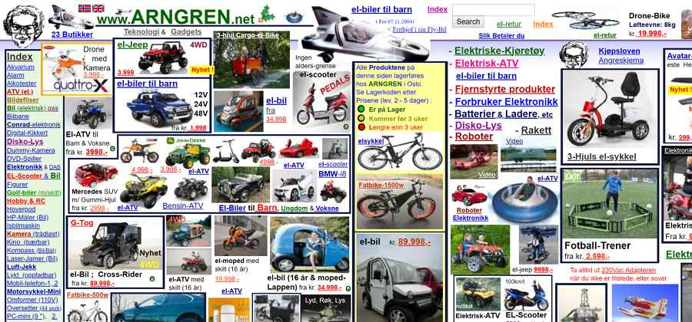
Clutter …

Slide 10
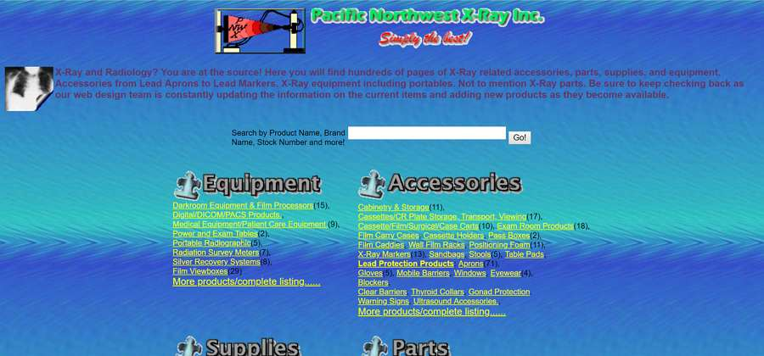
Over colourizing

Slide 11
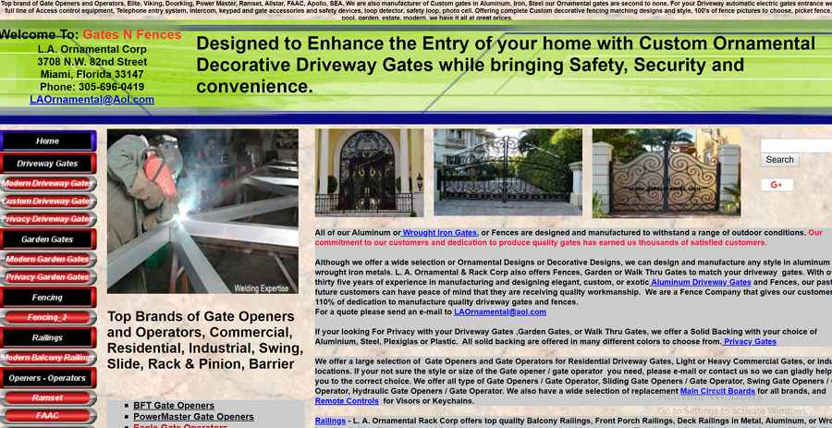
Cluttered AND over colourized

