Slide 1
Accessible Design

Slide 2
Universal Usability – a Case of Software Ethics
“Universal usability can be defined as having more than 90% of all households as successful users of information and communications services at least once a week.”
-Ben Schneiderman
“In a fair society, all individuals would have equal opportunity to participate in, or benefit from, the use of computer resources regardless of race, sex, religion, age, disability, national origin or other such similar factors.”
—ACM Code of Ethics

Slide 3
Universal Usability for the Web
“The power of the Web is in its universality.
Access by everyone regardless of disability is an essential aspect.”
Tim Berners-Lee, W3C Director and inventor of the World Wide Web
The UN Convention on the Rights of Persons with Disabilities recognizes access to information and communications technologies, including the Web, as a basic human right.

Slide 4
Section 508
Section 508 is an amendment to the United States Workforce Rehabilitation Act of 1973
Mandates that all electronic and information technology developed, procured, maintained, or used by the federal government be accessible to people with disabilities
Good accessibility design guidelines in general

Slide 5
Section 508
Technical standards:
1194.21 Software applications and operating systems.
1194.22 Web-based intranet and internet information and applications. 16 rules.
1194.23 Telecommunications products.
1194.24 Video and multimedia products.
1194.25 Self contained, closed products.
1194.26 Desktop and portable computers.
Section 508 validators available

Slide 6
508 Principles
Section 508 Mandates
Use a keyboard for text interaction
Accessibility features must always be available
Provide indication of current screen focus
Sufficient information about user interface element operation should be available
Image representation of UI elements should also have explanatory text
The use of images should be consistent
Minimum text information should include content, input cursor location, attributes
Don’t override individual display preferences
Information displayed as animation must also be available without animation
Color should not be the only means of communicating information
No flash or blink frequency greater than 2 Hz and lower than 55 Hz
Form interaction should support accessibility methods

Slide 7
Profile
User Diversity: Accommodate Different Users
Avoid lowest common denominator design – less useful to mainstream users, limits innovation
Skills
Computer newbie to hacker
Knowledge
Domain novice to expert
Disabilities
Visual, auditory, motor, cognitive
Disabling conditions
Mobility, injury, noise, sunlight
Culture
Western, Eastern,
developing, …
Personality
Introvert versus extrovert
Thinking vs. feeling
Risk aversion
Locus of control
Planful vs. playful
Income
Impoverished to
wealthy
Age
Gender
Race
Ethnicity
National Origin
Literacy
Fluent to illiterate
Multiple languages

Slide 8
Web Accessibility Principles
Web accessibility principles for users:
Make pages perceivable: because they cannot perceive (see) visual information such as graphics, layout, or color-based cues
Make pages operable: because they usually depend on a keyboard to operate (navigate) web content functionality, rather than a mouse
Make pages understandable: because they cannot understand content that is presented in an illogical linear order, or which contains extraneous text not meant to be read word for word or character by character (such as long Web addresses), etc.
Make pages robust: because the assistive technologies used by the people are not always capable of accessing a broad range of technologies, especially if they are new.

Slide 9
Accessible Web Design Approaches
Alternate Text
Table Headings
Forms
Meaningful Link Text
Captions and Transcripts
Other File Formats
Using Headings for Semantic Structure
Keyboard & Navigation
Never Rely on Color-Coding Only
Readability Level of Text
Cognitive Disabilities
Conforming to Standards
Site Maps, Site Search

Slide 10
Details of “alt” attribute
Screen readers can't describe images; they rely on there being some text in the document that serves as an alternative.
This is called the "alt" text for an image.
If you are using an editing tool, then you might need to look in some “Properties” of the image you added.

Slide 11
What is good "alt" text?
Good "alt" text conveys purpose or function of the image; appearance is less critical.
Same picture on different pages
Family site: "Picture of my aunt Sally."
Museum: "Oil-painting entitled Sally by Moonlight by Robert Caldwell in 1856."
Alt text should be as succinct as possible.
If decorative picture (no info content), then let alt="" The screen reader will pass it silently.
If clickable image (especially one with multiple different clickable regions), need alt text for each.

Slide 12
Other alt-text issues
Pictures of Words
Must set "alt" text as the same words as picture
Background Images (shouldn't be important info)
No “alt” text is read for the background image.
Graphs and charts.
Summarize the content of each graph and chart
Perhaps provide a link for full data description
Videos
Need a description of the main visible action if not clear from the audio portion.

Slide 13
Accessible Web Design Approaches
Alternate Text
Table Headings
Forms
Meaningful Link Text
Captions and Transcripts
Other File Formats
Using Headings for Semantic Structure
Keyboard & Navigation
Never Rely on Color-Coding Only
Readability Level of Text
Cognitive Disabilities
Conforming to Standards
Site Maps, Site Search

Slide 14
Forms
Ensure users can complete and submit all forms.
Ensure that every form element (text field, checkbox, dropdown list, etc.) has a label and make sure that label is associated to the correct form element using the <label> tag.
Also make sure the user can submit the form and recover from any errors, such as the failure to fill in all required fields.
http://www.webaim.org/techniques/forms
http://www.webaim.org/techniques/formvalidation/

Slide 15
Accessible Web Design Approaches
Alternate Text
Table Headings
Forms
Meaningful Link Text
Captions and Transcripts
Other File Formats
Using Headings for Semantic Structure
Keyboard & Navigation
Never Rely on Color-Coding Only
Readability Level of Text
Cognitive Disabilities
Conforming to Standards
Site Maps, Site Search

Slide 16
Meaningful Link Text
Screen reader users skim a page to get a sense of its structure by jumping from link to link.
There's a keyboard button for this, TAB.
Every link should make sense if the underlined link text is read by itself.
Certain phrases like "click here" and "more" must be avoided. Or that will be all that the screen reader user will hear when "tabbing" through the webpage.

Slide 17
Accessible Web Design Approaches
Alternate Text
Table Headings
Forms
Meaningful Link Text
Captions and Transcripts
Other File Formats
Using Headings for Semantic Structure
Keyboard & Navigation
Never Rely on Color-Coding Only
Readability Level of Text
Cognitive Disabilities
Conforming to Standards
Site Maps, Site Search

Slide 18
Captions for Deaf Users
Avoid websites with heavy sound/voice use.
Or it should be redundant with information presented visually through text, sign language, or pictures.
Deaf users rely on videos, animations, and audio on websites to be captioned. (This helps others, too.)
Captions are more than just "subtitles" in a foreign language film. They include: who is speaking, vocal emotion/stress, sound effects, background noises, key musical cues, and information about where to place the text boxes on the screen (near speaker, avoid stuff).
Professionally prepared for TV shows, sports events
Can be done "live" for events or in a classroom (CART).
http://www.webaim.org/techniques/captions/

Slide 19
Deafness and Literacy
Only half of deaf high school graduates (age 18+) can read English at a fourth-grade (age 10) level.
Various language development and educational reasons
American Sign Language ≠ Signs in English word order
Understanding complex concepts in English may be a challenge, especially spatial topics.
Videos or animations of ASL interpreting can be better than captions for complex or high-speed information.
Key idea: Just because there are letters displayed visually on a screen, this isn't a guarantee that the information is accessible for deaf website users.

Slide 20
Accessible Web Design Approaches
Alternate Text
Table Headings
Forms
Meaningful Link Text
Captions and Transcripts
Other File Formats
Using Headings for Semantic Structure
Keyboard & Navigation
Never Rely on Color-Coding Only
Readability Level of Text
Cognitive Disabilities
Conforming to Standards
Site Maps, Site Search

Slide 21
Headings as Semantic Structure
You can put codes in the file to indicate that some words are "headings" <H1> or "subheadings" <H2>
Some authors just set font/style attributes of some of the text to make it look like a heading without using these.
It is more accessible if you use these tags in the page.
Blind people using screen readers can't skim the entirety of a Web page as a sighted user can.
Blind users like to navigate Web pages by structure
Jump directly to top level elements (<h1>), next level elements (<h2>), third level (<h3>), etc.

Slide 22
Checking Semantic Headings
See the structure of one of your Web pages by accessing http://validator.w3.org/detailed.html.
Enter the Web page URL into the text box, check the Show Outline checkbox, and press Validate this page.
For now, ignore any HTML errors that are shown and go to the bottom of the page to see the page's outline.
You will see an outline of the content structure of your Web page as defined by headers tags (<h1> - <h6>).
If the output does not look like a real outline, it is likely that the heading tags are not being used properly (or that there are not any heading tags).
See also: http://www.w3.org/2003/12/semantic-extractor.html

Slide 23
Accessible Web Design Approaches
Alternate Text
Table Headings
Forms
Meaningful Link Text
Captions and Transcripts
Other File Formats
Using Headings for Semantic Structure
Keyboard & Navigation
Never Rely on Color-Coding Only
Readability Level of Text
Cognitive Disabilities
Conforming to Standards
Site Maps, Site Search

Slide 24
Keyboard-Only Users
Screen reader users use their keyboard as their primary means of navigating the computer.
Many people with motor disabilities also use input devices that simulate keyboard-only, not mouse.
Elements of a webpage that depend on clicking or movement of the mouse will be problematic.
Menus which require you to aim your mouse on top of them before the options appear.
Animated/moving elements on the screen which someone must click.
"Flash" animated elements on a webpage that aren't set up to allow keyboard button interaction.

Slide 25
Event Handlers
To ensure accessibility, use either a device-independent event handler (one that works with both the mouse and the keyboard) or use both mouse-dependent and keyboard-dependent handlers.
E.g., onMouseOver is only triggered for users of a mouse
Combine onMouseOver and onFocus

Slide 26
Accessible Web Design Approaches
Alternate Text
Table Headings
Forms
Meaningful Link Text
Captions and Transcripts
Other File Formats
Using Headings for Semantic Structure
Keyboard & Navigation
Never Rely on Color-Coding Only
Readability Level of Text
Cognitive Disabilities
Conforming to Standards
Site Maps, Site Search

Slide 27
Never Rely on Color-Coding
Don’t rely on color alone to convey meaning.
The use of color can enhance comprehension, but do not use color alone to convey information.
That information may not be available to a person who is colorblind and will be unavailable to screen reader users.
http://www.webaim.org/articles/visual/colorblind.php

Slide 28
Accessible Web Design Approaches
Alternate Text
Table Headings
Forms
Meaningful Link Text
Captions and Transcripts
Other File Formats
Using Headings for Semantic Structure
Keyboard & Navigation
Never Rely on Color-Coding Only
Readability Level of Text
Cognitive Disabilities
Conforming to Standards
Site Maps, Site Search

Slide 29
Reading Level of Text
Keep the complexity level of the text on your website as simple as possible.
Be careful of non-literal text like sarcasm, or texts in which someone needs to “read between the lines” or make lots of inferences.
There are online tools for scoring a text's difficulty level (or grade level).
More people will be able to use the website.
http://www.webaim.org/techniques/writing/

Slide 30
Design Impact: Text Comprehension
As a general statement, the more structured your document is, the easier it will be to understand. Structure in documents can be created by adding:
headings
bulleted lists
numbered lists
definition lists
indented quotes (using the <blockquote> tag)
Use of whitespace can also convey structure.
Notes:
Webaim

Slide 31
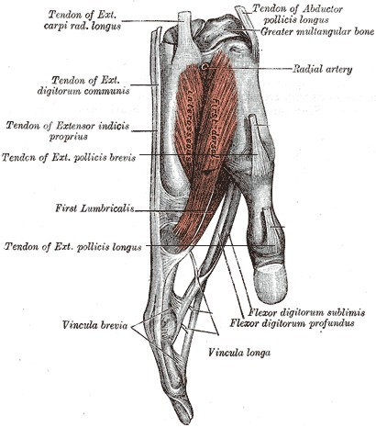
Worth a Thousand Words
Imagine trying to convey this complex anatomical structure to using words alone.
Supplemental media such as illustrations, icons, video and audio have the potential to greatly enhance the accessibility of web content for people with cognitive disabilities.

Slide 32
Accessible Web Design Approaches
Alternate Text
Table Headings
Forms
Meaningful Link Text
Captions and Transcripts
Other File Formats
Using Headings for Semantic Structure
Keyboard & Navigation
Never Rely on Color-Coding Only
Readability Level of Text
Cognitive Disabilities
Conforming to Standards
Site Maps, Site Search

Slide 33
Design Impact: Memory
Any kind of reminder of the overall context of a web site can help people with memory deficits.
Lengthy interactive processes, such as those required to purchase items online, should be kept as simple and brief as possible.
To focus the users' attention on specific tasks, the interaction should probably be broken up into separate pages, but help users keep track of their progress so they do not get lost in the process.
Notes:
Webaim

Slide 34
Design Impact: Problem Solving
Resilience can be low for errors and the resulting frustration may make someone abandon a computer program or website.
404 error from a bad link or a link that does not take them where they thought they were going
Error messages should be as clear as possible, telling users what they did wrong and how to fix the problem.
Search features should suggest alternate spellings to users if the original spelling seems suspicious
Users should be warned when actions can cause potentially serious consequences, such as deleting a file.
Notes:
Webaim

Slide 35
Design Impact: Attention
Distractions such as scrolling text and blinking icons can make the web environment difficult.
Use headings to draw attention to the important points and outline of the content.
Avoid background noises or images that distract.
Notes:
Webaim

Slide 36
Design Impact: Flashing Images
People with seizure disorders can be sensitive to images with flashing or with complex patterns that seem to “jump” or “wiggle” due to optical illusions.
Be careful when you design your animations. Don't cause a seizure!
Most designers don't create graphics that even approach the point that they might cause seizures, but some multimedia developers do venture into this territory.
Flash designers are especially notorious for creating modernistic animations that flicker and strobe across the screen.

Slide 37
Cognitive / Learning Disabilities
Flashing images: seizure disorders
Supporting Read-Aloud
May prefer to have the computer automatically read the text on a website out loud.
Spelling, writing difficulties
May benefit from spell-checkers, other tools.
Distractions on webpages (advertisements, many links, cluttered structure, decorative animations) may impact comprehension

Slide 38
Accessible Web Design Approaches
Alternate Text
Table Headings
Forms
Meaningful Link Text
Captions and Transcripts
Other File Formats
Using Headings for Semantic Structure
Keyboard & Navigation
Never Rely on Color-Coding Only
Readability Level of Text
Cognitive Disabilities
Conforming to Standards
Site Maps, Site Search

Slide 39
Conforming to Standards
Making sure that your website follows the official HTML format will make it more likely that users with disabilities will be able to access your site, because their tools will interact with it in expected ways.
For instance, it is recommended to follow the modern standard of separating the specification of your content from its visual appearance…

Slide 40
Several ways to control appearance
There are several ways in which someone can set the visual appearance (size, color, boldness, font, placement, borders, etc.) of items on a webpage.
Some ways of doing this are "hard coded" such that things don't resize or change appearance, even if the user asks their webbrowser to enlarge the page or override the colors.
This makes the page less accessible for low vision users who many need this flexibility.

Slide 41
Using CSS for Visual Details
Using "Cascading Style Sheets" (CSS) is the preferred way to set visual details.
This allows the author of a webpage to separate the information content of a page from the details of its visual presentation.
This makes it easy for the author to set the order in which elements of the webpage should be read by a screen reader, regardless of how they are laid out visually on the screen.
This provides more flexibility and accessibility.

Slide 42
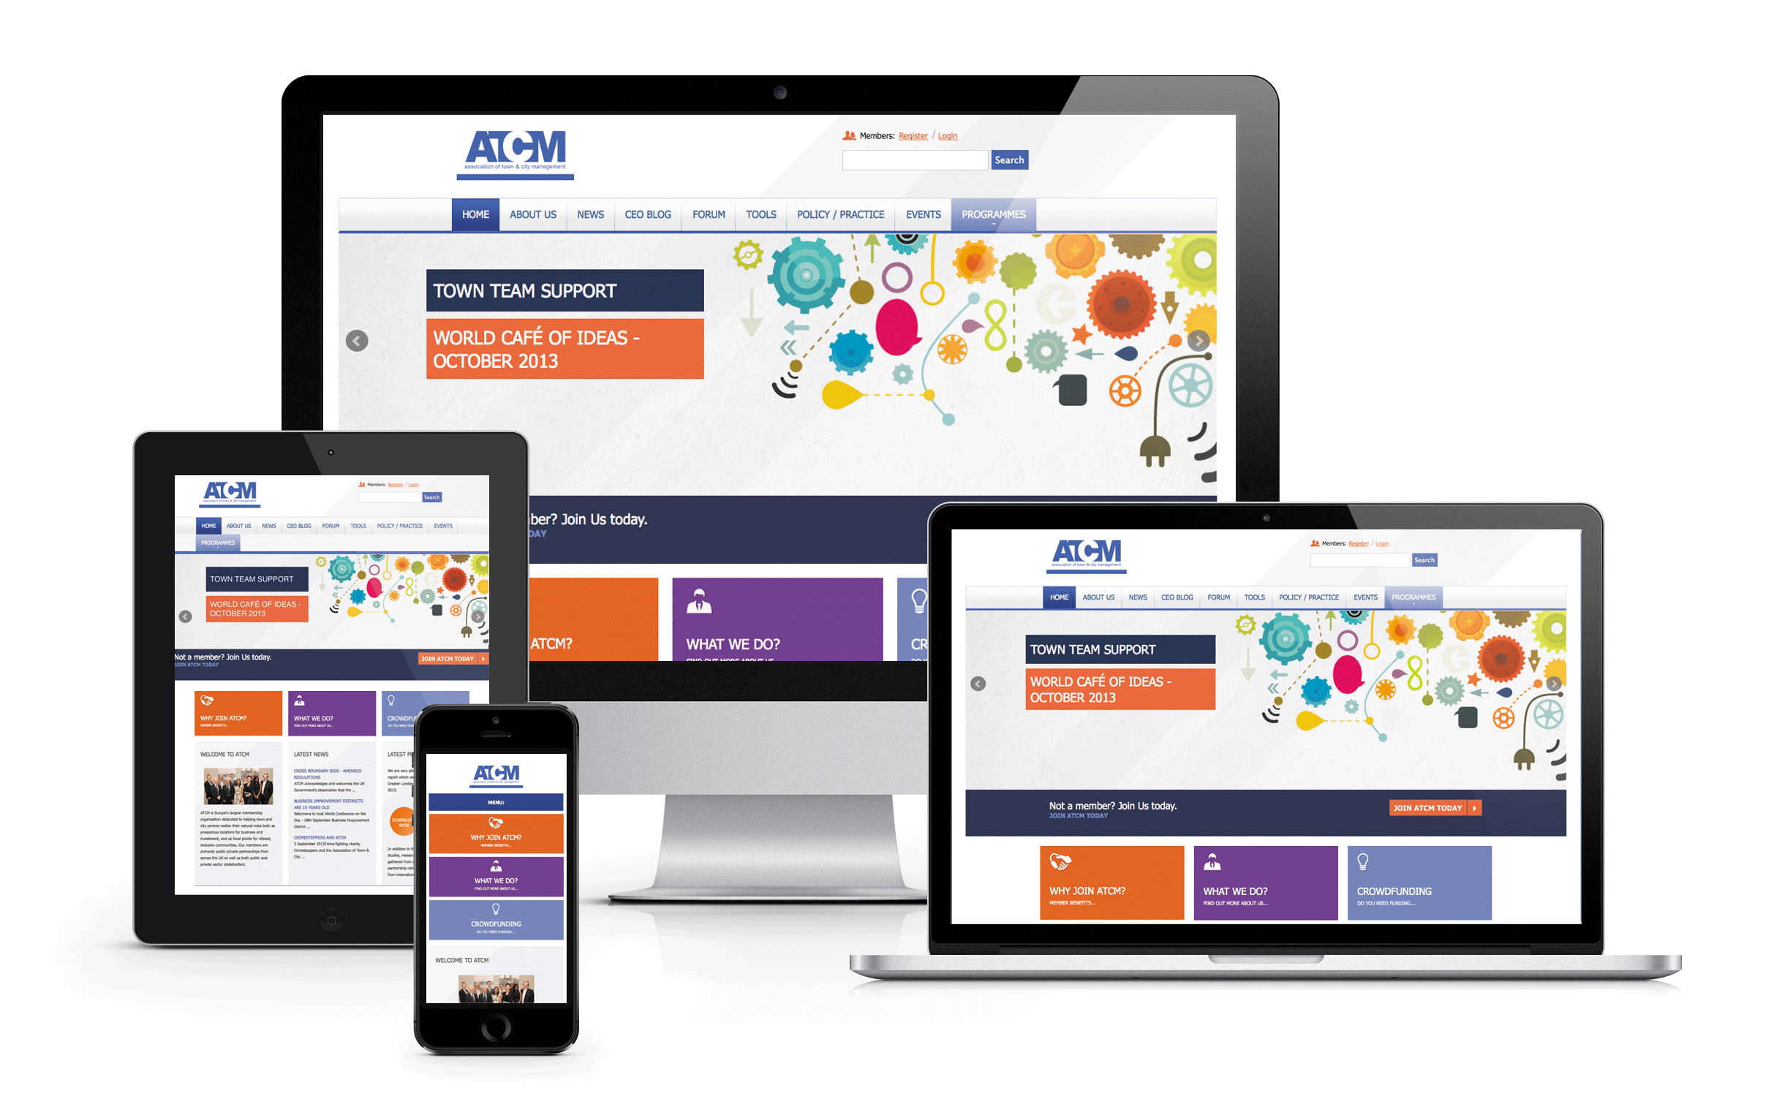
Responsive Design
Website design in which the presentation of pages adapts to the specific device or screen size of the user can benefit people with disabilities.
RD can help the user of a smartphone avoid “sideways scrolling” to read lines of text, and it also benefits people who use screen magnifiers.

Slide 43
Additional Topics & References

Slide 44
W3C Accessibility Design Guidelines
Web Content Accessibility Guidelines (WCAG) http://www.w3.org/WAI/intro/wcag
“explain how to make web content more accessible to people with disabilities”; principles …
Perceivable objects and content
Operable objects and navigation
Understandable content and interactive operation
Robust – reliably interpretable by assistive technologies
Accessible Rich Internet Applications (ARIA) http://www.w3.org/WAI/intro/aria
Guidelines for how to make dynamic web app functionality available to assistive technologies

Slide 45
Accessibility Auto-Checking Tools
Free "WAVE" tool: wave.webaim.org
Website will analyze other webpages for you, adding icons to a version of the page that represent structural, content, and accessibility features or problems.
It also has a toolbar you can add to your webbrowser for quick access to features.
It can also turn off images and styles/formatting on your page to help you see if it would be screen-reader friendly.
Notes:
“WebAccessibility” for Chrome

Slide 46
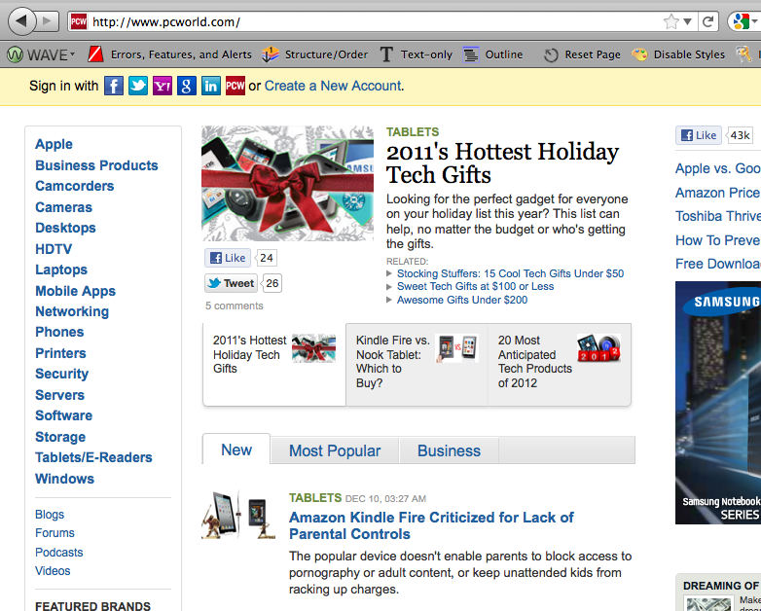

Slide 47
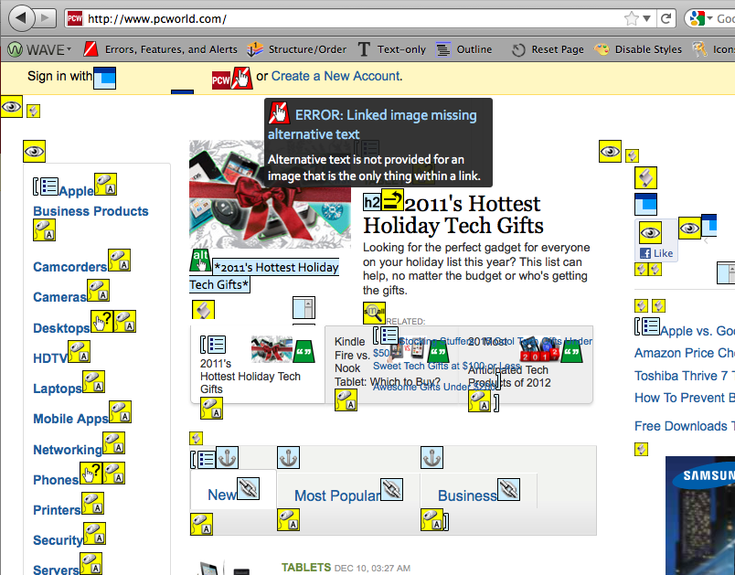

Slide 48
FANGS Screen Reader Simulator
FANGS is a plug-in you can install on your Firefox webbrowser that will present a script of what a screen-reader would say aloud to a blind person viewing the page.
Does the webpage text still make sense without images? Do all the images have good "alt" tags?
Is the page understandable without being able to visually scan it (to figure out its organization)? Imagine if you couldn't visually skip ahead with you eyes and had to listen to all of this. Would you "get it"?
It can also show you a list of all the headings and links on the page (how a blind user would scan).
FANGS: https://addons.mozilla.org/en-us/firefox/addon/fangs-screen-reader-emulator/
Or try ChromeVox: https://chrome.google.com/webstore/detail/kgejglhpjiefppelpmljglcjbhoiplfn

Slide 49
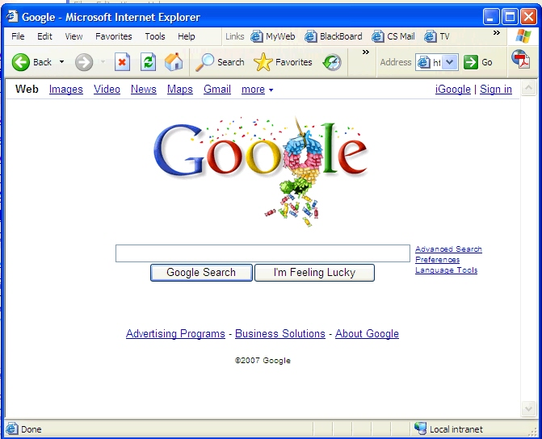
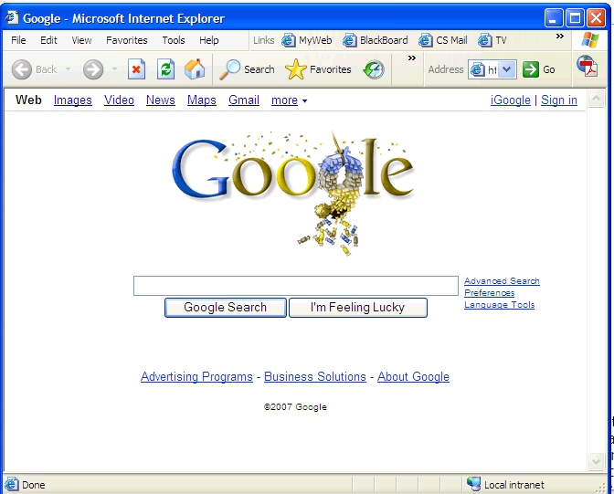
VisCheck
Vischeck shows what a web page or image looks like to a person who is colorblind. http://www.vischeck.com/

